Slide 1
Reproduction

Slide 2
The Cell Cycle

Slide 3
Important Terms
Genome: A genome is a cell's total DNA alotment. In a human this is 46 chromosomes.
Chromosome: A gene is made up of DNA that codes for one or more proteins. A chromosome is made up of many genes. The DNA is wrapped around proteins. Before DNA synthesis there is only one double stranded helix of DNA in each chromosome.

Slide 4
Important Terms
Chromatid: After DNA synthesis there are two identical DNA helices connected by a centromere. Each helix is called a chromatid. After DNA synthesis a chromosome is composed of 2 identical sister chromatids joined by a centromere. 2 sister chromatids still counts as 1 chromosome.
Centromere (AKA kinectochore): joins two sister chromatids.

Slide 5
Important Terms
Cell Cycle: Period of cell growth and division. Includes the phases Interphase, Prophase, Metaphase, Anaphase, and Telophase.
Mitosis: Period of cell division only. Includes Prophase, Metaphase, Anaphase, and Telophase.

Slide 6
Cell Cyle
The cell cycle is an endless repetition of mitosis, cytokinesis, growth, and chromosomal replication. Some cells break out of the cycle to die and perform their function . . .such as fingernails!
Typically there are 4 stages to the cell cycle:
G₁ phase
S phase
G₂ phase
M phase (mitosis)

Slide 7
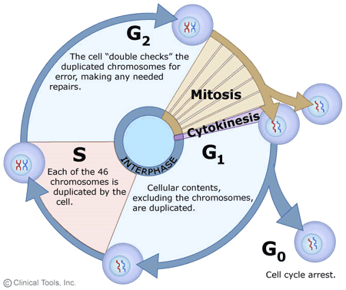

Slide 8
Interpahse
G₁ phase or Gap 1 phase-
chromosomes unwind partly. Only the sections of the DNA that are necessary to cell function unwind. Most of the DNA stays condensed
cell synthesizes necessary enzymes and proteins needed for cell growth.
DNA consists of a single un-replicated helix
Cell may be growing, active and performing intense biochemical functions.

Slide 9
Interphase
S phase or synthesis phase-
DNA and chromosomal proteins are replicated.
This phase lasts a few hours

Slide 10
Interphase
G₂ phase or gap 2 phase
Mitotic spindle proteins are synthesized (this is the structure responsible for moving chromosomes during mitosis).
M phase-mitosis and cytokinesis
Division of the nucleus which is followed by division of the cytoplasm called cytokinesis.

Slide 11
Regulation of the Cell Cycle
Regulation of the cell cycle:
Different types of cells take different amounts of time:
Ex. Bean cells take 19 hours to complete a cycle.
Nerve cells do not go through the cell cycle and no longer divide.
If cells divide too rapidly they invade specialized tissues disrupting the function of that tissue. This is cancer.

Slide 12
Regulation of the Cell Cycle
What can control the cell cycle?
Certain chemicals in the cytoplasm, that normally drive the cell cycle.
The Cell Cycle Control System is a set of molecules that act like a clock to coordinate key events.
Cell size: cells can only divide when they reach a particular size.

Slide 13
Regulation of the Cell Cycle
What can control the cell cycle? cont . . .
Environmental factors such as depletion of nutrients, change in Temperature and pH and availability of growth factors.
Ex. Platelet derived growth factor at wound sites to accelerate cell division for healing.
Density of cells: Cells need space. If they are too tightly packed they will stop dividing. Cancer cells do not demonstrate this trait.

Slide 14
Regulation of the Cell Cycle
When normal cells are inhibited by one of the previous factors they stop in the G₁ phase. This is known as the restriction point. They will then enter the G₀ phase until the inhibitor is gone.
Once a cell passes the restriction point they are committed to mitosis and must divide.

Slide 15
Regulation of the Cell Cycle
Checkpoints: there are 3 checkpoints set up on the cell cycle pathway to make sure that the cell is dividing properly. If any of these checkpoints are failed, the cell aborts the division and commits cell suicide, called apoptosis.
G1 checkpoint: checks the integrity of the DNA
G2 checkpoint: makes sure that all of the DNA has replicated properly
M checkpoint: makes sure that the spindle has connected to all of the kinetochores (centromeres) properly

Slide 16
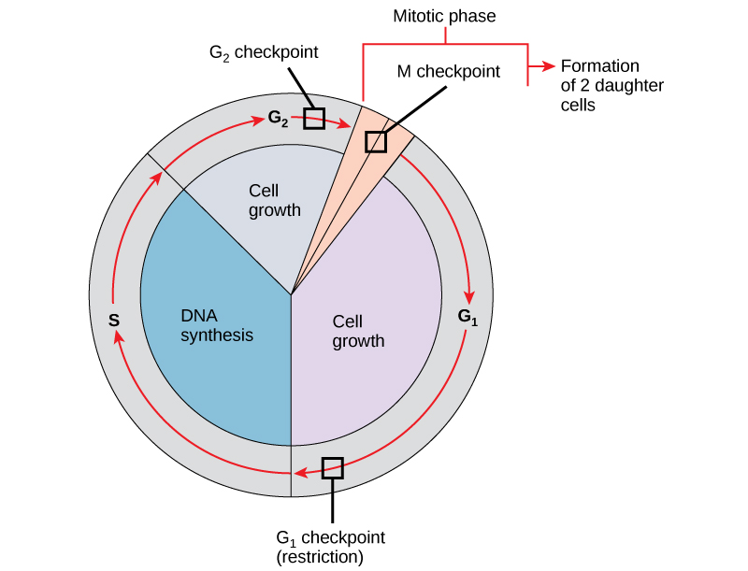

Slide 17
Important Terms
Diploid: cell has a full genome, also known as 2N. Can also say that the cell has homologous pairs of chromosomes
Haploid: cell has only half of the genome, also known as N. Cans also say that the cell has only 1 chromosome from each homologous pair

Slide 18
Phases of mitosis
Mitosis and Cell Division: (IPPMAT)
Cell stays 2N for all phases except for anaphase, where the cell is 4N for a brief period of time.
Interphase: G1, S and G2 phases
Are not part of mitosis, but ARE preparation for it.
At the end of interphase the chromosome consists of two identical DNA helices connected by the centromere.
In animal cells, the centriole copies itself so that there are 2 now

Slide 19
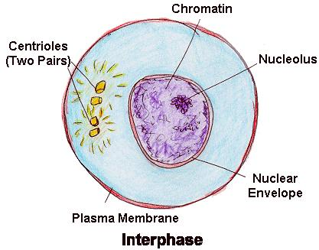

Slide 20
Phases of mitosis
Prophase-
Chromosomes condense becoming more compact and visible. This is the way chromosomes are drawn.
Nucleoli disappear because chromosomal parts are pulled out of it.
Each chromosome has 2 sister chromatids joined by a centromere.

Slide 21
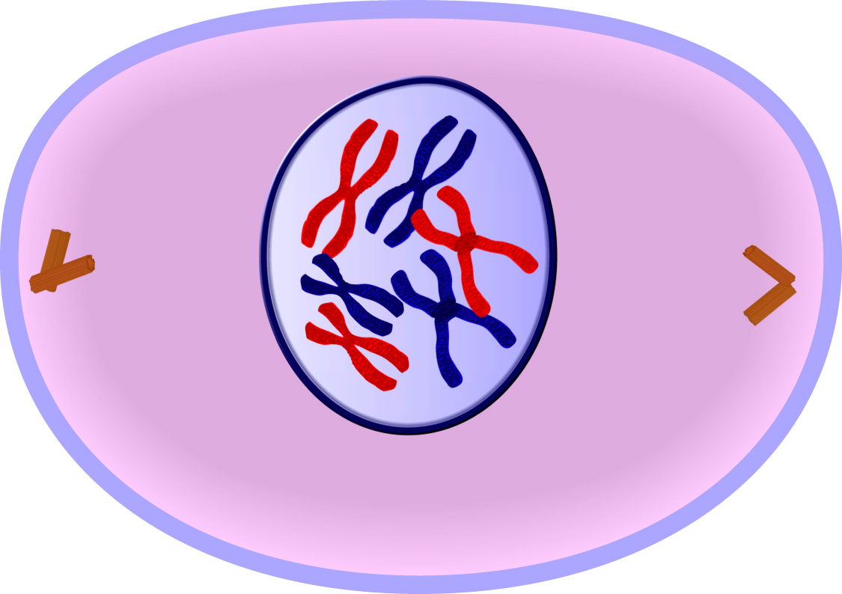

Slide 22
Phases of mitosis
Prometaphase:
Nuclear envelope fragments
Microtubules of the spindle now invade the nucleus and interact with chromosomes.
Spindle fibers extend from the poles to the equator.
In animal cells, while the spindle is forming, the centrioles are moving toward opposite poles

Slide 23
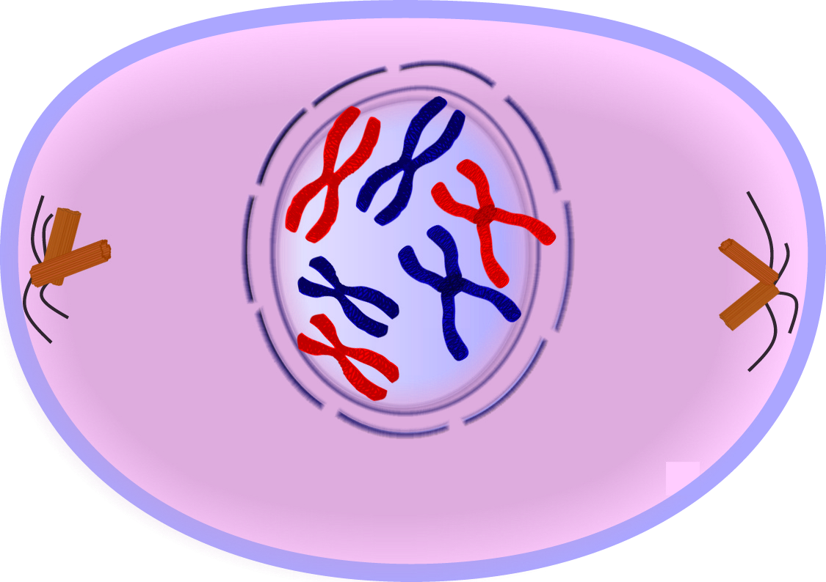

Slide 24
Spindle Fibers
The spindle apparatus-
Consists of 2 types of proteins-actin and tubulin.
At the beginning of mitosis the two centrosomes (centrioles in animal cells) move to the opposite poles of the nucleus.

Slide 25
Spindle Fibers
The spindle apparatus has 3 types of fibers:
kinetochore spindle fibers-attach to the kinetochore of the chromosome.
Polar spindle fibers-attach one centrosome to the other centrosome.
Aster spindle fibers-attach the centrosome to the cell membrane.

Slide 26
Spindle Fibers
The fibers to make the spindle fibers come from the cell's cytoskeleton. The cytoskeleton is partially disassembled and is reassembled after cell division is complete.

Slide 27
Phases of mitosis
Metaphase:
The chromosomes line up on a plane called the metaphase plate. This is in the middle of the spindle apparatus and perpendicular to the axis of the cell. In reality the kinetochore is the only thing on the plate. The chromosomes can be pointing any direction.

Slide 28
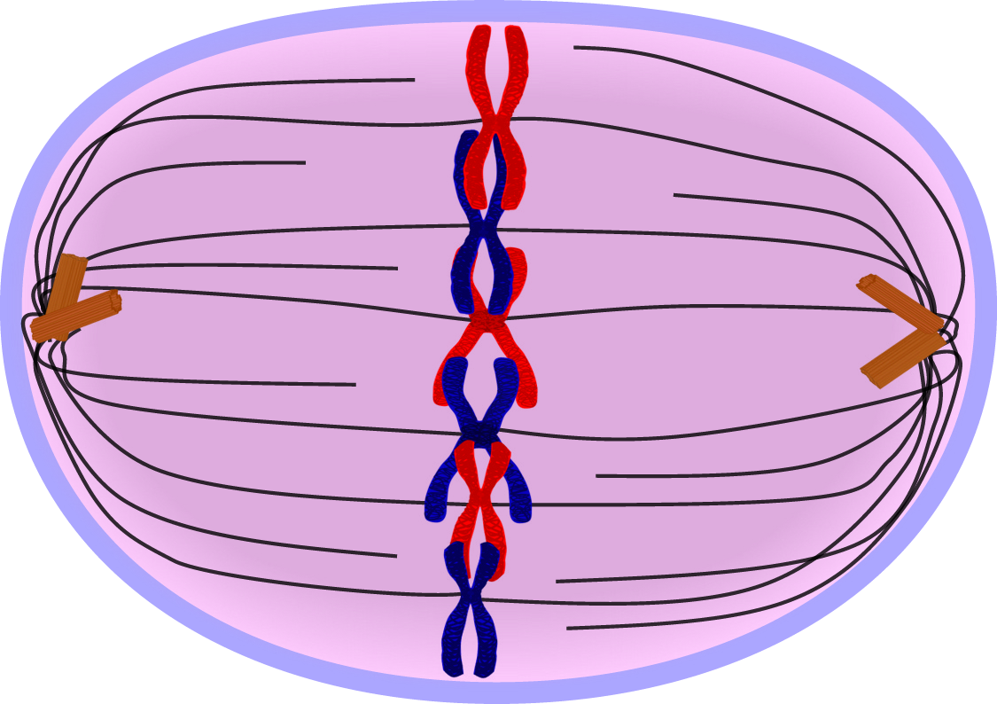

Slide 29
Phases of mitosis
Anaphase:
Centromeres divide and the spindle apparatus pulls the kinetochores to the opposite poles. The chromosome is now a single strand.

Slide 30
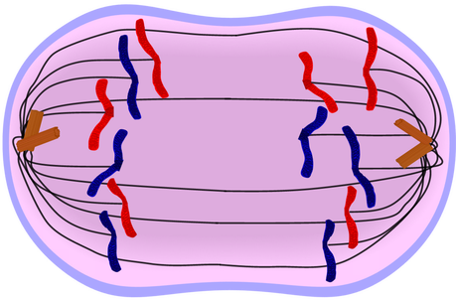

Slide 31
Phases of mitosis
Telophase:
The opposite of prophase
Chromosomes decondense
Nuclear membrane reappears
Spindle fibers become disorganized and are broken back down into individual amino acids
The cell pinches in the middle, beginning the formation of 2 cells.

Slide 32
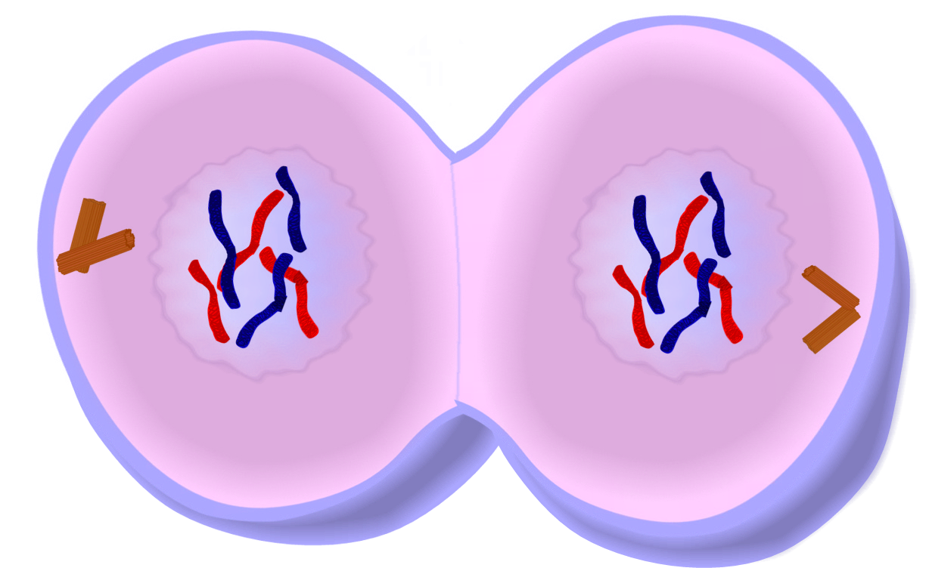

Slide 33
Warmup 11/16
Draw the following cells (they don’t have to be great, just recognizable) and label them with the proper phase of mitosis

Slide 34
Cytokinesis
Cytokinesis:
Animals: usually begins with a cleavage furrow at the metaphase plate. Looks as though a string is tied around the cell and then tightened. This is done by a contractile ring of actin microfilaments found in the cytoplasm

Slide 35
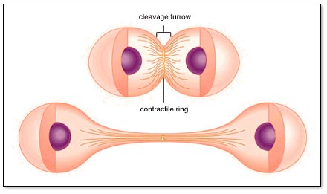

Slide 36
Cytokinesis
Cytokinesis:
Plants: Small vesicles filled with polysaccharides formed in the Golgi form on the metaphase plate. Vesicles continue to form until there is a double membrane called the cell plate. The cell plate gets filled with pectin and forms a cell wall.

Slide 37
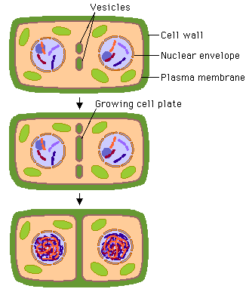

Slide 38
Reasons for Mitosis
Purpose:
Single-celled organisms:
This is how they reproduce and increase their population. Makes identical organisms as there is no variation in DNA.
Multicellular organisms:
Allow for growth while maintaining surface area to volume ratio.
Allow for specialization through cell differentiation.
Allows dead or damaged cells to be replaced.

Slide 39
Cancer
Abnormal cell division:
Cancer cells do not respond to normal cell division controls. They ignore density dependent inhibition and when they do stop they rarely stop at the restriction point.
Most cells divide 20-50 times before stopping due to age and death. There are lab maintained cancer cells called HeLa cells that have been dividing since 1951.

Slide 40
Cancer
First step is transformation. If this cell evaded destruction by the immune system cancer begins.
Benign tumors remain at the original site, malignant tumors spread.
The cancerous cells usually have:
abnormal chromosome numbers
aren't constructive
have surface changes so they cannot attach to neighboring cells.
These changes allow cancer to spread.

Slide 41
Cancer
Metastasis
Occurs when cancerous cells enter the circulatory system and can then spread to the entire body.

Slide 42
Meiosis

Slide 43
Differences between mitosis and Meiosis
Meiosis has 2 divisions
Meiosis allows for genetic variation
Meiosis has crossing over
Meiosis has Independent Assortment
Meiosis makes 4 daughter cells
Each cell only has ½ of the genome (1 of each homologous chromosome)
Meiosis only happens for the sex cells

Slide 44
Phases of Meiosis
Interphase
Happens the exact same way as Interphase of mitosis including the G1, S, G2, and G0 phases

Slide 45
Phases of Meiosis
Prophase 1
Cell is 2N
Same as Prophase of mitosis with 1 addition
Homologous chromosomes pair up
They then form a synapsis
The synapsis allows for crossing over to occur
First step of genetic variation

Slide 46
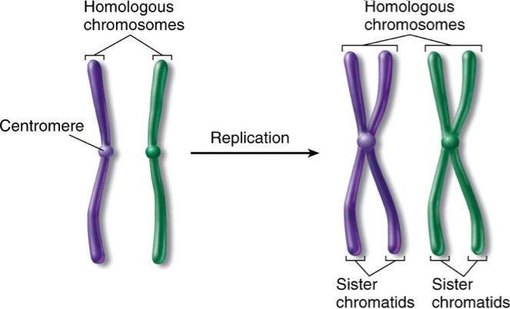
Homologous CHromosomes
Pair of chromosomes that are similar for several reasons:
They have the same genes
The kinetochore location is the same
When stained, they have the same banding pattern.

Slide 47
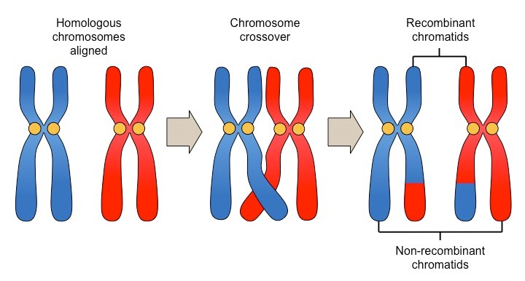
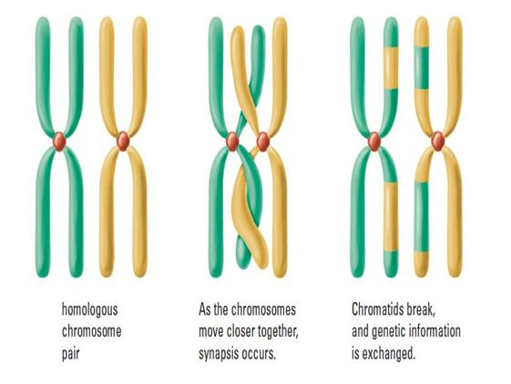
Crossing Over
Allows for homologous chromosomes to exchange pieces of DNA to mix the DNA from the organism’s mother’s chromosome and father’s chromosome
Synapsis
Synapsis

Slide 48
Phases of Meiosis
Metaphase 1
Homologous chromosomes are still paired up and move to the equator where one chromosome of the pair lines up on one side of the equator and the other chromosome is lined up on the other side of the equator
Independent Assortment Occurs

Slide 49
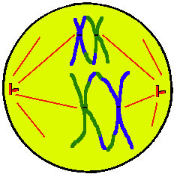

Slide 50
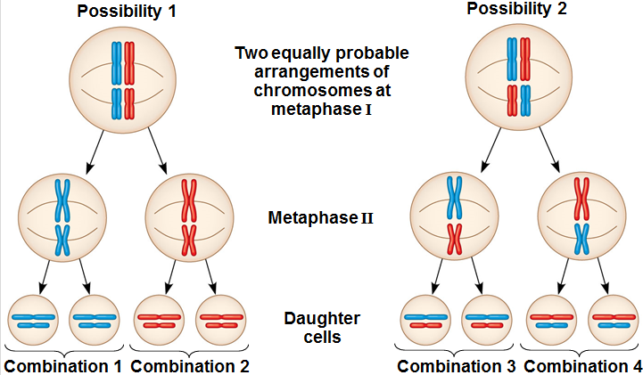
Independent Assortment
When the homologous chromosomes line up on the equator, each pair of chromosomes lines up independently of the others.
This means that if the mother’s chromosome 1 in the organism lines up on the left the father’s chromosome lines up on the right chromosome 2 doesn’t have to do that. It could reverse the order

Slide 51
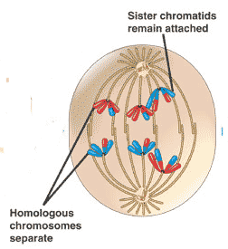
Phases of Meiosis
Anaphase 1
Homologous chromosomes are pulled apart, but the sister chromosomes are still stuck together

Slide 52
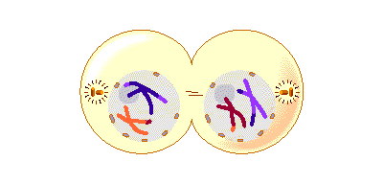
Phases of Meiosis
Telophase 1
The cell divides using cytokinesis
The cell is now N
Sister chromosomes are still connected
The nucleus may reform briefly in some organisms but not all, some organisms just go straight into the second division

Slide 53
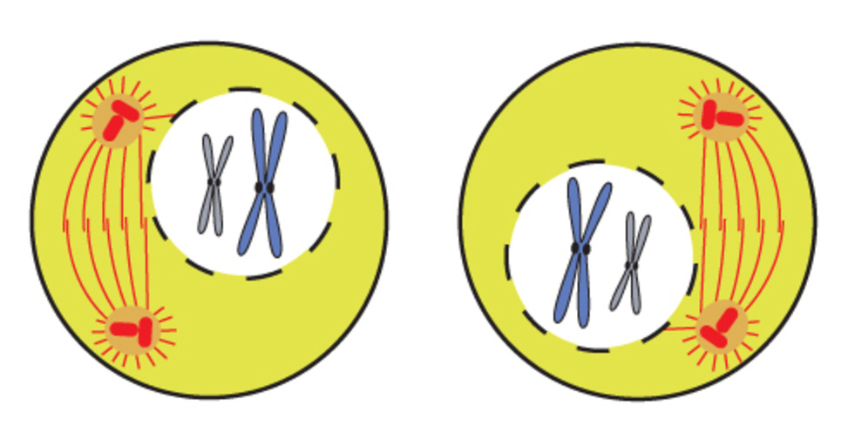
Phases of meiosis
Prophase 2
Happens the same way as mitosis prophase
The nucleus disappears if it is present
Centrioles double, spindle forms and attaches to the kinetochores of the sister chromatids
Cell is N

Slide 54
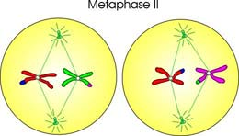
Phases of meiosis
Metaphase 2
Sister chromatids line up along the equator
Cell is N

Slide 55
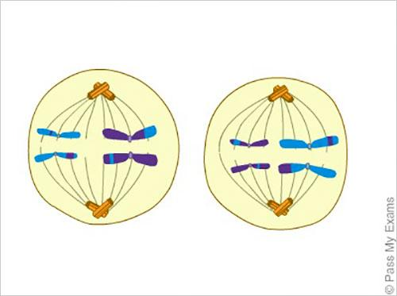
Phases of meiosis
Anaphase 2
Sister chromatids are pulled apart towards opposite poles

Slide 56
Phases of meiosis
Telophase 2
Both cells split to form 2 daughter cells
Each cell is N
Each cell is genetically different from the rest that are formed
Nucleus Reforms
Finishing touches are added to complete the process
Males: sperm cells are modified to have a flagella and the number of mitochondria are increased
Females: 3 of the cells are discarded and called polar bodies. All of the efforts are put into making 1 cell as perfect as it can be to maximize the chance of reproductive success

Slide 57
Problems with meiosis
Nondisjunction
Failure of the homologous chromosomes to separate during anaphase 1 or the sister chromatids to separate during anaphase II
Results in sperm and egg cells having too few or extra chromosomes which will result in the new organism not having 2n chromosomes
Monosomy: only having 1 of the homologous chromosomes
Trisomy: having 3 homologous chromosomes
Examples include Downs Syndrome (21), Klinefelter’s Syndrome (XXY), Turner’s Syndrome (X_), Edward’s Syndrome (18), Patau Syndrome (13),

Slide 58
Asexual Reproduction

Slide 59
What is asexual reproduction?
Aseuxal reporoduction uses the phases of mitosis as the mechanism to create new organisms
The goal is to create new organisms that are genetically identical to the parents
They use the steps of mitosis to make sure that the DNA is the same
Only 1 parent

Slide 60
Advantages and disadvantages
Advantages
Disadvantages
Faster
Parent gets to send genes to the next generation
Less energy used
Can happen at any time
Can increase the population very quickly
No genetic variation
Susceptible to diseases

Slide 61
Types of Asexual Reproduction
Binary Fission
Reproduction that happens in unicellular organisms. The method is exactly the same as mitosis but mitosis does not mean to create new organisms so we have a new term for it. (Mitosis generally means to make cells in multicellular organisms and doesn’t make entirely new organisms)
Budding
Growing a new organism out the side of the parent.

Slide 62
Types of Asexual Reproduction
Spores
Reproductive cells that act like seeds in the way they absorb water after landing in the soil and grow. Practically there isn’t a difference in the way that spores and seeds behave, just differences in their genetics.
Regeration
Regrowing missing body parts. Only applies to asexual reproduction though if the population size increases. Ex: starfish is cut in half and each half regrows is reproduction. A lizard who regrows a tail by the missing tail doesn’t regrow is not reproduction

Slide 63
Types of Asexual Reproduction
Vegetative Propagation
Methods of plant reproduction in addition to spores
Similar to budding in the sense that the new organism grows off the main parent but it may stay attached to the parent or be removed.
Sometimes it results from pieces being cut off and replanting.
Examples include tubers, bulbs, and runners

Slide 64
Sexual Reproduction

Slide 65
Basics
Uses meiosis as a method of creating the gametes needed to do sexual reproduction
Gametes are sex cells, sperm, egg, and pollen (plant sperm)
Requires 2 parents of opposite genders for most organisms
Gametes combine during fertilization
Zygote: term for the egg cell after fertilization happens
Starts to divide using mitosis from this point forwards

Slide 66
Types of fertilization
External Fertilization
Fertilization happens outside of the female organism. The eggs may move back into the female or male after fertilization occurs
Ex: most fish, bird, and lizard species
Internal Fertilization
Fertilization happens inside the female organism. The eggs may exit the female organism after fertilization occurs
Ex: humans, flowers

