Slide 1
Warmup 10/18
Why does DNA replicate?
What is made during translation?
What is the 3 letter code found on mRNA?

Slide 2
Warmup 10/19
What does it mean to have genetic variation?
What is asexual reproduction?
What are the advantages and disadvantages of asexual reproduction?

Slide 3
Asexual Reproduction

Slide 4
Asexual Reproduction/Mitosis
Results in babies that are genetically identical to the parent
Requires only 1 organism; no DNA is exchanged
No genetic variation
Genetic variation means that there are differences between the DNA of parents and offspring

Slide 5
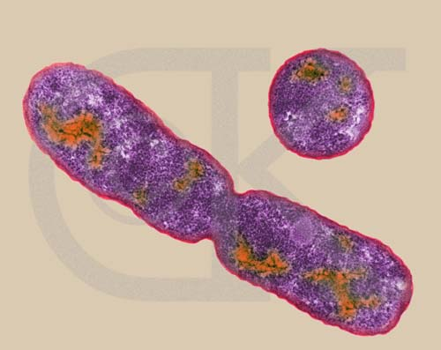
Binary Fission
Binary fission
Normal cell division that happens in single celled organisms
This is also known as mitosis

Slide 6
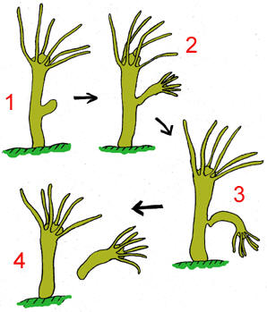
Budding
Budding
Process of growing a new organism out of the parent’s body
Happens in hydra and jellyfish

Slide 7
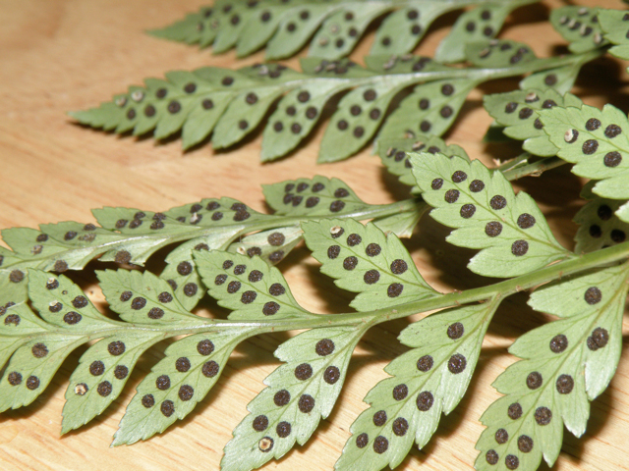
Spores
Spores
Seed-like reproduction that results in the formation of a new offspring genetically identical to the parent.
Happens in plants and mushrooms

Slide 8
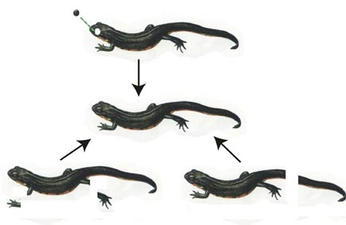
Regeneration
Regeneration
Happens in organisms like starfish, lizards, and worms
Multicellular organisms are able to regrow parts of their bodies

Slide 9
Warmup 10/22
What are the 4 types of asexual reproduction?
What is different about each?
What is similar about each?
What is the difference between offspring made from asexual reproduction and offspring from sexual reproduction?

Slide 10
Cell Reproduction

Slide 11
Cell Cycle
Life cycle of the cell
The Cell Cycle is split into two parts
Interphase
Mitosis

Slide 12
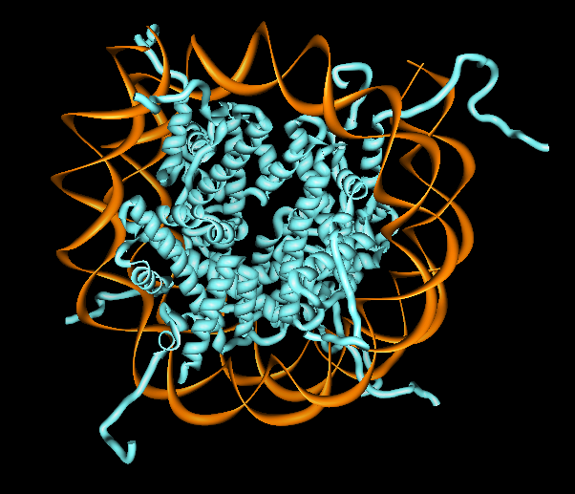
DNA
When DNA is uncoiled, it is called Chromatin
It resembles a bowl of spaghetti, with each noodle being a different piece of DNA

Slide 13
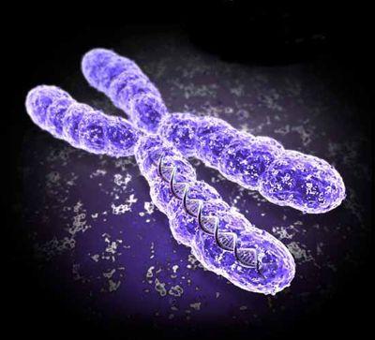
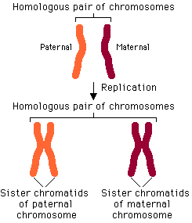
When DNA coils up, they are called Chromosomes
Chromosomes that look identical to each other but have different DNA are called Homologous Chromosomes

Slide 14
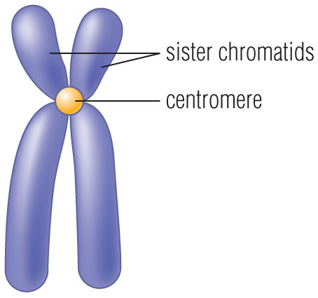
When DNA doubles, identical pieces are called sister chromatids and attach at the Centromere
Draw and label this picture in the box to the side

Slide 15
Phases of the Cell Cycle
Interphase
Occurs in all cells before cell division
Mitosis
Happens in every cell but the sex cells
Results in 2 new genetically identical cells (you clone the cell)
Spindles: fibers formed by the centrioles that move the sister chromatids
5 Stages: Prophase, Metaphase, Anaphase, Telophase, Cytokinesis (PMATc)

Slide 16
Interphase
Longest phase of the cell cycle
Split into 3 parts
G1 Phase
Cell grows in size
S Phase
DNA replicates
G2 Phase
Cell gets ready to divide

Slide 17
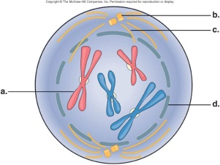
Prophase
Longest phase of Mitosis
Chromatin coil up into chromosomes
Nucleus Disappears
Spindle fibers form
Has all the DNA (2n)

Slide 18
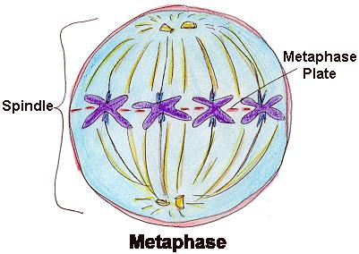
Metaphase
Sister chromatids line up along the equator
Equator is the middle of the cell

Slide 19
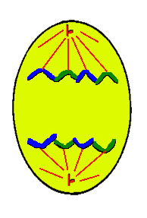
Anaphase
Sister chromatids are pulled apart toward opposite poles

Slide 20
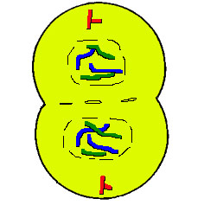
Telophase
Chromosomes uncoil
Nucleus Reforms
Cells are 2n

Slide 21
Cytokinesis
Cell finishes dividing into 2
Animals: form a cleavage furrow
Plants: form a cell plate

Slide 22
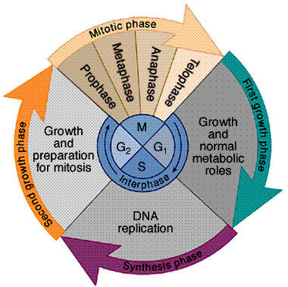
Cell Cycle pie chart

Slide 23
Cancer
Uncontrolled cell division
A problem with stopping mitosis
Causes the cell to enter Interphase just long enough to copy the DNA and grow quickly before going into Mitosis when it is not supposed to

Slide 24
Writing
On a half sheet of paper, answer the following questions.
How do organisms that do budding, spore production, regeneration, etc use mitosis as asexual reproduction?
How do multicellular, sexually reproducing organisms use mitosis? Is the way multicellular organisms use mitosis a type of asexual reproduction? Why or why not?

Slide 25
Warmup 10/23
What is mitosis??
What happens during telophase of mitosis?
What is the difference between chromatin, chromosomes, homologous chromosomes, and sister chromatids?
What happens during Interphase?

Slide 26
Warmup 9/29
What is DNA that is uncoiled called?
What are the phases of mitosis in order?
In which phase are the sister chromatids in the middle?
What does 2N mean?

Slide 27
Warmup 3/14
What are the 3 things that happen in Prophase?
What are the 2 most important things that happen in Interphase?
What happens in Anaphase?
What happens in Telophase?

Slide 28
Reminder
Quiz on the steps on mitosis Friday
Test is Tuesday!

Slide 29
Twilight Challenge
Grab a black microscope from the back counter and a film strip
You are responsible for identifying the phase of mitosis by looking at the picture and then describing what you see that tells you which phase it is (ie. The DNA is in the middle so it’s metaphase)
You will only use PMATc, you will not use Interphase

Slide 30
Why sexual reproduction
https://www.youtube.com/watch?v=DbEMrFdzPhg&list=WL&index=34

Slide 31
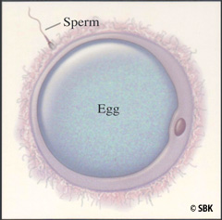
Sexual Reproduction
Results in one or more babies that are genetically different from the parents
Requires 2 organisms
Fertilization: combining of egg and 1 sperm to become a zygote
DNA is exchanged

Slide 32
Uses sex cells
Sex cells are the cells that are made by the reproductive organs
They are called gametes
They only have half the amount of DNA as a regular cell Ex: eggs and sperm cells, pollen (plants only)

Slide 33
Warmup 3/12
What is a zygote?
What is fertilization?
What is the main difference between sexual and asexual reproduction?

Slide 34
Fertilization Video
https://www.youtube.com/watch?v=_5OvgQW6FG4&list=WL&index=35

Slide 35
What are normal cells called then?
Body cells (not gametes) are also called somatic cells
They are made everywhere EXCEPT the reproductive organs
They have all of the DNA
Ex: skin cells and muscle cells

Slide 36
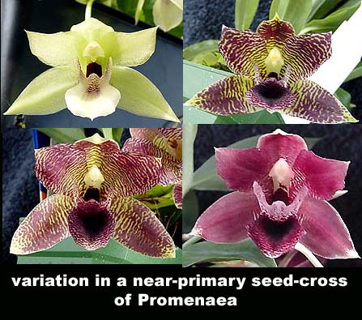
Why do we have sexual reproduction?
Causes genetic variation; a fancy way of saying that your DNA is different from everyone else’s

Slide 37
Opinion Essay
You need to write a fact-based persuasive essay on which type of reproduction (sexual or asexual) you think is the best.
You cannot use in your argument that sexual is the best because it feels good.
You will need to include advantages and disadvantages for each type of reproduction to help you support your claim

Slide 38
It is possible to imagine that human nature, the human intellect, emotions and feelings are completely independent of our technologies; that we are essentially ahistorical beings with one constant human nature that has remained the same throughout history or even pre-history? Sometimes evolutionary psychologists—those who belief human nature was fixed on the Pleistocene Savannah—talk this way. I think this is demonstrably wrong.

Slide 39
Consider ancient technologies, for example: cooking. When ancient hunter-gatherers discovered that firing their meat would not only make it tastier but could make their food easier to digest, it had a number of knock-on effects. It made parts of an animal carcass that were previously inedible edible, and also made it possible to preserve food longer. But this was not only a culinary but a cognitive success. Why? Because the amount of time our ancestors had to spend finding, hunting, and butchering their food, and thus maintain life, could be reduced making time available to invest in other activities such as thinking. Thanks to cooking, new time became available to prehistoric humans to plan, to consider, and invent other even more liberating technologies—or even to fritter away drawing bison and mammoth on the walls of caves.

Slide 40
Turn in your persuasive writing piece.
On your way back to the desk, grab a white board, marker, and a SMALL piece of tissue to wipe the board down with.

Slide 41
Whiteboards
If a sperm cell has 10 chromosomes, how many will a skin cell have?
If the muscle cell has 44 chromosomes, how many will an egg cell have?
If the sperm cell has 15 chromsomes how many will the egg have?
If the hair cell has 30 chromosomes, how many will the liver cell have?
If the leaf cell has 10 chromosomes, how many will the pollen have?

Slide 42
whiteboards
If the egg cell has 7 chromosomes, how many will the root cell have?
If the pollen cell has 20 chromosomes, how many will the egg have?

Slide 43
Amoeba Sisters
Write down what happens during meiosis
With a partner, create either a Venn diagram or a comparison T-chart that has similarities and differences between mitosis and meiosis.
When you are finished, turn it in.

Slide 44
Warmup 3/16
What is created in sexual reproduction?
What is a zygote?
What is used to create a zygote?
Draw a picture of fertilization that includes the egg, sperm, and zygote. Label each as either N or 2N.

Slide 45
Differences between mitosis and meiosis

Slide 46
Meiosis
Cell division that creates 4 genetically different cells (egg, sperm)
Part of Sexual Reproduction

Slide 47
 | Mitosis | Meiosis
# of Cells when done | 2 | 4
Amount of DNA in parent cell | All of it (2n) Diploid | All of it (2n) Diploid
Amount of DNA in daughter cells | All of it (2n) Diploid | Half as much as the parent (n) Haploid
# of Cell Divisions | 1 | 2
Genetic Variation Present? | No | Yes

Slide 48
What is genetic variation?
Differences in the DNA that cause individuals to be different from each other
Differences in the DNA
2n=100% of the DNA
N=50% of the DNA

Slide 49
Warmup 10/24
What is cancer?
If a monkey has 10 chromosomes in its sperm cell how many will be found in its brain cell?
What are 3 differences between mitosis and meiosis?

Slide 50
Quiz
Clear your desks of everything except something to write with.

Slide 51
Warmup 3/13
If a muscle cell in a gorilla has 30 chromosomes, how many will be found in its egg cell?
If an armadillo has 20 chromosomes in its egg cell how many will be found in its sperm cell?
If a banana has 10 chromosomes in its sperm cell how many will be found in its brain cell?

Slide 52
TURN IN
Turn in your cut and paste mitosis homework where you had to write out what is happening in each step of mitosis if you haven’t already done so.

Slide 53
Teach it!
You need to write down a description for the differences between mitosis and meiosis. Write it as though you were describing this to a seventh grader.
Vocabulary to include: interphase, DNA replication, mitosis, meiosis, diploid, haploid, # of cells created, genetic variation, crossing over, and independent assortment.

Slide 54
Sources of Genetic Variation

Slide 55
Crossing Over
Homologous Chromosomes exchange DNA at identical places on the chromosome

Slide 56
Independent Assortment of chromosomes
When the homologous chromosomes line up on the equator they stack on top of each other
Each set of homologous chromosomes stack separately, meaning that you will get a mix of mom’s chromosome and dad’s chromosomes on the top and bottom

Slide 57
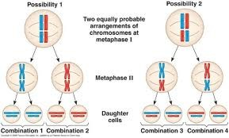

Slide 58
Genetic Mutations
Nondisjunction
Having too many or not enough DNA in the gametes will change the organism

Slide 59
Nondisjunction
Determined with a Karyotype
Allow your to count the number of chromosomes in a cell
Each chromosome should come in pairs (2); the last pair is always the sex chromosomes (determines the gender)

Slide 60
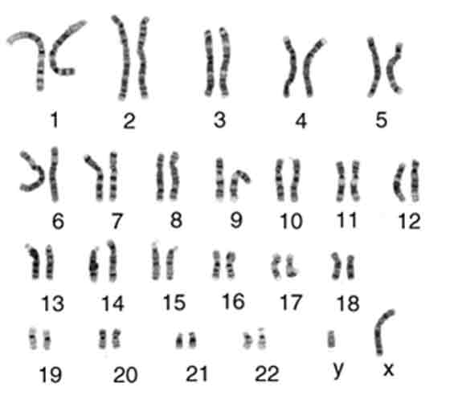
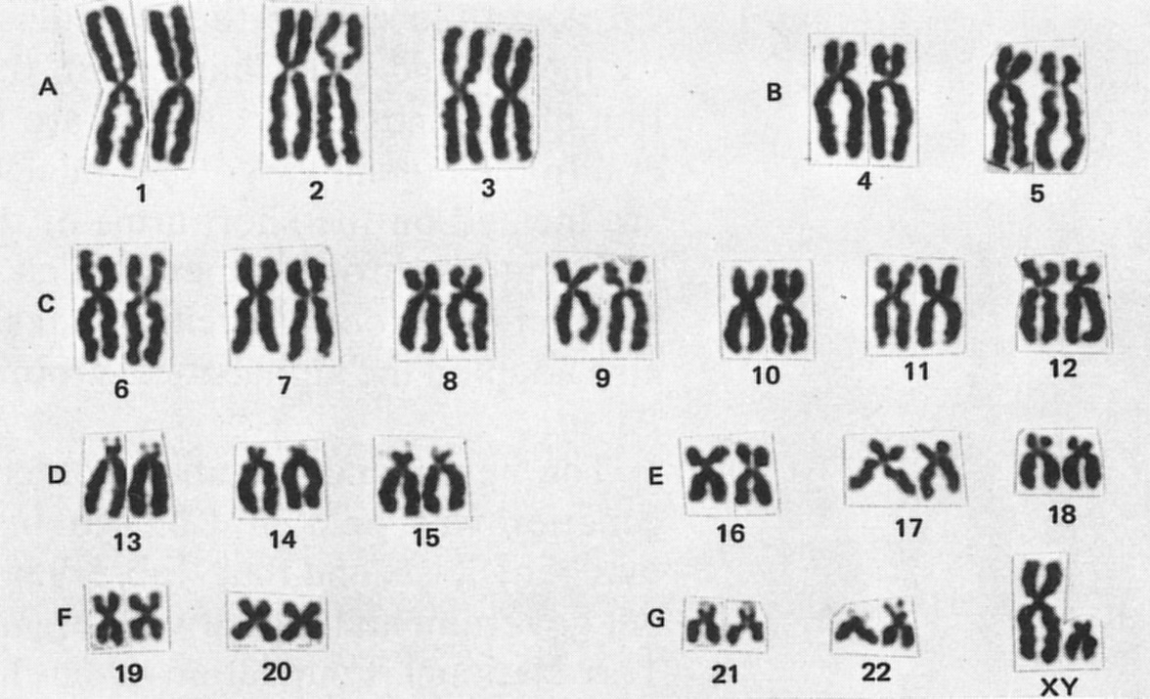
Karyotype

Slide 61
Sources of Genetic Variation
Fertilization
Only 1 egg will be released but millions of sperm that are all different from each other will be released

Slide 62
Karyotype Analysis Fixes
Website 2, Question 1:
Website changed to Mitosis, Meiosis, and Fertilization
Question 8
Click on “Extra or Missing Chromosomes” Link at the bottom
Question 11
Go to the home page, under the “Human Health” heading click “Genetic Disorders
Click on “Examples of Aneuploidy”

Slide 63
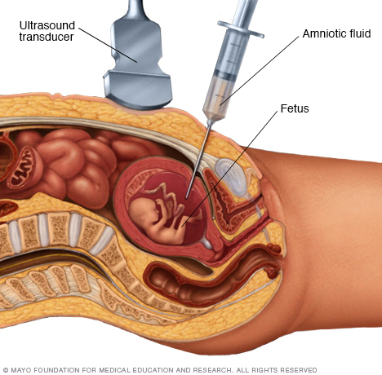
Karyotypes
The DNA is collected from the fetus with an amniocentesis

Slide 64
Nondisjunction disorders
Downsyndrome
Caused by having 3 chromosomes at 21st spot
Turner Syndrome
Caused by having only 1 X chromosome
Klinefelter’s Syndrome
Caused by having 2 X an 1 Y chromosome

Slide 65
Warmup 3/20
What is crossing over?
What is cancer?
What is a karyotype? What is it used for?
Is a pollen cell diploid or haploid?

Slide 66
Warmup 3/21
How many divisions are there in mitosis?
Which type of reproduction does NOT have genetic variation?
What does sexual reproduction make?
How is cytokinesis different in plants and animals?

