Slide 1
Differences between DNA and RNA
Making A Protein

Slide 2
RNA Structure
Ribonucleic Acid
Made of nucleotides
Nucleotide has 3 parts
Phosphate group
Ribose sugar
Nitrogen base

Slide 3
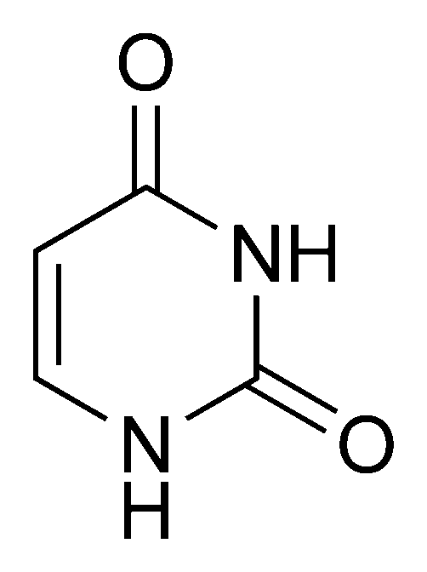
RNA Structure
Structure is a single helix
Nitrogen Bases
Guanine (G)
Cytosine (C)
Adenine (A)
Uracil (U) (only found in RNA)

Slide 4
Types of RNA
Types of RNA
Messenger RNA (mRNA): complementary copy of DNA that brings the directions to build proteins to the ribosome
Ribosomal RNA (rRNA): part of what makes a ribosome
Transfer RNA (tRNA): brings amino acids to the ribosome

Slide 5
 | DNA | RNA
Structure | Double Helix | Single Helix
Sugar | Deoxyribose | Ribose
Bases used | Thymine | Uracil
Location made | Nucleus | Nucleus
Location Used | Nucleus | Ribosome

Slide 6
Warmup 10/9
What is RNA?
What are 3 differences between DNA and RNA?
Where is RNA made?
Where is RNA used?

Slide 7
Transcribing RNA
Transcription: Process of making mRNA
Steps of Transcription
RNA Polymerase binds to the DNA
DNA unwinds only where the polymerase is bound

Slide 8
RNA polymerase adds RNA nucleotides together that form a complimentary copy of the DNA
C pairs with G
G pairs with C
A pairs with U
T pairs with A
When the mRNA is done being made it separates from the DNA and leaves the nucleus

Slide 9
Example
Example
Original DNA strand:
G T C A G T A G T T G C
mRNA strand:

Slide 10
Translation
Translation (mRNA → Protein)
Process of reading the mRNA to create the correct sequence of amino acids

Slide 11
Translation
What is a protein?
Chains of amino acids linked together
DNA encodes the instructions to make proteins
DNA needs to be changed into RNA to make the protein
Proteins are made of amino acids

Slide 12
Examples of polypeptides
Insulin: protein that regulates the amount of glucose in the blood
Hemoglobin: protein that is in red blood cells that transports oxygen and carbon dioxide into and out of the body

Slide 13
mRNA is read with a ribosome
The ribosome “reads” the mRNA 3 bases at a time
These 3 bases are called codons.
Each codon codes for 1 amino acid

Slide 14
Practice Problems
Write out the mRNA acodons to the DNA codons below
AAT
CGA
TAC
GAT

Slide 15
tRNA brings the amino acids to the ribosome
Ribsome binds the amino acid to other amino acids with a peptide bond
The tRNA forms a complement to the mRNA codon
Called an anti-codon

Slide 16
Practice Problems
Write out the tRNA anti-codons to the mRNA codons below
UUA
GCA
AUG
CUA

Slide 17
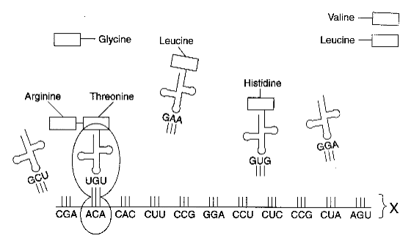

Slide 18
You use a codon chart to determine which amino acid bonds to the codon

Slide 19
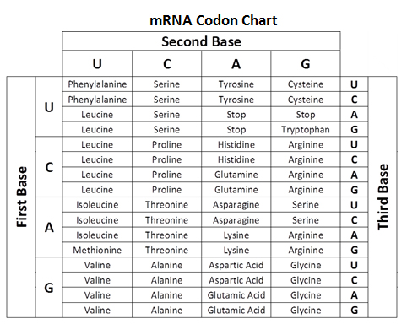

Slide 20
Practice Problems
Use the codon chart to match the amino acids to the codons
UUA
GCA
AUG
CUA

Slide 21
Mutations

Slide 22
Mutations
Change in the DNA of an individual
Can be inherited or received later in life
Can be caused by
Radiation
Chemicals
Mismatching nucleotides during DNA Replication
If it happens in the gametes (sperm or egg cells), it will be passed on to the children

Slide 23
Types of Mutations
Point Mutations
Change in 1 nucleotide base pair in the DNA sequence
EXAMPLE
TTT GGG CCC AAA: Original
TTT AGG CCC AAA: Mutated
Only changes 1 amino acid

Slide 24
Types of Mutations
Frameshift Mutations
Causes the codon reading frame to get moved up or down
Insertion: when a new nucleotide gets put into the sequence
TTT GGG CCC AAA: Original TTT GGG ACC CAA A: Mutated

Slide 25
Frameshift Mutations EXAMPLE
Deletion: when 1 nucleotide gets removed from the sequence
TTT GGG CCC AAA: Original TTT GGC CCA AA: Mutated

