Slide 1
Plants
Yea……

Slide 2
Characteristics of Plants
More than 280,000 of true plants in the world.
Most live on land
All multicellular
Have cell walls made of cellulose
Non-mobile

Slide 3
Have an elaborate method of reproduction that switches between sexual and asexual reproduction called the Alternation of Generations
Have many specialized tissues
Aerial parts (in the air) are coated with waxes to prevent dessication (drying out)

Slide 4
Gas exchange occurs through small pores in the leaf called stomata that are opened and closed by guard cells
Roots have an APICAL MERISTEM at the tip of each root and each shoot/branch where the cell division takes place and the plant elongates and widens
Use a multicellular embryo that depends on the parent plant
Uses transport tubes called Vascular tissue to move water upwards and move sugars down the plant

Slide 5
Produce haploid spores that will grow as a plant called gametophyte. The gametophyte will then produce haploid gametes
This is part of the Alternation of Generations
All plants will have multiple adaptations for helping them survive the challenges of living on land

Slide 6
Phylums of Plants
Bryophytes: non vascular plants
Pterophytes: seedless, vascular plants
Gymnosperms: seeded, vascular plants, no flowers
Angiosperms: flowering plants, seeded, vascular

Slide 7
Bryophytes

Slide 8
Group that includes mosses, liverworts, and hornworts
2 defining characteristics
Nonvascular
Vascular tissue is responsible for transporting food and water up and down the plant.
Xylem: portion of vascular tissue that transports water up the plant. Always located towards the outside of the plant. Made of dead cells. This is what wood is.
Phloem: transports food down the plant from the leaves. Always located towards the inside of the plant. Made of living cells. Has partitions.
Male gametes have a flagella

Slide 9
Since bryophytes are non-vascular they cannot grow very tall since gravity prevents the water from climbing up the plant very far.
Believed to be the first land plants
Challenges they faced
Dessication
Support against gravity
Little water to transport their gametes
How to get enough water, carbon dioxide, and waste into or out of the “body

Slide 10
Things that make them different from normal plants
They do not have a root
Use instead a structure called a rhizoid that anchors the plant to a surface and absorbs water and minerals
Central Cylinder: thick layer of support cells surrounded by photosynthetic cells. Supports the plant against gravity and stores food

Slide 11
Leaf Scales: Very primitive leaf like structure that does photosynthesis
Cutin: moisture barrier that prevents water loss. Covers the spidermis (skin) of the plant

Slide 12
Reproduction Style
Alternation of Generations
Lifestyle of alternating between the 2n phase called the SPOROPHYTE stage which goes through meiosis to produce n spores which grow into a full plant called the GAMETOPHYTE stage which then does mitosis to produce gametes which then fertilize to produce the SPOROPHYTE stage again.

Slide 13
In Bryophytes, the sporophyte stage is not well developed
Sporophytes look like a small capsule called a sporangium which produces the haploid spores
The Gametophyte is large and leafy to produce the haploid gametes that undergo fertilization

Slide 14
Once a spore settles on a place it can grow, it absorbs water and germinates (grows from the spore/seed)
Once it is large enough and there is enough water called a protonema
When enough water accumulates, an antheridium (male organ) releases the sperm that will swim to the archegonia (female organ) to fertilize the egg cell

Slide 15
Things to do
Write in the definitions for the following terms on your paper.
Stomata
Guard Cells
Xylem
Phloem

Slide 16
Pterophytes
The Ferns

Slide 17
Defining Characteristics
Have true roots
Have vascular tissue which allows them to grow further away from the ground than bryophytes
Use a protein called LIGNIN that is combined into the cellulose to further strengthen the cell wall and support the plant
Do not have seeds

Slide 18
Sporophyte generation is larger than the gametophyte generation
This is true for all vascular plants
Recently evolved plants have the gametophyte generation on a microscopic level
Plants also evolved to be heterospory which means that the spores will develop into either male gametophytes (microspores) or female gametophytes (megaspores)

Slide 19
Roots
The very tip of the root contains the apical meristem for growth
Surrounding the root is the epidermis (skin)
Root hairs are extensions of the epidermis that increase surface area which increase the amount of water that is absorbed
Inside the epidermis is the cortex which stores a lot of the extra water for the plant as well as the extra glucose
The central portion of the root is the vascular tissue

Slide 20
In the vascular tissue is the vascular cambium which is a layer of tissue that is in between the xylem and phloem
Responsible for increasing the size of the xylem and phloem as the root/trunk/stem gets larger.

Slide 21
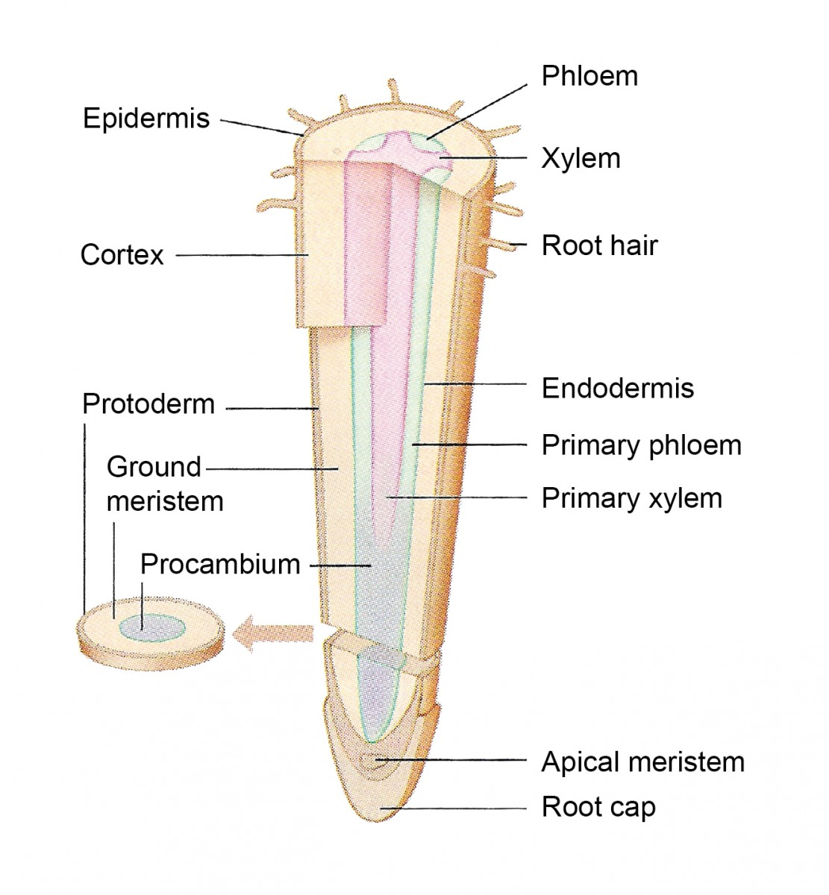

Slide 22
2 types of root systems
Tap root
1 primary root that is typically very thick and extends far down into the ground in search of water
Fibrous Root
A branching system of roots that stay on the surface level of the ground and spread out in a wide area from the plant searching for water

Slide 23
Leaf Structure
On the outside layer of the leaf is the cuticle
Waxy layer, thicker on the top of the leaf than the bottom, that prevents water loss from the plant
Inside is the epidermis of the leaf which is a thin layer of cells that acts as a skin to keep viruses and bacteria out
Right below the epidermis are the palisade cells
Responsible for photosynthesis, sit upright so that the chloroplasts can circulate through the cell to maximize photosynthesis. Only on the top layer.

Slide 24
Spongy mesophyll
Makes up most of the extra volume of the cell. Can do photosynthesis but are not as good as the palisade cells
Vein
Has the vascular tissue for bringing water in and glucose out

Slide 25
Stomata: opening that allows for gas exchange
Guard cells are responsible for opening the closing the stomata
Have the ability to close the stomata when they would usually open if the plant senses there is excessive water loss. Caused by changing the amount of water in and out of the plant by modifying the amount of solute in the cells

Slide 26
2 Divisions of Pterophytes (phylums)
Seedless Plants: Pteriodophytes
Lycophyta-spider like plants ex. club mosses, 1000 species
Pterophyta-winged plants ex. ferns

Slide 27
Lycophyta: Club Mosses
Often mistaken for pine seedlings
Have roots, stems and leaves
Fertilization occurs only when there is enough water for sperm to swim

Slide 28
Division Pterophyta: ferns
12,000 named ferns
In diploid form there are underground rhizomes that form many fine roots arise from.
Well developed vascular tissue
Diploid form is dominant generation.

Slide 29
Spores are produced under the leaves and are found in groups called sori. Most ferns produce homospores meaning no sexual differentiation.
Spores are wind-dispersed and produce a prothallus that has both male and female parts. Water is needed for sperm to swim to egg. A fertilized egg becomes a new sporophyte.

Slide 30
Include on your drawings
Taproot
Fibrous root
Vascular Cambium
Cuticle
Palisade Cells
Spongy Mesophyll
Vein

Slide 31
Gynosperms

Slide 32
Main Characteristics
Have vascular tissue
Use seeds in the gametophyte generation
No longer require water to reproduce because the plant uses pollen
Have true roots

Slide 33
4 Divisions
Coniferophyta: conifers (550 species)
Cycadophyta: cycads (100 species)
Ginkgophyta: ginkgoes (1 species)
Gnetophyta: gnetae (70 species)

Slide 34
Division Ginkgophyta: ginkgo
Only 1 species
This species is considered a living fossil
Male ginkgo trees produce air-borne spores that germinate close to female ovules in female trees.
motile multi-flagellated sperm swim down pollen tube to fertilize the egg, a seed is then produced.

Slide 35
Cycadophyta: cycads
Found in tropical regions
Pollen is produced in a cone and carried to female cones.
There are 100 species

Slide 36
Coniferophyta: conifers
9 families and 550 species-best known are pines, firs spruces and hemlocks
Produce needles or scale-like leaves that usually last a year and then are shed, but not all at once.
Bear pollen bearing cones and female cones and each tree only has one sex of cones (monoecious).

Slide 37
Gnetophyta: gnetum, ephedra, and welwitschia
Nothing special to know here except that they are gymnosperms

Slide 38
Heterosporous Fertilization
All gymnosperms are heterosporous (produce male and female spores)
Process:
Megasporangium produces a single megaspore mother cell surrounded by tissue. This is the ovule. This is produced on the female cone which is larger than the male one.
Microsporangium produces many haploid microspores. Each microspore matures into a pollen grain. Wind blows the microspores to the ovule.

Slide 39
Within the ovule meiosis creates 4 cells, but 3 disintegrate. (SOUND FAMILIAR??) The remaining cell matures into a gametophyte. The gametophyte will grow within the ovule and produce 2 or more archegonia, each containing a single egg cell. As the ovule ripens it secretes a sticky liquid to trap pollen.As the liquid dries, it pulls the pollen into the ovule, a few months later the pollen develops into a male gametophyte.

Slide 40
The male gametophyte produces 2 nonmotile sperm that are carried to the egg. This takes about a year but is faster in white pines than yellow pines.
When sperm meets egg a zygote is formed and begins to divide into an embryo (young sporophyte). As the ovule matures the integuments harden into a seed coat that encloses the sporophyte and the female gametophyte tissue that becomes the food socure.
After maturity is reached, the cone opens and releases seeds. No water is needed for fertilization.

Slide 41
Angiosperms

Slide 42
Basic Characteristics
True roots
Vascular tissue
Produce seeds
Use flowers in reproduction.

Slide 43
2 main groups
Monocotyledons (Monocots)
Dicotyledons (Dicots)
A cotyledon is a leaf located in the seed

Slide 44
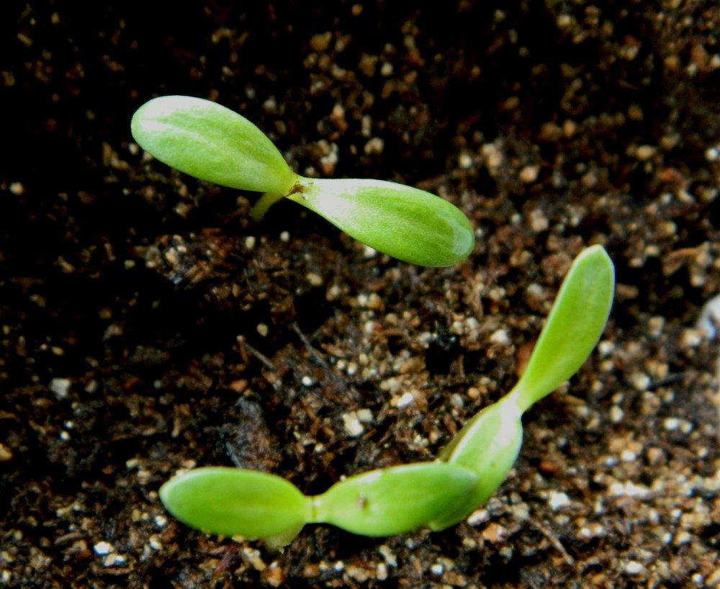

Slide 45
Monocots
Leaf veins are parallel
1 cotyledon
Flowers grouped in 3s
Vascular tissue is in scattered bundles
No vascular cambium
Roots are net-like or fibrous
No secondary woody growth

Slide 46
Dicots
Leaf veins are branching
2 cotyledons
Flowers in 4s or 5s
Vascular bundles arranged in a ring around the stem
Has vascular cambium
Roots are fibrous or tap
Secondary woods growth present

Slide 47
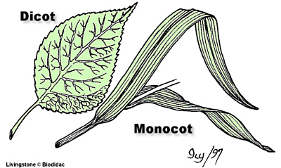

Slide 48
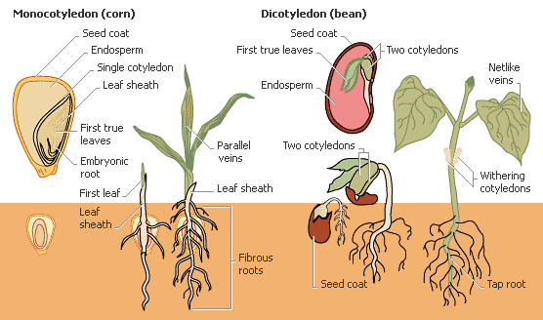

Slide 49
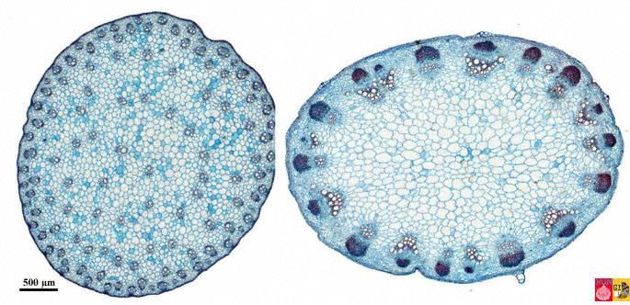

Slide 50
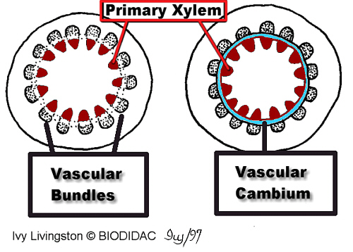

Slide 51
Flower Structure
Anther: makes the pollen. Male reproductive organ
Filament: holds up the anther
Stamen: anther and filament combined
Stigma: sticky tip of the pistil
Style: long tube that has the stigma at the tip and the ovary at the bast

Slide 52
Ovary: holds the ovules (eggs)
Pistil: stigma, style, and ovary combined
Petals: brightly colored to attract pollinators
Sepals: support and protect the petals

Slide 53
A complete flower has all of the parts listed for a flower. An incomplete flower is missing some parts.

Slide 54
Flower Dissection Lab
1. Label with: Name of Flower, Monocot or Dicot, Complete or Incomplete Flower
2. Take apart flower and place all parts on paper, laminated with tape. Each part must be labeled with name of structure and function.
3. If your flower is missing any parts, making it an incomplete flower, put the names and functions of the parts somewhere on your paper in a "Not Present" section.

Slide 55
Seeds

Slide 56
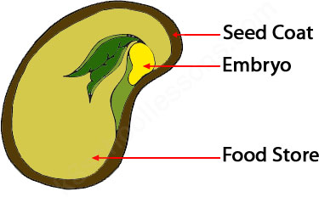
Seeds consist of:
an embryo
a food supply
a protective coat
A mature fertilized ovary becomes the fruit.

Slide 57
Types of fruit
Simple fruits-made of a single pistil
Aggregate fruits-have several pistils Ex. Raspberry and Strawberry
Multiple fruits-consist of pistils from more than one flower ex. pineapple

Slide 58
Seed Dispersal
Once a seed is created it needs to be dispersed away from the mother plant so that it does not need to compete for resources. When baby plant competes with the parent plant the baby plant will lose.

Slide 59
Methods of Seed Dispersal
Floating in water
Floating in the air
Wind can disperse
Animals can eat and excrete the seed.
The seed can attach to fur or body of an animal.
The seed can be flung by a parent.

Slide 60
Adaptations to seasonal changes
Annuals-entire life cycle of the plant takes place during a single growing season. Only the seeds survive the season and are resistant to cold, dessication and other environmental factors.
Perennials-Vegetative structures that persist year after year.

Slide 61
Biennials-the period from seed germination to seed formation spans 2 growing seasons. The 1st growing season produces a short stem and a rosette of leaves near the soil. The root stores food (ex beets and carrots). In the second season the stored food is mobilized for the plant's reproduction.

Slide 62
Seed Dormancy
Some seeds remain dormant for long periods of time before germination due to their seed coat. Sometimes the seed coat acts as a mechanical barrier by preventing water and gases from crossing. In these cases germination will begin when the seed coat is worn away, burned by fire, abraded by sand or soil, or partially digested.

Slide 63
Embryonic Plant Tissues
The embryo has 3 types of plant tissues:
Protoderm
Procambium
Ground meristem

Slide 64
These 3 tissues produce 3 tissue systems:
Dermal-outer cover for the plant body, the epidermis.
Vascular tissue system-made up of the vascular tissue.
Ground tissue system-fills the space between the dermis and the vascular system.

Slide 65
Common Cells
Parenchyma-most frequently encountered cell in the plant body. This cell type is found in all systems and consists of many sided thin walled cells. These cells function to photosynthesize, respirate, store food and water.

Slide 66
Collenchyma-These cells have a thicker primary cell wall and are usually grouped in cylinders or strands. These cells help support the plant without restraining growth.

Slide 67
Sclerenchyma-These cells have a secondary cell wall that is strengthened by lignin (makes wood wood like). Mature cells cannot lengthen and are may actually be dead. The rigid cell wall helps support the plant.

Slide 68
Germination-awakening of the dormant sweed:
The seed takes in water, swells and the seed coat ruptures.
Alpha amylase is produced which begins to digest starch in the seed to produce glucose for the embryo.
The radicle grows down the hypocotyl grow up.

Slide 69
The first leaves open to the sun and photosynthesis begins.
The primary growth will involve differentiation of the 3 tissue systems, elongation of roots and stems, and formation of lateral roots and branches.

Slide 70
Plant Growth

Slide 71
Most plants will grow as long as they live and this is referred to as inderterminate growth.
They do this using the apical meristem which is unspecialized and rapidly dividing cells. In the center of the apical meristem is the quiescent center. This center has cells that are resistant to radiation and toxic chemicals. They may act as reserves to produce new apical meristem if the primary cells are damaged.

Slide 72
Growth patterns are determined by the location of meristems.
Apical meristems are located at the tips of roots and in the buds of shoots, allowing both to grow in lengths.
-In herbaceous plants only primary growth occurs but in woody plants there is a secondary growth. This involves a thickening of the roots and shoots. This secondary growth is a result of lateral meristems and adds layers of vascular tissue.

Slide 73
Root Development
Root types:
Tap root-a primary root that gives rise to lateral roots.
Adventitious roots-develop from base of the stem or other parts of the plant and are not primary roots, but form a fibrous root system.
Aerial roots-adventitious roots produced by above ground structures.

Slide 74
Parts of the Root
Root cap-found at tip of root; protects apical meristem.
apical meristem-area of actively dividing cells.
zone of elongation-right above apical meristem; cells may elongate to 10 times original length.

Slide 75
zone of differentiation-found above the zone of elongation; the three primary tissues differentiate here into:
protoderm-gives rise to epidermis and root hairs.
procambium-gives rise to central vascular cylinder.
ground meristem-between dermis and central vascular cylinder.

Slide 76
Stems of the woody plants
Functions:
avenues of transport
supports and elevates foliage
stores food
produces new living tissue
supports and elevated flowers and other reproductive parts.

Slide 77
Primary growth of the shoot system
Growth in the stem is similar to the root. There is an area of cell division, a region of elongation and differentiation. However the growth zones are not as distinct. There is also no root cap.
Secondary Growth:
Plants become thicker due to lateral meristems producing growth rings.

Slide 78
Movement of materials
The plasma membrane allows for both passive and active transport through selective protein channels. Ex. potassium channels in the cell allow potassium to be transported but block sodium.
Tonoplast is the membrane of the large central vacuole and plays a major role in regulation. It controls the movement of solutes between the cytoplasm and the central vacuole.

Slide 79
Short Distance Transport
These deal with radial transport not vertical.
Osmotic
Symplastic-Cytoplasm is continuous with plant tissues and allows solutes and water to move from one cell to the other via plasmodesmata.
Apoplastic-moves substance through the cell walls

Slide 80
Long Distance Transport
Accomplished through xylem and phloem.
Water movement:
Absorption of Water: Water and minerals enter the plant through the root epidermis and enter the xylem. Root hairs increase surface area to allow greater absorption. Water and minerals flow upwards @ rates of 15 or more meters per hour. Plants also lose a lot of water through transpiration. A average sized maple tree will lose up to 200 liter of water per hour.

Slide 81
Root pressure: Plants get water from root hairs almost entirely due to diffusion and capillary action. The roots have a higher solute concentration then soil so water enters the roots. An example of the effectiveness of root pressure is morning dew. The roots early on a summer morning push up the drops of water on the edges of the blades of grass leading to an excess of water and it is pushed out of the leaf. Loss of water in the liquid form is known as guttation, in the vapor form is called transpiration.

Slide 82
Transpiration: the cohesion-tension theory
Transpiration is the movement of water up the stem, but water is not pushed up a tree, it is pulled due to 2 characteristics of water:
adhesion
cohesion

Slide 83
Transpiration pull
Capillary action occurs causing water to rise.
3 factors affect this:
temperature-rate doubles with every increase of 10 degrees Celsius.
humidity-water is lost much more slowly when the air is thick with water vapor.
air currents-wind blows water vapor away from the leaf surface.

Slide 84
Gas Exchange

Slide 85
Gas exchange cannot happen in the roots as we do not want gas to enter the xylem. If that happens, the water column will break and water won’t climb the plant.
If we want the guard cells to open they swell with water. If we want them to close, the water is pumped out
Regulated by the tonoplast by using active transport to regulate the amount of solute is inside and outside the cell.

Slide 86
Factors affecting stomata movements
Factors affecting stomatal movements
Availability of water
Abscisic acid: binds to receptors in guard cells causing them to close.
Carbon dioxide concentration: increased carbon dioxide in spongy mesophyll close stomata.
Temperature: increases in temperature close stomata.
Light: blue light opens guard cells because it triggers the uptake of potassium.
Internal clock

Slide 87
Plant adaptations
Xerophytes-plants adapted to arid environments that have small thick leaves, thick cuticles and stomata on lower leaf surface. Stomata are found in crypt-like depressions to protect them from wind. Some of these plants will even shed leaves during dry seasons or store water during the rainy season.

Slide 88
Crassulacean acid metabolism-causing plants to open stomata at night and close during the day. These plants take in carbon dioxide at night and convert it to malic acid and then during the day the carbon dioxide is released and used in photosynthesis. This preserves water for the plant.

Slide 89
Factors affecting plant nutrition
Uptake of minerals-naturally occurring inorganic substances required by plants is done through the endodermis playing a role in determining which substances can enter the xylem.
Mineral requirements:
There are macronutrients required by plants and they are C, O, N, S, P, K, Ca, Mg. Plants require these for:
regulation of water balance
magnesium is a key part of chlorophyll
phosphorus and calcium are part of cell membrane.
Help with protein production, hormone and the formation of other compounds.

Slide 90
Soil charcteristics such as type of parent rock, the soil horizon, pH and amount of humus.
Symbiotic relationships
Mycorrhizae-fungi extract nutrients (phosphates and water) for plants and make them available. Studies suggest they may even screen out chemicals in toxic soil.
Rhizobium and nitrogen fixing-bacteria that converts the atmospheric nitrogen into ammonium or nitrate.

Slide 91
Parasitic and predation
parasitic plants-these plants grow into the xylem or phloem of another plant
carnivorous plants-trap insects to obtain nitrogen.

Slide 92
Chemical Regulation and Behavior

Slide 93
Hormones-a chemical substance produced in one tissue and transported to another to integrate growth, development and metabolic activities.

Slide 94
Plant Hormones
Auxins-Indolacetic acid (IAA)-promote elongation of cells during growth, production of new ribosomes and secondary growth. Auxins inhibit the growth of axillary buds, but cutting off stem tips will cause the buds to begin to grow and plant to become bushier. Herbicides are made of synthetic auxins to disrupt plant growth.
Brassinosteroids-increase cell elongation and division in stem cells in seedlings. Similar to auxins.

Slide 95
Gibberlins-Formed in young leaves around the growing tip. Stimulate cell growth of the stems and leaves. Also increase the size of fruits. Seedless fruits are produced with this hormone.
Cytokinins-Stimulates cell division, can cause undifferentiated cells to differentiate and are foun din aging plants and are used to extend their live.

Slide 96
Abscisic acid-controls leaf separation form the stem. Used to reduce water loss due to transpiration when the plants are stressed by closing stomata.
Ethylene-a gas that causes the smell of ripening fruit. Intiates the ripening process, degrades the cell walls and decreases chlorophyll content.

Slide 97
Tropisms
+ tropism-plant grows towards something
- tropism-plant grows away from something
Photo tropism
+ phototropism-plant grows towards light
- phototropism-plant grows away from light

Slide 98
Geotropism
+ geotropism-plant grows towards the Earth
-geotropism-plant grows awayt from Earth
*These are controlled by auxins.
Thigmotropism-plants response to touch
-sensitive plants-leaflet fold in or down a second or two after touch
-venus fly trap closes when hairs are touched.
*controlled by auxins and ethylene.

Slide 99
Photoperiodism
Plants response to amount of day and night
day neutral plants (flower regardless of length of day and night, flower in response to a particular amount of maturity.)
short-day plants (flower ony when day 14 hours or less)
long-day plants (flower only when day is longer than 14 hours)
Even a short flash of light during a plants dark period can interrupt its ability to flower.

Slide 100
Circadian rhythm-a daily cycle of behavior in an plant or animal, for example when it releases auxins.

Slide 101
Coping with Environmental stresses
Water deficit-reduce the rate of transpiration by closing guard cells by reducing abscisic acid. Shallow root growth slows, deep roots growth increases to gather water.
Oxygen deprivation-too much water in soil decreases oxygen, plants use air tubes in the roots to provide air.

Slide 102
Salt stress-Plants will try to select ions for plants to avoid excessive salt uptake but cannot live long in this environment.
Heat stress-Try to give off heat using transpiration and some tropical plants produce heat shock proteins.

Slide 103
Cold stress-alter lipid concentration to maintain membrane fluidity, some plants even have solute concentrations to avoid the formation of ice.
Response to herbivores-thorns and chemical (distasteful or toxic) defenses.

Slide 104
Defense against pathogens-Has a gene produce to keep pathogens in check; similar to antibodies in humans.
Hypersensitive response-if area is infected plants can produce phytoalexins and PR proteins that attack the cell walls of bacteria. Cell walls can also cross-link to block pathogen entry.

Slide 105
UGH…DONE!

