Slide 1
Macroevolution

Slide 2
Warmup 2/26
Describe
Pre-adaptation
Allometric growth
Paedomorphosis

Slide 3
Mechanisms of Macroevolution

Slide 4
Mechanisms of Macroevolution
Preadaptation-This is the term used for a structure that evolved in one context but is used in another function. This does not imply the structure was formed for future use, but the organism solved a problem with what was available.
Ex. sweat glands in mammals being transformed into mammary glands

Slide 5
Mechanisms of Macroevolution
Development and macroevolution:
Allometric Growth-Genes that control when and how changes occur from zygote to adult. Can be the relative rates of growth of different body parts that help shape the organism.

Slide 6
Mechanisms of Macroevolution
Development and macroevolution:
Paedomorphosis-Genetic changes can also affect the timing of developmental events, such as the sequence in which different organs start and stop developing. Ex. sexually mature adults in one species keep structures that were found in juvenile form of ancestors.

Slide 7
Mechanisms of Macroevolution
Development and macroevolution:
Developmental Timing-this is important in human evolution. Chimpanzees and humans are closely related but brain development stops much later in humans and grows for several more years than chimpanzee's brains do.

Slide 8
Evolutionary Trends
Gradualism-a gradual change of organisms over time.
Punctuated equilibrium-long periods of no change, punctuated by short periods of drastic change. Natural disasters and intense natural selection could bring this about.

Slide 9
Speciation
Long term change in a gene pool. A change in the frequency of a population that splits a population, and that occurs over a long period of time.
Even though many populations live side by side, they may become reproductively and genetically isolated if they cannot produce fertile offspring. This is called reproductive isolation. A geographic barrier is not a form of reproductive isolation.

Slide 10
Isolation of Gene Pool
Allopatric speciation (geographic isolation)-when populations in one geographic area are split into 2 or more geographically separated populations.
Ex. glacier cutting down path or Pangea splitting up. If the populations stay separated for a long period of time they may begin to diverge genetically under the pressure of different selection forces (microevolution).
If enough time passes, and the selective forces are significant, interbreeding may not occur under natural conditions even if barrier is removed.

Slide 11
Isolation of the Gene Pool
When gene frequencies in a population diverge enough to create a new gene pool, a new species develops.
There are some hybrids, example a mule, but these are much more common in plants.

Slide 12
After isolation
So after two animal populations have been separated and have evolved into separate species why can't they produce fertile offspring?
Prezygotic isolating mechanism (preventing fertilization of egg)
Habitat differences-may never encounter each other.
Differences in breeding time
Mechanical differences-organism genitals are designed to fit like a lock and a key, if they don't fit, mating cannot occur.

Slide 13
Cont
So after two animal populations have been separated and have evolved into separate species why can't they produce fertile offspring?
Prezygotic isolating mechanism (preventing fertilization of egg)
Behavior differences-courtship behavior may differ
Gametic differences-even if mating occurs sperm will not be able to fuse with ovum for a variety of reasons.

Slide 14
Postzygotic isolating mechanism (prevent successful reproduction after fertilization occurs)
Zygote will not survive gestation period.
The offspring are sterile.
Hybrids are fertile but produce infertile or inviable offspring in the F2 generation (known as hybrid breakdown).

Slide 15
Introgression
When alleles from different species cross a reproductive barrier and enter the gene pool.
Example-There are some alleles in corn that have been traced back to wild grass.

Slide 16
Tracking Macroevolution

Slide 17
Phylogenetic Trees
Visual map showing how species are related to each other, where species diverged, if species is still alive or extinct, and roughly how old and primitive the specie is

Slide 18
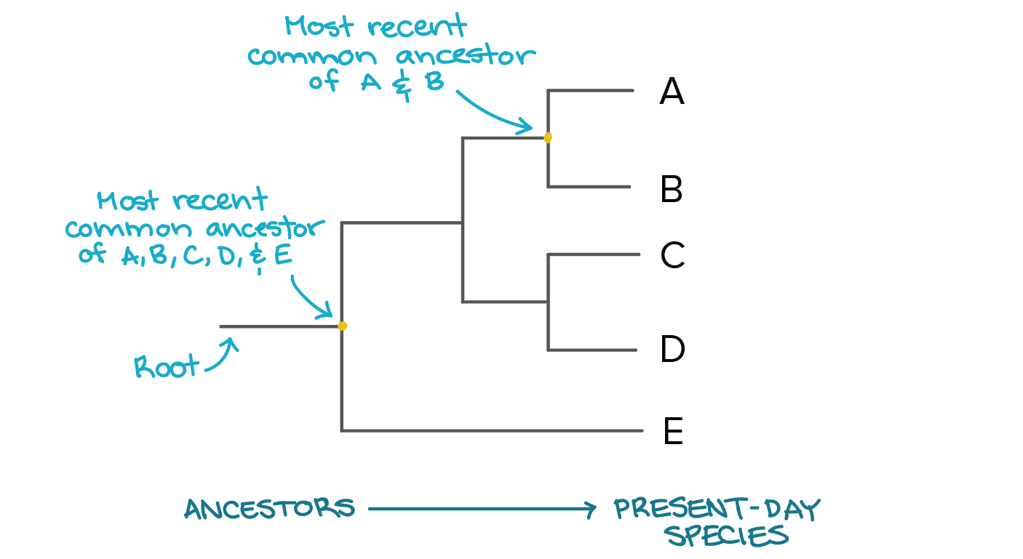
Phylogenetic Tree

Slide 19
Phylogenetic Tree
Where two lines come together is the location of a common ancestor of the 2 species
The oldest organism will always be at the bottom of the tree
The mot primitive organism is the oldest organism
How long the line is tells how long ago that species went through the speciation process

Slide 20
Cladograms
Modifications of phylogenetic trees
Generally simplified and showing a more linear picture of evolution
Shows what traits developed that allowed for speciation

Slide 21
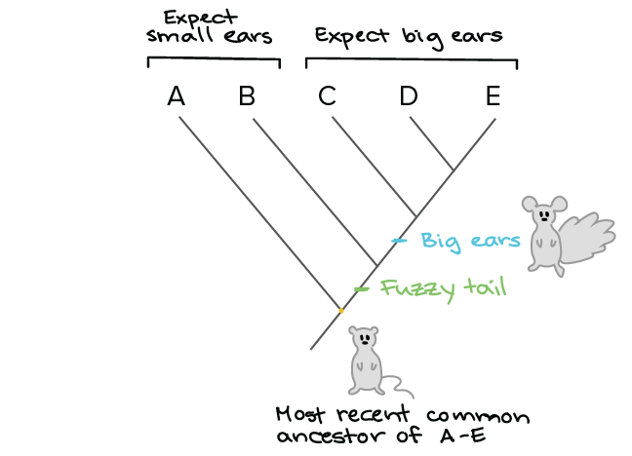
Cladograms

Slide 22
Create Your Own Trees
Create a cladogram using 5 of the 10 organisms at your lab station
Remember that you need to include a trait between each branch
Create a phylogenetic tree for all 10 of your organisms
After each split, write what traits you noticed that caused you to split the group in this manner.

