Slide 1
Warmup 11/01
What does the term dominant mean to you?
What does the term recessive mean to you?
What is a Punnett Square?

Slide 2
Warmup 11/01
Put the steps of mitosis in order: Cell divides, Nucleotides are added, DNA unwinds?
Will independent assortment be found in the offspring of sexual reproduction, asexual reproduction or both?
Why is meiosis important for sexual reproduction?

Slide 3
Trait | # Dom | # Rec | Total # | Dom % | Rec %
Tongue | 29 | 2 | 31 | 94 | 6
Hair | 11 | 20 | 31 | 35 | 65
Ear | 21 | 10 | 31 | 68 | 32
PTC | 23 | 8 | 31 | 74 | 26
Thumb | 11 | 20 | 31 | 35 | 65
Little finger | 14 | 17 | 31 | 45 | 55
Hair finger | 8 | 23 | 31 | 26 | 74
Freckle | 10 | 21 | 31 | 32 | 68
Dimple | 11 | 20 | 31 | 35 | 65
Index Finger | 16 | 15 | 31 | 52 | 48

Slide 4
Genetics!!
Mendelian

Slide 5
What is Genetics
Scientific study of inheritance
Inheritance is understanding how genes are passed from one parent to the next
Offspring receive one set of genes from mom and one set from dad
A gene is a segment of DNA that codes for a protein

Slide 6
Terms
Allele: different form of the same gene
Dominant: trait that is always expressed, written with a capital letter “A”
Recessive: trait that is only expressed when a dominant trait is not present, written as a lower case letter “a”

Slide 7
Terms
Homozygous: both alleles are the same AA or aa
Also known as a purebred
Heterozygous: the alleles are different Aa
Also known as a hybrid

Slide 8
Homozygous vs Heterozygous
Alleles
Trait

Slide 9
Genotype: combination of dominant and recessive alleles (Tt)
Phenotype: what you look like on the outside (tall)

Slide 10
Gregor Mendel
Father of Modern Genetics
Mendel was an Austrian monk who enjoyed math and science
He worked out the probability of different traits (genes) that will be passed down to the offspring.
Probability is the chance that something will happen

Slide 11
The Experiment
Used pea plants in his experiments

Slide 12
Mendel’s Laws of Genetics
Law of Dominance
Dominant genes will hide recessive genes or alleles
Recessive genes may remain hidden for several generations

Slide 13
Law of Independent Assortment
Homologous chromosomes will be inherited separately from each other, so when you make gametes, there will be a random combination of the chromosomes you inherited from your parents.

Slide 14
Hitchhiker’s Thumb

Slide 15
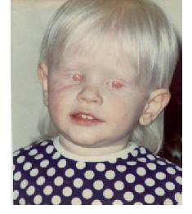
Albinism

Slide 16
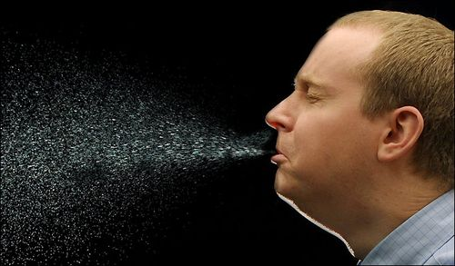
Photic Sneeze Reflex

Slide 17
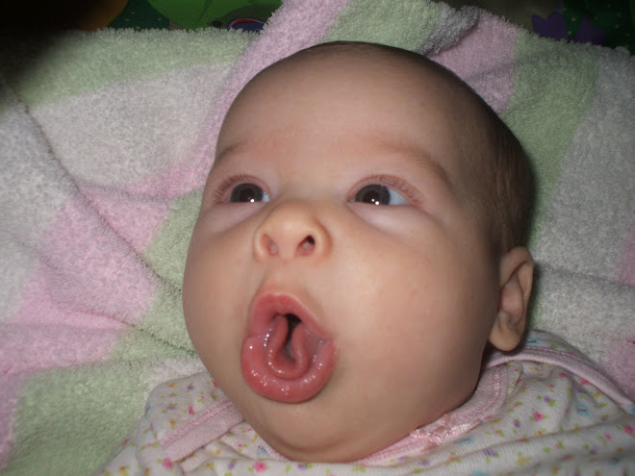
Tongue Rolling

Slide 18
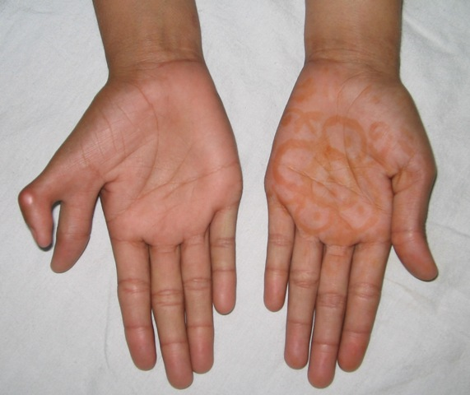
Polydactly (Six digits)
Recessive
Dominant

Slide 19
Warmup 10/10
Define the following terms:
Homozygous
Recessive
Allele
Hybrid

Slide 20
Warmup 11/02
What is the difference between a genotype and phenotype?
What is the difference between homozygous and heterozygous?
How would you write homozygous recessive?

Slide 21
Punnett Squares
Rules
Each person will have 2 forms of the trait, only 1 can be passed on to offspring from each parent
Homozygous Dominant: AA
Homozygous Recessive: aa
Heterozygous: Aa

Slide 22
Example
A homozygous dominant round seed plant is crossed with a homozygous recessive wrinkled seed plant. (Round is Dominant)
What is the chance of getting a round seed?

Slide 23
Example
A heterozygous round seed plant is crossed with another heterozygous round seed plant.
What is the chance of getting a homozygous recessive plant?

Slide 24
Example
A homozygous wrinkled seed plant is crossed with a heterozygous round seed plant.
What is the chance of getting a heterozygous plant?

Slide 25
Important Cross Ratios
AA x aa = 100% Aa; 100% dominant
Aa x aa = 50% Aa, 50% aa; 50% dominant, 50% recessive
Aa x Aa = 25% AA, 50% Aa, 25% aa; 75% dominant, 25% recessive

Slide 26
Warmup 10/12
What is the genotype of the father if he is dominant for brown fur when the mother is recessive for pink fur and 50% of the babies also have pink fur?

Slide 27
Warmup 3/09
In dogs, long tails are dominant to short tails. Two long tailed dogs mate and they produce offspring who have 75% long tails and 25% short tails. What is the genotype of the parents?

Slide 28
Warmup 11/05
What would be the chance of getting a black furred baby if a heterozygous black furred dog and a white furred dog mated?
Green is dominant to purple. If a homozygous green frog and a purple frog have babies, what are the possible phenotypes of those babies?

Slide 29
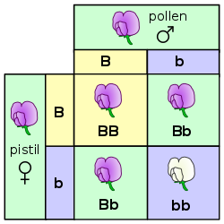
Mendelian/Simple Inheritance
What is going on here?
How many types of alleles are there?
What are the types of alleles?
What happens when you mix the 2 alleles to get a heterozygote?

Slide 30
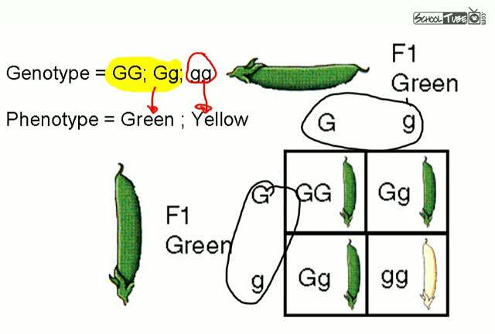
Mendelian/Simple Inheritance

Slide 31
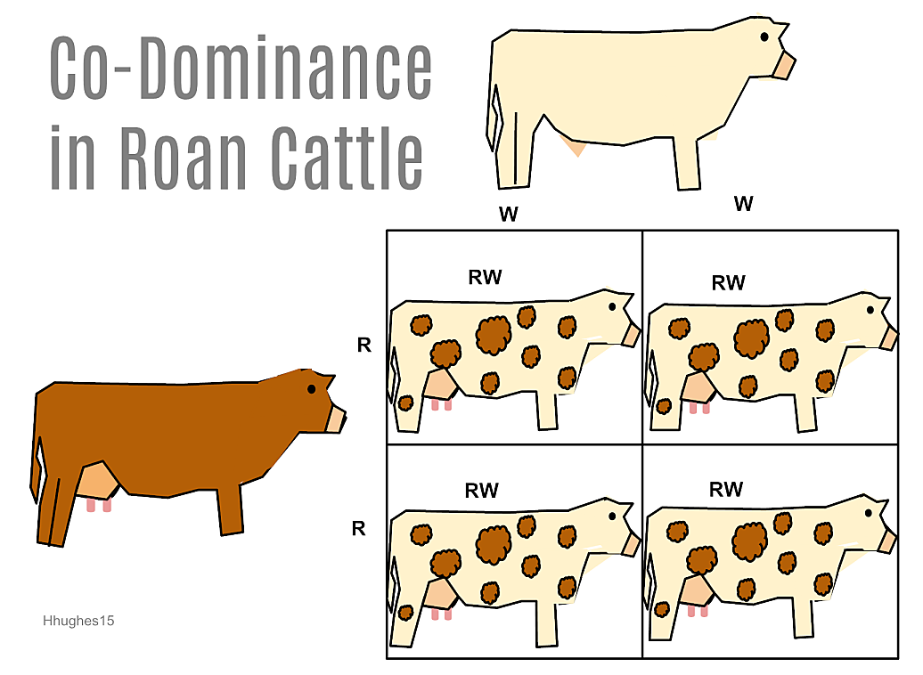
Codominance
What is going on here?
How many types of alleles are there?
What are the types of alleles?
What happens when you mix the 2 alleles to get a heterozygote?

Slide 32
Codominance

Slide 33
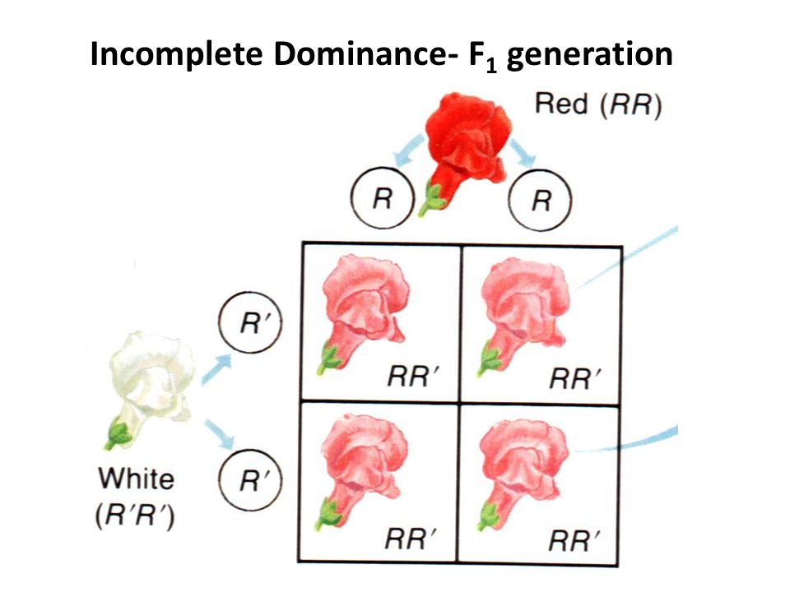
Incomplete Dominance
What is going on here?
How many types of alleles are there?
What are the types of alleles?
What happens when you mix the 2 alleles to get a heterozygote?

Slide 34
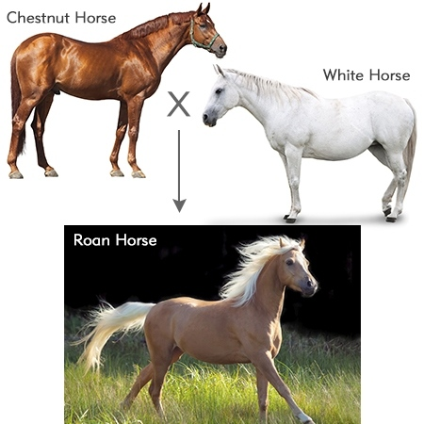
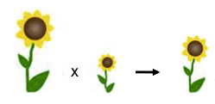
Incomplete Dominance

Slide 35
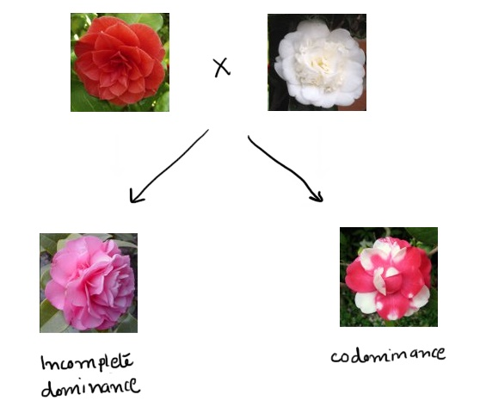
Codominance and Incomplete Dominance Comparison
What is the main difference between codominance and incomplete dominance?

Slide 36
Non-Mendelian Genetics

Slide 37
Co-Dominance
Both alleles are dominant and expressed equally, use two different capital letters
The 2 parent phenotypes are shown in the offspring
Example: Roan cows
Brown cow
White cow
Roan cow

Slide 39
Incomplete Dominance
Both alleles are dominant and the traits blend
A new phenotype is present in the offspring
Common examples: pink flowers,
Example
Red flower
White flower
Pink flower

Slide 40
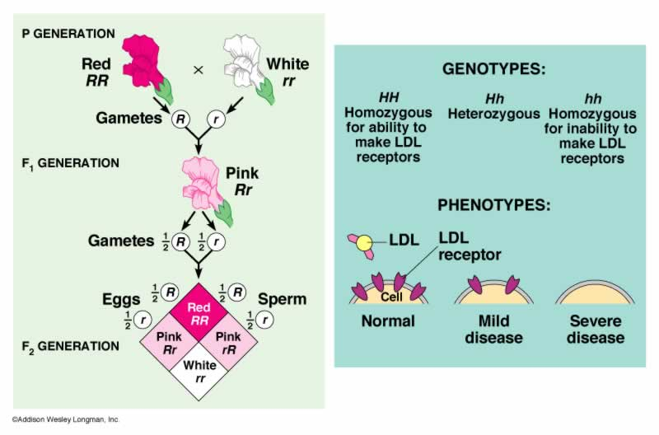

Slide 41
Copy this into your chart
 | Dominant | Recessive
Breathing Ability | Fire (F) | Lightning (f)
# of spikes on tail | 7 (T) | 9 (t)
Horn | Present (H) | Absent (h)
Number of claws | 4 (N) | 5 (n)
 | Dominant 1 | Dominant 1 and 2 | Dominant 2
C-Tail color | Blue (BB) | Splotches (BW) | White (WW)
C-wing color | Pink(PP) | Stripes (PY) | Yellow (YY)
I-Body color | Blue (BB) | Purple (BR) | Red (RR)
I-eye color | Red (RR) | Pink (RW) | White (WW)

Slide 42
Copy this into your chart
 | Dominant | Recessive
Breathing Ability | Fire (F) | Ice (f)
# of spikes on tail | 3 (T) | 6 (t)
Horn | Absent (H) | Present (h)
Number of claws | 4 (C) | 2 (c)
 | Dominant 1 | Dominant 1 and 2 | Dominant 2
C-Tail color | Yellow (YY) | Stripes (YP) | Purple (PP)
C-wing color | Red (RR) | Red w/ Blue Spots (RB) | Blue (BB)
I-Body color | Red (RR) | Orange (RY) | Yellow (YY)
I-eye color | Yellow (YY) | Green (YB) | Blue (BB)

Slide 43
Dragons
We have decided what traits you will be using.
You need to flip the coin to determine what traits your dragons are going to have. You need to flip for both the male and female dragon.
You have 10 minutes.

Slide 44
Warmup 4/12
A green frog and a white frog are crossed and a light green frog is produced. What type of inheritance is shown?
A red and blue striped zebra is crossed with a blue zebra. What is the chance they will produce a red zebra?

Slide 45
Warmup 11/06
Two pink flowers are crossed, what are all the possible genotypes and phenotypes we can have? What type of genetics is this?
A roan cow (white with brown spots) is crossed with a white cow. What is the chance they will make another roan cow?

Slide 46
Multiple Alleles
Controlled by 3 or more alleles of the same gene
Examples: Blood typing
Blood typing also shows Codominance for the A and B alleles

Slide 47
Blood Typing
Blood Type | Can Give Blood To | Can Receive Blood From | Possible Genotypes
A
B
AB
O

Slide 48
Blood Type Example
A mother who is blood type A has a child with a man who has blood type B, what are the possible blood types the child could have?

Slide 49
Warmup 11/07
A woman who has Type B blood and a man with Type O blood have a child, what’s the chance the baby will have Type O?
A woman has Type O blood. Her children have Type O and Type A blood. What are the possible blood types of the father?

Slide 50
Sex-Linked Traits
Controlled by genes found only on the X chromosome
Affects males more than females because males only have 1 copy of the X chromosome and women have 2 copies
Sex-linked traits are typically recessive; ie if you have a sex linked trait you are recessive, if you do not have the trait you have dominant alleles
Males: XY
Females: XX

Slide 51
Examples
Color blindness
Hemophelia

Slide 52
Warmup 10/13
Is it possible for a man with type AB blood and a woman who has type B blood to have a child with type O blood?
What are all the possible blood types for a child whose parents are heterozygous for type A and homozygous for type B?

Slide 53
Warmup 3/10
A woman comes in with severe pain. After looking at her blood cells, the doctor notices that they are abnormally shaped. What disorder is this?
A child has the following chromosomal composition, XXY. What disorder is this?
Which disorder causes increased amounts of mucous to build up in the lungs, preventing them from being cleared regularly?

Slide 54
Warmup 1/08
What procedure is an amniocentesis commonly used with to determine genetic disorders?
How do you determine if an individual has the trait on a pedigree?
If black is dominant to grey, what is the chance of getting a grey organism if the mother is grey and the father is heterozygous?

Slide 55
Warmup 3/15
A man with A blood and a woman with B blood have a child with O blood. Is this possible?
What is the genotype of a person with AB blood?
What genotype is the father is the mother has blood type A and the child is blood type B?

Slide 56
Warmup 4/10
Name of the disorder which is dominant?
What is the genotype of a person who has cystic fibrosis?
What is the genotype of an individual who is resistant to malaria?
Describe the heterozygous advantage.

Slide 57
Warmup 4/10
A man with hemophelia has a child with a normal woman who is a carrier. What is the chance their child will have hemophelia?
A woman with colorblindness has a son with a normal man. What is the chance the son will be colorblind?

Slide 58
Warmup 11/09
What is the genotype if a woman has cystic fibrosis?
What is the genotype of a guy with hemophilia?
What is the genotype of a guy with Huntington’s?
What is the genotype of a woman with sickle cell anemia?

Slide 59
Polygenic Inheritance
Traits that are controlled by 2 or more genes
You have to look at the entire population to see the differences
Examples:
Height
Eye color
Hair color
Skin color

Slide 60
Environmental Influences on Phenotype
The environment you live in can change the phenotype but not the genotype
Environment is considered to be anything that is not part of your DNA
Ex: food, water, disease, amount of gases in the atmosphere, inhaled smoke, etc

Slide 61
Environmental Influences on Phenotype
lung/mouth cancer – tobacco use
skin cancer – vitamin D, folic acid and sun exposure
diabetes – diet/exercise and genetics interact
PKU – diet, cannot eat proteins
heart disease – diet/exercise and genetics interact

Slide 62
Inheritance Pattern | Description | Examples
Incomplete Dominance
Codominance
Sex-linked Traits
Polygenic Inheritance

Slide 63
Pedigrees and Karyotypes

Slide 64
Used to follow traits through different generations in a family
Autosomal Dominant
Affects males and females equally
Many people are affected
No carriers, carriers are people that are heterozygous for a recessive trait

Slide 65
Autosomal Recessive
Affects males and females equally
Only a few people affected
Men and women can be carriers

Slide 66
Sex-linked
Affects men more than women
Only females are carriers

Slide 67
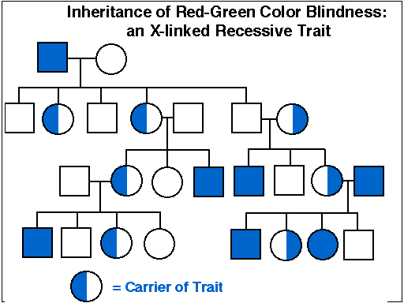
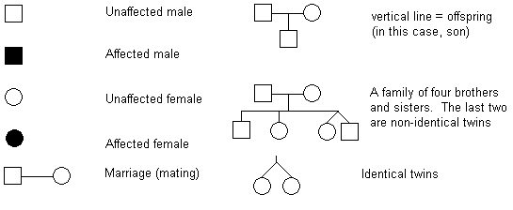

Slide 68
Karyotypes
Photograph that shows the chromosomes of an individual
Abnormalities in chromosome number help to identify nondisjunction genetic disorders
The last set of chromosomes are always the gender chromosomes
The DNA is collected from the fetus with an amniocentesis

Slide 69
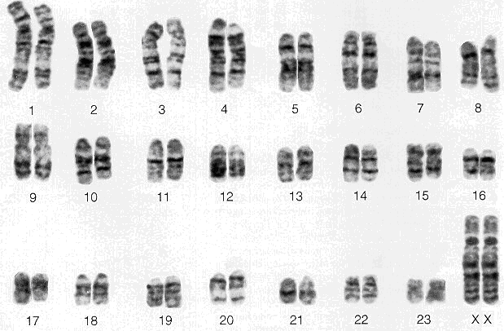

Slide 70
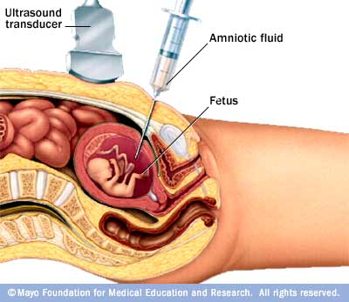
Amniocentesis
Method of getting the DNA of a fetus

Slide 71
Warmup 3/28
A blue and red striped tiger is crossed with a blue tiger. What is the chance that they will produce more blue tigers?
A pink flower is crossed with another pink flower, what is the chance that they will produce a white flower?

Slide 72
Warmup 11/8
A man with hemophelia and a woman who is homozygous normal for the condition have a son together. What is the chance the son will have hemophelia?
A woman who is a carrier for colorblindness and a normal man have a daughter. What is the chance the daughter will be a carrier?

Slide 73
Genetic Disorders

Slide 74
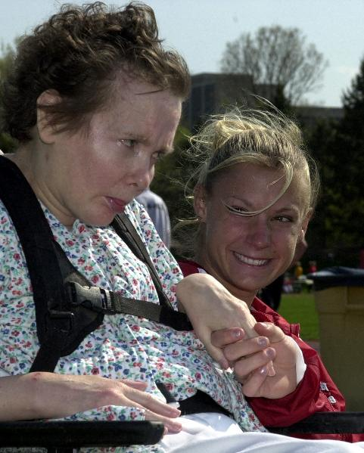
Huntington’s Disease
Autosomal Dominant
Symptoms
Memory loss
Loss of control of the body’s movement
Depression and mood swings

Slide 75
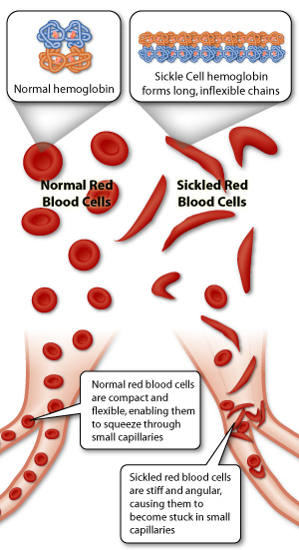
Sickle Cell Anemia
Symptoms
Blood cells resemble crescent moons
Oxygen cannot get to tissues well and patients are anemic (low iron in blood)

Slide 76
Heterozygous Advantage
Sometimes being heterozygous for a genetic condition allows the individual to survive where a homozygous dominant person would die
EX: being heterozygous for sickle cell gives partial immunity to malaria

Slide 77
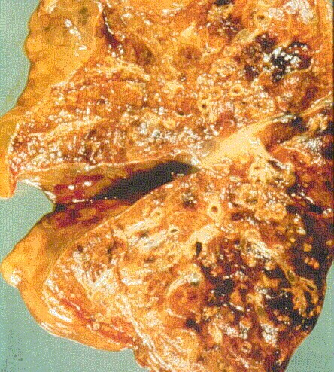
Cystic Fibrosis
Autosomal Recessive
Symptoms
Mucous builds up in the lungs, liver, and intestines
Treatment
Have to clear the mucous

Slide 78
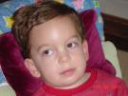
Tay Sachs
Autosomal Recessive
Symptoms
Affects the brain cells
Lose ability to control body’s movement
Blindness, deafness, paralysis

Slide 79
Phenylketonuria (PKU)
Autosomal Recessive
Symptoms
Unable to break down the amino acid phenylalanine
Causes brain damage, epilepsy
Treatment
No protein diet

Slide 80
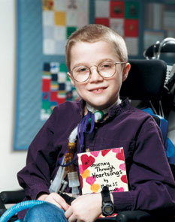
Hemophelia
Sex Linked
Symptoms
Unable to clot blood
Treatment
Blood transfusions

Slide 81
Color blindness
Sex linked
Symptoms
Unable to tell the difference between certain colors

Slide 82
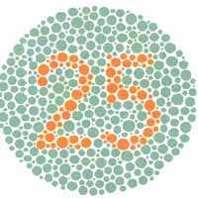
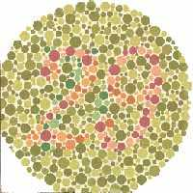
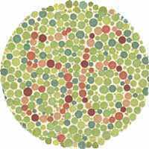
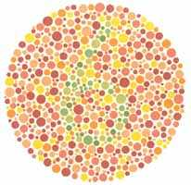
What
Colors
Do
You
See?

Slide 83
Down Syndrome
Trisomy 21
3 chromosomes at 21st spot

Slide 84
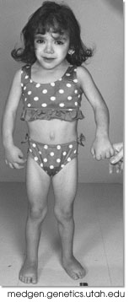
Turners Syndrome
Monosomy
Only 1 X chromosome, no other X or Y

Slide 85
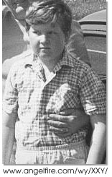
Klinefelter’s Syndrome
Trisomy
Has genotype XXY
Symptoms
Increased female sex characteristics
Treatment
Hormone therapy

Slide 86
Warmup 4/10
A man with A blood and a woman with B blood have a child with O blood. Is this possible?
What is the genotype of a person with AB blood?
What genotype is the father is the mother has blood type A and the child is blood type B?

Slide 87
Warmup 4/13
A roan cow shows co-dominance in fur color (brown and white). What is the phenotype ratio expected if a roan cow and a roan bull mate together?
If butterflies can have straight or curly antennae, and curly is recessive; what is the possibility that a pure breeding straight who is crossed with a hybrid straight, will have offspring with straight antennae?
In a flowering plant species, red flower color (R) is incompletely dominant over white flower color (W). What is the genotype of any red-flowering plant resulting from this species?

Slide 88
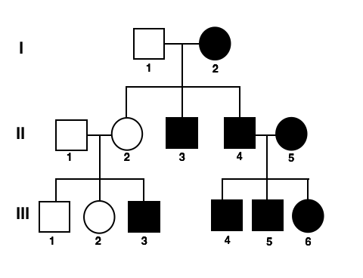
Warmup 11/13
Draw this pedigree and identify
Dominant, recessive, or sex-linked
Identify the genotype

