Slide 1
Warmup 5/08
Describe what a notochord and a dorsal nerve cord is.
What is a defining characteristic of superclass agnatha?
What is a defining characteristic of class chondrichtyes?
What is the difference between viviparous, ovoviviparous, and viviparous?

Slide 2
Evolution
Microevolution

Slide 3
Concept of Natural Selection

Slide 4
Jean Baptiste de LeMark
Proposed two evolutionary theories:
Acquired characteristics-organisms can change their body when needed and pass these changes onto their offspring.
Law of use and disuse-If you don't use a body part, it will be lost in the next generation.
*Both of these theories have been disproven.

Slide 5
Charles Darwin
Darwin observed plants and animals on the Galapagos Islands off the coast of Ecuador. Some of the organisms observed were: finches, giant tortoises, iguanas and orchids.

Slide 6
Charles Darwin
When Darwin returned home he wrote about his discoveries. Darwin also received an essay outlining natural selection from Wallace. Darwin sent both of these documents to a publisher and they were published at the same time. Darwin was given credit for discovering natural selection because his work was more extensive.

Slide 7
Principles of Natural Selection According to Darwin
1. Individuals in a species vary.
2. Some variations are heritable.
3. More individuals are produced than an environment can support.
4. Competition for resources occurs.
5. Individuals with favorable traits (and genotypes) will survive and reproduce, with the traits passed on to the offspring. According to Darwin you were not fit if you did not reproduce.

Slide 8
Natural Selection
Natural selection states that nature is acting upon a phenotype, and genes code for the phenotypes.
If an organism is well adapted it will live and reproduce. If an organism is not well adapted it will move to a new environment or die. Organisms must adapt, migrate or die.

Slide 9
Natural Selection Cont
The population is the smallest unit capable of evolving.
Gene frequencies of a population may change over time but an individuals genes will not change.
Darwin's theory does not emphasize survival but instead reproductive success.

Slide 10
Evolution

Slide 11
2 methods of Evolution
Microevolution: Changes in Gene Frequencies
Gene Frequency: the percentage of each allele for a gene in a population
Macroevolution: Changes in the genetic structure of populations thus creating new species
Populations evolve, not individuals
Genetic Variation is necessary

Slide 12
Evidence for Evolution
Fossils-remains or imprints of organisms that have been preserved.
Mold fossil- impression left in surrounding rock by the decay of organic matter.
Cast fossil-natural filling of a mold left behind after a fossil has been removed from the rock by a solution.

Slide 13
Evidence for Evolution
Fossils
Permineralization: the process by which shell or skeletal material is infiltrated by mineral matter making the hard part denser and heavier. Also known as petrification. In petrified wood, wood is present, but minerals have filled the little holes.

Slide 14
Evidence of Evolution
Fossils
Replacement fossils-process of fossilization in which the original mineral material of a hard part is replaced by another mineral. Eventually there will be no organic molecules.
Organic matter-some organic material can be left behind such as bones, teeth and other materials rich in minerals.

Slide 15
Evidence of Evolution
Fossils
Preservation-organisms that are entrapped quickly and completely in an oxygen free environment preventing decay. Examples include insects in amber, tar pits, peat bogs, glacial ice and volcanic ash.

Slide 16
Evidence of Evolution
Comparative anatomy-
homologous structures-same structure different function. Ex. Human arm and wing of an eagle have same bone structure. This may indicate a common ancestor.
analogous structures-Similar function but different structure. Ex. Bird wing and butterfly wing. This may indicate evolution in a similar environment.

Slide 17
Evidence of Evolution
Comparative Anatomy
vestigial structure-organs that are reduced in size with no apparent functions. Ex. appendix, tail bone in humans, snake leg bones, wisdom teeth. This may indicate that ancestors needed this organ and it formerly had a function or it may never have had a function.

Slide 18
Evidence of Evolution
Comparative embryology
Developmental patterns are similar in organisms with similar evolutionary relationships. We can see relationships between organisms more easily when fetal development is viewed.

Slide 19
Evidence of Evolution
Biogeography-
The distribution of a species first suggested the idea of common descent to Darwin. Islands have many species of plants and animals that are found nowhere else and those that are closely related to species on the nearest mainland or neighboring island. Species tend to be more closely related to others in the same area.

Slide 20
Evidence of Evolution
Comparative Biochemistry-
Similarities in the sequence of DNA and the proteins that the organism produces show how closely organisms are related by evolution.
Fossil dating-
Relative dating-layers of sediments give us approximate age of fossils with newest being on top of older fossils as long as rock layers are undisturbed.

Slide 21
Evidence of Evolution
Fossil Dating
Absolute dating-determining actual age of fossil.
Radioactive dating-radioactive isotopes accumulate when organisms are alive. Once dead isotopes stop accumulating. Each isotope has a fixed rate of decay called a half-life. This is the time it takes for 1/2 of the amount of the isotope present to decay. This is unaffected by temperature, pressure and other environmental factors. You can use these known values to determine exact age of the fossil.

Slide 22
Evidence of Evolution
Fossil Dating
Absolute Dating
Amino acid racemization- Amino acids exist in two isomer forms-left handed (L) and right-handed (D) symmetry. During life organisms only synthesize L symmetry. After death amino acids change to a mix of D & L symmetry. Using the rate of conversion and ratio of the D & L symmetry the exact age can be determined.

Slide 23
Variation and hardy-Weinberg

Slide 24
Variation
variation is the key concept in evolution, but where does it come from?
Mutations-permanent, random chemical changes in the DNA molecule that can be passed to offspring.
Variation from recombination-This deals with sexual reproduction and can occur through crossing over, independent assortment and combination of genes from 2 individuals.

Slide 25
Variation
variation is the key concept in evolution, but where does it come from?
Variation from migration-migration causes genes to enter or leave a population.

Slide 26
Variation
Examples of variation:
Morphological variation-different body shapes and colors; ie the shell of the land snail may be pink or yellow.
Chromosomal variations-some species # and shape of chromosomes differ. Common in plants, insects and a few mammals.
Protein variations-amino acid substitutions in proteins of animals within a species.

Slide 27
Variation
Maintenance of Genetic Variation:
Sexual reproduction produces new genetic combinations.
Mechanisms that promote outbreeding:
Plants
some plants have only male or female parts
anatomical arrangements of some flowers do not promote self-fertilization.
There are genes for self-sterility.

Slide 28
Variation
Maintenance of variation
Animals
hermaphrodites rarely self fertilize
Mammals:
males leave communes to mate
human cultural taboos against incest

Slide 29
Variation
Maintenance of Genetic VariatioN
Diploidy-A haploid organism shows all genes in their phenotype, but a diploid organism will store recessive alleles that can be passed to offspring.

Slide 30
Variation
Maintenance of Variation
Heterozygote Superiority-Recessive alleles are sometimes dangerous in a homozygote but actually strengthen a heterozygote.
Ex. Heterozygous for sickle cell-resistant to malaria, Heterozygous for cystic fibrosis resistant to typhoid, Heterozygous for tay sachs are resistant to tuberculosis, AB blood is resistant to cholera.

Slide 31
Changes in Gene Frequency
Gene pool-all the genes on any population at a given time. The various genes can change over time and evolution is any change in these allelic frequency. Evolution can proceed randomly or it can be under the influence of natural selection.

Slide 32
How Gene Pools Change
Gene flow-movement of alleles into or out of a population.
Genetic Drift-change in a gene pool that takes place as a result of chance. There are 2 situations where the chance plays a role in evolution:
The founder effect-a small population breaks off from a larger one. The group may or may not mirror the gene pool of the large population it broke off from. Ex Amish
Population bottleneck-population is drastically reduced by an event having little or nothing to do with natural selection such as a natural disaster.

Slide 33
How gene pools change
Nonrandom mating-When individuals of a population tend to mate with those that are close geographically or those with a particular phenotype.
Mutation

Slide 34
Hardy-weinberg
Changes in Gene Frequency due to natural selection:
These are non-random changes to gene frequency. Phenotypes that are selected for live and reproduce, other phenotypes die out.
The Hardy-Weinberg equilibrium considers gene frequencies in a population.
Consider AA, Aa, aa
Alleles: A and a
Frequency of A in a population f(AA) +1/2 f(Aa)=p
Frequency of a in a population f(aa) + 1/2 f(Aa)=q

Slide 35
Hardy-Weinberg
The frequency of both genes =1
p + q=f(AA) + f(Aa) + f(aa)=1
In other word p+q=1 so if you know p, you can figure out q.
Ex. If the frequency of A=0.7 than
0.7 + q=1 q=0.3

Slide 36
Hardy-Weinberg
The probability of A meeting A is p x p=p²
The probability of A meeting a is p xq + p x q=2pq
The probability of a meeting a is q x q=q²
Therefore:
p² + 2pq + q²=1
So if given A=.3 you can solve for the probability of each genotype.
p +q =1, .3 + q=1, q=.7
p²=.3 X .3=.09 or 9% of the population being AA
2pq=2(.3)(.7)=.42 or 42% of the population is Aa
q²=.7 X .7=.49 or 49% of the population is aa

Slide 37
Hardy-Weinberg
Using these calculation natural selection can be substantiated in a population.
Rules of Hardy-Weinberg:
You must use a trait controlled by a pair of alleles.
There must be a random sampling of the population.
The trait appears equally in both sexes.
Mating is random.
No net changes in alleles through mutation.
Population size must be large enough for the rules of probability to be valid.

Slide 38
Usefulness of hardy-weinberg
Usefulness of Hardy-Weinberg:
Most population genetics theory are built on models. Hardy-Weinberg is the base for most of these models.
H-W predictions are useful for studying population since they provide a benchmark for genetic equilibrium.
It permits an estimation of gene frequencies, especially useful when estimating number of carriers of lethal alleles.

Slide 39
Types of Evolution

Slide 40
Fitness
For Darwin this was defined as the relative contribution to the gene pool, but fitness is affected by both survival and fertility.
Relative Fitness-Contribution of a genotype to the next generation as compared to an alternative genotype.
Ex. AA-red flower, aa-white flowers, Aa-pink flowers.
Red flowers produce the most offspring, white only produce 80% as many offspring as red. Therefore red is assigned a relative fitness of 1 and white of 0.8.

Slide 41
Fitness
Fitness
Selection Coefficient
Is defined as the difference b/t the most fit genotype's relative fitness and the less fit genotype's relative fitness.
Ex. Using previous example the selection coefficient is 0.2 (1-0.8).
A homozygous recessive will never be eliminated completely because it is protected by the heterozygous condition.

Slide 42
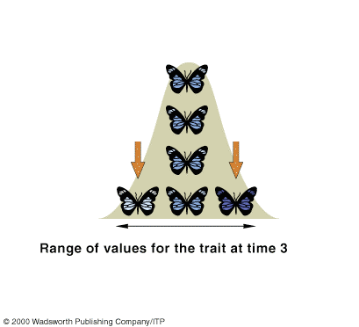
Types of Natural Selection
Stabilizing selection-extreme individuals are eliminated and intermediate forms are favored. Mutant forms are usually eliminated quickly.

Slide 43
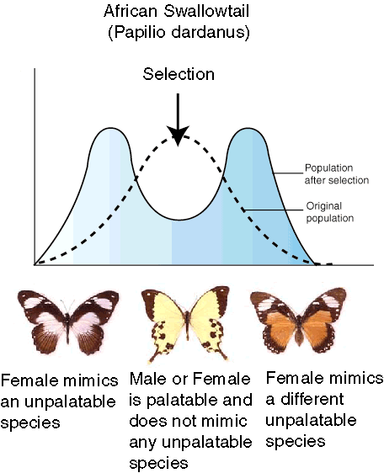
Types of natural selection
Disruptive selection-Increases the 2 extreme types in a population at the expense of the intermediate forms. The result is a marked difference between the two groups.

Slide 44
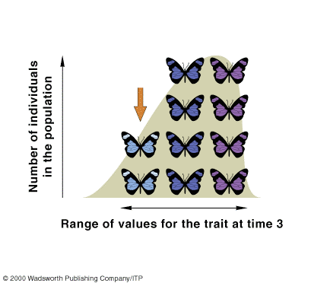
Types of natural selection
Directional Selection-Results in an increase of one extreme phenotype over the other. This is a gradual replacement of one allele or group of alleles over another.

Slide 45
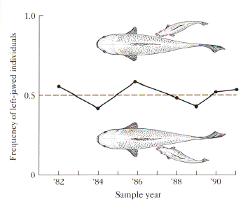
Types of natural selection
Frequency dependent selection-Decreases the frequency of the more common phenotype and increases the frequency of the least common phenotype. Common in many predator/prey relationships.

Slide 46
Types of natural selection
Sexual selection takes two forms:
Intrasexual selection-competition among members of one gender for the other.
Intersexual selection-members of one gender exert strong selective pressures on the characteristics of the opposite gender through the choice of mates. ex. male birds having extravagant plumage or oversized antlers on some males.

Slide 47
Patterns of evolution
Coevolution-occurs when a population of 2 or more species interact closely so that each exerts stronger selective forces on the other.
Ex. Bee and flower

Slide 48
Patterns of evolution
Convergent Evolution- Organisms that occupy similar environments often resemble one another even if they are only distantly related.
Ex. dolphins and manatees

Slide 49
Patterns of evolution
Divergent evolution-when populations become isolated from one another, different selective forces lead to different phenotypes.
Ex. Brown bear and polar bear

Slide 50
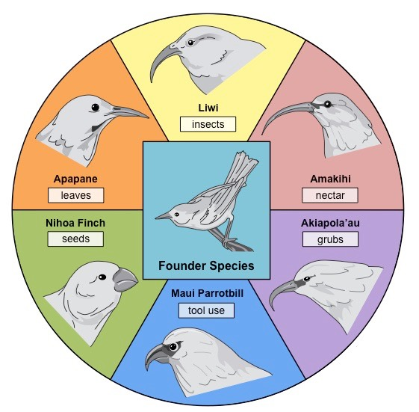
Patterns of evolution
Adaptive radiation: Pattern where one species is separated into multiple new environments and a new species emerges from the parent species

