Slide 1
True Facts
Identify 2 traits from each video. Think of a reason as to why this trait exists in the animal or plant.

Slide 2
True Facts
Trait
Reason
Leaves that close
Sensitive hairs
Slippery pitcher
S
Sweet nectar
Moustache thing
Camouflage
Really big mouth
Modified fins
So insects don’t get out
Sense when insects are inside
Makes organisms fall in and can’t get out
Lures insects in
Lures in prey
Blend in to hide from prey
Eat big prey
They can walk along the ground

Slide 3
Warmup 11/29
What is it that causes shifts in organism phenotypes during natural selection?
Describe natural selection.
How does natural selection change the genotypes of a species?
Predict what would happen to the species if the environment changes and no individuals have the trait necessary to survive?

Slide 4
Simulation Debrief
Did you get your expected results of Bird 1 surviving the best and Bird 2 surviving the worst?
If Bird 2 was still alive at the end, what did they get that allowed them to survive?
Were all mutations that the organism got beneficial?
Do you think that just because a species NEEDS a mutation that results in a necessary trait that they will GET that mutation?

Slide 5
Warmup 4/03
What is the effect mutations have on phenotypes?
What are the 2 things that can determine phenotype?
How do crossing over and independent assortment influence genetic diversity?

Slide 6
Peppered Moth
Which color survived best in the light forest? Why?
Which color survived best in the dark forest? Why?
What do you think would happen to each population over time?
What drove the differences in your results? The forest or the moth color?

Slide 7
Video Questions- Stated Clearly
What is natural selection
What is used as evidence of natural selection?
What did Darwin observe about species on the islands compared to the species on the mainland?
How did island species get over from the mainland?
What was different about tortoises in very green environments compared to tortoises in desert environments?
What does Common Descent mean?

Slide 8
Warmup 4/04
What is the definition of natural selection?
What determines the phenotype that the bird needs to survive its environment?
What is a common ancestor?

Slide 9
Natural Selection

Slide 10
Learning Target 1
I can explain how natural selection changes organisms and populations.

Slide 11
Vocabulary
Species: a group of organisms that are able to reproduce and create viable offspring
Population: group of organisms of the same species that live in the same place and interbreed
Gene Frequency: percentage of each allele in the population

Slide 12
Rules for Natural Selection to happen
The population of a species must be able to grow exponentially
There has to be genetic variation from mutations and sexual reproduction
There are limited resources
Ex: food, water, shelter, mates, etc.

Slide 13
What happens to the population
Those organisms most adapted will survive, those that are not adapted will die
Your DNA (genotype) is what determines if you are adapted to your environment

Slide 14
Overtime the percentage of dominant and recessive alleles will change to give the population the best genes for the survival of the species in that environment
The changes in the population accumulate over time and change the species so most members have the favored allele
Speciation: process of making a new species from an old species

Slide 15
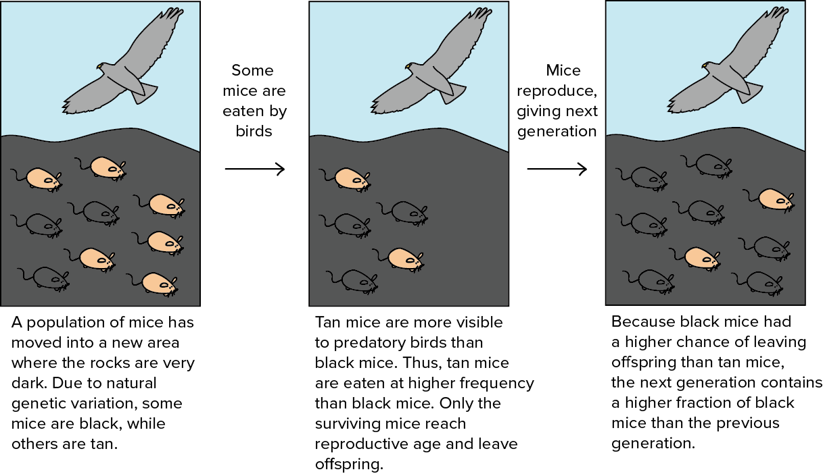

Slide 16
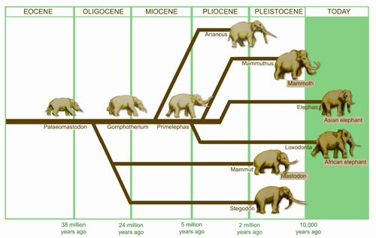
How did this happen?
With a partner, write down what possible environments caused the evolution of the ancient elephant into what it is now and what could have caused some of the species to go extinct.

Slide 17
Geographic isolation
Step 1: separate the population by a geographical formation
Mountain, desert, ocean, etc
Step 2: each side has a different type of environment
Means that the populations need different adaptations in order to survive

Slide 18
Step 3: the populations cannot breed with each other
Step 4: Each population accumulates different adaptations to survive until the populations can no longer breed with each other

Slide 19
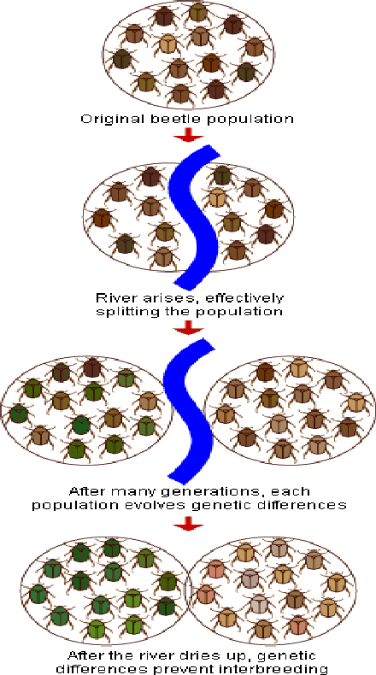
Speciation

Slide 20
Learning Target 2
I can identify biological trends over geological time.

Slide 21
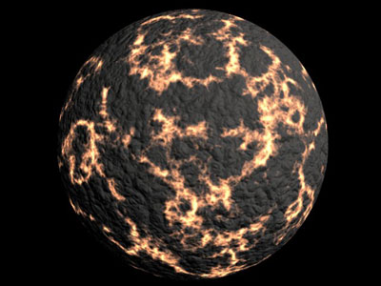

Slide 22
History of the Earth
Earth is about 4.6 billion years old
Conditions of early Earth
Extremely hot
No breathable oxygen
Lots of Carbon Dioxide
Very dry

Slide 23
Warmup 4/25
What are the 3 conditions of natural selection?
Describe geographical evolution?
What were the conditions of early earth?

Slide 24
Warmup 4/08
What are the 3 conditions needed for natural selection to occur?
What is speciation?
What is a method of getting new phenotypes in the population? Are they always useful phenotypes for the species?

Slide 25
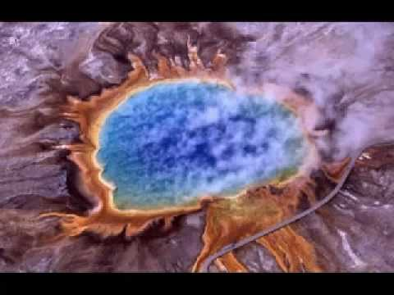
First Organisms
Archaebacteria (3.6 bya)
Archae means old
Anaerobic prokaryotes
Very simple single celled organisms which make energy without oxygen
Created CO₂ as a waste product and let it into the atmosphere

Slide 26
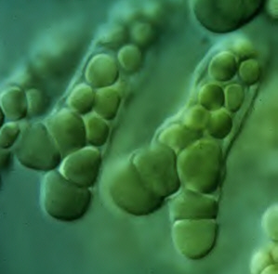
Second Organisms
Cyanobacteria
Single celled, Photosynthetic
Used the CO₂ made by archaebacteria
Created O₂ and released it into the atmosphere
Anaerobic prokaryote

Slide 27
Eukaryotes
First
Single celled amoebas and paramecium which are more complex than prokaryotes
Aerobic: use oxygen to make energy
Second
Multicellular aerobic organisms

Slide 28
Trends
Aquatic → Terrestrial
Prokaryote → Eukaryote
Simple → Complex
Anaerobic → Aerobic

Slide 29
Put the following organisms in the order they appeared on earth.
Anaerobic, autotrophic/photosynthetic, prokaryotic
Aerobic, prokaryotic, heterotrophic
Anaerobic, prokaryotic, heterotrophic

Slide 30
Warmup 12/4
Describe the conditions of early earth?
Use the trends to put the following organisms in order of their appearance on earth
#1: eukaryote, aerobic, multicellular
#2: prokaryote, anaerobic, photosynthetic
#3: eukaryote, anaerobic, unicellular
#4: prokaryote, anaerobic, heterotrophic
#5: eukaryote, aerobic, unicellular

Slide 31
Learning Target 3
I can explain how scientists used evidence to support their theory of evolution.

Slide 32
Biogenesis vs. Abiogenesis
Abiogenesis: life comes from non-living things
Biogenesis: life comes from living things
Alexander Oparin: thought life began in the ocean

Slide 33
Stanley Miller and Harvey Urey: tried to prove Oparin’s theory
Developed the idea of the Protocell
Organic molecules were able to join together in such a way that they formed organic molecules such as sugar, DNA, and amino acids

Slide 34
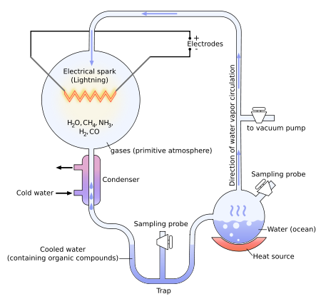

Slide 35
Warmup 4/09
Put the following organisms in order of how they appeared on earth
#1: single celled, aerobic eukaryote
#2: multicellular, aerobic eukaryote
#3: photosynthetic, anaerobic prokaryote
#4: heterotrophic, anaerobic prokaryote
What was the result of the Miller/Urey experiment?
Explain the saying “survival of the fittest.”

Slide 36
Developed by Charles Darwin and Alfred Russell Wallace
Darwin’s Observations: from HMS Beagle trip
Finches have different types of beaks that are specially adapted to the type of food they eat

Slide 37
Natural Selection is the theory that organisms that are the best suited to their environment survive and reproduce
Adaptation: inherited characteristic that increases the chance for survival
Evolution is the theory that organisms change over time

Slide 38
Evidences for Natural Selection
Fossil Record: we have found fossils that are myo which resemble organisms today
We can compare fossils found to other fossils for similarities
We can compare fossils found to living organisms for similarities

Slide 39
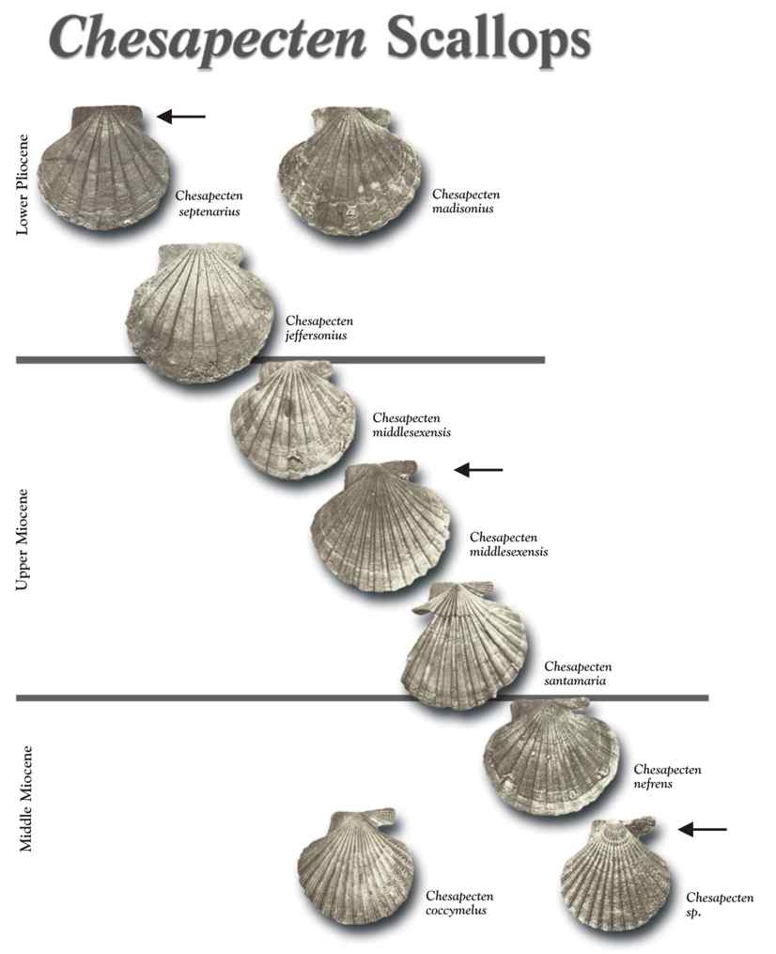
Fossil Record

Slide 40
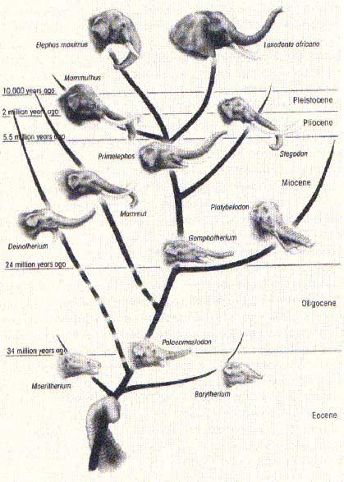

Slide 41
Anatomical Structures
Homologous Structures: structures are similar but function may be different
the forearms of different species have similar bone structures
Vestigial Structures: organisms have organs and bones that are no longer used or needed

Slide 42
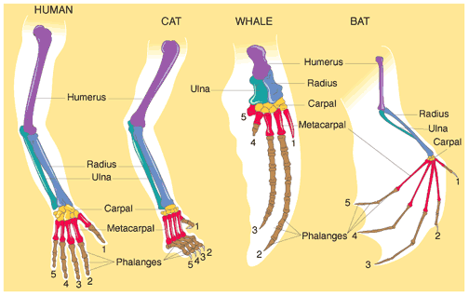
Anatomical Evidence

Slide 43
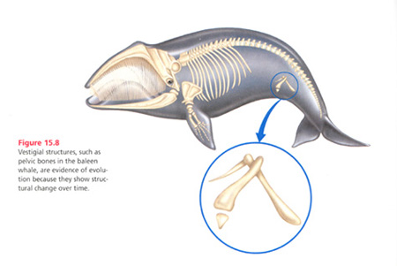
Vestigial Structures

Slide 44
Embryonic Development: many organisms resemble each other while in the first stages of growing as a fetus
Biochemical Similarities
All organisms use DNA and RNA
Protein similarities

Slide 45
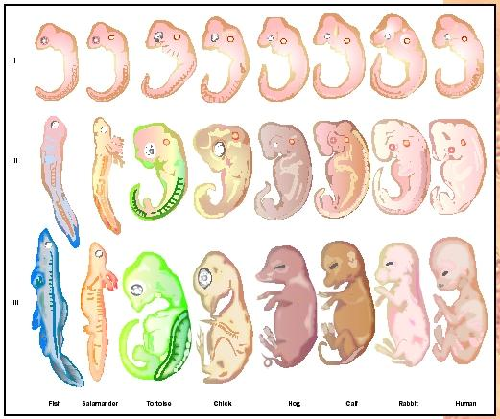
Embryonic Development

Slide 46
Warmup 4/27
How are fossils used as evidence of evolution?
What is an example of a vestigial structure?
What do homologous structures like the layout of arm bones among humans, bats, and whales suggest?

Slide 47
Resistance Video
How can E. coli spread resistance other than through reproduction?
Can antibiotics be used to treat viruses? Are they sometimes prescribed to treat viruses?
Why is the over-prescription of antibiotics such a challenge?
Does farming help spread antibiotic resistance?
What can be done to help stop the spread?

Slide 48
Antibiotic Writing
On your own paper, write 1 paragraph for each of the following
What is an antibiotic and what is it used for?
What is antibiotic resistance and how it effects the population?
How is this process similar to natural selection?
What can we do to reduce the spread of antibiotic resistance?

Slide 49
Warmup 12/03
How are natural and artificial selection similar?
Why can continued use of antibiotics be harmful?
What are antibiotics?

Slide 50
Learning Target 4
I can explain how humans can act as an artificial selector of organisms.

Slide 51
Humans can choose the traits that are “beneficial” to an organism whether they want to or not
Examples of where we have chosen traits we want the organism to have
Dog breeds
Improvements on crops
Examples of where we have accidentally chosen traits that are beneficial to the organism but we don’t want them to have it.
Antibiotic Resistance
Pesticide Resistance

Slide 52
Used for bacterial infections
Antibiotic kills the bacteria
What happens when a mutation occurs in the bacteria and the antibiotic no longer works?
It will survive to reproduce
It will pass its protection on to its offspring
The antibiotic no longer works and humans have to use a stronger one
Bacteria must be born with the genes for resistance or they can pick the genes up from their environment
On rare occasion the bacteria gets a mutation for resistance. This is how resistance entered the population in the first place

Slide 53
Use of pesticides
Humans use pesticides in their houses, on their crops, and in their yards to protect their food and homes
Pesticides: chemicals that kill insects

Slide 54
Pesticides
What happens when a mutation occurs in an insect and the insecticide does not work on it anymore
It will survive to reproduce
It will pass its protection on to its offspring
The pesticide no longer works and humans have to use a stronger one that is more harmful to us

Slide 55
Insects must be born with the genes for resistance On rare occasion the insect gets a mutation for resistance. This is how resistance entered the population in the first place

Slide 56
Methods of Immunity
Vaccines: protection against viruses only before infection
Antiviral Medications: new type of medicine being used to target viruses after infection

Slide 57
Natural Immune Response
Passive immunity: protection that your body uses that you get from your mother against invaders
Drinking antibiodies that mom makes in breast milk to fight infections
Advantage: immediate immunity
Disadvantage: you don’t know how to make them so when you stop getting them from mom you are susceptible to infection again

Slide 58
Active Immunity: protection that is specifically targeted to 1 particular invader
Making your own antibodies to fight infections
Advantage: you know how to fight off the infection and you won’t get sick from it again
Disadvantage: you have to get sick to and may die before you finish

Slide 59
Warmup 11/13
What were the conditions of early earth?
What are the 4 trends of evolution?
Put the following organisms in the order they appeared on earth.
Anaerobic, autotrophic/photosynthetic, prokaryotic
Aerobic, prokaryotic, heterotrophic
Anaerobic, prokaryotic, heterotrophic

Slide 60
Warmup 5/1
Grab an article off the front table
Read and annotate
At least 1 per paragraph, 3 different annotations
Answer the questions on the back

Slide 61
DO NOW
Grab your chromebooks and get set up o continue your test. Grab out your test codes. All answers entered yesterday will be saved and you should not have to answer them again. Still always check your answers

Slide 62
After the test
Grab an article on Taxonomy
Read
Annotate
Answer the questions on the back

Slide 63
Marker Classification
Split your markers into two groups where each group has a common trait for it’s members.
Continue to do so until there is only 1 marker in each group
What things did you use to split the markers?
If you go up your paper does each marker in the final groups still have all the traits in the previous groups?
What happened to the specificity as you moved down?
What happened to the diversity in each group as you moved down?

Slide 64
Online
Go to the class website and click on the link called “Heirarchy”
Working with your buddy, answer the questions on the article on a piece of paper with your names on it. The answers are in the paragraphs above. The questions are in blue boxes.

Slide 65
Amoeba Sisters! (they’re back mwahahahahahaha)
What is the most inclusive group in the classification system?
What is causing the classification system to change?
What is the most specific/least inclusive level of the classification system?
What are the 2 groups we use when naming organisms?

Slide 66
Warmup 12/07
Who was the first person to classify?
When organisms are classified, or markers, what do scientists use?
What does the word taxonomy mean?

Slide 67
Learning Target 5
I can explain how the classification system has changed over time and is used to identify organisms.

Slide 68
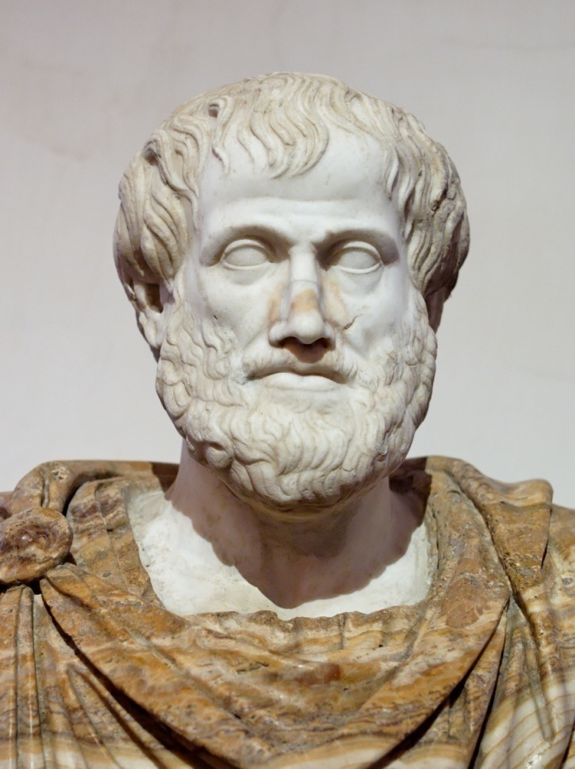
Methods of Classification
Earliest
Created by Aristotle
Classified all things into either a plant or animal category

Slide 69
Linnean Classification
Created by Carolus Linneaus
Classified things into categories based on physical characteristics
Came about after the invention of the microscope

Slide 70
Modern classification
Groups organisms with similar DNA together
The more DNA that is shared, the more closely the organisms are related
Still uses the same naming methods as Linnaean Classification

Slide 71
Classification levels
Taxonomy: science of grouping organisms
Most inclusive, least specific
Least inclusive, most specific
Domain
Kingdom
Phylum
Class
Order
Family
Genus
Species

Slide 72
In order to determine how related 2 organisms are, you start at the top (domain) and work your way down.
Which organisms are more similar?
Eukarya
Animalia
Chordata
Mammalia
Primata
Homindae
Gorilla
Beringei
Organism 1
Eukarya
Animalia
Chordata
Mammalia
Primata
Felidae
Homo
Beringei
Organism 2
Eukarya
Animalia
Chordata
Mammalia
Carnivora
Homindae
Puma
ursus
Organism 3

Slide 73
To name an organism you use binomial nomenclature
You use the Genus and Species names only
Scientific names do not change from country to country
Common names do change from country to country

Slide 74
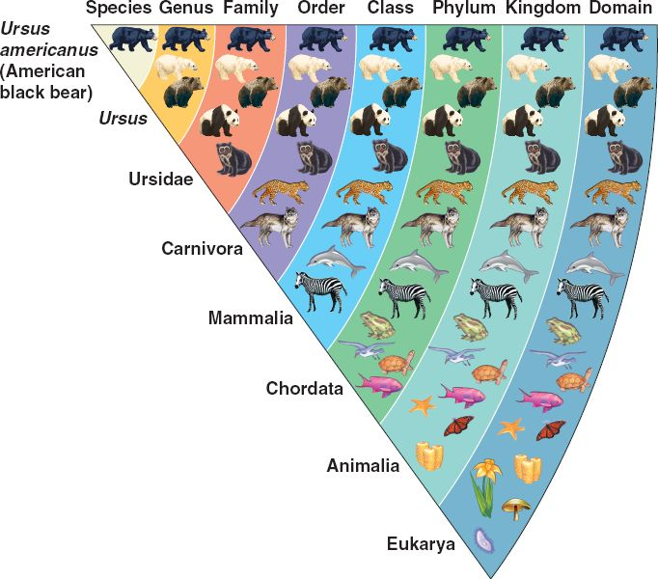

Slide 75
Phylogenic Trees
Shows evolutionary relationships
Organisms on the bottom or the left hand side are the oldest
A common ancestor is found when 2 lines come together
A common ancestor is a species from whom a current species has descended

Slide 76
Phylogenic Tree
What is the common ancestor of B and C?
What is the common ancestor of C and D?
Who are most closely related? D and C or B and C
What is the oldest organism on this tree?

Slide 77
Cladograms
The oldest organisms are on the left
Shows the physical characteristics that caused the split between 2 organisms
Common ancestors result when organisms split off

Slide 78
Cladogram
Circle the common ancestor of lizards and sharks.
Who are most closely related? Lamprey and sharks or sharks and lizards
What is the oldest organism on this cladogram?
What trait does a salmon have that a shark does not?
What trait(s) does a lizard and a salmon have in common?
Lungs
Bony Skeleton
Jaws

Slide 79
Dichotomous Keys
Allow us to identify organisms based on physical characteristics
Always start with number 1 of the directions when identifying a new organism

Slide 80
Warmup 12/12
What has caused the changes in the way that we classify organisms?
What 2 groups are used in an organism’s scientific name?
What is the order of classification from smallest to largest?
What is the difference between a scientific name and a common name?

Slide 81
Make Your Own Cladogram
You need to create a cladogram for the organisms in the jars that have been assigned to your group.
Create a chart like was provided for you in the practice
Create the actual cladogram complete with traits

Slide 82
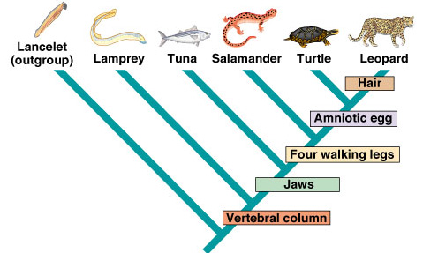
Warmup 12/13
What is the purpose of a phylogenic tree and cladogram?
Who is the oldest organism?
What trait separates tuna from salamanders?
Where would you insert a human in this cladogram?

Slide 83
Making a dichotomous key questions
Write out the steps to follow when making a dichotomous key

Slide 84
Make Your Own Dichotomous Key
Create a dichotomous key with the 5 organisms at your lab station.
If you finish early you may
Finish the classification activity from Friday where you are making your own organisms
Work on your study guide. (Due Tue)

Slide 85
Warmup 11/28
What caused changes in the way organisms are classified?
What is the phylum and order of the organism below?
Eukarya → Animalia → Chordata → Mammalia → Carnivora → Felidae → Panthera → tigris
What is the scientific name?

Slide 86
Warmup 4/20
What is the difference between a vaccine and an antiviral?
Why is antibiotic resistance an example of artificial selection?
How are active immunity and passive immunity the same? Different?

Slide 87
Warmup 3/27
What type of inheritance does Huntington’s show?
How do you create a transgenic organism?
Describe the Law of Independent Assortment in your own words.

Slide 88
Warmup 4/08
What is the structure of DNA?
What is the job of DNA?
What are mutations and how can they be both harmful and helpful?

Slide 89
Warmup 12/16
What are vestigial structure?
How are fossils used to support evolution?
Where in the earth levels are the oldest fossils found?
How are arm bones used as evidence of natural selection?

Slide 90
Warmup 4/12
What are the 5 evidences for natural selection?
How are biochemical similarities used as evidence of natural selection?
What is natural selection?

Slide 91
Warmup 4/02
Grab one of the adaptation articles from the front table and complete it.

Slide 92
Warmup 10/29
Does the population change during natural selection or do the individuals change?
What is speciation?
How are the arm bones of animals used as evidence of natural selection?

Slide 93
Warmup 11/15
Did some individuals have resistance to antibiotics before the use or antibiotics or did resistance develop as a result of antibiotic use?
In a few words, describe how antibiotic resistance has spread.

Slide 94
Warmup 1/10
What is the difference between active and passive immunity?
What is the difference between an antiviral and a vaccine?
If a pesticide is used by a farmer, what will likely happen to the insect population over time?

Slide 95
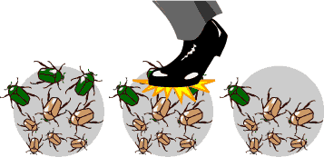
Warmup 4/14
Explain what is happening in the picture. The environment the insects live in is green.

Slide 96
Warmup 11/
What is an example of a homologous structure in organisms? Why do we use it as an example of natural selection?
What is a vestigial structure?
How do we use biochemistry as a source of natural selection evidence?

