Slide 1
Warmup 2/20
What is the monomer of a protein?
Draw the shape of a monomer of a protein.
What is a polymer of a protein?
What are the functions of proteins?

Slide 2
Warmup 2/21
What did temperature do to the enzyme reaction speed?
What did pH do to the enzyme reaction speed?
Why are enzymes specific?

Slide 3
Lab Clean Up
Clean
All glass!!!
Graduated cylinders
Rinse test tube rack and tray if avocado spilled onto them
Throw away the dropper for the avocado

Slide 4
Warmup 9/28
What is cellulose?
What gas does yeast make?
What is starch?
What are examples of passive transport?
What are the 2 differences between passive and active transport?
When doing osmosis, what moves? The salt or the water?

Slide 5
Amoeba Sisters Video Questions
What are most enzymes?
What is the active site?
Why is the enzymes specific?
What do enzymes do to the speed of chemical reactions?
How many times can an enzyme be used?
What does denatured mean?
What are examples of the ideal conditions that enzymes like?

Slide 6
Warmup 10/2
What do enzymes do to the speed of reactions?
What do enzymes do to the activation energy of the reaction?
What is the optimal pH?
What would be an appropriate name for an enzyme that breaks down cupcakes?

Slide 7
Enzymes
Special proteins that SPEED UP reactions!

Slide 8
Basic Information
Enzymes are a protein catalyst which speed up chemical reactions.
A catalyst is any substance which affects the speed of a chemical reaction without itself being changed.
Enzyme names end in -ase

Slide 9
Enzymes regulate body processes by speeding up certain chemical reactions.
They affect the reaction rate by decreasing the activation energy (energy required to start the reaction).
Makes the reaction happen faster.

Slide 10
1. Enzyme are Specific → shape matters!
Enzymes are very selective; they may catalyze only one reaction or one specific class of closely related reactions.
SUBSTRATE = What enzymes react with
ACTIVE SITE =Place where enzyme + substrate meet
PRODUCT = What the reaction makes

Slide 11
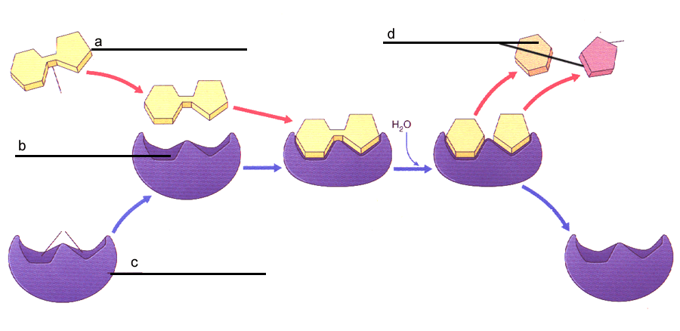

Slide 12
If the enzyme shape changes, then the enzyme becomes denatured
Enzyme Model = INDUCED FIT → the shape of the active site changes slightly to fit the substrate

Slide 13
2. Reusable
Enzymes are recyclable.
They will not be used up by the reaction and can catalyze another reaction involving the same substrate type

Slide 14
3. The speed of the enzyme is effected by the environment
Effect of TEMPERATURE
In general, as the temperature INCREASES the rate of enzyme action INCREASES, until an optimal temperature is reached (usually around 37º C).
Optimal temperature is the temperature where the enzyme is its fastest

Slide 15
Beyond optimal temperature, the heat DENATURES the shape of the active site of the enzyme molecule and LOWERS the rate of the reaction.

Slide 16
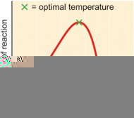

Slide 17
3. Enzyme Action
Effects of pH (acid or base)
For each enzyme, there is an optimal pH above and below which enzyme activity SLOWS.
Optimal pH changes based on what part of the body the enzyme is located in.

Slide 18
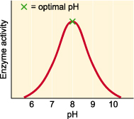

Slide 19
Warmup 2/22
What is the definition of an enzyme?
How do enzymes affect activation energy?
What term is used for when the active site of an enzyme changes and the enzyme is no longer working?

Slide 20
Warmup 4/24
Do enzymes always break down molecules or always put them back together? (35)
Why is the difference in activation energy between using an enzyme (less energy used) and not using an enzyme (more energy used) important for chemical reactions? (41)
Why are enzymes commonly found in the digestive tract?

