Slide 1
Cell Energy

Slide 2
Photosynthesis

Slide 3
Overview
Process of making glucose from inorganic compounds
Uses the sun's energy, inorganic CO₂ to produce organic compounds
Carried out by plants and cyanobacteria. Cyanobacteria do not have chloroplasts but do have thylakoid stacks.ds

Slide 4
Overview
Requires:
Carbon dioxide & water for elements necessary to make glucose
Sunlight is the energy source.
2 steps
Light dependent reaction (light reaction)
Light independent reaction (dark reaction) (Calvin Cycle)

Slide 5
Pigments of Photosynthesis
The pigments in the plant absorb light.
Different pigments absorb different wavelengths.
White absorbs no light,
black absorbs all light.
Green absorbs red, blue and violet and reflects green.
Found in the plastid organelles (chloroplast, chromoplasts, etc)

Slide 6
Pigments of Photosynthesis
3 pigment types
Chlorophyll a-main pigment involved in converting light energy to chemical energy in photosynthesis.
Chlorophyll b-similar to chlorophyll a

Slide 7
Pigments of Photosynthesis
Carotenoids: accessory pigments; yellow, red and orange. ex. Beta-carotene. Generally hidden by chlorophyll. Can only be seen in the fall when plants stop producing chlorophyll.
Allows the plants to absorb green light but not as well as chlorophyll does

Slide 8
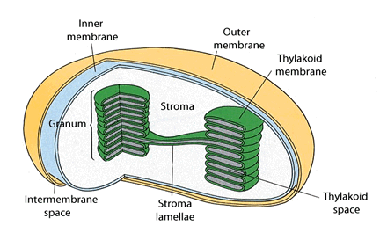
Chloroplast Structure

Slide 9
Light Dependent Reactions
Occurs in the thylakoids of the chloroplast
Has 2 photosystems:
photosystem II: p680 absorbs light rays that are 680 nm in length. This one comes before photosystem I
P stands for pigment
photosystem I: p700 absorbs light rays that are 700 nm in length.
Both photosystems are needed for the light reaction.

Slide 10
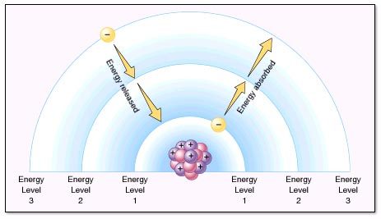
Light Dependent Reactions
When light hits the chlorophyll, the electrons of the pigment absorb energy and the light antenna vibrate. The Energy of Excitation is passed from molecule to molecule, without passing electrons until it reaches the reaction center. Two electrons are boosted to higher energy and transferred to the primary acceptor at the reaction center.

Slide 12
Light Dependent Reactions
Z diagram:
Electrons lost by the reaction center must be replaced. Z diagram is how this happens.
Requires water and a protein called the Z-protein.
Products: 4 H+, 4e-, 2 H₂0

Slide 14
Light Dependent Reactions
Boosted electrons move through the p700 electron transport chain producing 2 electrons that are bonded to NADP⁺ making it NADPH. These electrons are carried to the light independent (AKA dark reaction).

Slide 15
Light Dependent Reactions
Photosystem I can work independently. While it doesn't produce NADPH it does produce ATP as electrons are passed.
It is believed that Photosystem I evolved first because it is able to operate independently.
This system is used in many photosynthetic bacteria but is an alternative system for eukaryotes.

Slide 16
Light Independent Reactions (Dark Reactions)
This reaction occurs in the Stroma and makes carbohydrates.
This can occur two ways:
1. C₃ cycle or Calvin Cycle: makes a 3 carbon compound called phosphoglycerate.
2. C₄ pathway: makes a 4 carbon compound phosphenolpyruvate (PEP)

Slide 17
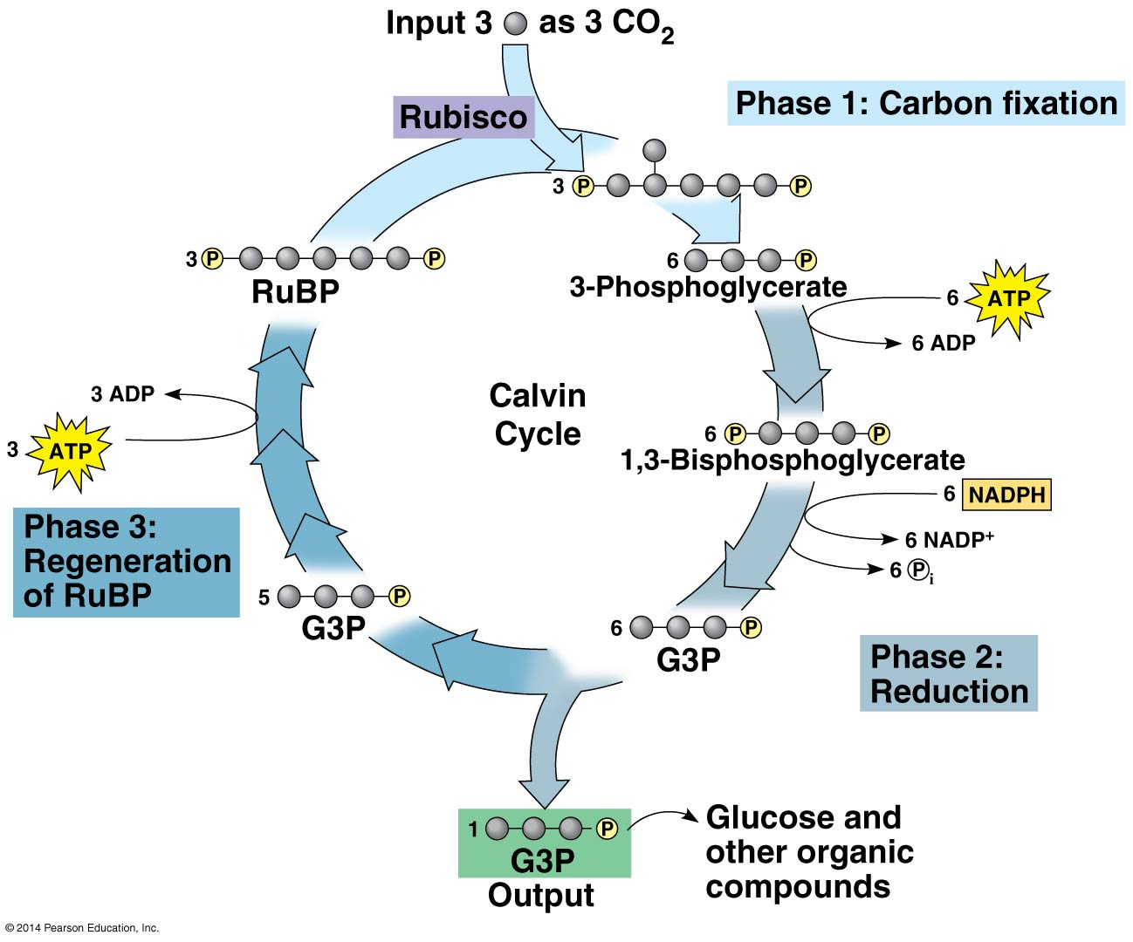
Calvin Cycle

Slide 18
C3 Pathway or Calvin Cycle
Multi-step pathway that can produce glucose, cellulose, maltose, starch, fatty acids, amino acids or other molecules.
Uses an enzyme called RuBP carboxylase (Rubisco). This is the most abundant protein in plants and on Earth.
This pathway only converts 1% of light energy to carbohydrates.

Slide 19
C4 pathway
Utilizes the carbon dioxide that enters through the stomata and collects in the mesophyll cells.
When stomata are open, carbon dioxide enters a C4 leaf more efficiently than a C3 leaf.
These plants evolved in the tropics and are adapted to high intensity light, high temperatures and dry conditions.

Slide 20
Cellular Respiration

Slide 21
Formula

Slide 22
Overview
Aerobic respiration is the production of energy in the presence of oxygen. This process occurs in the mitochondria.
Produces 21-36 ATP per molecule of glucose.
Anaerobic respiration is the production of energy with no oxygen present. Can only produce 2 ATP.

Slide 23
Overview
Why Glucose?
Although carbohydrates, fats and proteins can all be processed and consumes as fuel, glucose is tracked in the production of energy.
The breakdown of glucose is exergonic with a free energy value of -686 kcal/mol.
The energy currency for cells is ATP.

Slide 24
What is ATP?
It is an adenine nucleotide with 2 extra phosphates added.
The more phosphates you bind together the more potential energy you store in the molecule.
When there are 3 phosphates it is called adenosine triphosphate (ATP), when there are 2 phosphates it is adenosine diphosphate (ADP), and when there is only 1 phosphate it is adenosine monophosphate (AMP)

Slide 25
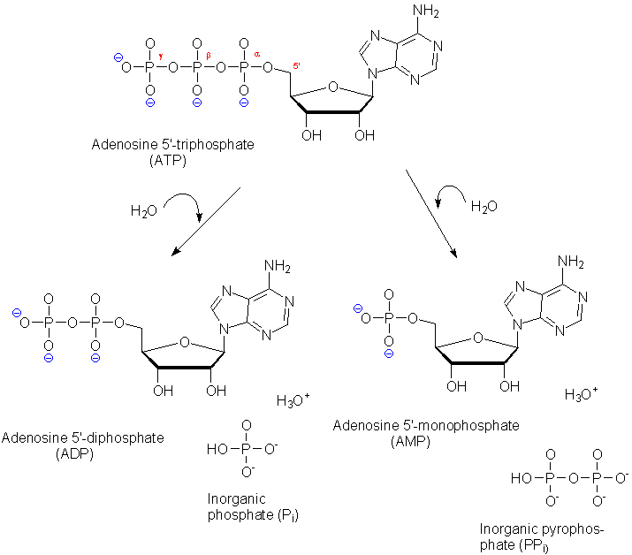

Slide 26
Uses of ATP
ATP is the primary energy molecule of living organisms.
Can be recharged from AMP to ADP and then from ADP to ATP
Uses
Reproduction
Movement
Production of proteins
Active transport (exocytosis, endocytosis, pinocytosis, phagocytosis, etc.)
DNA replication
Nerve transmission
Metabolism of food

Slide 27
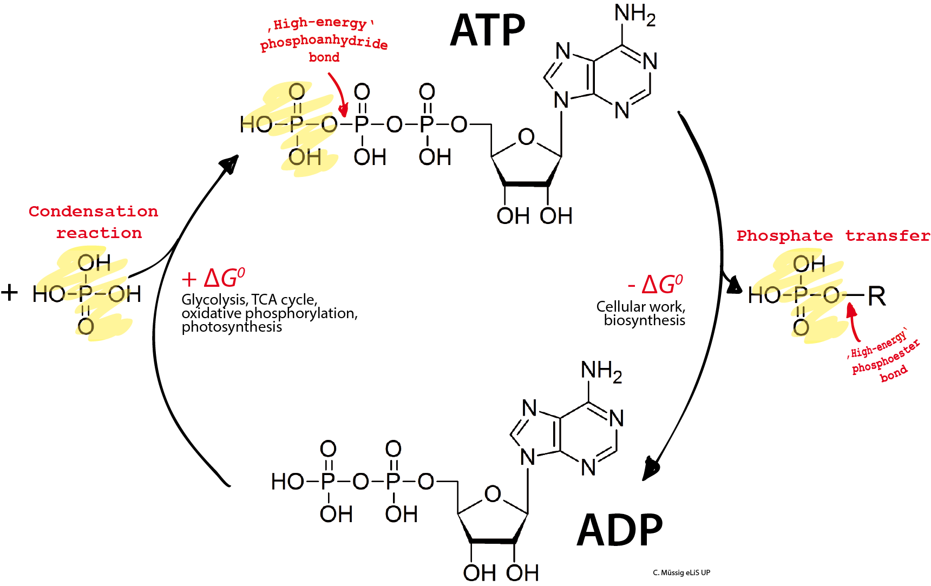

Slide 28
Making ATP
In order to understand the process of making energy you must understand oxidation/reduction reactions.
Oxidation-losing electrons, hydrogen or the gaining of an oxygen.
Reduction-gaining electrons, hydrogen or losing oxygen.

Slide 29
Making ATP
When an electron moves from a less electronegative atom to a more electronegative atom, chemical energy is released as potential energy is lost.
In the combustion of glucose, sugar is oxidized and oxygen is reduced. Meanwhile electrons lose potential energy releasing chemical energy.

Slide 30
Making ATP
Changing covalent status to produce energy:
Usually organic molecules have an abundance of hydrogen which is an excellent fuel because their bonds have high potential energy. In aerobic respiration the change in covalent status from hydrogen to an oxygen atom is what liberates energy.

Slide 31
Making ATP
Hydrogens are stripped from glucose (C₆H₁₂O₆) and passed to a coenzyme called NAD+ (nicotinamide adenine dinucleotide). Another enzyme called a dehydrogenase can remove a pair of hydrogens from the substrate.
These electrons lose very little potential energy when transferred to NAD+ to make NADH allowing them to store energy to make ATP.

Slide 32
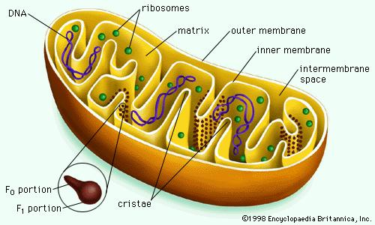
Draw This

Slide 33
Mitochondria Structure
2 membranes:
Outer smooth membrane
Outer membrane is permeable to small molecules but inner membrane only permits the passage of certain molecules like pyruvic acid and ATP.

Slide 34
Mitochondria Structure
2 Membranes
Inner folds called cristae
Within the inner compartment surrounding the cristae there is a dense solution known as the matrix that contains:
enzymes
coenzymes
water
phosphates
other molecules needed in respiration

Slide 35
Mitochondria Structure
Proteins are built into the cristae. The proteins are involved in the electron transport chain.
The inner membrane is 80% protein, 20% lipids.
95% of ATP generated in a heterotrophic cell is produced by the mitochondria.

Slide 36
Respiration Steps
4 stages to aerobic respiration:
Glycolysis
Pyruvate Oxidation
The Krebs Cycle
The Electron transport chain

Slide 37
Respiration Steps
2 Stages of Anaerobic respiration
Glycolysis
Either Alcoholic Fermentation or Lactic Acid Fermentation

Slide 38
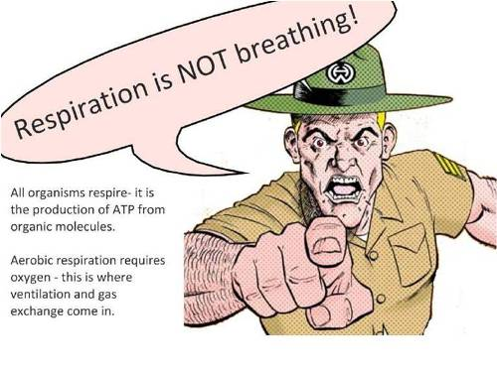

Slide 39
Stages of Respiration

Slide 40
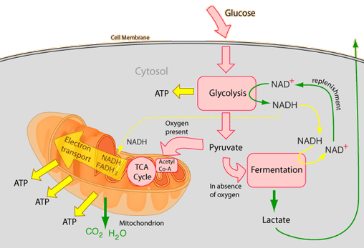

Slide 41
Glycolysis
Resembles anaerobic respiration
2 ATP molecules are used to break down glucose into 2 molecules of pyruvate, 4 ATP molecules, and 2 NADH molecules. The pyruvate moves on to stage 2.
ATP is used as energy.
The NADH moves to the electron transport chain. NADH is a reduced form of NAD+

Slide 42
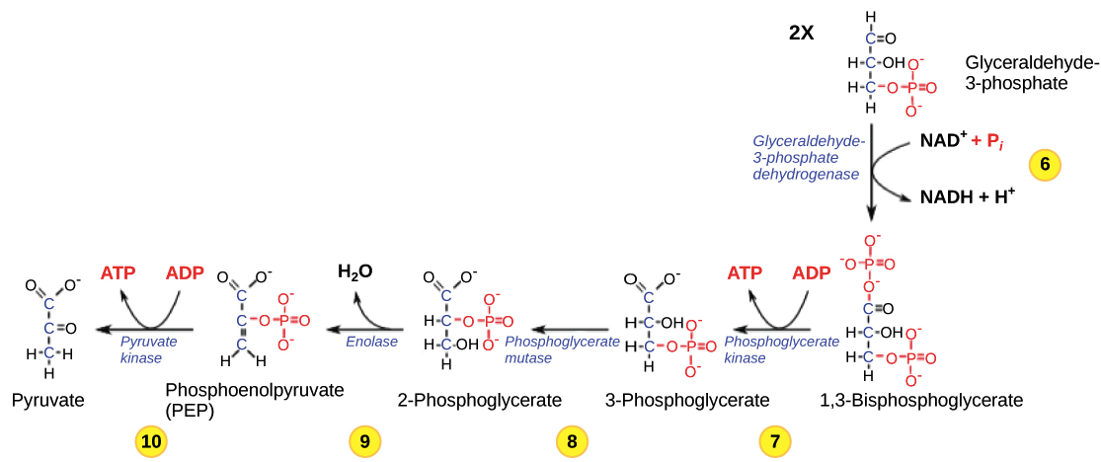

Slide 43
Glycolysis
NADH and pyruvate are formed in the cytoplasm of the cell. The remainder of aerobic respiration takes place in the mitochondrion.
NADH cannot enter the inner chamber but it can pass its electrons to a shuttle carrier on the surface of the inner membrane and build up a supply of interior electrons. The pyruvate can enter the mitochondrion.

Slide 44
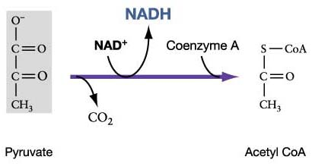

Slide 45
Production of Acetyl CoA
Both Pyruvate are further oxidized, removing the carbon and oxygen atoms of a carboxyl group leaving two acetyl groups.
The two acetyl groups give 2 electrons to NAD+ to form 2 molecules of NADH and Co-enzyme A attaches to the acetyl groups to form Acetyl CoA. Acetyl CoA is a large unstable molecule. Which means it has a lot of potential energy.

Slide 46
Production of Acetyl CoA
Acetyl CoA can enter the Krebs cycle (Citric Acid Cycle). Acetyl CoA moves into the mitochondrial matrix using facilitated transport and is completely dismantled by enzymes in the mitochondria.

Slide 47
Krebs Cycle
During the Krebs cycle pyruvate is dismantled producing carbon dioxide and 2 more ATP. At this point you have only made 4 net ATP, 6 ATP total. The other 32 are made in the electron transport chain.

Slide 48
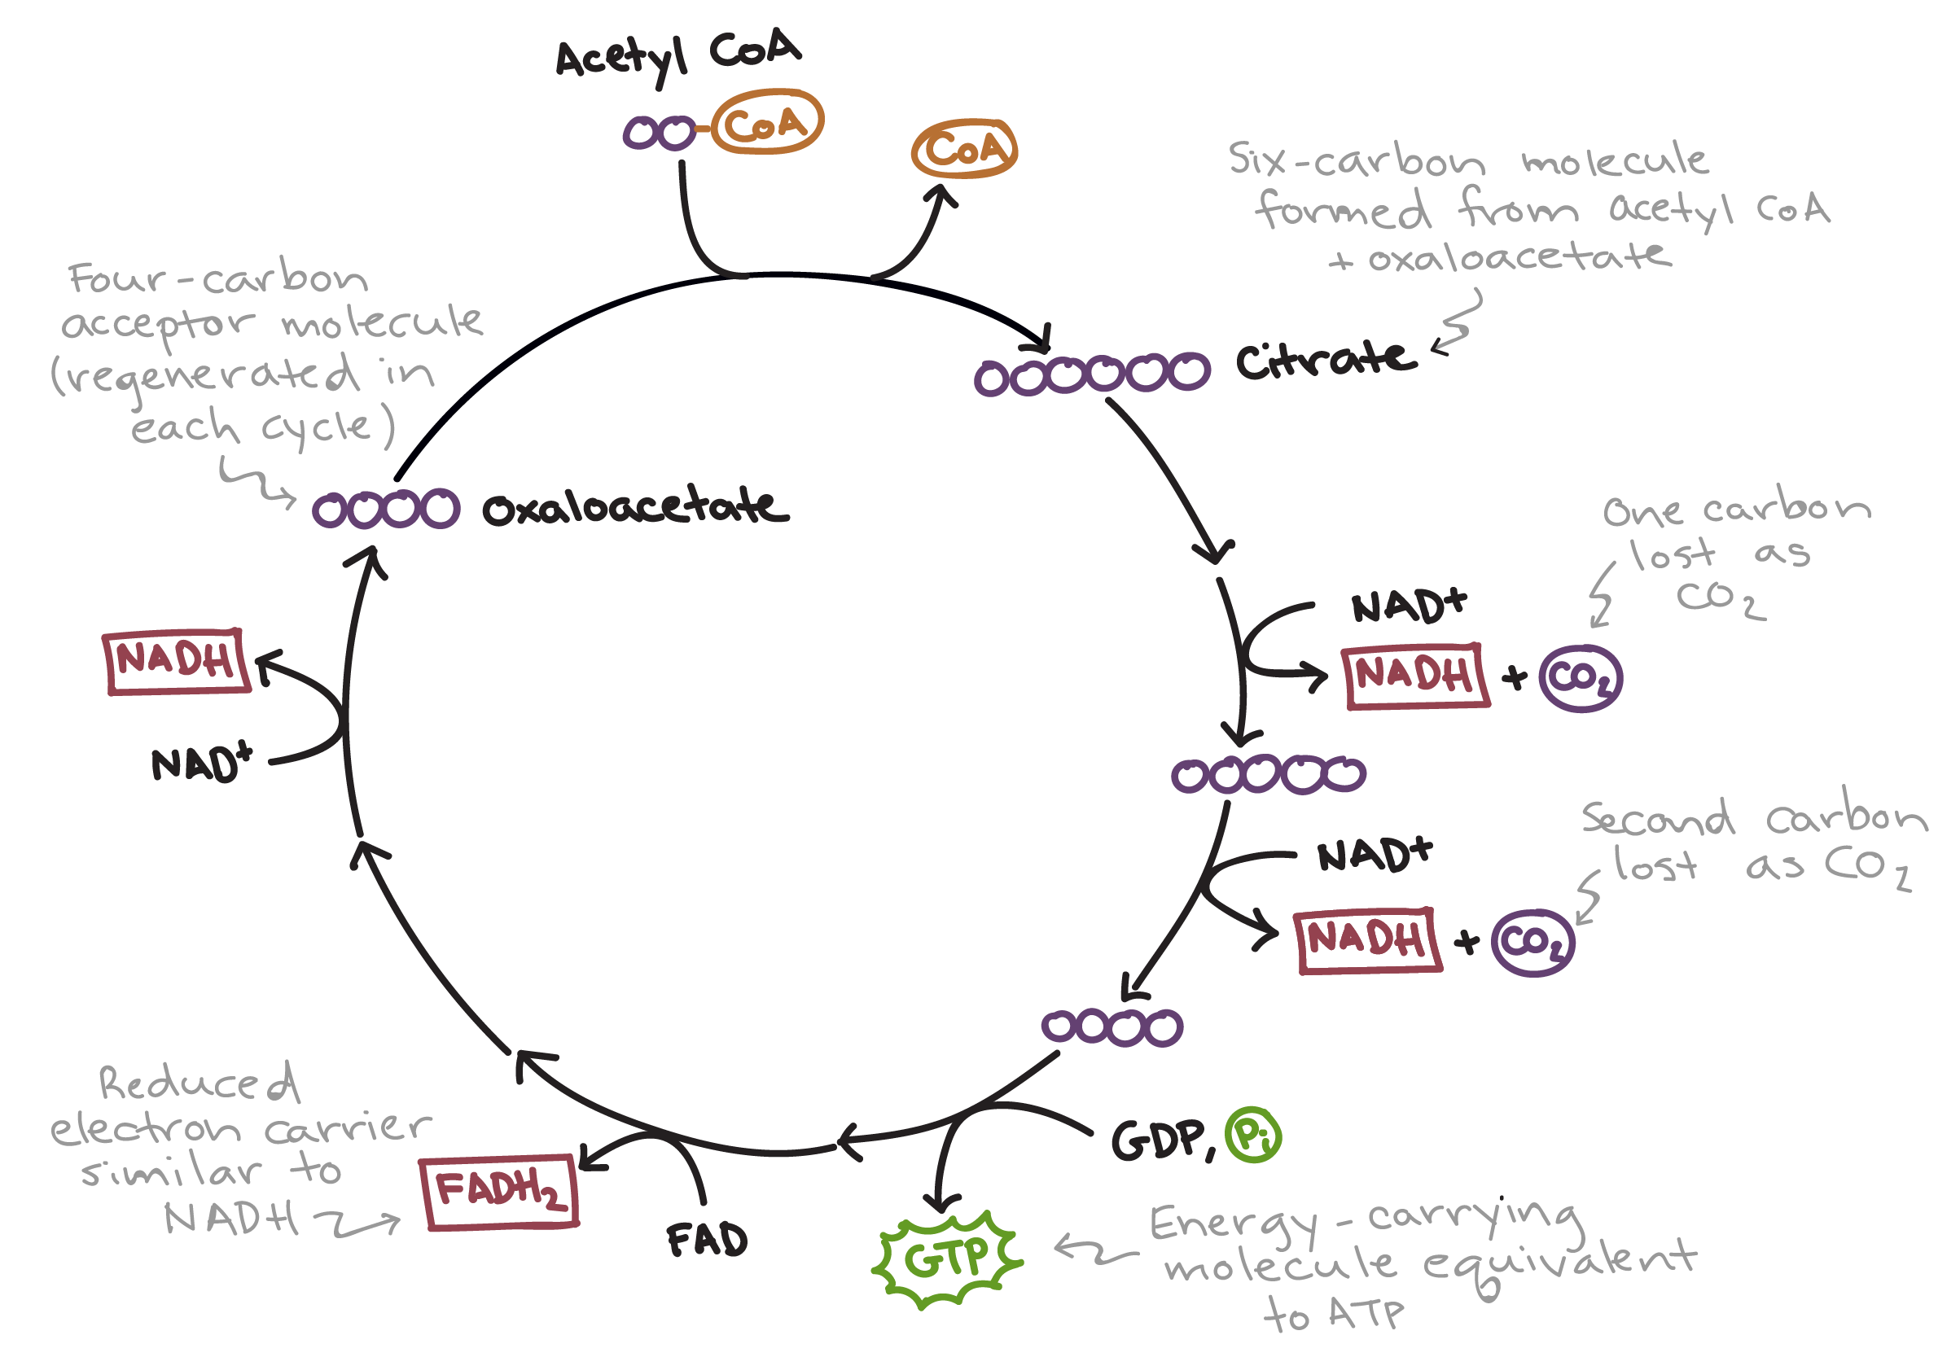

Slide 49
Krebs Cycle
The Krebs cycle converts GDP to GTP (guanine tri-phosphate) where the terminal phosphate is eventually transferred to ADP to form ATP.
It is unknown why the Krebs cycle uses GDP instead of ADP.
At this point glucose has been taken apart with only 4 net ATP produced-2 from glycolysis and 2 from GTPs.

Slide 50
Krebs Cycle
The remainder of the ATP will be created from the hydrogens linked on the electron carriers NADH and FADH2.
Glycolysis-2 NADH
Pyruvate to Acetyl CoA-2 NADH

Slide 51
Krebs Cycle
Citric Acid Cycle (8 steps involved):
step 3- 2 NADH
step 4- 2 NADH
step 6- 2 FADH₂
step 8- 2 NADH
TOTAL 24 electrons

Slide 52
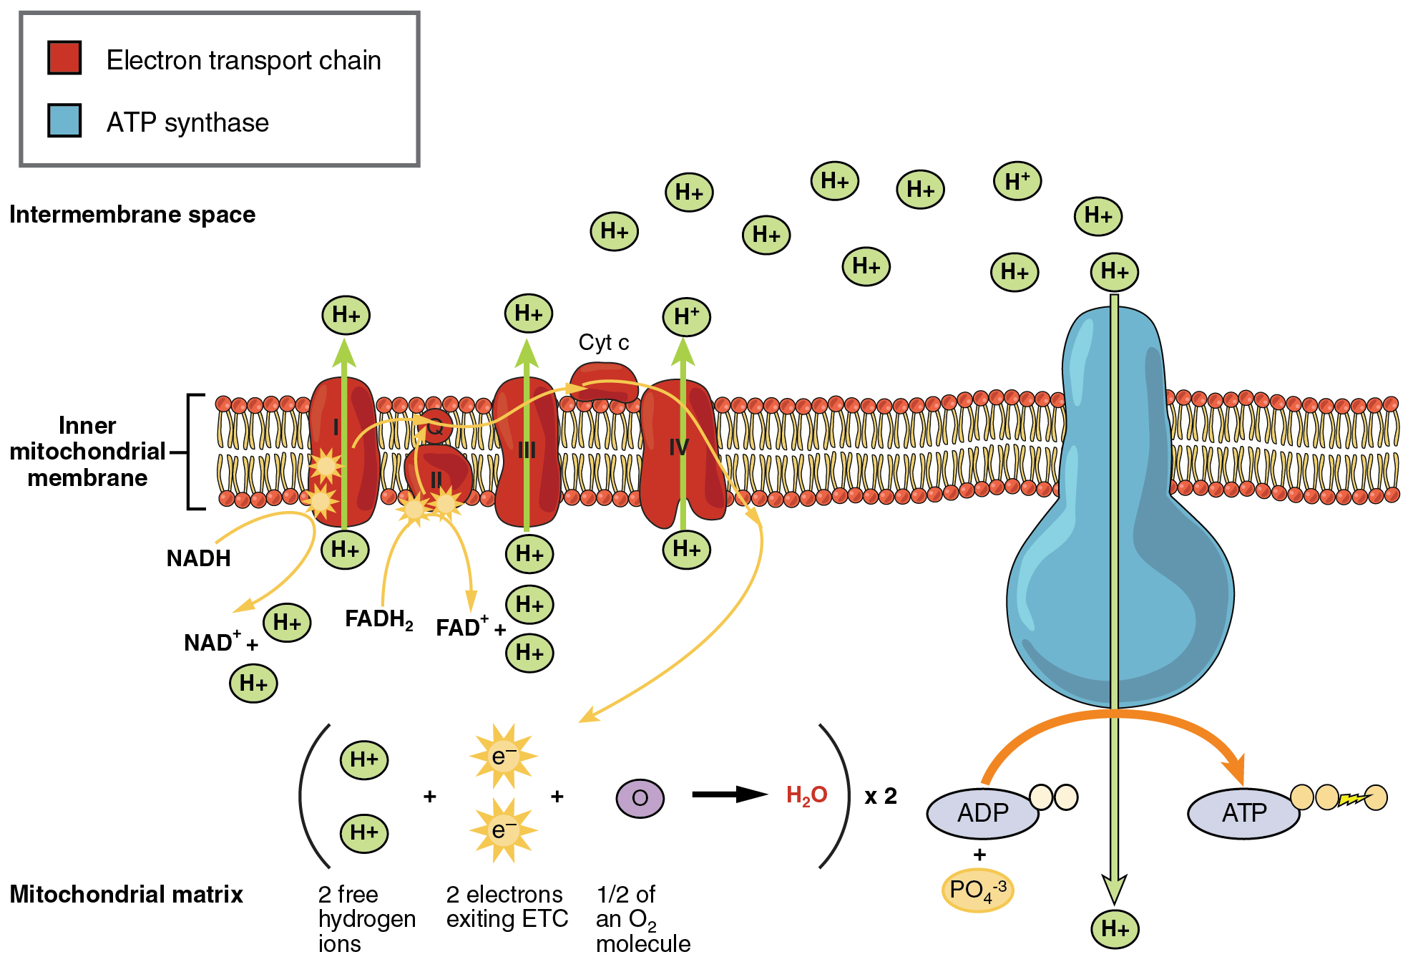

Slide 53
Electron Transport Chain (ETC)
The electron carriers in the chain are positioned so that the electrons travel in a zig zag manner from the inner to the outer surface of the membrane. Each time the electrons travel to the inside surface, the electrons pick up 2 H^{+.} On the outside they release 2 H⁺. Actual number of protons moved is not known but at least 6 are moved.

Slide 54
ETC
There is a proton gradient formed between the outer and inner membrane because of a pH and electric charge difference. This difference allows the H⁺ to flow through channels called ATP synthase using diffusion. As H⁺ flows through the channels ATP is formed from ADP and a phosphate.
3 ATPs are made from 1 NADH
2 ATPs are made from FADH₂.

Slide 55
ETC
At max efficiency the electron transport chain will produce 32 ATP. Adding that to the six from glycolysis and Krebs cycle you make 38 ATP which equals 277.4 Kcal of energy.
This approximately a 32% efficiency rate. The remainder of the energy is lost as heat.

Slide 56
Fermentation/Anaerobic Respiration

Slide 57
Overview
Used by obligate anaerobic organisms as their primary method of ATP production
Used by facultative anaerobic organisms as a backup method when oxygen is scarce but they can fully sustain themselves with it
Used by obligate aerobic organisms as a backup when oxygen is scarce but it cannot be sustained for long

Slide 58
Fermentation
Starts with the process of Glycolysis to reduce 1 molecule of glucose into 2 molecules of pyruvate
Depending on the type of organism they can either do alcoholic or lactic acid fermentation to finish breaking down the pyruvate and oxidize NADH
Still only nets 2 molecules of ATP

Slide 59
Alcoholic Fermentation
Alcoholic Fermentation oxidizes pyruvate into ethyl alcohol (C2H5OH) and oxidizes NADH into NAD+ so that glycolysis can start again
Ethyl Alcohol is a byproduct
Also produces CO2 gas
Used by various types of bacteria and yeast
Can be used to make various alcoholic beverages and bread (CO2 bubbles trapped in the dough cause bread to rise)

Slide 60
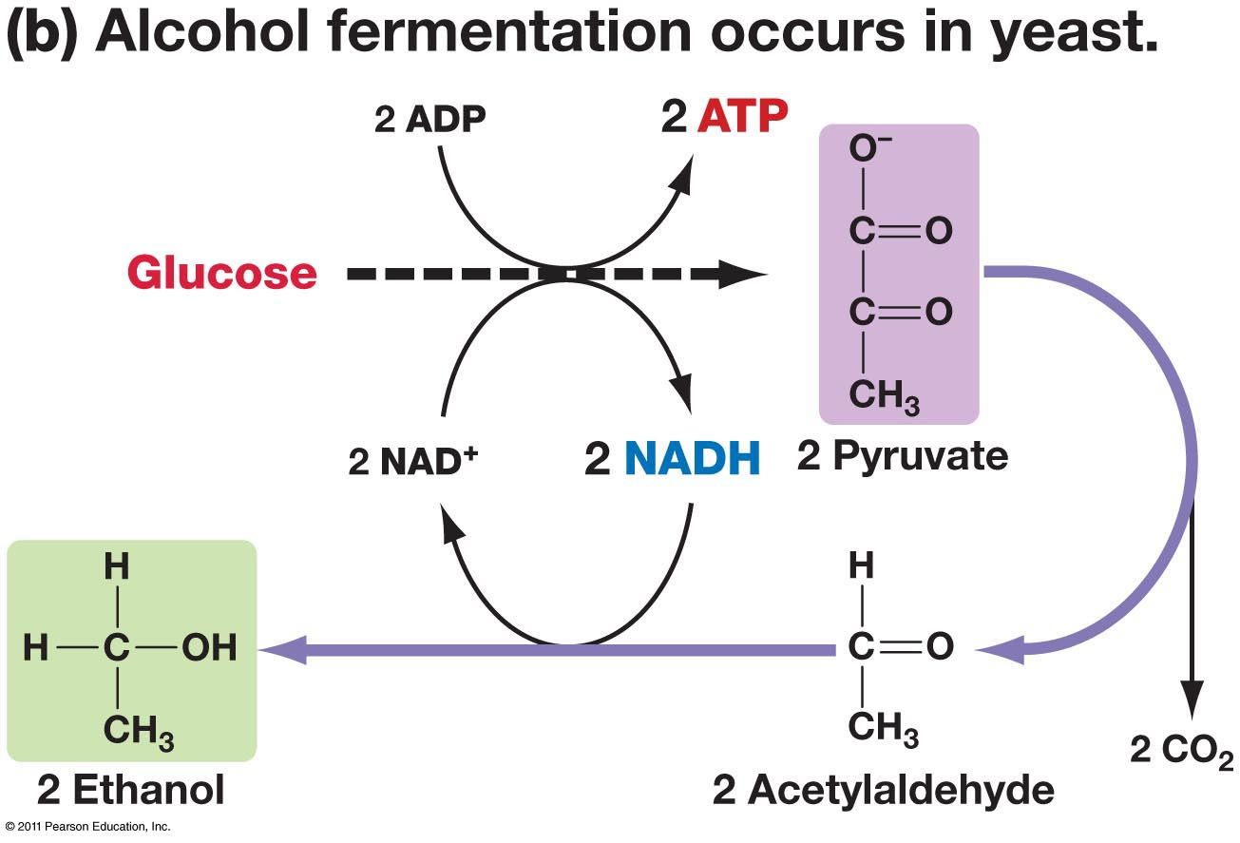

Slide 61
Lactic Acid Fermentation
Lactic Acid Fermentation oxidizes pyruvate into lactic acid which further breaks down into lactate and oxidizes NADH into NAD+ so that glycolysis can start again
Lactic Acid is a byproduct
The reduction of lactic acid into lactate means that there is no carbon dioxide production
Used by various types of bacteria and fungi
Can be used to make various dairy products such as cheeses and yogurts
Also used by humans when oxygen is scarce during exercise

Slide 62
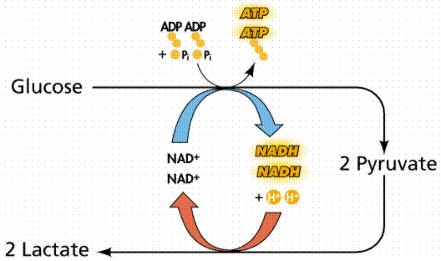

Slide 63
