Slide 1
When you are done with the test
Go to the class website (nebelbiology.weebly.com)
Click on Honors Biology at the bottom
Click on the link called “Modifying the Human Genome”
Read the article
Write an opinion essay (3 paragraph) on whether you think it would be a good idea or not. You must use 3 pieces of evidence from the article to justify your answer.
There’s not a right or wrong answer in my mind for this, your grade is based on how well you justify your point

Slide 2
Come in and find your partner
Find a person with a different color card than you. This is your Accountabilibuddy!
Find a POD to sit in.
Write your name on the sticky note
There can be 1 group of 3, they need to sit at the POD that has 5 desks.

Slide 3
Warmup 11/15
What is the difference in DNA shape of prokaryotes and eukaryotes?
What is similar between DNA of different species?
What is different in the DNA between different species?
How are transcription, translation, and genes related?

Slide 4
DNA Technology

Slide 5
When you are done
Working with a partner, on one sheet of paper with both your names on it…
Write out the steps of gene therapy
Write down what the purpose of gene therapy is
Write down what are some drawbacks to the technology in its current state

Slide 6
Gene Therapy

Slide 7
Gene Therapy: changing the DNA of humans with disorders
We have cured Severe Combined Immune Deficiency (SCID)
Involves the use of viruses to transfer “healthy DNA” to the unhealthy cells

Slide 8
We hope to cure other genetic disorders such as
Cystic Fibrosis
Sickle Cell
Huntingtons
PKU
Hemophilia
Tay Sachs
Research is being done on these but there is no cure yet

Slide 9
We can also combine this with the use of stem cells
When using stem cells to grow a new organ or tissue that is damaged by a genetic disorder (ie. Heart failure) the new organ will have the same problem with the DNA and will eventuall fail again
Use gene therapy on the stem cells before cloning to “fix” the DNA and the regrown organ will not fail

Slide 10
Human Genome Project

Slide 11
Human Genome Project
Genetic Map of all the DNA in a human
Each segment or gene codes for a protein
There are 30,000 genes in the human body
Took 13 years to complete

Slide 12
Human Genome Project
How does this help us?
Now that we know where harmful genes are, we can check to see if a person has it

Slide 13
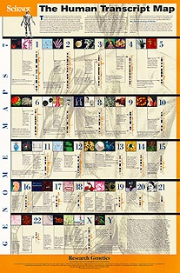

Slide 14
Warmup 11/16
How does gene therapy happen? (What are the steps?)
What are the pros and cons of gene therapy?
What was the purpose of the Human Genome Project?
What is the connection between the HGP and gene therapy?

Slide 15
Warmup 11/19
What are stem cells?
What are ways that stem cells can be used to help humans?
What is the controversy surrounding embryonic stem cells?

Slide 16
Stem Cells

Slide 17
Research
Go to the class web page and click the link at the bottom called “Applications of Stem Cells”
List 5 human diseases that stem cells could be used to treat.
Using Google, write down what the disease is
Using Google, write down what cells the stem cells would be used to replace.

Slide 18
Ethical Questions about Stem Cells
What is the ethical question behind stem cell research?
Where do scientists get a lot of their stem cells?

Slide 19
Stem Cell Discussion
Share among your group members your opinion about stem cell research.
Provide your group with the reason for why you think this way
Remember that everyone’s opinion is very personal and should not be made fun of

Slide 20
Stem Cells and Gene Therapy
Stem Cells: cells in an organism that do not have a specific function and can become any cell in the organism

Slide 21
Called undifferentiated cells: they don’t have a job yet
Stem cells are given a job with cell differentiation (go back to your cell notes)
Only certain genes are activated in the cell
Ie. If the cell is to become a liver cell, it only activates the DNA/genes necessary to become a liver cell, the rest of the DNA remains inactive but still present.

Slide 22
Applications
Applications
Cure Alzheimer’s Disease by regrowing damaged brain cells
Cure paralysis by regrowing new motor nerves
Cure diabetes by growing new cells that produce insulin
Grow various organs for those people who need transplants
Clone various organisms

Slide 23
Cloning

Slide 24
Cloning
Cloning: the process of making an exact copy of the organism
Uses of cloning
Preserve endangered species
Clone organisms for food

Slide 25
Ethics of cloning
People are worried that we are playing God
We may mess up the organisms that we are cloning for food and make them unhealthy
We would be able to clone humans
People wo want to clone organisms may not understand that the new organism won’t have the original’s memories so it won’t be like they were brought back

Slide 26
Spider Goat Video Questions
Can you tell the difference you can see with the appearance of the spider goats and normal goats?
How did they turn the normal goat into a spider goat?
Does the goat produce the silk protein in all of its cells?

Slide 27
Warmup 11/20
What are 3 applications of cloning?
How do you use stem cells in cloning?

Slide 28
Transgenics

Slide 29
Transgenic Technology
Genetic Engineering: modification of organisms DNA by humans so the organism will have a trait we want
Recombinant DNA: DNA that has been taken from 2 different organisms and combined into one chromosome.

Slide 30
A T T A T T T A C A T A T A T G G G C
A T T A T T T A C A T A T A T G G G C

Slide 31
How is it made?
Restriction Enzymes are used to cut DNA at specific spots
The cut DNA is moved to another piece of DNA and is inserted using an enzyme called DNA synthase

Slide 32
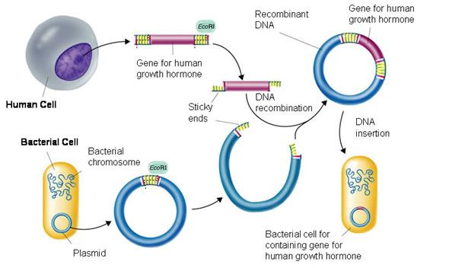

Slide 33
Transgenic Organism: Organism with the DNA of another species inside it (it has recombinant DNA)

Slide 34
How it is made
Remove a targeted gene from one organism (ie the insulin gene from a human cell)
Insert the gene into the DNA of another organism (the bacterial DNA)
If that DNA belongs to a bacteria it is called a plasmid
If that DNA belongs to any organism other than a bacterial it is called a chromosome
Now that organism (bacteria) can do what the first organism was able to (make insulin)

Slide 35
How is it used?
Medicine
Produce insulin for diabetics
Produce growth hormone for dwarfs
Produce vaccines

Slide 36
Agriculture
Make crops resistant to herbicides and repel insects
Increase the quality of the crops (more vitamins, minerals, etc)
Increase the quantity of the crops

Slide 37
Industrial Application
Removing metal ores from rocks
Cleaning up oil spills

Slide 38
Genetically Modified Organism: organism that has been modified by humans to better fulfill our needs
All transgenics are GMOs but not all GMOs are transgenic

Slide 39
Ethics of Transgenics
Pros:
The GMOs we make produce more food, are juicier, have more vitamins that their normal counterpart
The GMOs are more resistant to pests, drought, and herbicides

Slide 40
Cons
While no problems have been reported yet, many people are unsure if GMOs will have unforeseen long-term consequences
People are not told that the food they are buying is a GMO

Slide 41
Are they safe?
How have humans been genetically modifying organisms for thousands of years?
What is an example of a way we use transgenics in medicine?
Are transgenic foods dangerous for humans?
Are transgenic foods dangerous for the environment?
How have GMOs improved the life of humans?

Slide 42
Warmup 4/19
What is the controversy over stem cells?
What are the applications for cloning?
How are stem cells linked with cloning?

Slide 43
Warmup 4/20
What is a transgenic organism?
What are the controversies over transgenics?

Slide 44
Warmup 4/23
What are 3 applications of transgenic organisms?
How is Golden Rice different from regular rice?
What was the purpose of Golden Rice?

Slide 46
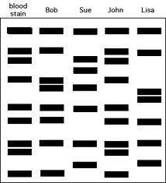

Slide 47
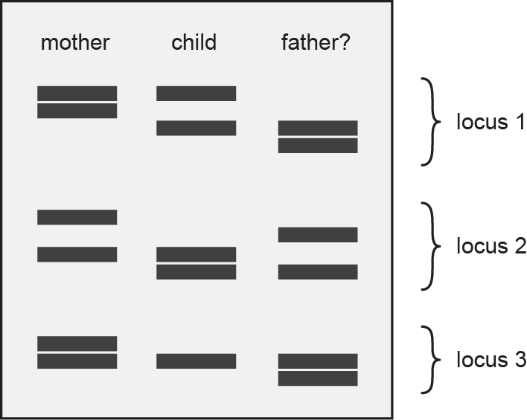

Slide 48
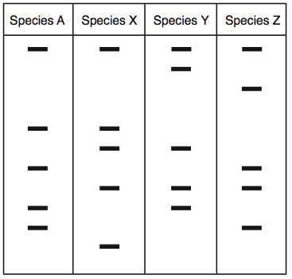

Slide 49
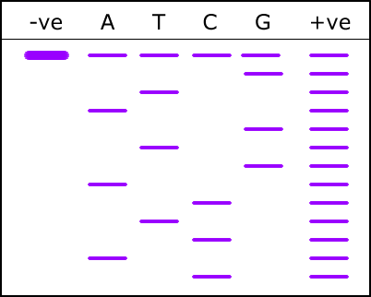
Gel Electrophoresis (DNA Fingerprinting)

Slide 50
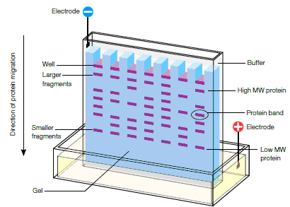

Slide 51
How does it work?
Gel electrophoresis is a technique that separates DNA into different sized pieces and then moves them through the gel
It forms a DNA pattern that is unique to each individual
The more similar the banding pattern is, the more related the organisms are

Slide 52
How does it work?
Restriction enzymes are used to cut DNA
The DNA is placed into the gel and an electrical current is run through it
The current separates the DNA pieces (RFLPs) by size. The shorter go farther

Slide 53
Real World Application
Determining who your biological parents are: only ½ of the DNA will match mom, the other ½ matches dad
Maternity testing: mother
Paternity Testing: Father

Slide 54
Crime Scene Investigation: all of the DNA should match
Matching DNA found at the crime scene to suspects
Natural Selection Evidence
The more bands organisms share, the more related they are

Slide 55
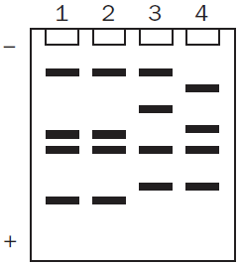
Warmup 11/06
Which 2 organisms are most closely related?

Slide 56
Warmup 2/19
What are 3 ways we can use a gel electrophoresis?
What is the role of a restriction enzyme?
What causes the bands of a DNA fingerprint to separate? Which size travels the least?

Slide 57
Answers to questions 8-12
8. Transgenics are made when you pinsert the DNA of one organism into another organism.
9. Two agricultural uses of transgenics are increasing the quality of the food (vitamins, size, etc) and making them resistant to insects.
10. Skip this question.

Slide 58
11. Two medical uses of transgenics are to create insulin and growth hormone.
12. Insulin is produced by inserting the human gene for insulin into a bacteria, allowing the bacteria to grow and produce the insulin, then harvesting the insulin.

Slide 59
Warmup 11/01
What is recombinant DNA?
How is recombinant DNA used in DNA technology?
What is a transgenic organism? Give 1 example.

Slide 60
Warmup 11/03
What is a stem cell?
What is the controversy over stem cells?
What does the term undifferentiated mean?

Slide 61
Warmup 4/24
What was the goal of the Human Genome Project?
How many genes were found in the human genome?
How are segments of DNA separated in a gel electrophoresis?
What are the applications for gel electrophoresis?

Slide 62
SG 13-17
13. The goal of the HGP was to map out the genes on human DNA.
14. There were approximately 30,000 genes sequences by the HGP
15. One use of gene therapy that has resulted from the HGP is the cure for ALD.
16. The ethical dilemmas associated with gene therapy center around the retrieval of embryonic stem cells.
17. Stem cells are cells that are unspecialized. They can be used to regrow cells/tissues/organs that have degenerated.

