Slide 1
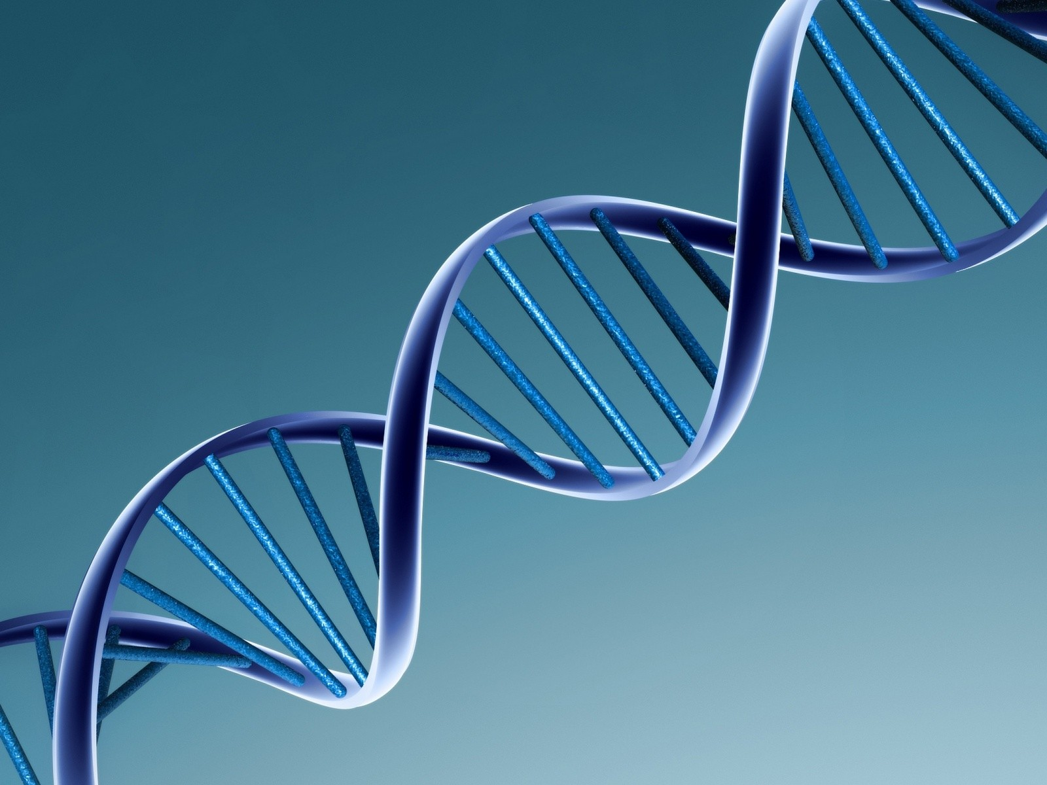
DNA Structure

Slide 2
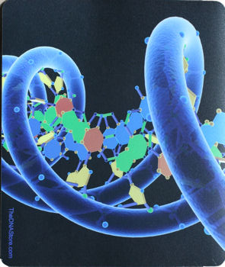
What is it?
What is DNA?
Deoxyribosenucleic Acid
Located in the nucleus of a cell
DNA is a nucleic acid
DNA is made of nucleotides

Slide 3
Nitrogen Bases
Made of three things
Phosphate Groups
Deoxyribose sugar
Nitrogen Base

Slide 4
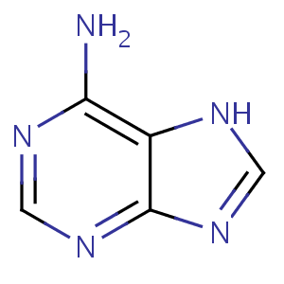
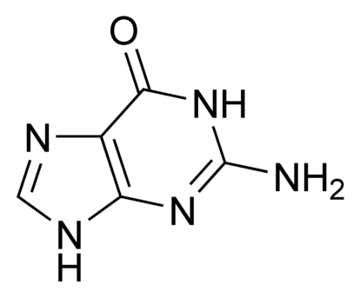
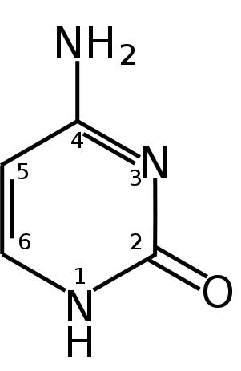
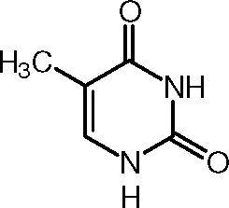
Nitrogen Bases
Nitrogen Bases
Two bases are called purines (larger)
Adenine (A)
Guanine (G)
Two bases are pyrimidines (smaller)
Thymine (T) (only found in DNA)
Cytosine (C)

Slide 5
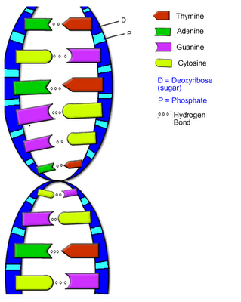
Nitrogen Bases
Chargaff’s Rule
Adenine only pairs with Thymine
Guanine only pairs with Cytosine
Therefore, for every A there is a T and for every G there is a C

Slide 6
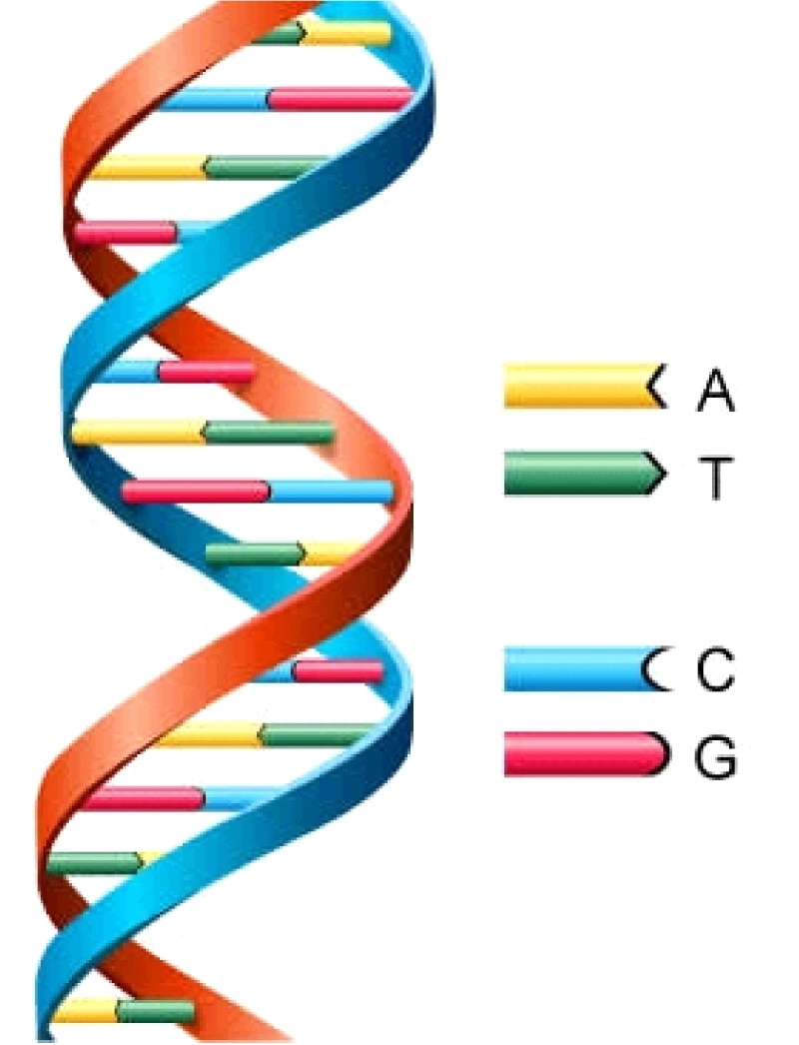
Structure
The DNA has a characteristic double helix
Double because there are two sides
Helix because it forms a spiral
Resembles a twisted ladder

Slide 7
The structure was discovered by Watson and Crick
Contributions were made by Pauling, Franklin, and Wilkins

Slide 8
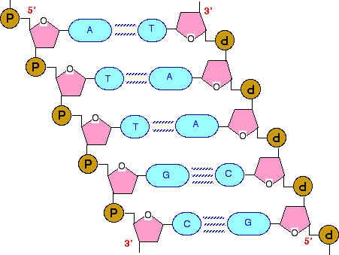
Structure
The nitrogen bases are held together by Hydrogen Bonds

Slide 9
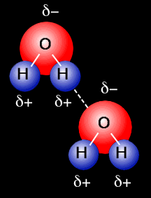
Hydrogen Bond
Hydrogen bonds are attractions between hydrogen atoms on 1 molecule and oxygen atoms on another. Like a magnet
Very weak bonds

Slide 10
Sequence
How the nitrogen bases are arranged are
Unique to the species
Unique to the individual
The more similar the sequence of DNA is, the more closely related the two species are

Slide 11
DNA Replication

Slide 12
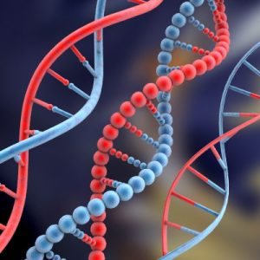
Making A Copy
Replication: process of making an exact copy

Slide 13
Reasons for DNA Replication
Start Cell Division
Tissue growth and/or repair

Slide 14
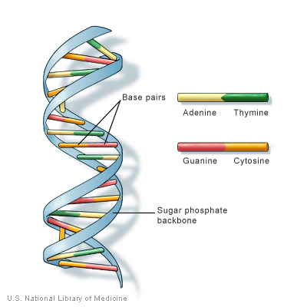
Steps of DNA Replication
We use the semi-conservative model
You will use the original piece of DNA as a template (half the old DNA will be used in the new DNA strand)
The right strand will form one new piece of DNA
The left strand will form another new piece of DNA

Slide 15
Remember that A pairs with T and C pairs with G
Each strand is complementary to the other (it matches)

Slide 16
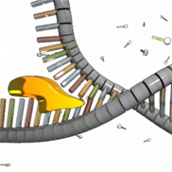
Helicase
Step 1: DNA unwinds
Uses an enzyme called helicase
You need the weak Hydrogen Bonds so you can pull the DNA apart easier

Slide 17
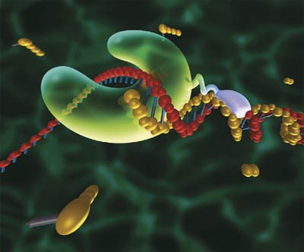
Making our DNA longer
Step 2: Add new nucleotides to the original DNA strands
Proteins called DNA polymerases help add the new nucleotides

Slide 18
Models of DNA Replication

Slide 19
Example of Replication
Example:
Original piece of DNA: A T G C T G T T A
Complementary piece:

