Slide 1
Warmup 5/04
What is the similarity between classical conditioning, operant conditioning, and habituation?
What is the difference between the 3?

Slide 2
DNA and Protein Synthesis

Slide 3
Nucleus and DNA synthesis
Nuclear membrane-double membrane that is often continuous with the ER. Contains numerous pore like structures that are highly selective. Large mRNA molecules easily pass, yet smaller molecules are not allowed through.
Nucleolus-only obvious feature of the nuclear fluid where rRNA reproduction takes place and appears to be the source of ribosomes.

Slide 4
Nucleus and DNA synthesis
DNA, chromatin and chromosomes are inside the nucleus. Chromatin is DNA combined with proteins. When cells are dividing chromatin is coiled into chromosomes (approx 12 cm end to end).

Slide 5
DNA information and synthesis
DNA acts as a cells set of directions for survival.
DNA molecule is broken into 3 parts:
Nitrogen bases
Pyrimidines are single ring bases-cytosine and thymine.
Purines are double ring bases-guanine and adenine.
Sugar backbone
Phosphate groups
A deoxynucleotide is the basic unit and is composed of one of each of the above.

Slide 6
DNA information and synthesis
In DNA the backbone consists of alternating sugar and phosphates linked by shared oxygen atoms. The nitrogen bases are side groups of the sugar and are not part of the backbone.
The nucleotide chain has 2 ends. The end with the phosphate attached to the #5 C of the sugar is called the 5' end. The end with the OH group attached to the #3 carbon is called the 3' end.

Slide 7
Double Helix
DNA is almost always found in a double strand, RNA in a single strand. Each strand is forged with covalent bonds but only has weak H bonds between the two strands.
The two strands wind around each other in a double helix, making it appear like a twisted ladder.
Adenine will always form 2 hydrogen bonds with thymine. Guanine will always form 3 hydrogen bonds to cytosine.
Strands are anti-parallel. Bases will be perfectly flat stacked on top of one another like a stack of pennies.

Slide 8
Forces that hold DNA together
Hydrogen bonding-between base pairs.
Hydrophobic interactions-DNA bases are insoluble in water so they stick together in aqueous solutions.
Base stacking-when the bases lie on top of one another, base stacking interactions will occur.

Slide 9
Levels of DNA Folding
Straight DNA molecule with just ATCG nucleotides
Primary- DNA wraps around histone proteins and appears like a string of beads. Each bead is called a nucleosome.
Secondary- Nucleosomes continue wrapping and form a 3D zigzag structure
Tertiary- Forms alternating large and small loops
Quartenary- Continues wrapping until the loops form a cylinder that we identify as a chromosome

Slide 10
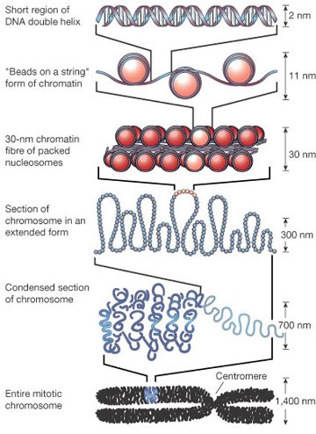

Slide 11
Conditions for denaturing DNA
Decrease the pH
Increase the heat
Free radicals
All will make the H⁺ bonds break.

Slide 12
Replication
This won’t be the exact same as in your notes because I cannot find the original powerpoint

Slide 13
DNA Replication is the process that makes an exact copy of the DNA in an organism
Replication occurs using the Semi-Conservative Method
This method means that the original DNA splits into 2 single helices and then the 2 old strands are used as a template to add the new complementary nucleotides to turn the DNA back into 2 double helixes that are identical to each other and to the original starting DNA

Slide 15
Beginning Steps
The place where DNA replication begins is called the Origin of Replication. This is where the first enzyme Topoisomerase binds. Topoisomerase runs down the length of DNA in a 5’ → 3’ direction weakening the hydrogen bonds between the nitrogen bases
Helicase follows the Topoisomerase and actually breaks the hydrogen bonds.
Where the DNA is splitting is called the replication fork

Slide 17
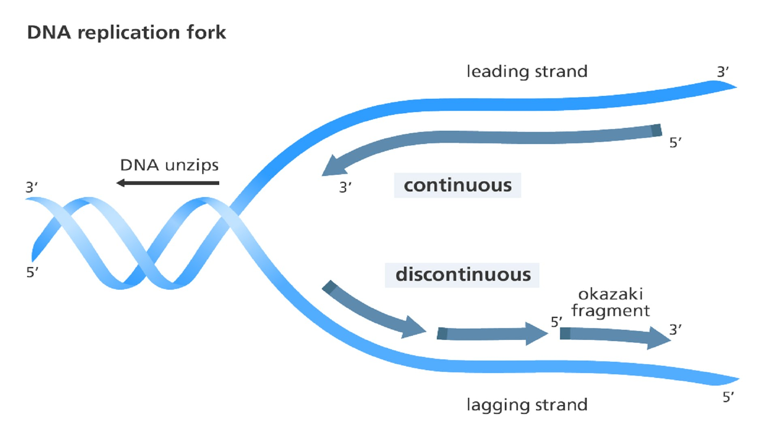

Slide 18
To prevent the 2 single strands of DNA from recombining, small proteins attach to each strand called Single-Strand Binding Proteins. These prevent the attractive nature of the hydrogen bond from undoing the work of helicase

Slide 19
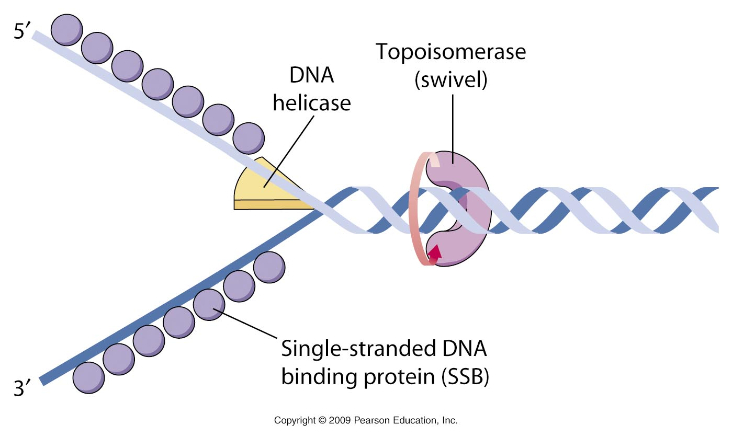

Slide 20
Once the DNA has been split another enzyme called Primase attaches to the 3’ end of the DNA and attaches a small sequence of RNA nucleotides called the primer.
The primer allows the next enzyme DNA polymerase to bind to the DNA. DNA Polymerase can only bind to the DNA at a primer.

Slide 22
Because of the anti-parallel nature of DNA, and the fact that nucleotides can only be added in a 5’ → 3’ direction, the leading strand is the original strand that runs in the 3’ → 5’ direction, the new nucleotides are added in the 5’ → 3’ direction. This strand only needs 1 primer.
The other DNA strand that runs in the 5’ → 3’ direction will be made in small parts and will require several primers every few thousand bases to allow replication to occur

Slide 23
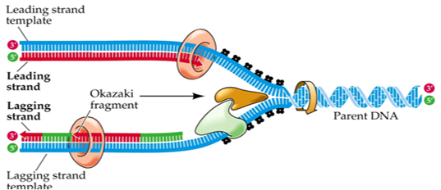

Slide 24
DNA Polymerase duns down the DNA in a 3’→ 5’ direction adding new DNA nucleotides to the complementary bases found on the original strand. The new bases are in the 5’ → 3’ direction
There are several types of DNA polymerase in organisms but you don’t have to know the specifics of what each one does.

Slide 25
On the lagging strand because of the backwards direction it runs, it has to be assembled in pieces. Each piece is called an Okizaki Fragment.
Each Okizaki fragment is started by a primer

Slide 26
The green is the RNA primer, the red are the new nucleotides for DNA

Slide 27
Once all of the DNA has been replicated, an enzyme called DNAse or Nuclease cuts out each of the RNA primers from the DNA.
DNA polymerase then comes back in to replace the primer with DNA nucleotides
Another enzyme called DNA Ligase attaches the replaced nucleotides to the rest of the DNA strand.

Slide 28
Once Ligase is done, DNA polymerase will “Proofread” the DNA looking for any mismatched bases and correcting them as it finds them
If one is found, DNAse comes in to cut it out and polymerase adds the correct nucleotide

Slide 29
The final stage is to fill in the telomeres.
Telomeres are the very ends of the DNA found on eukaryotic chromosomes. Since prokaryotic DNA is circular, they don’t have telomeres.

Slide 31
When copying DNA, the primers are not placed on the very end of the 3’ strand (this is the telomere), which means that several hundred nucleotides are still left single stranded.
An enzyme called telomerase comes in to add the complementary bases. It is still not able to copy all of the letters though and every time the DNA is copied, the telomere will become a little shorter. You literally lose DNA every time you have to copy it!

Slide 32
It is believed that this shortening of the telomere is what causes aging and eventually death.
It is also believed that if you could find a way to prevent the telomeres from becoming shorter then you would stop aging and live forever

Slide 33
Transcription

Slide 34
Transcription-synthesis of messenger RNA from a DNA template.
Translation-synthesis of a polypeptide (AKA a protein) from the messenger RNA sequence.
Differences between RNA and DNA:
Ribose sugar found in RNA vs deoxyribose in DNA
Uracil found instead of thymine
Single stranded instead of double stranded
Three kinds instead of one kind

Slide 35
Types of RNA
rRNA-ribosomal RNA, the principle component of ribosomes. This is the site where amino acids are synthesized into proteins. This is produced in the nucleolus.
mRNA-messenger RNA, carries the DNA code to the ribosome. This is the physical link between the blueprints (DNA) and the factory (the ribosome).
tRNA-transfer RNA carries amino acids to the ribosomes. This is produced in the nucleolus.

Slide 37
Steps of Transcription
An enzyme called RNA Polymerase binds to the DNA at a site called the promotor.
The function of RNA polymerase is 2-fold
Unwind the DNA locally
Synthesize the complementary strand of mRNA by matching RNA nucleotides to the DNA template
The specific location on the promotor that polymerase binds is called the TATA box

Slide 38
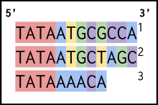

Slide 39
To make sure that RNA polymerase binds to the correct TATA box, several proteins called transcription factors bind to the promotor first.
RNA polymerase runs down the DNA in a 5’ → 3’ direction
Multiple RNA polymerases can run down the gene one right after the other to maximize the amount of mRNA that can be made

Slide 40
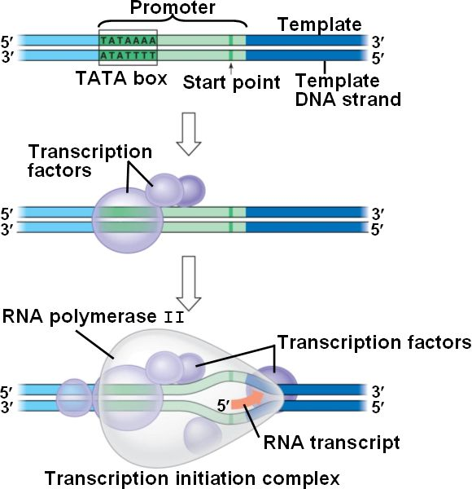

Slide 41
RNA elongation
RNA polymerase can transcribe multiple genes at once if all of the genes code for the same protein.
EX: the hemoglobin molecule is made of 4 different gene sequences so RNA Polymerase transcribes all of them together on the same mRNA molecule
The gene sequences are called exons and they code for a functional protein
In between the exons are non-coding sequences of DNA called introns. These will be removed when RNA processing starts

Slide 42
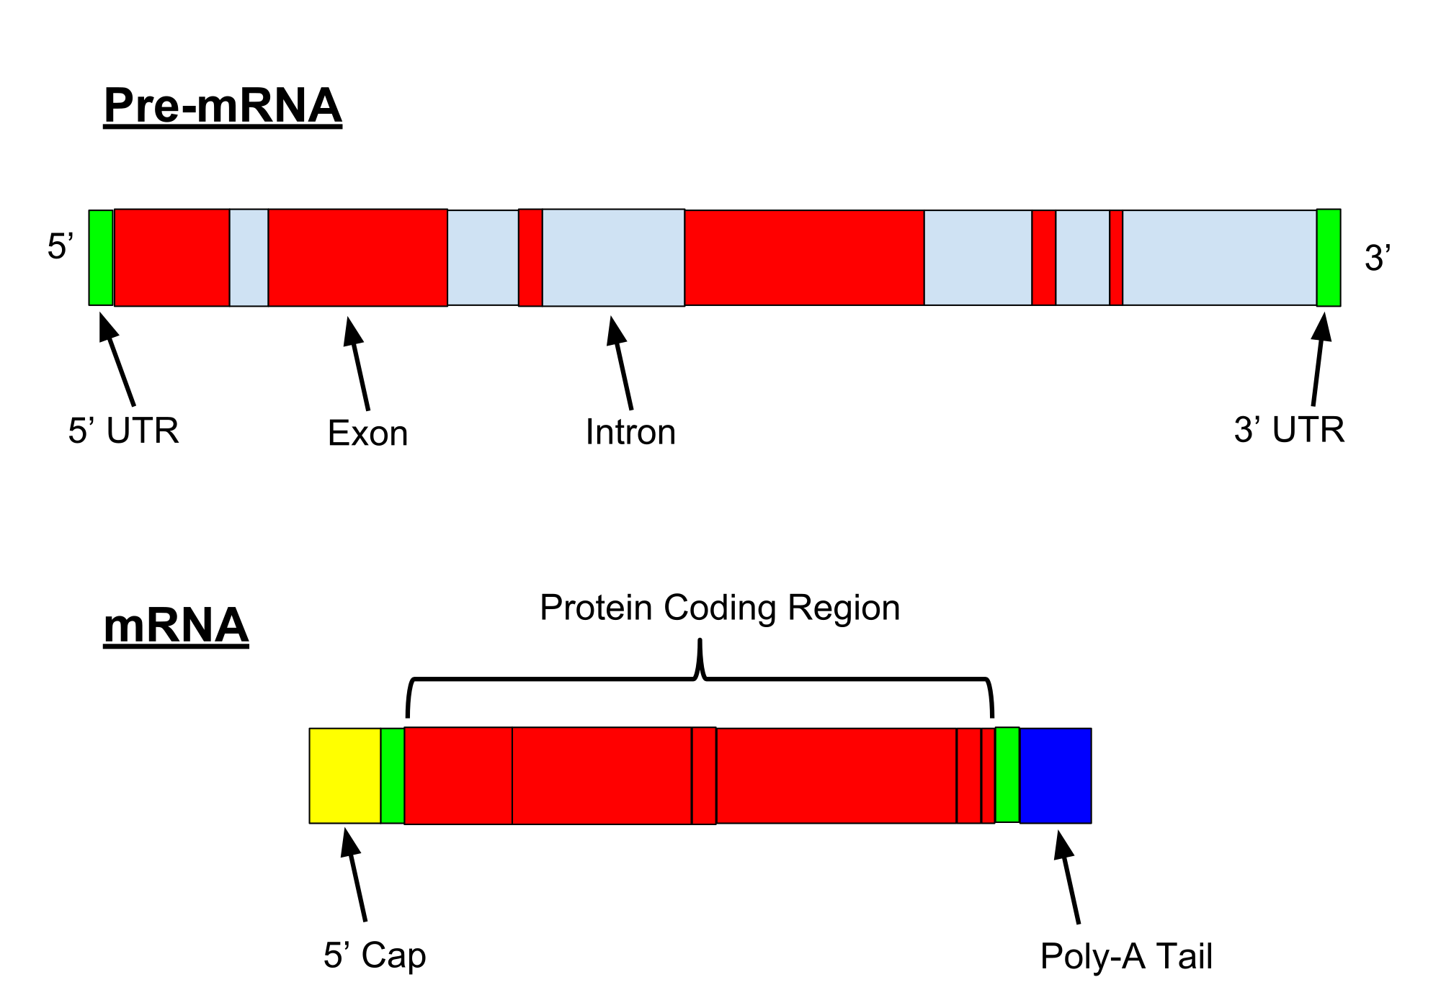

Slide 43
RNA polymerase finishes when it transcribes a sequence called the terminator.
In prokaryotes this is just a RNA sequence in the DNA
In eukaryotes it is a poly-adenylation signal (AAUAAA)
Behind the polymerase another enzyme called gyrase reseals the DNA

Slide 44
RNA Processing
The pre-mRNA that falls off the DNA needs a lot of work before it can be sent outside the nucleus.
The first thing that has o happen is that the introns must be removed.
This is done with a protein called a spliceosome made from another protein called snRNPs (small nuclear ribonuclear proteins)
snRNPs attach to the beginning and ends of the exons to denote where the intron is located

Slide 45
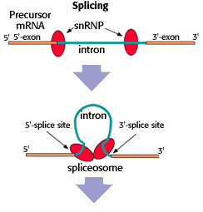

Slide 46
The snRPS then combine together with other proteins into the spliceosome which cute the intron from the exons and joins the 2 exons together
The DNA is bent so the snRNPs can come together by DNA bending proteins

Slide 47
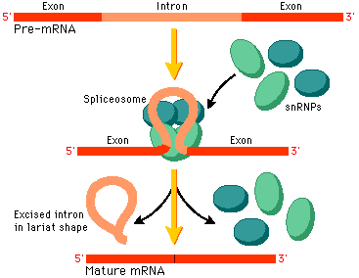

Slide 48
Once all of the introns are removed from the DNA, a guanine cap is placed on the 5’ end of the mRNA
A long sequence of Adenine molecules are placed on the 3’ end. This is called the poly-A tail
Both of these help to protect the mRNA molecule from damage when it moves out of the nucleus

Slide 50
Translation

Slide 51
Beginning translation
Translation is the process of converting mRNA into the amino acid sequence.
It starts when the mRNA leaves the nucleus and moves into the cytoplasm.
A ribosome large subunit and a small subunit attach along the 5’ end of the mRNA and start moving down the RNA

Slide 52
Reading the mRNA
Ribosomes read the mRNA every 3 letters.
Each combination of 3 letters is called a codon
The 3 letters that the ribosome is “reading” is called the reading frame
Every protein starts with the same codon, AUG, and the reading frame constantly moves one letter at a time down the RNA strand until it finds the AUG sequence, after which it them moves down the RNA every 3 letters

Slide 53
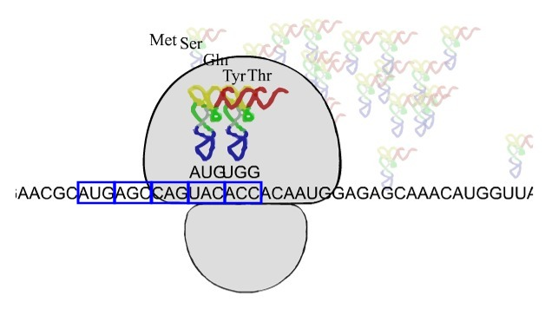

Slide 54
Bringing the correct amino acids
Once the ribosome finds AUG, transfer RNA brings the correct amino acid.
On the bottom of the tRNA is a sequence of 3 ribonucleotides called an anticodon which is complementary to the mRNA codon.

Slide 55
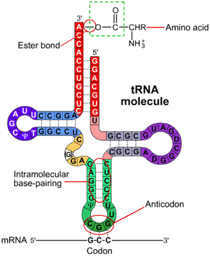

Slide 56
Ribosome structure
The ribosome has 3 slots in it called the APE site
A= arrival site. tRNA arrives here, if the anticodon matches the codon the tRNA moves into the P site. If they don’t match, tRNA is kicked out so another one can come in
P= polymerization site. This is where the amino acid attached to the tRNA is attached to the other amino acids in the growing polypeptide chain
E= exit site. The now empty tRNA leaves the ribosome to find a free amino acid to bind to

Slide 57
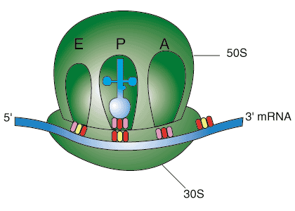

Slide 58
It requires energy in the form of GTP to bind the new amino acid to the amino acid chain. This forms a peptide bond between the amino acids.
The ribosome will continue adding amino acids to the chain until it reads a stop sequence.
When this happens the 2 ribosomal subunits fall off the mRNA and the amino acid sequence folds into the quaternary structure. (Review the 4 levels of protein folding from the biochemistry notes)

Slide 59
Post-translation Processing
Once translation is done, additions may be made to the protein so that it can fulfill it’s function. These may include
Adding polysaccharide chains
Adding lipid chains
Adding phosphate groups
Removing an amino acid to activate it
This is typically done by the Golgi Body

Slide 60
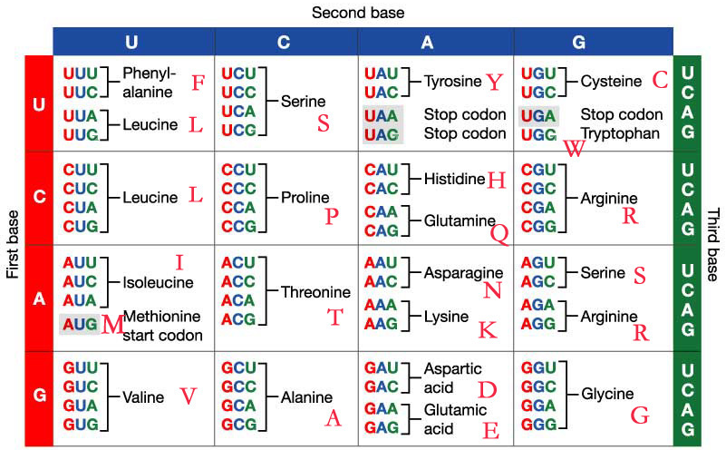
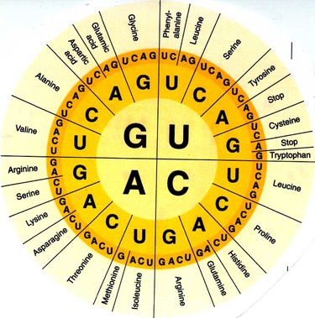
To figure out what the amino acid sequence is, we use a codon chart.

Slide 61
Mutations

Slide 62
Most of the time, mutations are quickly fixed
DNA polymerase not only puts bases in order but also proofreads. If the nucleotide is the wrong one polymerase will undo it. DNA polymerase actually removes 10% of all bases it puts down even if the base is correct. If the polymerase gets more than 2 bases past a mismatch a correction is unlikely. It proofreads in a 3' to 5' direction.

Slide 63
Consequences of Mutations
Mutations are inheritable changes in a DNA molecule. These changes can range from no effect to being disastrous for the cell.
Mutations produce genetic variation and is a major contributor to evolution if they occur in gametes. Mutations in somatic cells lead to cancer.

Slide 64
Types of Mutations
Original strand: GATTCCTTAA
Changing one base-These are mismatch or base substitutions.
Mutated strand: GAATCCTTAA
Insertion of one or more nucleotides
Mutated strand: GAATTCCCTTAA
Deletion of one or more nucleotides
Mutated strand: GA_TT_CTTAA

Slide 65
Types of Mutations
Original strand: GATTCCTTAA
Inversion of part of a sequence
Mutated strand: GATTCCAATT
Breakage and loss of a fragment of DNA.
Mutated strand: GATTCCT___
Extra copies of DNA.
Mutated strand: GATTCCTTCCTTAA

Slide 66
Operons

Slide 67
What is an Operon?
It is a sequence of genes that allow prokaryotes to create a series of enzymes that work together to accomplish a task.
What makes a sequence of genes an operon is that they can be either repressed (stopped) or induced (activated) allosterically.
There is a small sequence called the operator that is located after the promotor that a repressor can bind to and turn the operon off or not be bound to and turn the operon on

Slide 68
Trp Operon
The Trp operon codes for the enzymes responsible for making the amino acid tryptophan. This is an example of a repressible operon.
When the levels of tryptophan are low, the gene is turned on. As levels of tryptophan rise, some of the extra amino acids bind to the repressor allosterically which then changes the shape of the repressor allowing it to bind to the operator preventing more tryptophan to be made

Slide 69
When tryptophan levels fall again, the amino acid bound to the repressor falls off, changing the shape of the repressor again and it drops off the operator allowing the gene to turn on again.

Slide 70
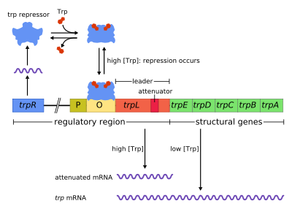

Slide 71
Lac Operon
The Lac Operon codes for the enzymes that allow prokaryotes to break down lactose for energy.
It is an inducible operon meaning that it is normally off and you need lactose to activate it.

Slide 72
Under normal circumstances, the repressor is bound to the operator of the Lac operon. When lactose is present, it binds to the repressor allosterically and changes the shape of the repressor causing it to fall off and the operon to activate
When the levels of lactose fall, the lactose falls off the repressor allowing it to change shape and rebind to the operator and turning the operon off again.

Slide 73
