Slide 1
Classification, Viruses, Protists, Fungi

Slide 2
Classification

Slide 3
Carlus Linneus
The classification system was developed by Karl Von Linne who latinized his own name to Carlus Linneus. He developed the category within category scheme, named many organisms on earth with Latin.

Slide 4
Linnean Classification
He used latin to give each organism two names known as binomial nomenclature. He used Latin for these names because:
Latin is not commonly spoken and therefore not likely to change meanings.
Latin forms the root of many words in a number of languages.

Slide 5
Linnean Classification
His category system from largest to smallest is:
Domain
Kingdom
Phylum
Class
Order
Family
Genus
Species

Slide 6
Linnean Classification
These are called taxon. There is also super category (above the taxon) and a sub category (below the taxon).
Ex. Mammalia is the taxon at the class level.
You can have a super phylum, phylum and sub phylum.

Slide 7
Taxonomy
Taxonomy has 2 main objectives:
Sort out closely related organisms by assigning them to separate species
Organize species into higher taxonomic categories.

Slide 8
Taxonomy
2 schools of taxonomy:
Phenetics-based only on a species' observable characteristics. These characteristics are divided into unit characteristics and these are assigned a value. A computer then compares the values. This system is considered effective if enough characteristics are compared.
Cladistics-Based on phylogeny (evolutionary relationships).

Slide 9
Taxonomy
Taxonomic Methods:
An organism is assigned a taxon based on outward similarities to other organisms in the taxon.
The similarities are compared to fossils in the taxon.
Compare DNA/RNA/Proteins of organisms whenever possible.
Various stages in the life cycle and embryonic development are compared.

Slide 10
Taxonomy
Currently we have 3 domain, 5 kingdom system.
3 domains:
eukarya-eukaryotes
archae-archaebacteria
bacteria-eubacteria

Slide 11
Taxonomy
Kingdoms:
Archaebacteria-Prokaryotes that prefer extreme environments
Eubacteria- all other prokaryotes that are not archaebacteria
Protista (superkingdom)-eukaryotic-includes single celled eukaryotes like algae
Fungi-eukaryotic-non-photosynthetic organisms
Plants-eukaryotic-non-vascular and vascular plants
Animals-eukaryotic-multicellular from sponges to humans.

Slide 12
Naming Organisms
Binomial Nomenclature System
Uses the Genus and species names for the official scientific name
Ex. Homo sapiens
Genus name must be capitalized, species name is never capitalized
Name should be either italicized or underlined
Can shorten the genus name to just the first initial
Ex: H. sapiens
Uses of the naming system is that it allows for scientists all over the world to use a common language for species. Common names will differ between regions of the world.

Slide 13
Viruses

Slide 14
Properties and Characteristics
Viruses are highly organized but by definition are not alive because it cannot reproduce itself. A virus is a cell killing machine that injects its DNA into a cell and tricks it into making more viruses that can then infect more cells.

Slide 15
Virus Disease
Rhinovirus Common Cold
HIV AIDS
Herpes Simplex I Cold Sore
Herpes Simplex IV Chicken pox/shingles
Epstein-Barr virus Mononucleosis
Influenza virus Flu

Slide 16
Virus Shapes
The shape is composed of a protein coat called a capsid that protects the genetic material.
1. Icosahedrons or Polyhedrons-Crystal shape that contains 20 triangular sections. Ex. AIDS virus is this shape with a lipid coat.
2. Spiral form-RNA surrounded by many proteins called capsomeres.
3. Bacteriophage-Includes a head for DNA storage, contractile tail sheath and tail fibers.

Slide 17
Icosahedrons and Polyhedrons
Spiral Form

Slide 18
Bacteriophage

Slide 19
Virus Shapes
4. Trapezoidal-a modified icosahedron. This is the shape of HIV
5. Filovirus-this virus looks like a wet noodle.

Slide 20
Trapezoidal
Filovirus

Slide 21
Viral Structure
Viruses contain double stranded or single stranded DNA or RNA surrounded by a capsid and viruses are classified by their nucleic acid type.

Slide 22
Viral Reproduction
1. Attachment-viruses land on the correct cell and bind to specific receptor site. Viruses are specific and their binding site is like a lock and key.
2. DNA insertion-This is done different ways with different viruses. Some enter cells and then the capsid is broken down by enzymes releasing DNA/RNA. Others insert DNA or RNA.
3. Virus reproduction and assembly. This can happen through either the lytic or lysogenic cycle but both end with viruses being assembled, usually spontaneously.

Slide 23
Viral Cycles
Lytic cycle:
Viral DNA incorporates into the cell's DNA. The cell then makes the part of the virus. The cell puts the virus together. When there are too many viruses the cell bursts and releases the viruses. The released viruses will attack more cells. This is how the cold virus works.

Slide 24
Viral Cycles
Lysogenic cycle:
Viral DNA incorporates into the cell's DNA and remains dormant. In prokaryotes this DNA combination is called a prophage. In eukaryotes it is called a provirus. At any time the virus can go lytic. The AIDS virus works this way.

Slide 25
Types of animal viruses:
1. Viruses with envelopes-extra lipid outer layer.
2. Provirus
3. RNA virus-most complicated viral reproductive cycle. Known as retrovirus and uses reverse transcriptase to make a DNA molecule once it is inside the target cell.
4. Viroids and prions-infectious agents that are simpler than viruses.

Slide 26
Tumors-
A virus can cause drastic changes in the DNA causing a mutation that can lead to cancer. There are two types of tumors:
1. Benign-harmless confined to a local area.
2. Malignant-ones that spread throughout the body and can kill an organism.

Slide 27
Defenses against viruses
Medications cannot cure a virus but can lessen symptoms. There are 3 ways to combat a virus:
1. Phagocytes-1st line of defense. The phagocytes surround and destroy the virus by eating the virus or the infected cell.
2. Antibodies-proteins that react to a specific virus. Antibodies are produced and then the body mounts an immune response. The antibodies flood the blood stream and targe the invading organism. Vaccines cause a person to build a specific antibody.

Slide 28
3. Interferon-Protein produced by the cell that prevents the virus from reproducing by:
a. Prevents the virus from attaching to cell's attachment site.
b. Prevents virus from injecting DNA
c. Prevent viral DNA from overtaking the host cell's machinery.

Slide 29
Protists

Slide 30
General Characteristics
Protists-was once a kingdom by itself but has been broken down further into other kingdoms so now it is a super kingdom.
Characteristics:
1. Unicellular or simple colonial
2. Eukaryotic
3. Have diverse nutritive modes including photosynthesis, ingestion and absorption. These are called mixotrophs.
4. May reproduce sexually or asexually
5. May have motility by eukaryotic cilia or undulipodia, by other means (pseudopods), or may be non-motile.

Slide 31
Types:
*This is constantly being revised since it is so diverse and evolutionary relationships are uncertain. This one is made from many texbooks including ours.
Super Kingdom: Protista Phylum: Chrysophyta
Kindgom: Diplomonadida Phylum: Bacillariophyta
Phylum: Diplomonads Phylum: Phaeophyta
Kingdom: Parabasala Kingdom: Rhodophyta
Phylum: Trichomonads Phylum: Rhodophyta
Kindgom: Euglenozoa Kingdom: Chlorophyta
Phylum: Euglenoids Phylum: Chlorophyta
Phylum: Kinetoplastids Kingdom: Mycetozoa
Kingdom: Alveolata Phylum: Myxogastridia
Phylum: Dinoflagellates Phylum: Dictyostelida
Phylum: Apicomplexa Kingdom: Unknown
Phylum: Ciliates Phylum: Rhizopoda
Kingdom: Stramenophila Phylum: Actinopoda
Phylum: Oomycota Phylum: Formanifieran

Slide 32
Kingdom: Diplomonadida & Parabasala
These kingdoms contain heterotrophic flagellates.
Some are parasitic, some free-living, and some symbionts
Parasitic forms have a complex life cycle involving 2 hosts.

Slide 33
Kingdom: Diplomonadida & Parabasala
Symbionts are found in the guts of termites and wood roaches; these flagellates engulf and digest the wood eaten by the insect hosts. They lack mitochondria
Ex. Diplomonadida-Giardia-found in lakes and reservoirs and cause digest illnesses
Parabasalid-trichomanas vaginalis-can be found in male or female sex organs.

Slide 34
Kingdom Euglenoza
Most members live in fresh water and are abundant in polluted habitats.
These protists have 2 flagella-one for movement and the other is specialized to detect light.
Lack cell walls but have elastic transparent pellicles made of protein just inside the plasma membrane.
They contain chlorophyl a, b and carotenoids.

Slide 35
Kingdom Euglenoza
Reproduce asexually through binary fission.
Can be autotrophic or heterotrophic (mixotrophic)-If they are not in light their pigments fade and they become heterotrophic.
Ex. genus Trypanosoma which is found in animals and causes things such as sleeping sickness. Transferred by blood sucking insects.

Slide 36
Kingdom Alveolata
Phylum Dinoflagellates-2 flagella one wrapped around the middle to make a groove, the second along the length of the cell, most photosynthetic, Ancient dinoflagellates formed large oil deposits, reproduce asexually through binary fission. One Gonyaulax has a red pigment and poisons humans and fish, known as the red tide.

Slide 37
Kingdom Alveolata
Phylum Apicomplexa-all parasitic and heterotrophic. Ex. Plasmodium that causes human malaria
Phylum Ciliates-Have cilia all over body or in specialized areas. Body has trihocysts that can discharge poison. Most prey on bacteria, small animals or other protists. Ex. Paramecium

Slide 38
Kingdom: Stramenophila
1. Phylum Bacillariophyta-Diatoms found in the sea, freshwater and in wet spots on rocks, plants or wood. Have a rigid cell wall of pectin and silica glass; diatomaceous earth may be mined for commercial uses such as silver polish, toothpaste and filters.
2. Phylum Oomycota-resemble fungi and can reproduce sexually or asexually; Most feed off of dead decaying matter. This organism is responsible for the potato famine blight.

Slide 39
Kingdom: Stramenophila
Phylum Chrysophyta-Golden algae-biflagellated and live in freshwater and marine environments.
Phylum Phaeophyta-Brown algae-about 1500 named species

Slide 40
Kingdom/Phylum Rhodophyta-Red algae
4000 species of seaweed and a few freshwater species
Red algae absorb blue light which has the greatest penetration in water.
Some red algae are black or green
Produce agar-agar which is used to thicken soups
Irish moss, a red alga, produce carrageenan which is a thickening agent in ice cream. It is non-caloric and contains no fat.

Slide 41
Kingdom Chlorophyta: Green Algae
7000 named species
most are fresh water forms, with a few marine species
can be unicellular or multicellular
some sexual some asexual
various species live as plankton
many are photosynthetic
Ex. Volvox

Slide 42
Kingdom Mycetozoa: Slime molds
Superficially resemble fungi due to convergent evolution. They do have flagellated reproductive cells that fungi do not have, and their cell wall is not made of chitin.

Slide 43
Kingdom Unknown
Phylum Rhizopods-move and engulf prey with pseudopodia. Ex. Amoebas
Phylum Foraminiferans-Inhabit warm oceans and secrete shells made of calcium carbonate containing many holes. Through the holes they extend their pseudopodia and trap food. When they die they sink to the bottom and form limestone.

Slide 44
Kingdom Unknown
Phylum Actinopods-Radiolarians & Heliozoans
Radiolarians-secrete elaborate outer shells and extend pseudopodia out, capture food and then bring into shell.
Heliozoans-AKA sun animals-May be free or attached to a stalk.

Slide 45
Fungi

Slide 46
Some fungi cause disease:
Ascomycete causes Dutch elm disease
Aspergillus can contaminate grain or peanuts and can produce a toxin that is carcinogenic.
Most fungi names end in mycota or mycetes which means fungus.

Slide 47
Parts of a fungus
Mycelium-body of the fungus
Hyphae (hypha singular)-thread-like structures that make-up the mycelium.
Septate hyphae-are tubular with one nucleus per cell.
Coenocytic hyphae have no cell wall separating the nucleus and have a continuous cytoplasmic mass.

Slide 48
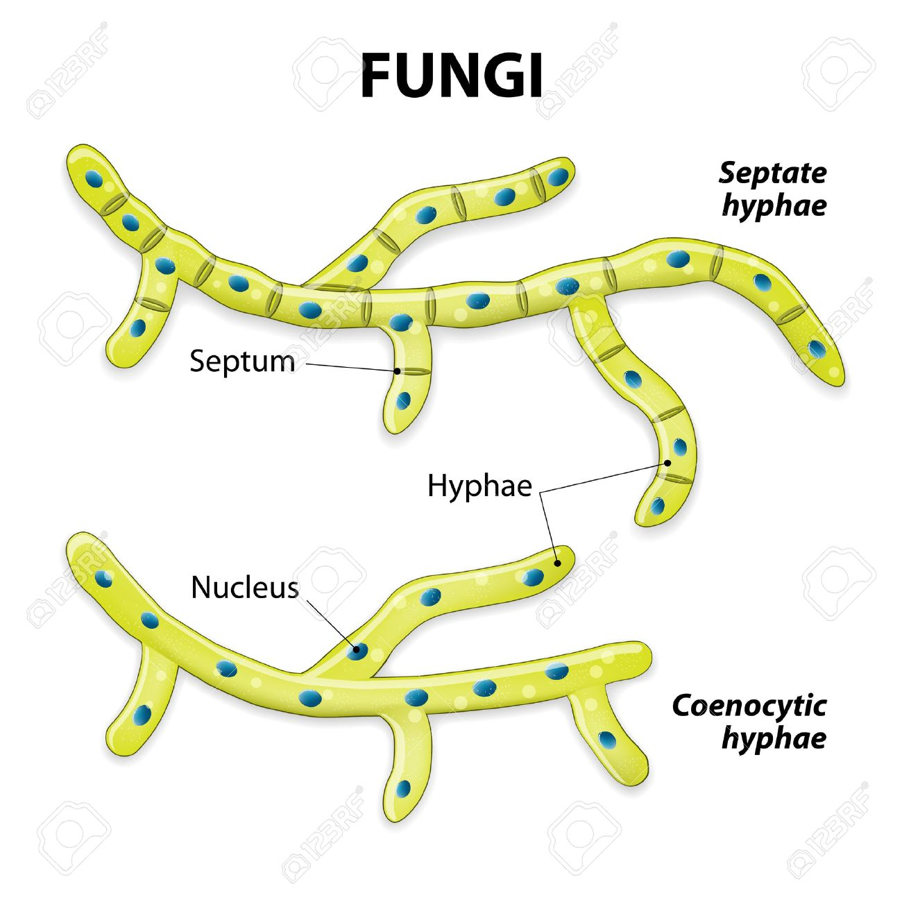
Hyphae

Slide 49
Characteristics of Fungi
Have a cell wall made of chitin (a carbohydrate that also makes up insects exoskeleton).
The mycelium is the feeding structure that secretes digestive enzymes and absorbs the products. The mycelium is the result of usually only one spore. The growth occurs at the tips of the hyphae.

Slide 50
Characteristics of Fungi
Parasitic fungi also have a specialized hyphae called a haustoria which have nutrient absorbing tips that can penetrate the host.
Most fungi reproduce asexually using spores. These are tiny and can survive long periods of drought and extreme temperature. They can also reproduce sexually at times.

Slide 51
Types of Fungi
Chytridiomycota-organisms that are believed to be the link between protists and fungi.
mainly aquatic
some are saprobes, while other parasitize protists, plants and aquatic invertebrates.
have chitin cell walls and have coenocytic hyphae

Slide 52
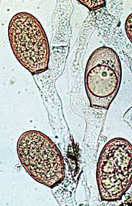
Chytridiomycota

Slide 53
Types of Fungi
Zygomycetes: Conjugating Molds
Terrestrial fungi that are saprobes
Reproduce sexually
Some form mycorrihizae-mutualistic relationship between roots and plants.
Example Bread mold

Slide 54
Sexual reproduction in fungi:
spores are haploid.
2 spores fuse-called karyogamy-forming a diploid zygospore.
The zygospore can stay dormant for a long period of time but when conditions are right, meiosis occurs and the zygospore degenerate down to only 1 haploid nucleus.

Slide 55
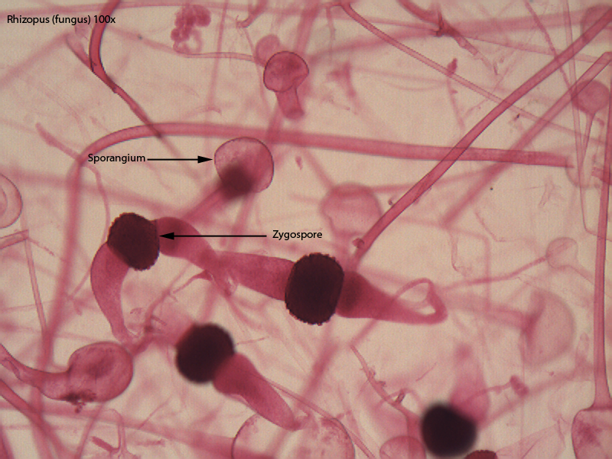
Zygomycota

Slide 56
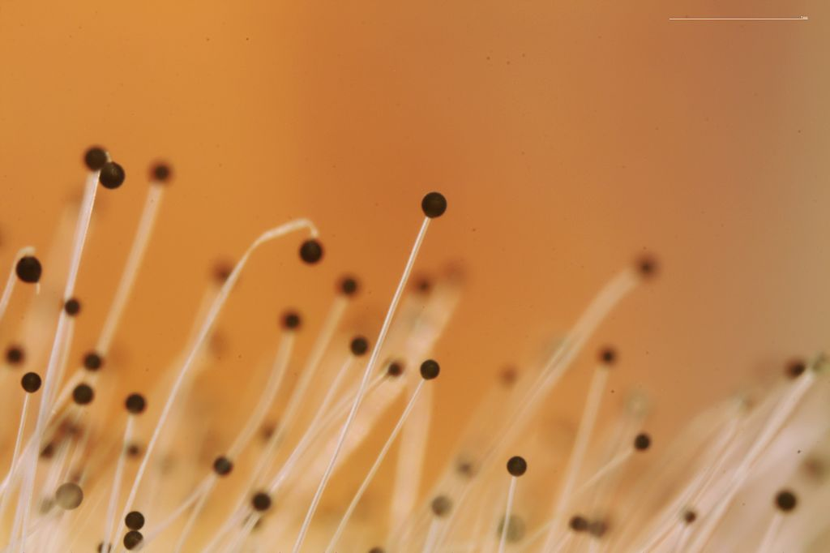
Zygomycota

Slide 57
Types of Fungi
Ascomycetes-
considered a higher fungus
nearly 60,000 species including edible mushroom Morchella, blue and green molds, neurospora, yeasts and ergot.
can reproduce sexually or asexually.

Slide 58
If ergots infect rye bread it will cause restricting of blood vessels in the person who consumes the bread. Repeated ingestion of ergot-infected bread leads to a disease called ergotism also known as St. Anthony's Fire.
Most famous ergot produces a compound called lysergic acid diethylamide commonly known as LSD. This causes extreme hallucinations and is one of the major suspected causes of the Salem Witch Trials.

Slide 59
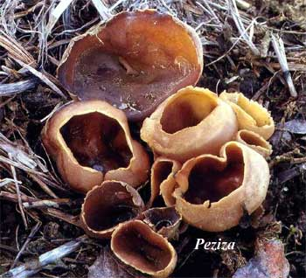
Ascomycota

Slide 60
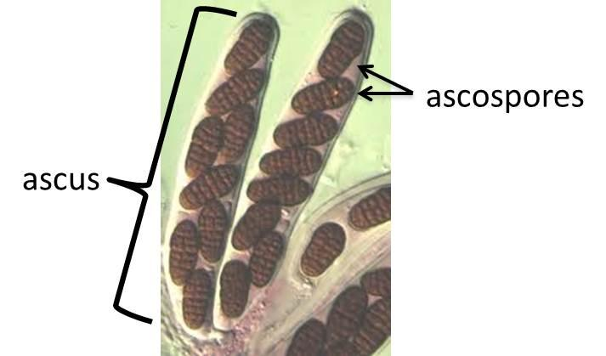
Ascomycota

Slide 61
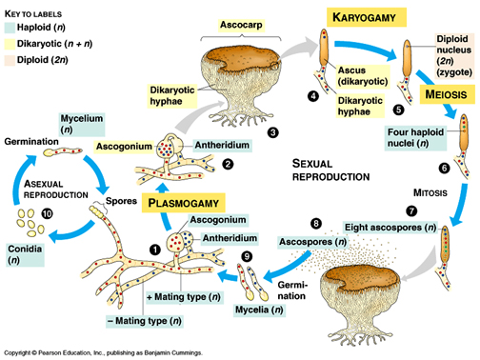
Ascomycota

Slide 62
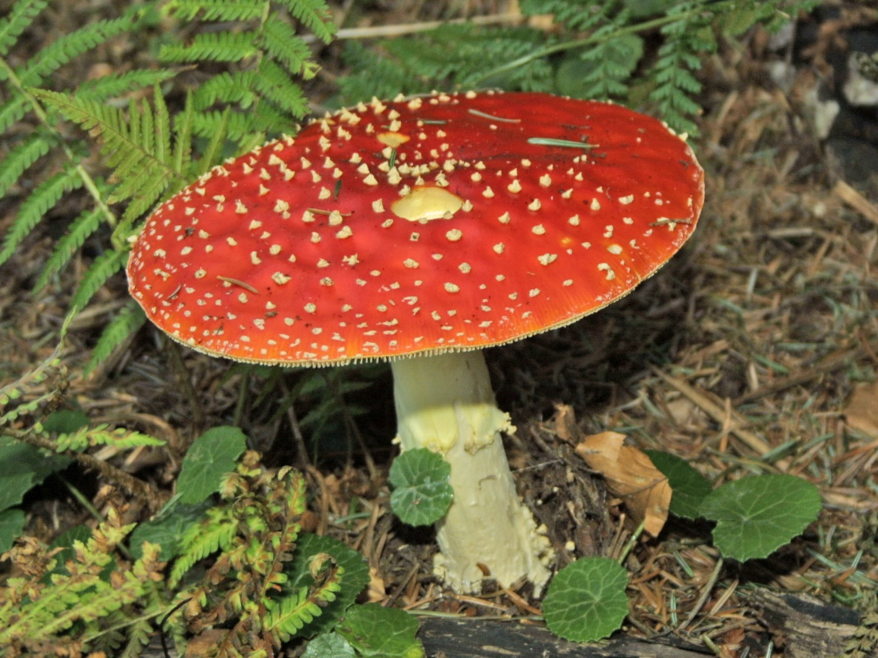
Types of Fungi
Basidiomycetes
includes mushrooms, rusts, smuts and shelf fungi

Slide 63
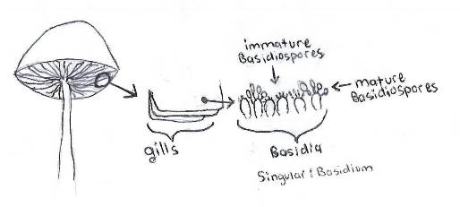
Basidiomycota

Slide 64
Types of Fungi
Deuteromycota: Fungi Imperfecti
this group encompasses the 25,000 species where sexual reproduction is unknown
includes: ringworm, athlete's foot and thrush
some are important in the production of Roquefort and Camembert cheeses
They are also used to produce penicillin and the drug cyclosporin, which suppresses the immune system in transplant patients.

Slide 65
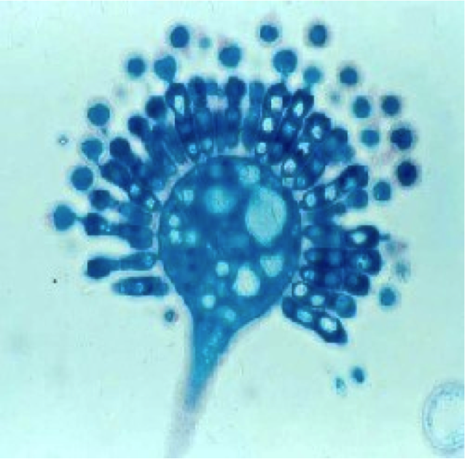
Deuteromycota

Slide 66
Symbiosis and Fungi
Lichens-formed between an alga and a fungus. They are important soil builders because they erode rock surfaces. Can also live in harsh environments such as the tundra.
Mycorrhizae-formed between zygomycetes and the roots of vascular plants and aid in nitrogen fixation for the plant.
Ectomycorrhizae-form between an ascomycete or basidiomycete and plants such as trees and shrubs-including pines, beeches and willows. Forms a sheath around the root.

