Slide 1
Unit 1
Chemistry of Life

Slide 2
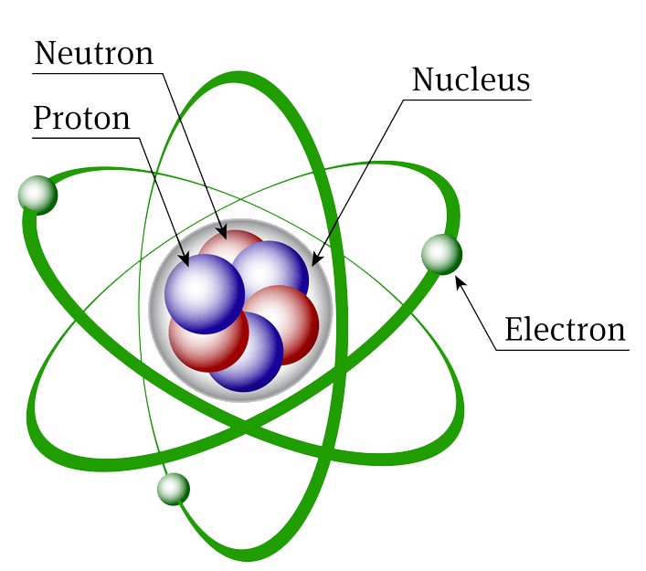
The Atom
Made of protons (positive), neutrons (neutral), and electrons (negative)
Protons and neutrons have roughly the same mass
Electrons have mass because they are matter but the mass is so small that it is not considered

Slide 3
The Atom
Atomic Number: number of protons in a molecule
If you add or remove protons you change the element
Atom Mass: number of protons and neutrons in the nucleus of an atom
You may change the number of neutrons
Results in an isotope, some isotopes are radioactive if the nucleus becomes unstable and loses subatomic particles

Slide 5
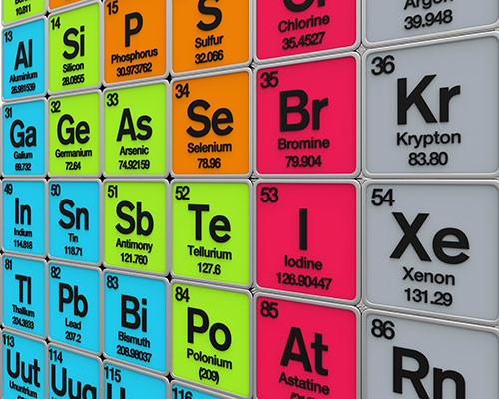
Elements
An element is a pure substance, could be 1 atom or multiple atoms bonded together but they must all be the same type of atom
Ex: H2, Au, F

Slide 6
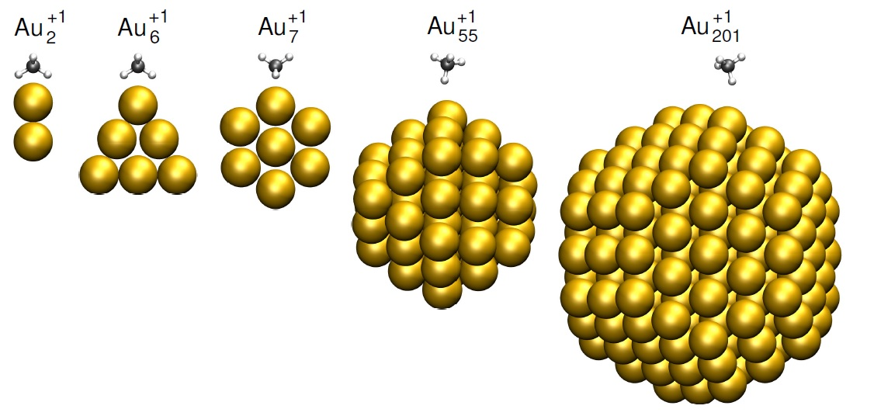
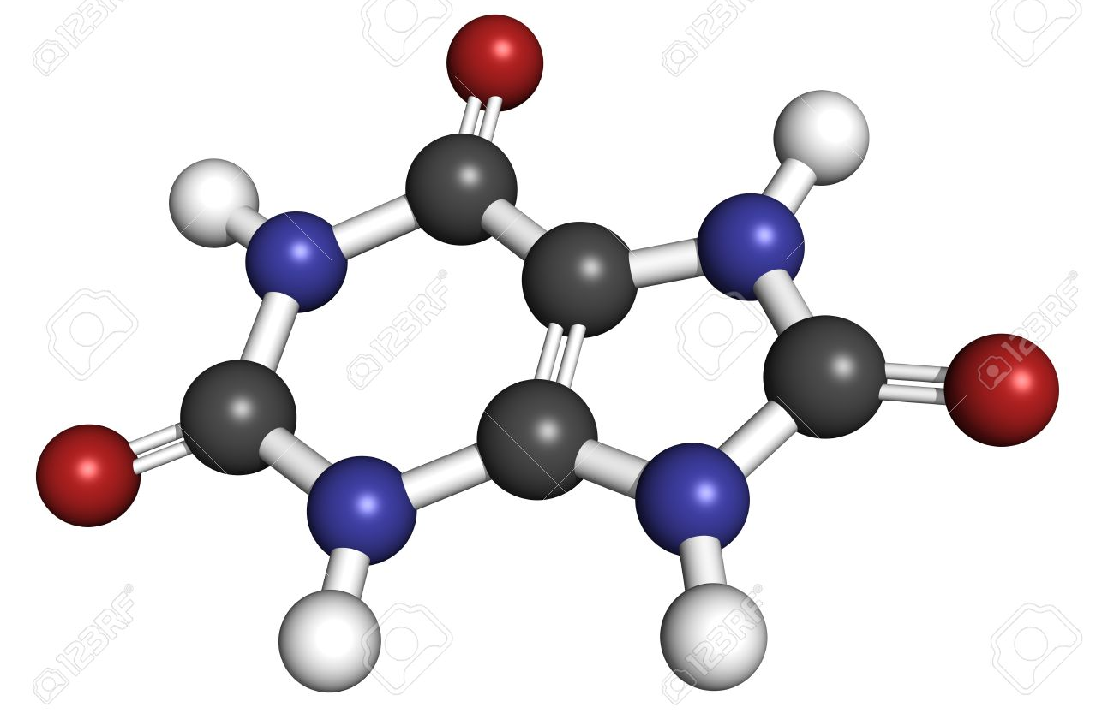
Molecules vs. Compounds
A molecule is a result of multiple atoms bonding together
EX: H2, H2O, C6H12O6, C1200
Compound a molecule with different types of atoms bonded together
EX: H2O, C6H12O6, NH4

Slide 7
2 Types of Elements in
Essential Elements are those that are necessary for life
6 elements make up 99% of the mass of living organisms
17 other elements make up the last 1% and are called trace atoms

Slide 8
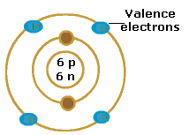
Bonds
Atomic bonds are created from the interactions of electrons orbiting the nucleus in concentric shells
Called valance electrons

Slide 9
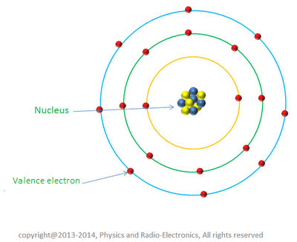
Properties of valence electrons
Level 1- 1 orbital or 2 electrons allowed
Level 2- 4 orbitals or 8 electrons allowed
Level 3- 4 orbitals or 8 electrons allowed

Slide 10
Ionic Bonds
Result from gaining or losing electrons to give the atom a charge
The number of valence electrons in the outermost shell will determine if the atom will become positive or negative. If more than half of the shell is full, the atom will steal electrons and become negative, if less than half of the shell is full it will give up electrons and become positive.
Positive atoms are attracted to negative ones
Very strong but easily break in water since water is polar as well, this is called dissociation

Slide 11
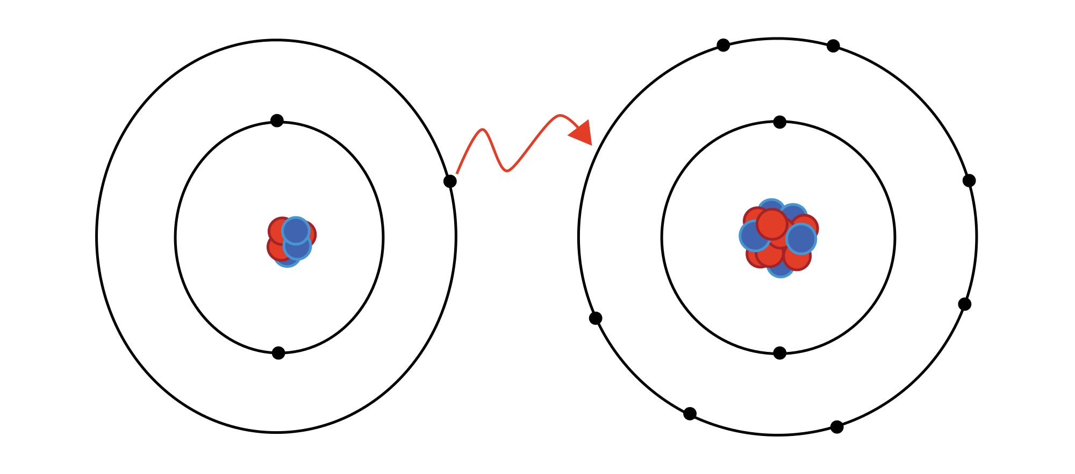
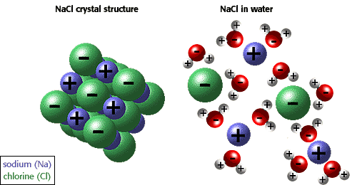

Slide 12
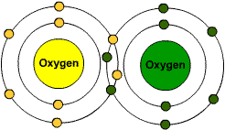
Covalent Bonds
These form from sharing electrons between atoms rather than stealing or giving them up full time
Very strong, will not break up as easily as ionic in water
Single bond- 2 atoms are shared, weakest type of covalent bond
Double bond- 4 atoms are shared
Triple bond- 6 atoms are shared, strongest type of covalent bond

Slide 13
Covalent Bonds
Nonpolar covalent bond: where all electrons are shared equally between atoms
Polar covalent bond: one atom is more electronegative than the others resulting in the electrons being shared spending more time around that atom than the others. It results in some areas of the molecule being more negative and some areas being more positive
EX: water
Hydrogen bonds
Result from the polar nature of water

Slide 15
Water

Slide 16
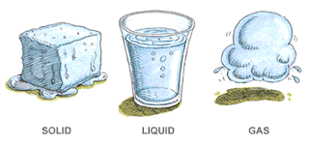
Water Properties
Why is water so special?
It is the only chemical found naturally in all three states of matter: solid, liquid, gas
All living things require water to exist
Water is a primary component in many organic reactions

Slide 17
Water Is Polar
This results in hydrogen bonding
Hydrogen bonds are very weak attractions between the hydrogen atom of one molecule and either an oxygen, nitrogen, or fluorine atom of another molecule.
Because there are 2 hydrogen atoms on each water molecule, each water molecule can be attached to 4 other water molecules which results in several other properties of water.

Slide 18
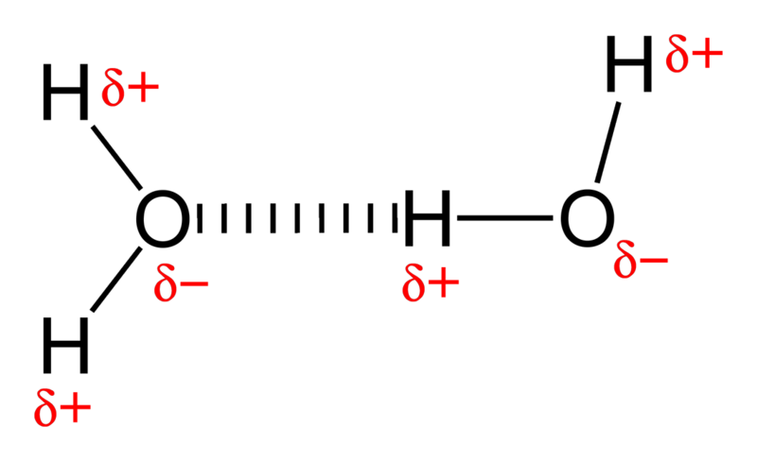

Slide 19
Properties of Water
Cohesion
The ability of water molecules to stick to each other
Creates surface tension
Adhesion
The ability of water to stick to chemicals other than water
Reason why water moves from your skin to the towel, creates the meniscus in a graduated cylinder, allows water to move up the stem of plants

Slide 20
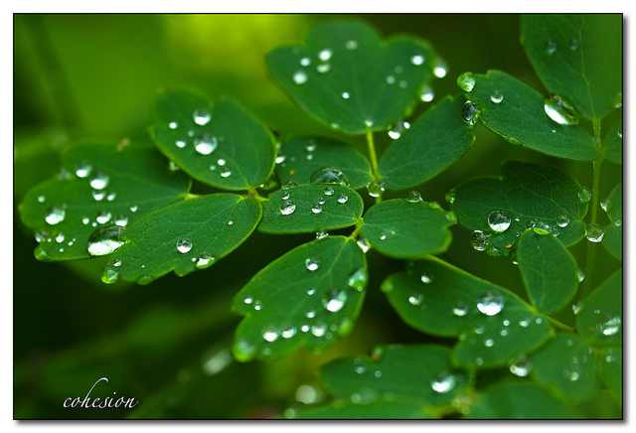

Slide 21
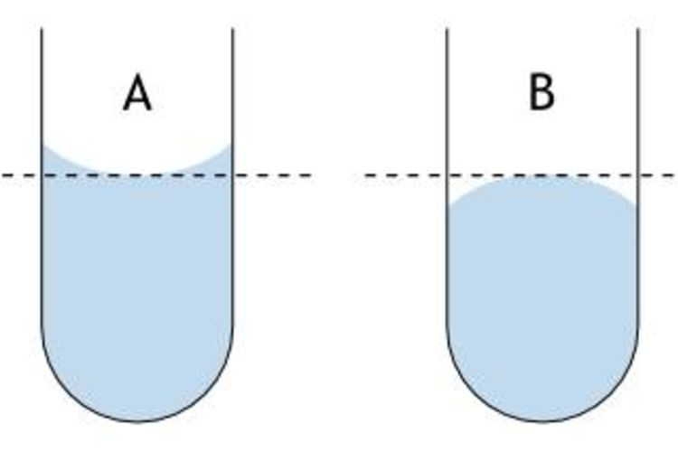

Slide 22
Properties of Water (Continued)
Water has a high specific heat
Because water requires a lot of energy to change its temperature it plays an important part in temperature regulation. H bonds are formed with energy is released, and broken when energy is absorbed
Heat of vaporization
Amount of energy required to cause the liquid to evaporate
Heat of fusion
Amount of energy required to cause the solid to melt

Slide 23
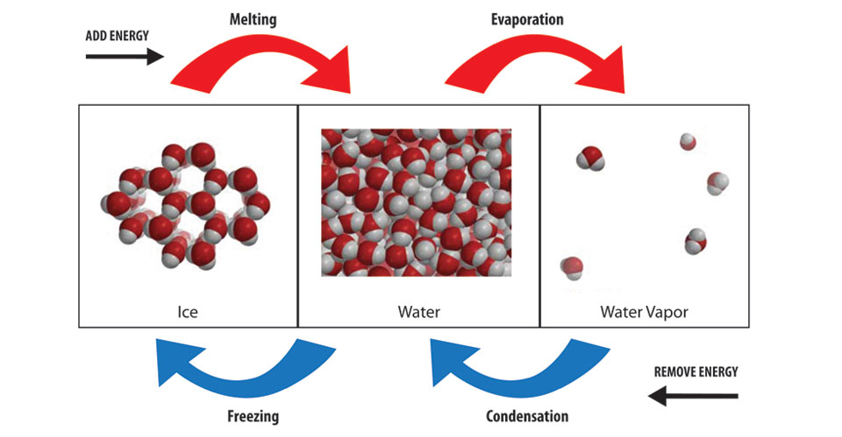
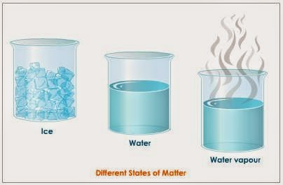

Slide 24
Properties of Water (Continued)
Universal Solvent
Because of its polarity water can dissolve many other polar chemicals

Slide 25
Effects of PH

Slide 26
pH
Measure of how acidic or basic a chemical is
Results from the dissociation of that substance in water

Slide 27
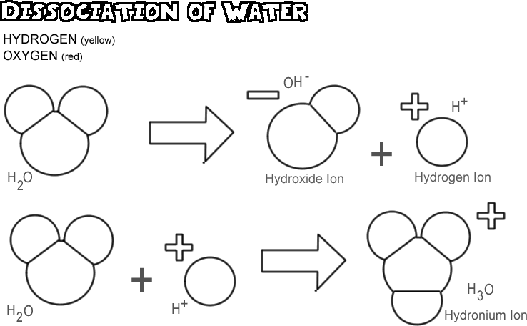

Slide 28
Acids- dissociate and release H ions into the water resulting in a lower pH
Bases- dissociate and release OH ions into the water resulting in a higher pH
Neutral- dissociate into equal numbers of H ions and OH ions, EX OH + H → H2O (water)

Slide 29
pH= -log [H+]
a pH of 5 means that the H+ concentration per liter of water is 10^-5
Therefore a pH of 5 is 10x more acidic than a pH of 6 and 100x more acidic than a pH of 7

Slide 30
Fill in the pH chart for numbers and complexity

Slide 31
A buffer is something that either absorbs or releases H or OH ions to keep the concentration of those ions the same, thereby preventing the pH from changing
Typically weak acids or bases
EX: H2CO3, carbonic acid is used in the blood

Slide 32
Changes in pH can effect living orgnaisms
Small changes in pH can distress and even kill organisms
Changes in pH can change the rates of chemical reactions
EX: blood pH must remain between 7.0 and 7.8 for humans to live. Any below or above they will die
Optimal pH is 7.4
Between 7.0-7.3, people will feel tired, disorientated and may have problems breathing
Between 7.5 and 7.8 people will feel dizzy and agitated

Slide 33
Mild acidosis (the blood becoming too acidic) can cause
Cardiovascular damage
Weight gain and diabetes
Bladder and kidney problems including kidney stones

Slide 34
Mild acidosis (the blood becoming too acidic) can cause
Immune deficiency
Acceleration of free radicals, which are leading causes of some cancers
Premature aging

Slide 35
Mild acidosis (the blood becoming too acidic) can cause
Weak and brittle bones
Joint pain
Low energy and chronic fatigue

Slide 36
It’s very important that pH remains the same
Known as homeostasis/regulation
Buffers help to maintain this in us with the bicarbonate system

Slide 37
Functional Groups

Slide 38
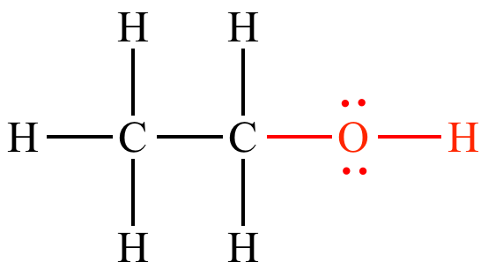
Hydroxyl
-OH
Properties
Can form hydrogen bonds
Generally polar

Slide 39
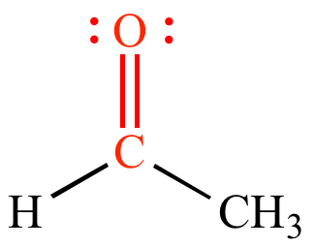
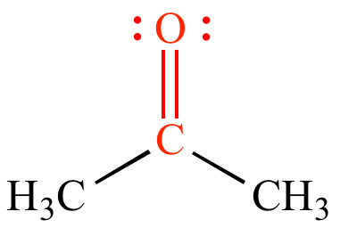
Carbonyl
-C=O
A double bond formed between oxygen and carbon
Aldehydes are carbonyl molecules with it at the end of the molecule
Ketones have it in the middle of the molecule
Properties
Ketones are much less reactive than aldehydes because the polarity of the O is more shielded

Slide 40
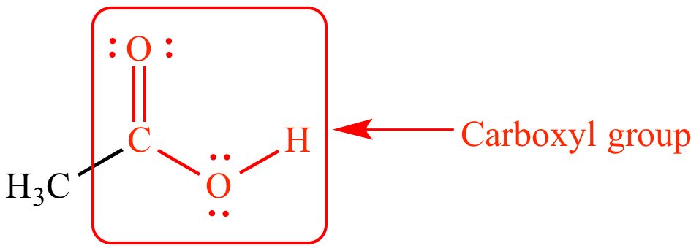
Carboxyl
-COOH
Found at the end of molecule
Properties
Can form hydrogen bonds
Very reactive
Typically loses the H in water

Slide 41
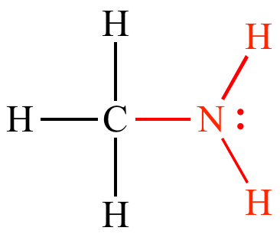
Amino
-NH2
Typically found at the end of the molecule
Properties
Can form hydrogen bonds
Typically reactive
Picks up extra H in water

Slide 42
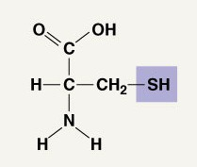
Sulfhydryl
-SH
Properties
Not very reactive unless with other sulfhydryl groups
Stabilize the structure of proteins

Slide 43
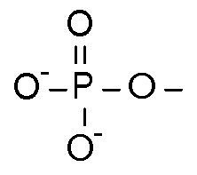
Phosphate
-PO4
Properties
Very polar
Very Reactive
Found in DNA and ATP

Slide 44
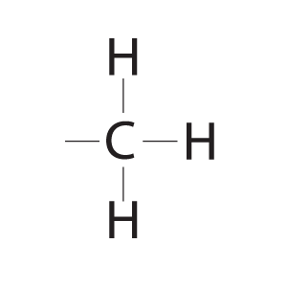
Methyl
-CH4
Properties
Great at energy storage
Not reactive at all
Used as a place filler in a lot of molecules

Slide 45
Warmup 9/14
Describe or illustrate the process of digestion in an animal (do not include organs) and how that organism will use the food they bring into their body. You may choose any of the 4 biomolecules we have talked about.

Slide 46
Organic Chemistry

Slide 47
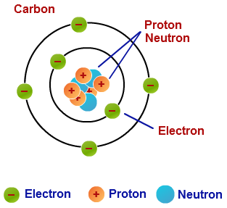
All about that Carbon
All organic molecules contain carbon
Carbon is very versatile because it has 4 valence electrons and each electron can form a bond with another atom.
If necessary it can form double and triple bonds with atoms (double=carbon dioxide, triple=cyanide), the more bonds the stronger the bond is
It can form straight chains or rings

Slide 48
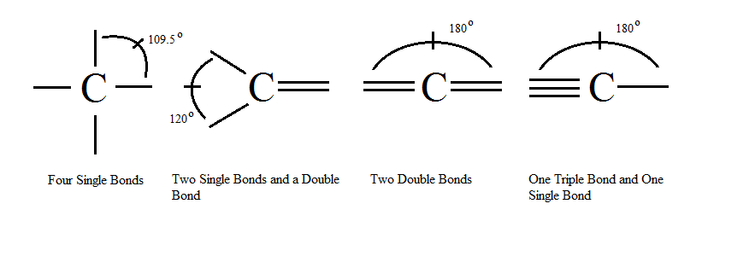

Slide 49
Important terms
Monomer: single molecule that can be combined in different ways to form larger ones
Polymer: large molecule that is made of 3 or more monomers bonded together

Slide 50
Carbohydrates

Slide 51
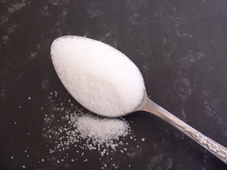
Carbohydrates
Also called sugars and starches
Elements: C, H, and O in a 1:2:1 ratio (Example: C₆H₁₂O₆)
Typically end in –ose (Example: glucose)
Function: to store and release short term energy

Slide 52
Carbohydrates
Monomer: Monosaccharide
Example: glucose
Disaccharide: 2 monomers connected
Transport form
Examples: Maltose, Sucrose, Lactose

Slide 53
Polymer: Polysaccharide
Starch → sugar storage in plants
Glycogen → sugar storage in animal muscle
Cellulose → found in plant cell walls; most animals can not digest
Chitin → found in cell walls of fungi and insect exoskeletons
Pectin → from algae and is used to thicken jellies

Slide 54
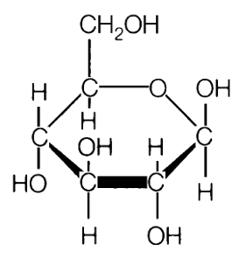
Monosaccharide Picture

Slide 55
Carbohydrates Test
Starch: Iodine test
Color changes from brown/yellow to black/dark purple
Monosaccharide: Benedict’s reagent
Color changes from light blue to orange when heated

Slide 56
Lipids

Slide 57
Lipids
Commonly called fats, oils, and waxes
Elements: C, H, and O in a non-specific ratio (Example: C₂₁H₁₇O₄₃)
Monomer: Glycerol and 3 fatty acids

Slide 58
Function:
Long-term energy (twice as much as carbs)
Cell membranes
Insulation
Body padding

Slide 59
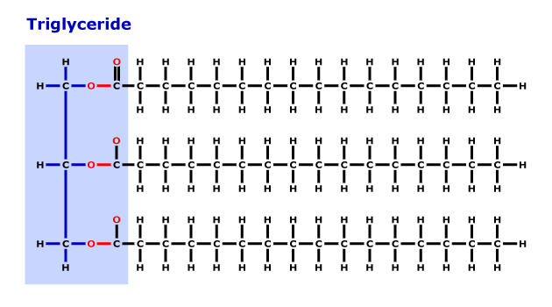
Lipid Picture

Slide 60
Lipids
Types of Lipids (Fats)
Saturated – bonds in molecule are unbendable; tend to clog arteries; typically from animals (fats, butter, lard)
Unsaturated – some bonds in molecule bend; better, but can still clog arteries; typically from plants (oils)

Slide 61
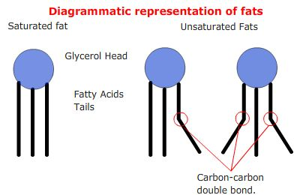

Slide 62
Polymers
Steroids: involved in chemical signaling in your body
Phospholipids: fats that make up the outside of each cell

Slide 63
Chemical Tests
Brown Paper Bag Test
Brown paper will absorb the lipids and spots form
Think about what happens to a 5 guys bag when you add fries
Sudan Red Reagent
Starts a dark red color and changes to bright red/orange for a positive test

Slide 64
Proteins

Slide 65
Proteins
Elements: C, H, O, N, sometimes S
Monomer → amino acids
R-group is what makes each amino acid different
Polymer → polypeptide
Examples: hemoglobin in red blood cells and insulin which controls blood sugar levels
Account for 50% of the dry weight of cells

Slide 66
Proteins
Functions of Proteins
Movement
Building and repairing fibers in bone, tendons, ligaments, and cartilage
Homeostasis/Regulation (hormones and enzymes)
Defense against disease (antibodies)

Slide 67
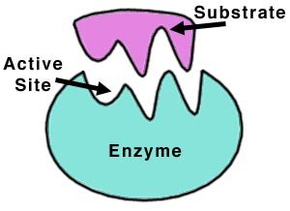
Proteins
Enzymes are special protein polymers that speed up chemical reactions in the body.

Slide 68
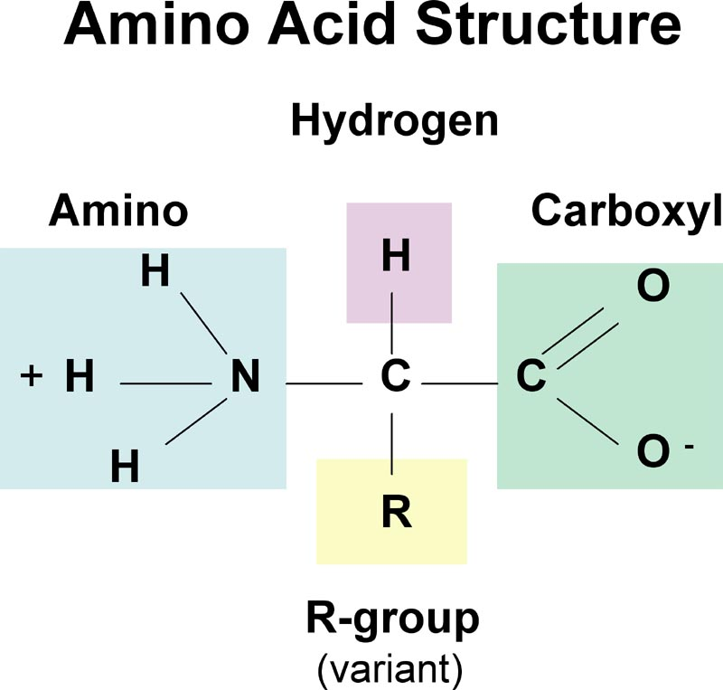

Slide 69
Structure
Bonds are created using a dehydration reaction between the amino group of 1 amino acid and the carboxyl group of the second amino acid
The bond is called a peptide bond
Creates the primary structure of the protein
Secondary structure is created by forming hydrogen bonds between the amino acids and forming alpha helices and beta pleated sheets
Tertiary structure is created by the interactions between the R groups to form the 3D structure
Quaternary structure is created when you combine multiple peptide chains into 1 larger molecule

Slide 70
Chemical Test
Proteins: Biuret’s Reagent
Color changes from Blue to purple when proteins are present

Slide 71
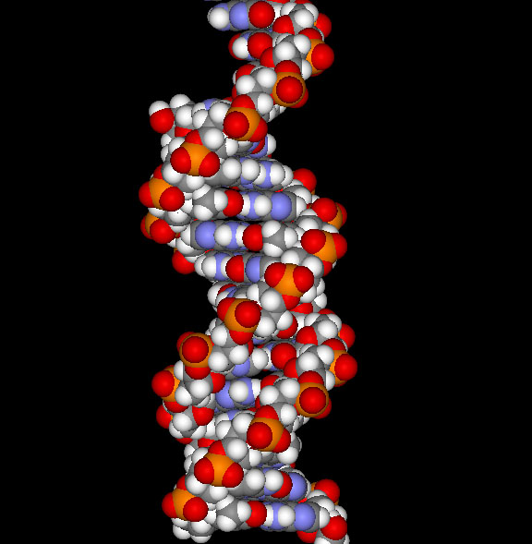
Nucleic Acids

Slide 72
Nucleic Acids
Elements: C, H, O, N, P
Function → control genetic information
Monomer → nucleotide
Polymers
DNA → deoxyribonucleic acid (double stranded) – genetic information storage
RNA → ribonucleic acid (single stranded) – genetic information transfer

Slide 73
DNA Bases: adenine, thymine, cytosine, and guanine
RNA Bases: adenine, uracil, cytosine, and guanine
3 types of RNA
mRNA: genetic information transfer
tRNA: moves the amino acids to the ribosome
rRNA: combines with proteins to build ribosomes

Slide 74
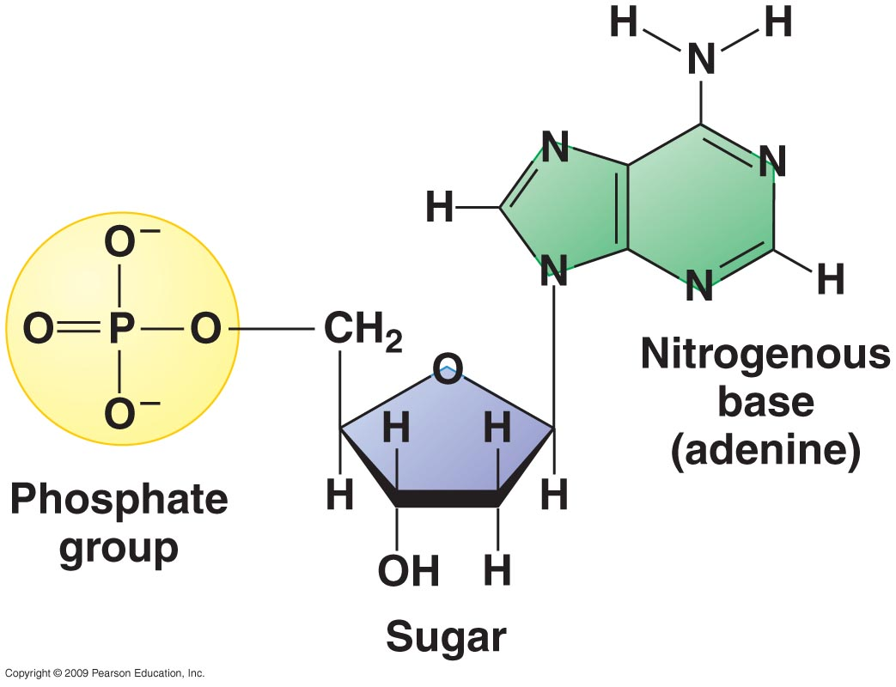
Nucleotide Picture

Slide 75
Chemical Test
Luminol Solution: binds to DNA and will glow under a black light

Slide 76
Metabolism

Slide 77
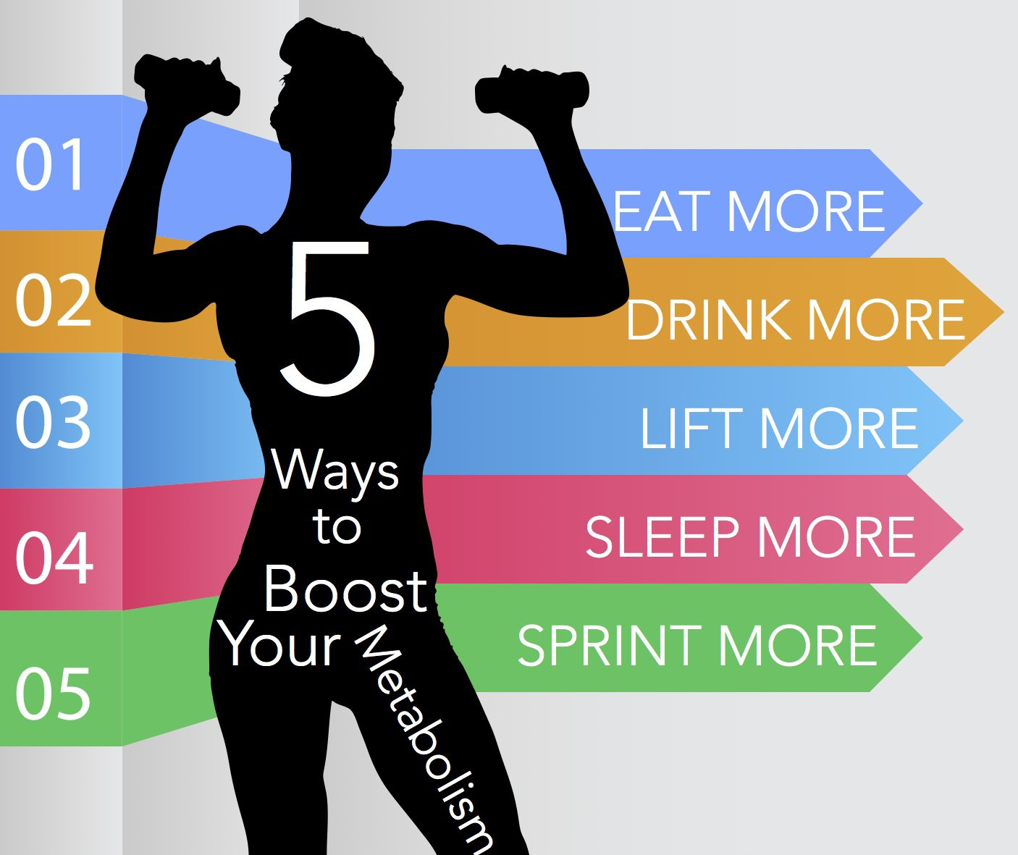
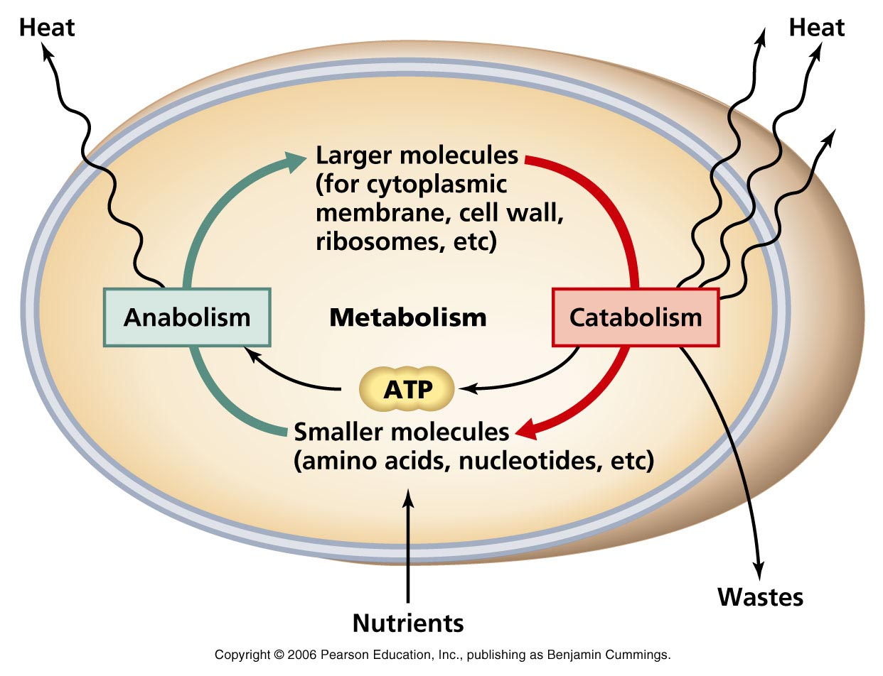
Metabolism
Refers to all of the chemical reactions that happen in a living organism

Slide 78
2 Primary Pathways
Catabolic: breaking large, complex molecules into smaller ones
EX: respiration breaking sugar into carbon dioxide, water, and ATP
Hydrolysis, use of water to split a molecule into smaller ones
Anabolic: combining small molecules into larger, more complex ones
EX: photosynthesis combining carbon dioxide and water into sugar
Dehydration reaction, removing water from 2 organisms to cause them to bond

Slide 80
We use this for store and use energy (ability to do work)
2 forms of energy
Kinetic: energy of motion, usable energy. Light charging solar panels, a car rolling down a hill and crashing through the front of a store, atoms being split in a nuclear bomb
Potential energy: energy that is stored in an object because of its structure. A spring coiled, magnets being held close to each other and not being allowed to repel, water behind a dam, crouching before jumping up.
Potential energy that then gets used (ie. Releasing the spring so it jumps into the air) then converts the energy into kinetic energy

Slide 82
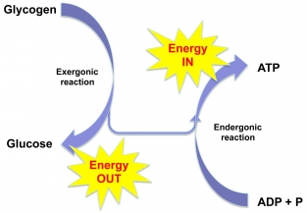

Slide 83
Thermodynamics
All living organisms are systems which give off and receive energy so the rules of thermodynamics apply
1st Law: energy cannot be created or destroyed only changed
2nd Law: every chemical reaction increases the disorder of the universe, this is called entropy
Because of this Gibbs Free Energy Equation applies to living things

Slide 84
Gibbs Free Energy
The part of the organisms energy that can be used for work
In all spontaneous reactions a system’s free energy decreases. All systems want to be at their lowest energy level possible

Slide 85
∆G = ∆H - T∆S
∆ = change
G = free energy
H = system’s total energy (enthalpy)
S = Entropy

Slide 86
Exergonic reactions result in a -∆G value, the majority of reactions in a living organism
Endergonic reactions result in a +∆G value

Slide 87
ATP
Chemical currency used by living organisms
Can be used for:
Mechanical work: ie. causing flagella to spin or cilia to move
Chemical work: ie. pushing endergonic reactions that do not occur spontaneously

Slide 88
Enzymes

Slide 89
Enzymes
Organic catalysts that either break down or synthesize molecules in a chemical reaction

Slide 90
Cause Reactions to happen faster by lowering activation energy
Activation energy is the energy needed by a reaction to start the reaction
Low activation energies mean that the reaction starts quicker (less time required to build up then energy means the faster it starts and the faster it finishes)
High activation energies mean that the reactions starts slower

Slide 91
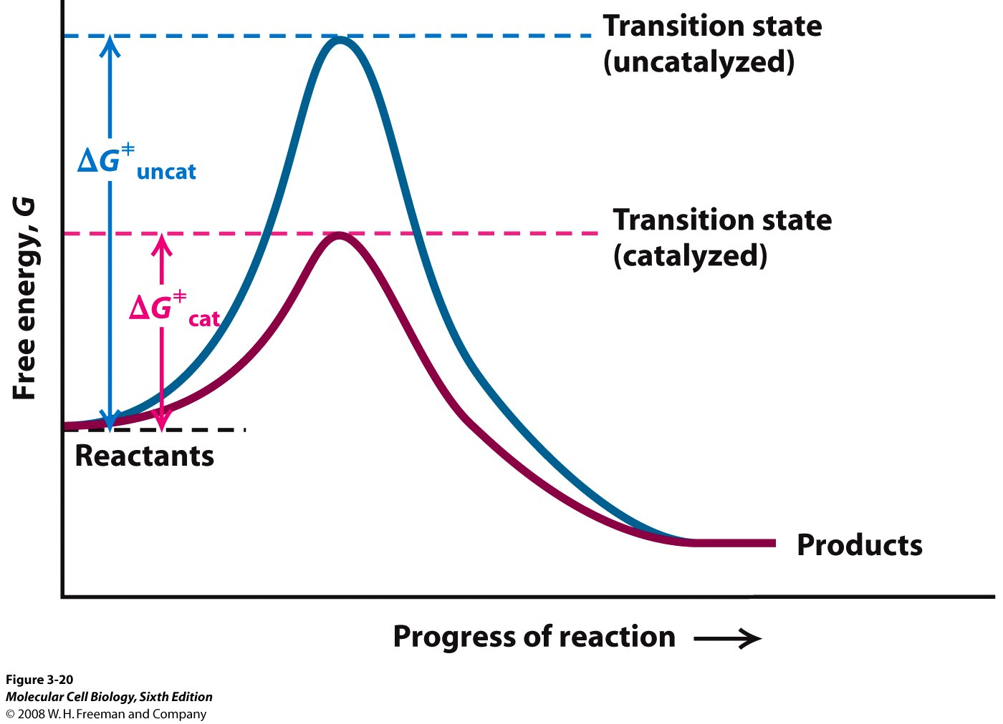

Slide 92
Enzymes are not used up in the reaction, they facilitate the reaction but are unchanged by it.

Slide 93
Properties of Enzymes
Enzymes are specific
They have a specific shape that has a groove called an active site that only is able to bind to 1 type of molecule called a substrate
When the enzyme and substrate are bound it is called the Enzyme-Substrate Complex
The active site can change its shape slightly (very slightly) to better fit the shape of the substrate. This is called the Induced Fit Model

Slide 94
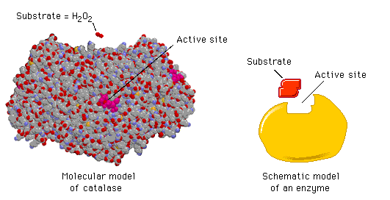

Slide 95
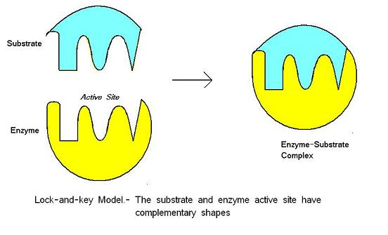

Slide 96
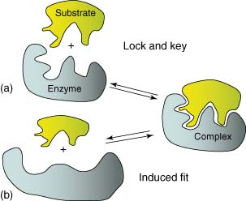

Slide 97
Rate of the Reaction can be changed
Enzymes have optimals, meaning that there are certain conditions under which they will perform their best, their speed will be the fastest

Slide 98
Temperature
As more temperature is added to the system up to around 40 C (changes based on the organism) the speed of the reaction will increase. Above 40 C the bonds of the enzyme stretch and break and the enzyme loses its shape and denatures. Each enzyme will have its own optimal temperature depending on the organism it is in

Slide 99
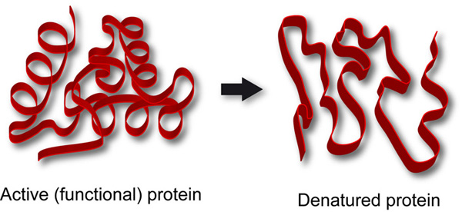
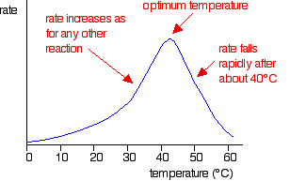

Slide 100
pH
The optimal pH of an enzyme will depend on the area of the body it is used in. The enzyme will denature if it is outside its optimal pH range. Think back to what happens when the blood pH changes too much

Slide 101
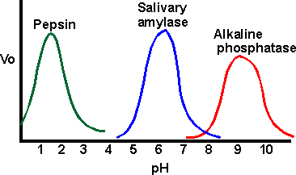
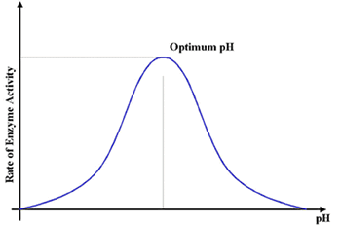

Slide 102
Negative Feedback
The product will bind to the active site preventing more substrate from binding and therefore stopping the enzyme from continuing reactions
Prevents the cell from wasting resources
https://www.youtube.com/watch?v=_2cFQ7XqKSU

Slide 103
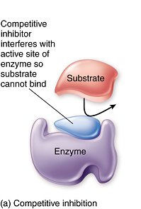
Competitive Inhibition
A molecule that can fit into the active site but is not the substrate binds to the active site and blocks the substrate from binding to the enzyme.

Slide 104
Allosteric Control
At times there is a secondary binding site that a chemical can bind to that will change the shape of the enzyme. This is not a denaturation. Sometimes an enzyme needs the substrate to bind to the allosteric site to activate the enzyme and start the reaction. Sometimes a chemical will bind to the allosteric site to deactivate the enzyme and stop the reaction because there is enough product now.

Slide 105
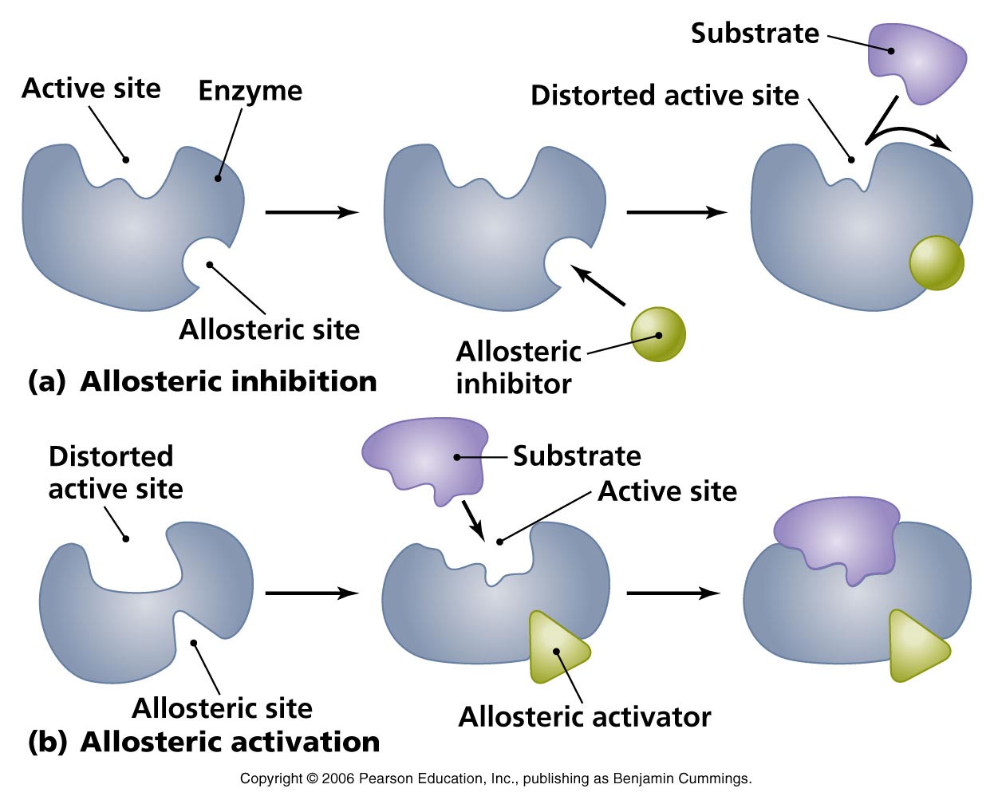

Slide 106
Allosteric Sites are affected by Co-factors and Co-Enzymes
Cofactor: an inorganic ion that binds to the allosteric site
Co-Enzyme: an organic molecule made from vitamins that bonds to the allosteric site
Sometimes an enzyme will need multiple cofactors and coenzymes to function properly

Slide 107
Warmup 9/28
A carbon atom has an atomic number of 6 and an atomic mass of 14,
How many protons does it have?
How many neutrons?
How many electrons?
How many valence electrons?
List the 4 types of nucleic acids.
What are the monomers of nucleic acids?
What are the 3 parts of the monomer?

