Slide 1
Warmup 2/13
Grab your computers and get logged in

Slide 2
Warmup 9/26
What is the job of the plasma membrane?
What are 2 differences between prokaryotes and eukaryotes?
Where is the plasma membrane located?
What is another name for the plasma membrane?

Slide 3
Warmup 2/15
What are 2 differences between active and passive transport?
What are 2 examples of active transport?
Inside the cell there is a 10% concentration of oxygen and in area outside the cell there is a 50% concentration of oxygen. Which way will the oxygen move? What type of transport is this?

Slide 4
Amoeba Sister Video Questions
What is homeostasis
In what direction does diffusion move?
What is facilitated diffusion?
What is the difference between passive and active transport?

Slide 5
Cell Membrane

Slide 6
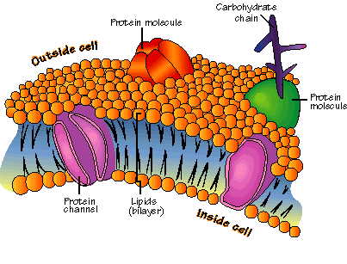
Basics
Also known as the Cell Membrane
Flexible boundary that surrounds the cell
Allows water and nutrients to enter and exit the cell

Slide 7
Basics
Helps the cell maintain homeostasis
Called a Selectively Permeable Membrane
Only allows some things into and out of the cell

Slide 8
Structure
Phospholipid bilayer
Phospholipid: Molecule that has a phosphate group and 2 fatty acid chains
Phosphate heads are hydrophilic which means they like being around water
Fatty acid tails are hydrophobic which means they do not like being around water
Phosphate group
Fatty acid chains

Slide 9
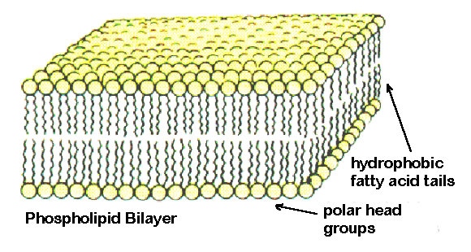
Structure
Called a bilayer
There is a top and bottom layer
One layer lines the inside and one lines the outside of the cell

Slide 10
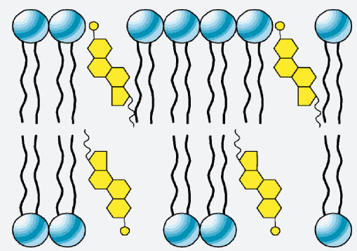
Extra Components
Cholesterol: prevents the fatty acids from sticking together
Proteins: either structural or transport
Sugars: help the cell stick to other cells

Slide 11
Lipid Polymers
Phospholipids
Cholesterol
Steroids: variations of cholesterol that are used to signal in organisms
They do not build proteins

Slide 12
Cell Transport

Slide 13
Passive Transport
NO Energy (ATP) is required
Moves with the concentration gradient
Concentration gradient: difference in percentage between 2 places
The greater the difference the faster things move, the lower the difference the slower
Movement stops when equilibrium is reached, both areas are equal in percentage

Slide 14
Water, small lipids, and small things that dissolve in lipids can diffuse across the plasma membrane

Slide 15
Diffusion
Movement of liquids and gases from an area of high to low concentration
High Concentration: there are a lot of air freshener molecules
Low Concentration: there are few air freshener molecules
The air freshener molecules will move across the room so they are evenly distributed

Slide 16
Osmosis
Diffusion of water from an area of high water concentration to an area of low water concentration
Osmotic Pressure: pressure put on the cell membrane by the water in the cell

Slide 17
Warmup 9/25
Define: concentration gradient
What is the difference between osmosis and diffusion?
If a cell is placed in pure water, will the water move into or out of my cell?

Slide 18
Types of Solutions
Isotonic
Concentration of dissolved substances is the same on the inside of the cell as is on the outside of the cell
Water enters the cell at the same rate it leaves the cell
Preferred by animal cells

Slide 19
Types of Solutions
Hypotonic Solution
Concentration of dissolved substance is higher on the inside of the cell than the outside of the cell
Water enters the cell faster than it leaves the cell causing the cell to lyse (burst)
Preferred by plant cells

Slide 20
Types of Solution
Hypertonic Solution
Concentration of dissolved substance is greater on the outside of the cell than on the inside of the cell
Water leaves the cell faster than it enters the cell causing the cell to shrink

Slide 21
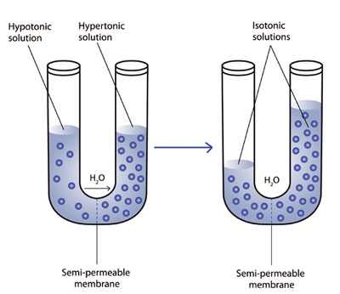

Slide 22
Cell Transport
Facilitated Diffusion
Protein channels in the plasma membrane that allow large molecules to diffuse into and out of the cell
No energy (ATP) required
How sugars and amino acids get into the cell
Moves with the concentration gradient

Slide 23
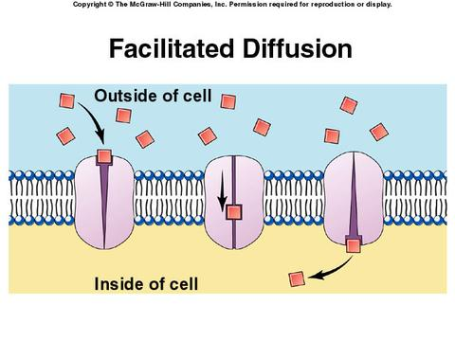

Slide 24
Retest Codes
1.1.1: NE8HA6
1.1.2: HE8HY2RE2
1.1.3: JA8TY8C
1.2.3: TE9RY7MY
4.1.1:MU9ZY2DE

Slide 25
Cell Transport
Active Transport
Requires energy (ATP)
Proteins move things into and out of the cell against the concentration gradient
Used to transport large molecules into and out of the cell
Endocytosis: cell membrane surrounds stuff outside and brings it inside
Exocytosis: cell expels waste from itself

Slide 26
Sodium Potassium Pump
Type of active transport
3 sodium are pumped out of the cell then 2 potassium are pumped into the cell
Creates strong gradients for sodium and potassium that nerves use to send signals.

Slide 27
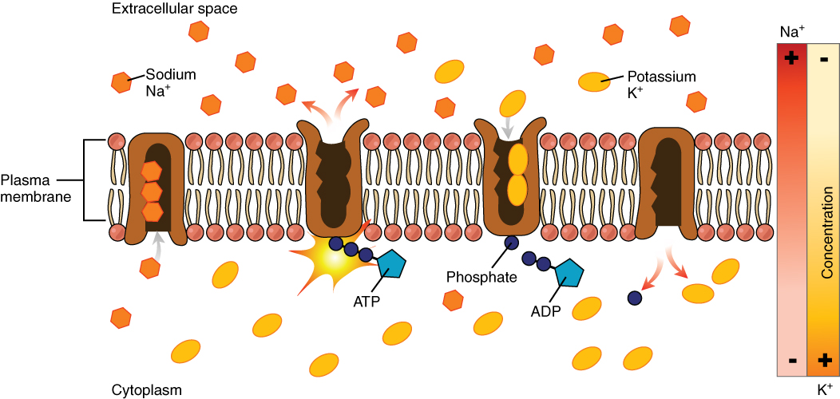

Slide 28
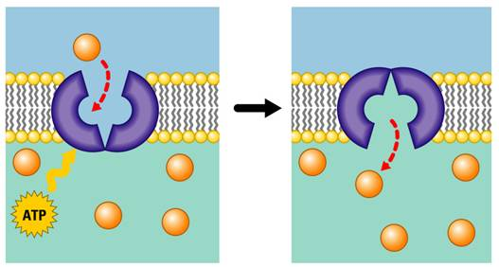

Slide 29
Exit Ticket
What are you still struggling with most in photosynthesis and cellular respiration?
What are you still struggling with most in cell transport and cell membrane structure?

Slide 30
1.1.1: NE8HA6
1.1.2: HE8HY2RE2
1.1.3: JA8TY8C
1.2.3: TE9RY7MY

Slide 31
Energy and Transport Retest Codes
4.2 Energy Test: QU6RE5M
1.2.1 Transport Test: BY9PU4PU

Slide 32
Warmup 12/04
What is the job of cholesterol in the cell membrane?
Draw and label a phospholipid.
What are the 2 characteristics of things that do passive transport?

Slide 33
Transport Issue Conditions
Choose one of the following to research and answer the questions on your answer sheet:
Bartter Syndrome
Long-QT Syndrome
Hyperkalemic Periodic Paralysis
Cystic Fibrosis
Myasthenic Syndrome
Retinitis Pigmentosa

Slide 34
After the test, get a chromebook
On the login screen, click on the link called “Apps” in the bottom left corner of the screen
Click on NC Test
Click on the Tutorial
Choose “EOC”
Choose “Biology”

Slide 35
Warmup 9/27
What does the cell membrane use to move things from outside the cell inside?
What is a phospholipid?
What are the monomers and polymers for carbohydrates and lipids?

