Slide 1
Warmup 9/12
What is the job of the chloroplast?
What is the job of the mitochondria?
What is the role of carbohydrates in the body?

Slide 2
Annotating a Picture
Look at the picture and look for structures that you know. Identify them. (Hint: think about the structure of a nucleotide from your biochem notes)
Look at the captions and make inferences about what the overall goal is of this picture. (ie. What is the ATP used for? What does the sunlight/food have to do with it)
Look at the interactions of the molecules. Look for charges, look for why it forms a loop.

Slide 3
Cell Energy
Photosynthesis and Cellular Respiration

Slide 4
ATP

Slide 5
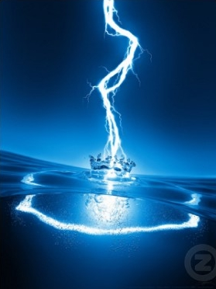
What is Energy?
Energy is the ability to do work!
It can be used for
Active Transport
Production and storage of proteins
Movement of Cilia or Flagella
Cell Division

Slide 6
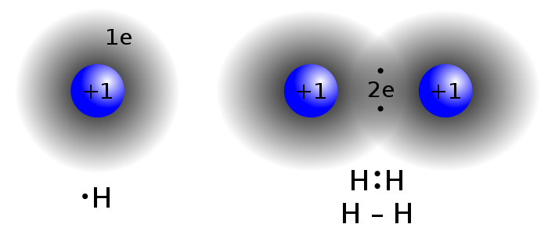
Electrons
Energy in a molecule comes from the interaction of electrons between molecules

Slide 7
Adenosine Triphosphate (ATP)
Comes in the form of Adenosine Triphosphate
Made of an adenosine nucleotide, ribose sugar, and 3 phosphate groups
Energy is stored in bonds between the phosphates

Slide 8
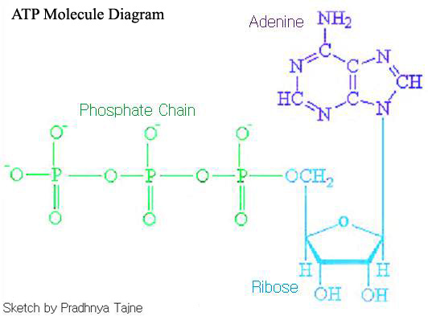

Slide 9
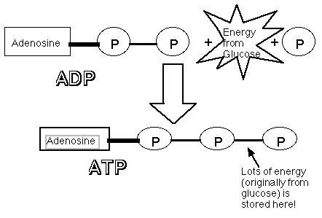
ATP
Cells store energy by creating bonds
Cells release energy by breaking bonds

Slide 10
Warmup 9/18
What is ATP?
Draw the cycle that forms ADP from ATP and then back.
How do you store energy in an organism?

Slide 11
Cellular Respiration

Slide 12
Cellular Respiration
Converts sugar into energy the cell can use
Organisms converting food into energy
Occurs in the mitochondria in plants and animals
Occurs in all organisms

Slide 13
Mitochondria
The more folds on the inside membrane, the more energy will be produced.

Slide 14
Anaerobic Respiration
No oxygen is needed
Produces very little ATP
Only way bacteria make energy since they do not have mitochondria
Produces Carbon dioxide

Slide 15
Aerobic Respiration
Requires oxygen
Lots of ATP is made
Happens in the mitochondria
Uses an enzyme called ATP synthase to make ATP

Slide 16
Formula
C6H12O6 + O2 → CO2 + H2O + ATP
Glucose/sugar + Oxygen → Carbon dioxide + water +ATP

Slide 17
Fermentation
Lactic Acid Fermentation
Happens in animals and some bacteria
Produces lactic acid and carbon dioxide
This is what makes our muscles sore and turns milk into yogurt
Anaerobic process
No bubbles are formed

Slide 18
Fermentation
Alcoholic Fermentation
Occurs in some bacteria and yeast
Produces alcohol and carbon dioxide
This is what causes bread to rise and bubbles to form in alcoholic drinks
Anaerobic process
Bubbles are formed

Slide 19
Warmup 9/19
Find your new seats and turn in your respiration lab from Tuesday
What are the reactants of cellular respiration?
What organisms do cellular respiration?
Where does cellular respiration take place?
What is the difference between anaerobic and aerobic respiration?

Slide 20
Photosynthesis

Slide 21
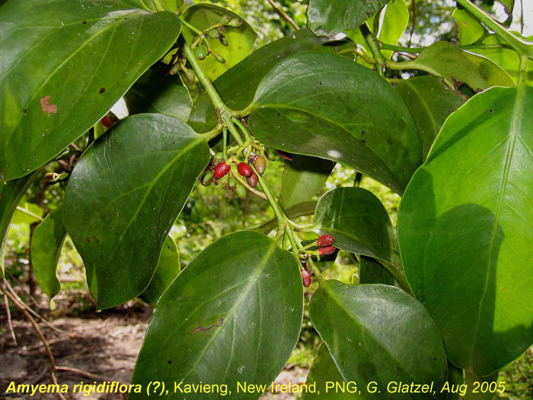
Photosynthesis
Conversion of light energy into sugar
Occurs in plants and protists
Takes place in the chloroplast

Slide 22
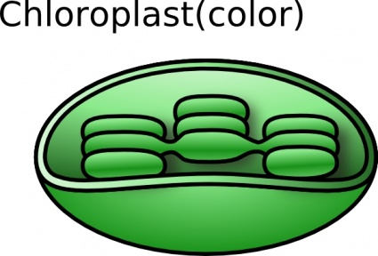
Chloroplast
The more disks inside, the more sugar will be made
Thylakoid is filled with pigments that absorb light called chlorophyll

Slide 23
Chloroplast Reactions
 | Light Dependent Reactions | Light Independent Reactions (Calvin Cycle)
Needed Parts | Light, water | Carbon dioxide
Products | Oxygen | Glucose (C6H12O6)
Location | Thylakoid | Stroma

Slide 24
Photosynthesis
Light Dependent Reaction
Only occurs during daylight
Water is split and makes oxygen
Energy is created from breaking the bonds in the water that is used in the light independent reactions

Slide 25
Photosynthesis
Light Independent Reactions
Also called the Calvin Cycle
Happens all the time as long as there’s energy
Time when the CO2 is used to make the glucose molecule

Slide 26
Add to your notes where you can find room
Polymers of carbohydrates
Cellulose: Structural sugar made of glucose and is used in plant cell walls
Glycogen: made of glucose and stores extra sugar in animal muscle tissue
Starch: made of glucose and stores extra sugar in plant roots and seeds

Slide 27
Photosynthesis Formula
CO2 + H20 + light C6H12O6 + O2
Carbon dioxide + water + light → glucose/sugar + oxygen

Slide 28
Warmup 9/21
What is photosynthesis?
Where does photosynthesis take place?
What are the reactants of photosynthesis?
What is produced by photosynthesis?

Slide 29
Aerobic vs Anaerobic
Anaerobic
Aerobic

Slide 30
Photosynthesis vs Respiration
Photosynthesis
Cellular Respiration

Slide 31
Photosynthesis Lab
Save it to your Google Drive and share it with erict.nebel@cms.k12.nc.us when you’re done. Make sure

Slide 32
Warmup 9/24
What would you expect to happen to the CO2 concentration in the chamber as photosynthesis occurs?
What would you expect to happen to the CO2 concentration in the chamber if it was wrapped in foil and no light came in.
A plant is submerged and you observe bubbles being made by the plant and floating to the surface. What gas would be found in it?

Slide 33
Limiting Reactants
Limiting factors are things that slow down the production of product. EX: you need 2 cups of flour to make enough pancakes but you only have 1 so you can only make ½ of the necessary pancakes. Once you run out of flour, you can’t make any more pancakes even though you have plenty of the rest of the ingredients. This makes flour a limiting factor.

Slide 34
Limiting Factors
Work with a partner if you want.
Analyze the limiting factors on the handout
On a separate piece of paper write down why or how each factor is limits the production of glucose.
Title your paper “Photosynthesis Limiting Factors”

Slide 35
Limiting Factors
Working with your partner (if you have one)
Draw a line under your phptosynthesis limiting factors and title the area under it “Respiration Limiting Factors”
Hypothesize what could be limiting factors for respiration and include why or how it could limit the production of ATP
Turn in when you are done. If you finish early, work on your study guide

Slide 36
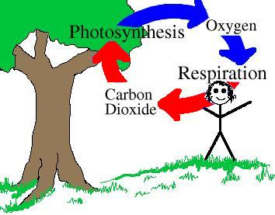
Carbon-Oxygen Cycle
Draw this picture

Slide 37
Warmup 2/12
What would happen if the amount of carbon dioxide in the plant environment is reduced?
What is the pigment that allows plants to use light energy?
How does the formula for photosynthesis relate to the formula for respiration?

Slide 38
Warmup 12/5
Write out the reaction for respiration.
What are the products of alcoholic fermentation?
What are the products of lactic acid fermentation?
Is fermentation an aerobic or anaerobic process?

Slide 39
Warmup 11/29
Where is energy stored in ATP?
How can the energy be released from ATP to be used to do work in the cell?
How can ADP be charged back up to become ATP again?

