Slide 1
Unit 2: Cells

Slide 2
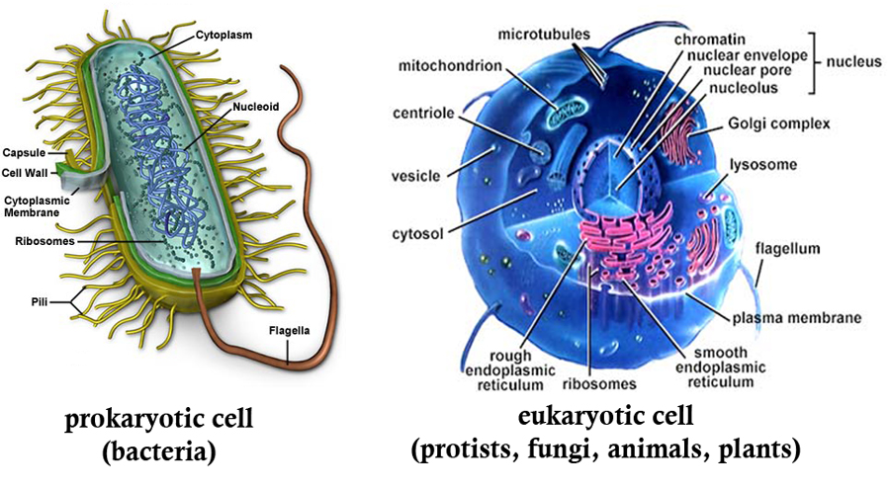

Slide 3
2 Types of Cells
Prokaryotes
Simplest cell type
No membrane bound organelles, but they do have nonmembrane bound organelles such as the cell membrane and the ribosome

Slide 4
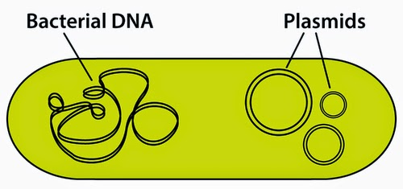
2 Types of Cells
Prokaryotes
DNA is circular and free floating in the cell. The area where the DNA spends the most time in the cell is called the nucleioid region since prokaryotes don’t have a nucleus
Only example if bacteria

Slide 5
2 Types of Cells
Prokaryotes
The prokaryotes are split into 2 kingdoms
Archaebacteria: the oldest species of life on earth, live in extreme earth conditions; high temperature, high chemical levels, high salinity
Eubacteria: most common, live in most places of the earth. Type that most living organisms come in contact with on a frequent basis

Slide 6
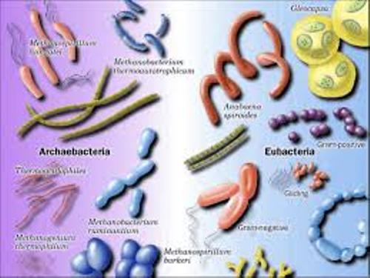

Slide 7
2 Types of Cells
Eukaryote
Large, complex cells that can become specialized in multicellular organisms
Have membrane bound organelles such as a nucleus and mitochondria and nonmembrane bound organelles such as the ribosome
Broken into 4 kingdoms
Animals, plants, fungi, protists

Slide 8
Earliest forms of life on earth
1st forms of life were anaerobic and prokaryotic
Cannot be definitively proven since there is no fossil evidence
Theory based on the idea that organisms are constantly becoming more complex and bacteria are the simplest so they must have evolved first

Slide 9
Earliest forms of life on earth
First Eukaryotes
The first actual eukaryotic cells cannot be scientifically proven as well since there is no fossil evidence
Theory is that they were unicellular, anaerobic, aquatic, heterotrophic protists
Examples of what these organisms look like may be Giardia, Trichomonads, and Microsporidia since they lack mitochondria and are among the simplest of the protists

Slide 10
Endosymbiosis Theory
https://www.youtube.com/watch?v=-FQmAnmLZtE
Scientists theorize that several organelles at one time existed as unicellular prokaryotes that heterotrophic eukaryotic cells tried to eat but were unable to

Slide 11
Endosymbiosis Theory
Evidence for this includes the plastids (ex. chloroplast), undulipodia (flagella and cilia), and mitochondria
Both of these have their own DNA
They have 2 membrane layers rather than just 1 like most membrane bound organelles

Slide 12
Endosymbiosis Theory
Reasons for why they were kept include that evolutionary pressure made it so that protists that had these prokaryotic cells (mitochondria and chloroplast) were more successful and the symbiotic relationship these 2 organisms was made permanent

Slide 13
Endosymbiosis Theory
Evidence
The outer membrane layer has the same composition as the cell membrane of the eukaryotic cell, the inner membrane has a different composition
The mitochondria are able to move around the cell at will

Slide 14
Lack of Fossil Evidence is due to many reasons
These organisms lived in aqueous environments where it was unlikely they would be buried in sediment to be preserved when they died
Most lacked hard parts that would leave an impression

Slide 15
Cell Theory
All living things are made of cells
Cells are alike in structure and function
Cells need information to survive
New cells come from pre-existing cells

Slide 16
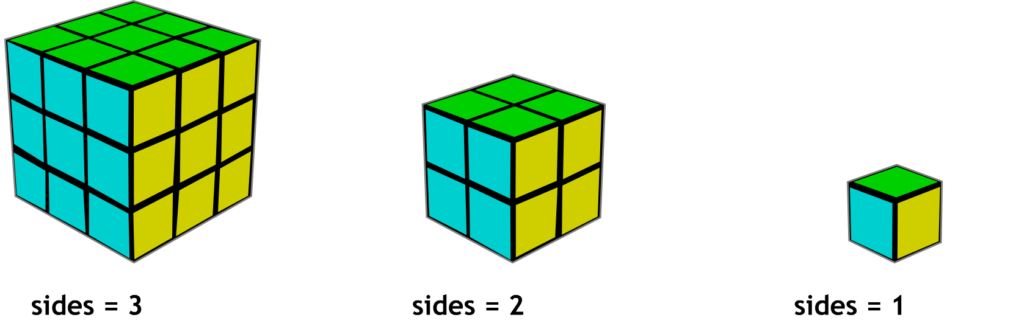
Why cells must be small
Do this math! Muwahahahahahahahahahahah
SA = (length x width) x 6
Volume = (length x width x height)

Slide 17
Why cells must be small
Cells must be small to preserve the surface area to volume ratio
Cells with a high surface area to volume ratio are more successful
The materials that they take in have less of a distance to travel, meaning they get to their destination quicker, with a smaller volume. A larger volume means more surface area which means more material can come in but the materials have a longer distance to travel once they get in

Slide 18
Why multicellular organisms are more complex
Cell specialization happens when an organism is multicellular and it can change the function of sets of cells to perform one job while other cells will provide for the needs of that cell.

Slide 19
Prokaryotic Diversity

Slide 20
Archaebacteria
Have cell walls made of a protein-sugar complex called peptidoglycan
Have a cell membrane with a unique composition
Live in extreme environments
Have different rRNA than either eubacteria or eukaryotes

Slide 21
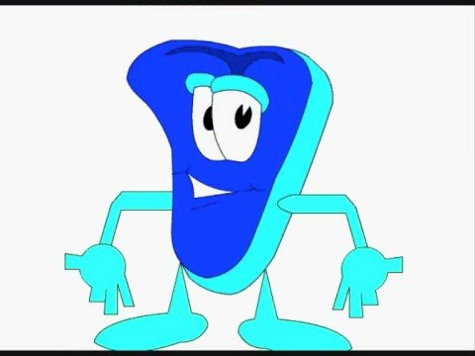
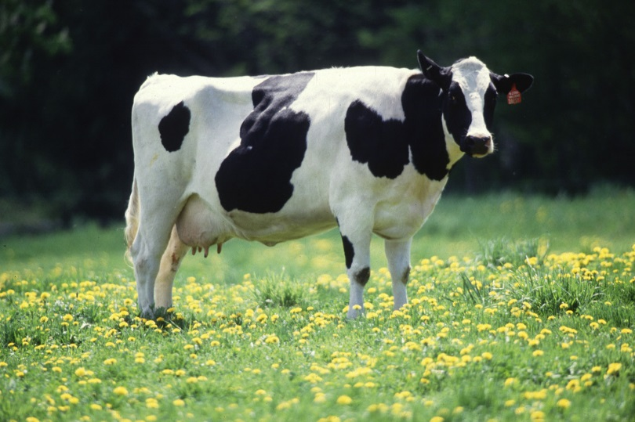
3 subgroups of archaebacteria
Methanogens
Use hydrogen to reduce carbon dioxide into methane
Obligate anaerobes (must avoid oxygen, it’s very toxic to them)
Found in marshes, swamps, and the guts of animals such as cows, sheep, and camels (this is why those things smell so bad!)
Act as decomposers in sewage treatment plants

Slide 22
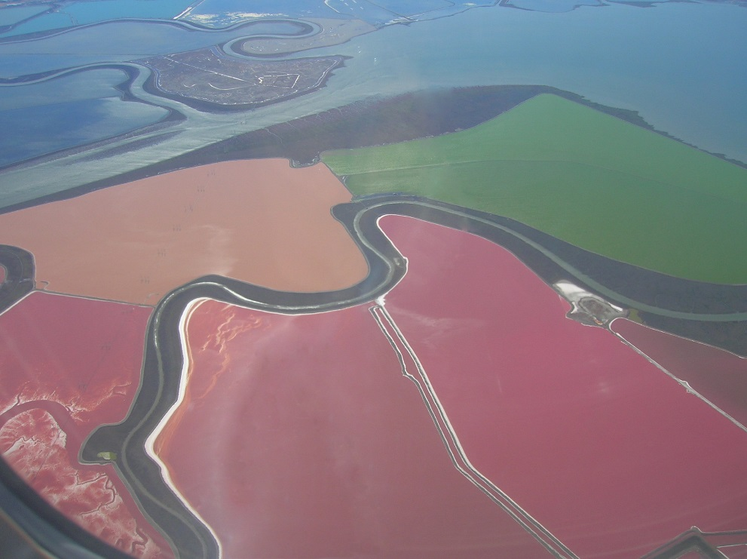
3 subgroups of archaebacteria
Extreme halophiles
Live in high salinity environments (more salty than the ocean)
Can color the salt pink because of their photosynthetic pigment

Slide 23
3 subgroups of archaebacteria
Thermoacidophiles
Need the environment both hot (60-80 C) and acidic (pH of 2-4)
Found in hotsprings, water heaters, and coal piles
Do not have a cell wall
Can grow aerobically and anaerobically

Slide 24
Eubacteria
Simplest of all cells
Only have a cell wall, cell membrane, and ribosomes
They know how to maximize their use however
This group includes regular bacteria and cyanobacteria

Slide 25
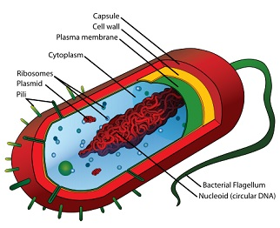
Characteristics of prokaryotes
Have a nucleioid region
Area of the cytoplasm that contains almost all of the DNA in a long loop. The rest of the DNA can be found in small plasmids that are also circular but are able to float around the cell at will

Slide 26
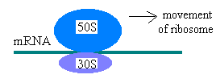
Characteristics of prokaryotes
Ribosomes
Site of protein synthesis. Bacterial ribosomes are different than eukaryotic ribosomes. Eukaryotic are larger, referred to as a 60S and 40S subunit. Prokaryotes have a 50S and 30 S subunit.

Slide 27
Characteristics of prokaryotes
Cell wall made of protein and sugar
Serves to protect the cells
2 types of peptidoglycan
Gram positive: very thick with no outer membrane layer
Gram negative: thin but multilayered call with an outside membrane made of lipopolysaccharides

Slide 28
Gram positive
Gram negative

Slide 29
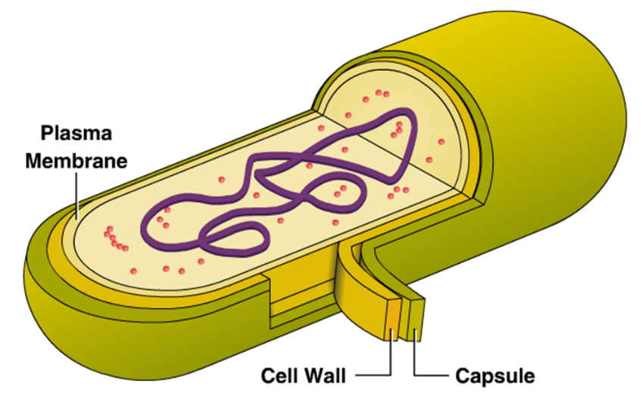
Characteristics of prokaryotes
Capsule
Jelly-like layer that some bacteria make that surrounds the cell in times of stress
Functions
Prevents drying out
Stick to surfaces
Slide on surfaces
Protection from eukaryotic immune responses

Slide 30
Characteristics of prokaryotes
Flagella
Long whip-like tail used for movement
Tail spins one direction to go straight very quickly, tail spins the other direction to start it tumbling and allow for direction change

Slide 31
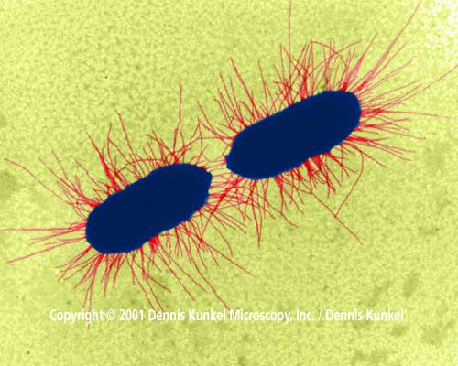
Characteristics of prokaryotes
Pili
Short appendages that are hollow
2 functions are to stick to surfaces and transfer DNA from one organism to another (usually a copy of the plasmid)

Slide 32
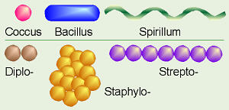
Characteristics of prokaryotes
3 general shapes
Coccus: round ball
Bacillus: long rod
Spirillus: spiral shape

Slide 33
Characteristics of prokaryotes
Movement
Bacteria move in response to chemotaxis, movement based on what chemicals are in its immediate area

Slide 34
Bacterial Survival
When conditions are extremely unfavorable and the bacteria will die some can produce an endospore and go dormant within it to survive the extreme conditions. The endospore disappears when conditions are again favorable
This is why it is important to take all your pills you get from the doctor

Slide 35
Reproduction
Most common type is binary fission
Type of asexual reproduction
DNA copies itself, both loops of DNA attach to opposite sides of the cell on the membrane and the cell pinches in half
Produces clones

Slide 36
Sexual reproduction
Conjugation: use of pili to transfer copied plasmids from one bacteria to another. Can be between different species
Transformation: bacteria picking up floating pieces of DNA from their environment that dead bacteria have released
Transduction: movement of bacterial DNA from one organism to another through the use of viruses

Slide 37
Eukaryotes

Slide 38
Basic Characteristics
Generally larger than prokaryotes
Contain membrane bound organelles including the nucleus, rough and smooth ER, golgi body, mitochondria, and chloroplasts

Slide 39
Basic Characteristics
Eukaryotic cells have the ability to consume other (smaller) cells through one of 2 processes
Phagocytosis: process of ingesting a bacteria or smaller eukaryotic cell and dissolving it in a lysosome for cellular nutrition, this is one way in which white blood cells kill bacteria
Pinocytosis: ingestion of liquids and small ions into the cell by pinching in a small piece of the cell membrane

Slide 40
Phagocytosis
Pinocytosis

Slide 41
Basic Characteristics
When environmental conditions are tough they can form a protective cyst in which the bacteria grow and reproduce while waiting for better environmental conditions.
Some single celled eukaryotes can form poison darts called trichocysts or toxicysts to disable their prey

Slide 42
Cyst

Slide 43
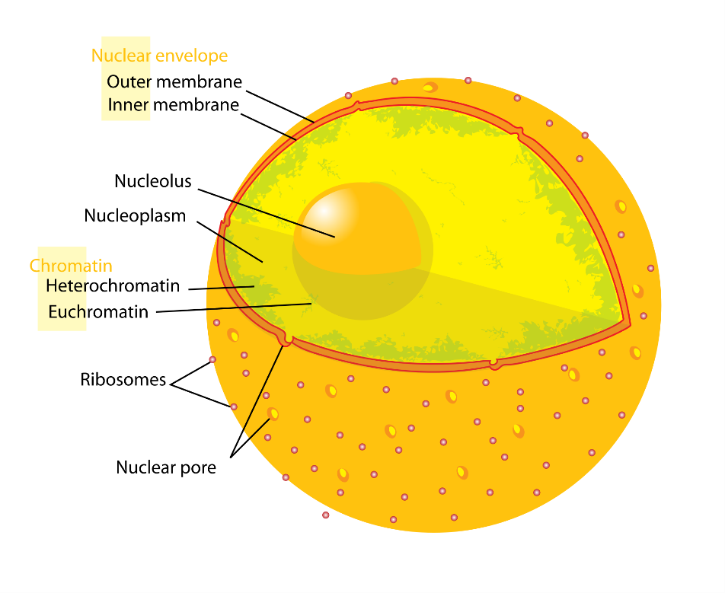
Organelles
Nucleus:
Has a nuclear membrane that separates the chromosomes inside from the cell environment outside the nucleus
Control center which controls the production of mRNA, rRNA, tRNA, and protein synthesis

Slide 44
Organelles
Nucleolus
Very dense area of the DNA in the nucleus which has the DNA necessary to create ribosomes.

Slide 45
Organelles
Mitochondria
Responsible for producing ATP, the energy molecule cells use
Typically there will be several mitochondria in a cell. The more use a cell gets (ie. Nerve cell or muscle cell) the more mitochondria it will get. This is part of cell specialization.
Inside membrane is very folded to increase the surface area. More surface area means more ATP will be produced
Have their own DNA

Slide 46
Draw and label this picture of the mitochondria

Slide 47
Organelles
Plastids
Have their own DNA
Amyloplasts: white in color and store starch in the roots
Chromoplasts: many colors and contain accessory pigments (ie. Carotenoids which are orange) to aid photosynthesis
Chloroplasts: green in color from the pigment chlorophyll, found in the green parts of the plant. Most important organelle for photosynthesis

Slide 48
Plastids

Slide 49
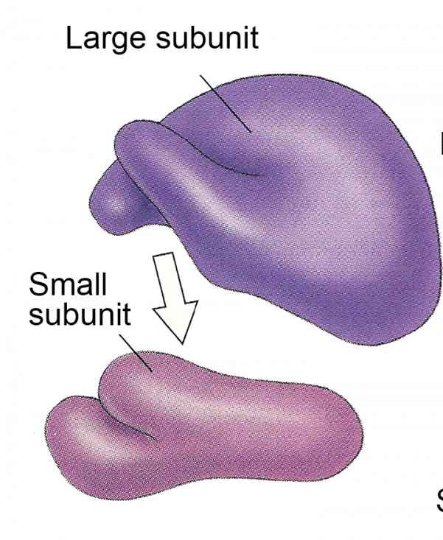
Organelles
Ribosomes
Job is to synthesize proteins
Non-membrane organelles also found in prokaryotes
Eukaryote ribosomes are larger than prokaryote ones
Can be either bound to the rough endoplasmic reticulum or free floating

Slide 50
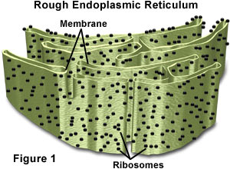
Organelles
Endoplasmic Reticulum
Network of interconnected sacks, tubes, and channels
Rough Endoplasmic Reticulum (RER): has ribosomes attached and assist in the production of proteins, transporting, and the production of phospholipids

Slide 51
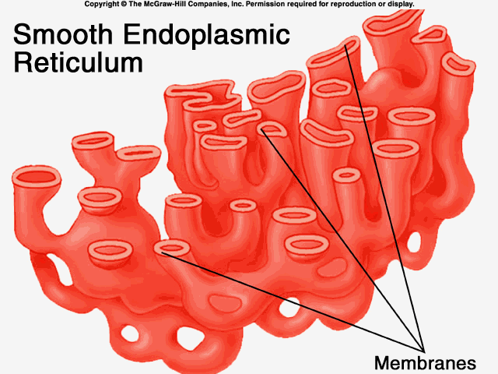
Organelles
Smooth Endoplasmic Reticulum: no ribosomes attached and are responsible for toxin (such as alcohol) breakdown and the production of lipid polymers
Increased drug and alcohol use will increase the amount of SER in cells, thereby increasing the tolerance to the drug

Slide 52
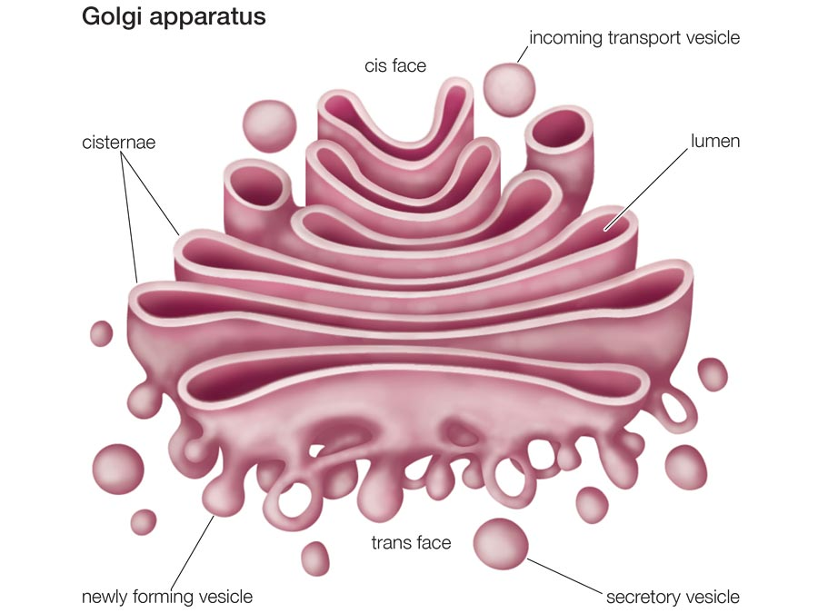
Organelles
Golgi Complex
Flattened membrane sacs stacked together near the cell membrane
Finishes packaging lipids, carbohydrates, and proteins for transport outside of the cell
Transports materials into vesicles for transport
Produce lysosomes

Slide 53
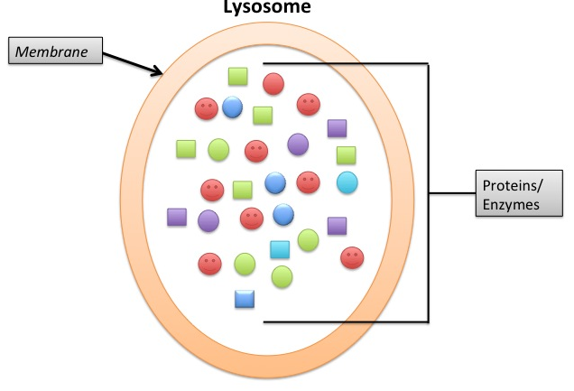
Organelles
Lysosomes
Use highly reactive enzymes to break down organic molecules in food as well as old organelles that don’t work anymore
They can break apart, releasing their enzymes. When this happens the cell will die

Slide 54
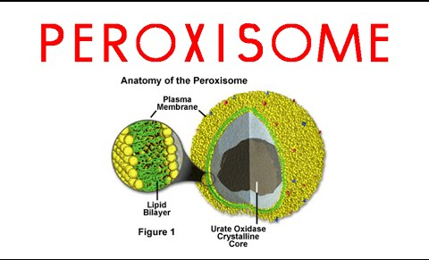
Organelles
Peroxisomes
Responsible for forming hydrogen peroxide in a cell as well as storing the catalase a cell will use
Will break down long fatty acid chains and large proteins

Slide 55
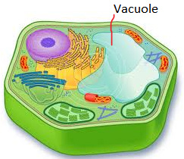
Organelles
Vacuole
Store water, food, waste, pigments for an organism. Different organisms and different cells in the organism will store different chemicals in their vacuoles

Slide 56
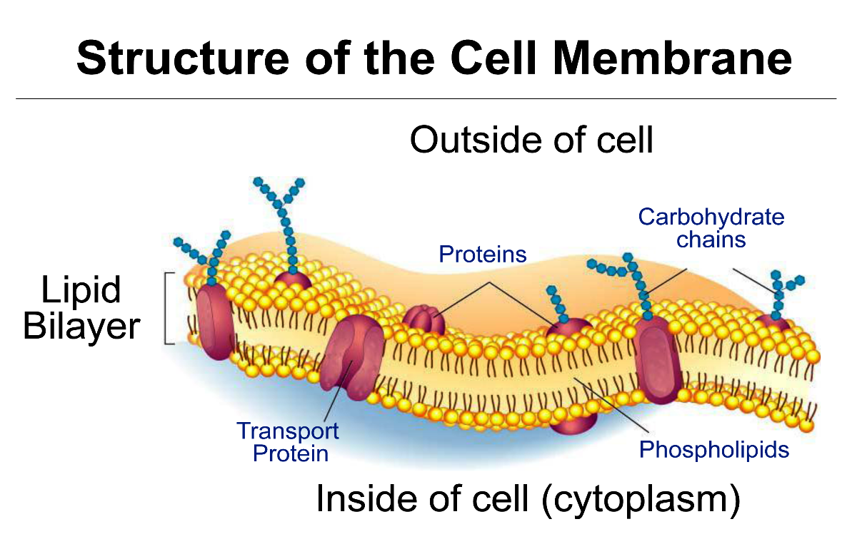
Organelles
Cell membrane
Double layer of phospholipids which controls what enters and leaves the cell

Slide 57
Organelles
Cytoskeleton
Supports and protects the cell (the protection is really poor but it is there)

Slide 58
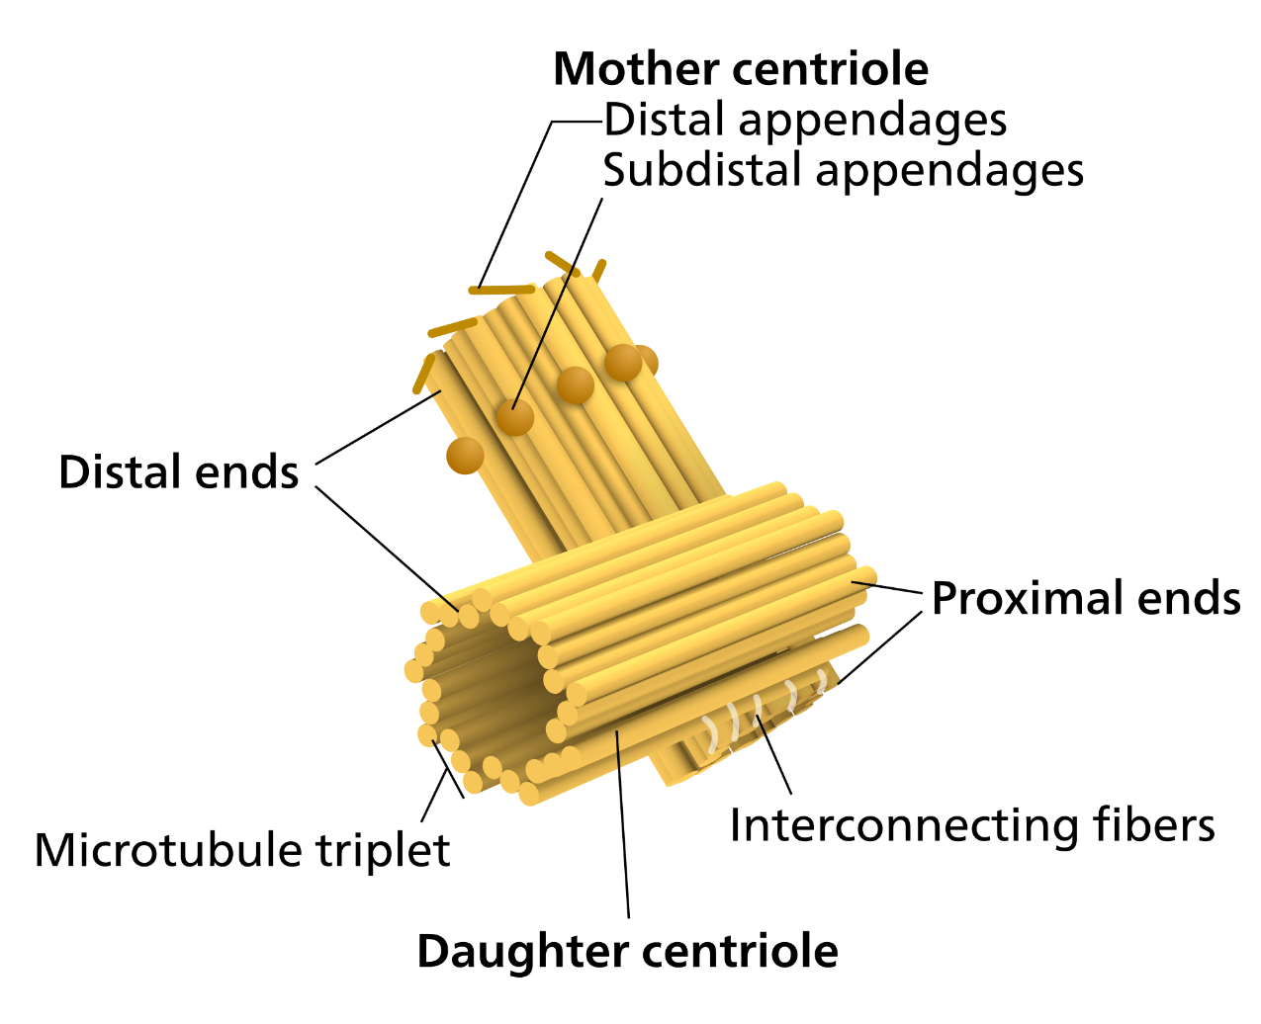
Organelles
Centrioles
Used in animal cells during cell division

Slide 59
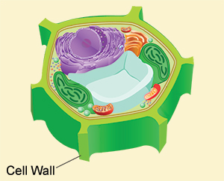
Organelles
Cell Wall
Supports and protects the cell (much better at protection than the cytoskeleton)
Found in plants (cellulose), fungi (chitin), and some prokaryotes

Slide 60
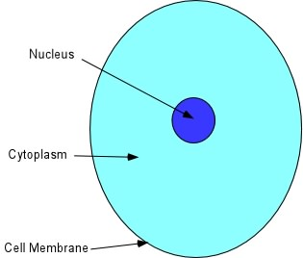
Organelles
Cytoplasm
Fluid inside the cell that suspends the organelles
Allows a place for a lot of chemical reactions in the cell

Slide 61
Metabolic Diversity

Slide 62
2 Ways to Get Food
Heterotroph: organism that relies on outside getting it’s organic molecules from outside sources.
Autotroph: organisms who are able to make their organic molecules themselves

Slide 63
Heterotrophs
Photoheterotroph: organisms that are able to use light energy to make their own ATP but must obtain organic carbon from other sources.
Found only in prokaryotes

Slide 64
Heterotrophs
Chemoheterotroph: organisms that consume organic molecules for both their energy and carbon. (This is the one most of us think about when we think heterotroph)
Found in prokaryotes, protists, fungi, and animals

Slide 65
Autotrophs
Photosynthetic autotroph: organisms that are able to convert light energy into chemical energy to synthesize organic molecules from carbon dioxide.
Found in plants, algae, and cyanobacteria

Slide 66
Autotrophs
Chemoautotroph: organisms that consume inorganic molecules such as ammonia, sulfates, nitrates, and carbon dioxide to produce their organic molecules
Found in prokaryotes

Slide 67
To use oxygen or to not use oxygen
Obligate Aerobes: organisms must use oxygen to go through cellular respiration and cannot survive without it
Ex: humans

Slide 68
To use oxygen or to not use oxygen
Facultative anaerobes: organisms that will use oxygen if it is present but can grow with fermentation if it is not
Ex: yeast

Slide 69
To use oxygen or to not use oxygen
Obligate anaerobes: organisms that cannot use oxygen and are actually killed by it
Ex: bacteria that causes botulism

Slide 70
Making Your Cell Membrane
Create your cell membrane as directed on the page. Please color them!!!!!!!
You will also need to create pieces for the following components:
Cholesterol
Glycoprotein
Glycolipid
Grab a tooth pick for each part of the cell membrane. Attach a strip of paper that describes the function of the part. (Include the phospholipid bilayer)

Slide 71
Cell Membrane

Slide 72
Characteristics
The cell membrane is a type of plasma membrane that surrounds all cell types
Plasma refers to the fact that the cell membrane is very fluid and does not stop moving
2 Key terms
Extracellular fluid. The fluid outside the cell
Intracellular fluid: the fluid inside the cell

Slide 73
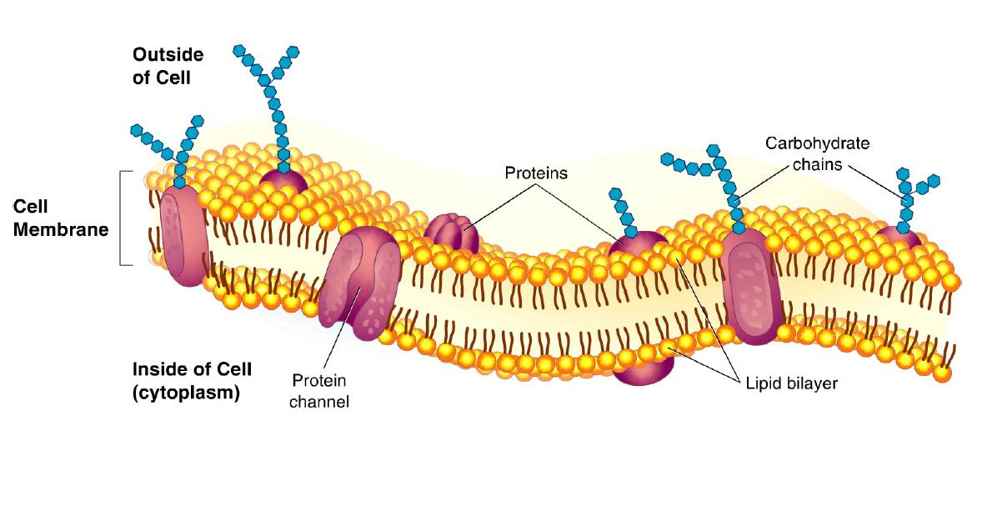

Slide 74
6 Major Components
Phospholipids
Proteins
Integral:
Transport
Cholesterol
Glycoproteins
Glycolipids

Slide 75
Fluid Mosaic Model
If the cell membrane stops moving the cell will die, we do not want the phospholipids to stick together more than what is necessary to hold the membrane together
The permeability changes
Mosaic refers to the large number of molecules other than phospholipids that make up the membrane

Slide 76
Cholesterol
Cholesterol is important to maintaining the fluidity of the membrane
In warm temperatures it decreases fluidity by restraining phospholipid movement
In cold temperatures it increases fluidity by preventing the phospholipids from packing together

Slide 77
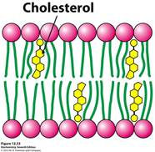

Slide 78
Proteins
Integral: There are 3 regions on the integral protein. The ends of the protein are hydrophilic and the middle is hydrophobic. This is so that when the protein is embedded in the membrane the hydrophobic portion is interacting with the hydrophobic fatty acid tails of the membrane
Firmly attached to the membrane

Slide 79
Integral Proteins
Unilateral: only reach halfway through the membrane
Used for a lot of functions but 2 of the most important are cell signaling and the regulation of enzymes
Only functions on the side of the membrane that it is bound to
Peripheral proteins may attach themselves to unilateral proteins

Slide 80
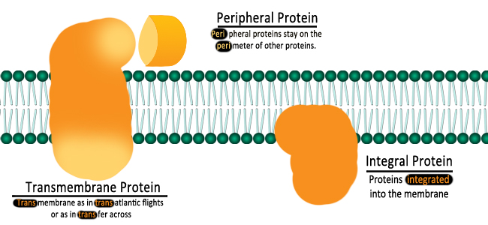

Slide 81
Integral Proteins
Transmembrane/Transport: run completely through the membrane
Can work on both sides of the membrane
Used for a huge number of functions including cell transport, identifying bacterial and viral invaders, Cell signaling, Electron carriers

Slide 82
Glycoproteins
A polysaccharide chain extending extracellularly that is attached to an integral protein
Typically used in cell-cell interactions
Recognizing “self” cells and “invader” cells
Attachment to other cells to form tissues and organs
Used as hormones sent between cells

Slide 83
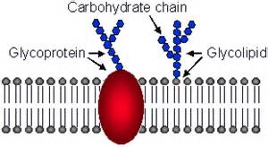

Slide 84
Glycolipids
A phospholipid that has a polysaccharide chain attached extracellularly
Used to attach one cell to another to form tissues
Initiate immune responses
Determine blood type

Slide 85
Cell Transport

Slide 86
Basics
It’s important to remember that transport will only occur when there are differences in either pressure or concentration
The difference in concentration or pressure between the two areas (inside the cell and outside the cell) create a concentration or pressure gradient.
Movement comes to a net halt when pressures or concentrations inside and outside the cell are equal. This is called equilibrium

Slide 87
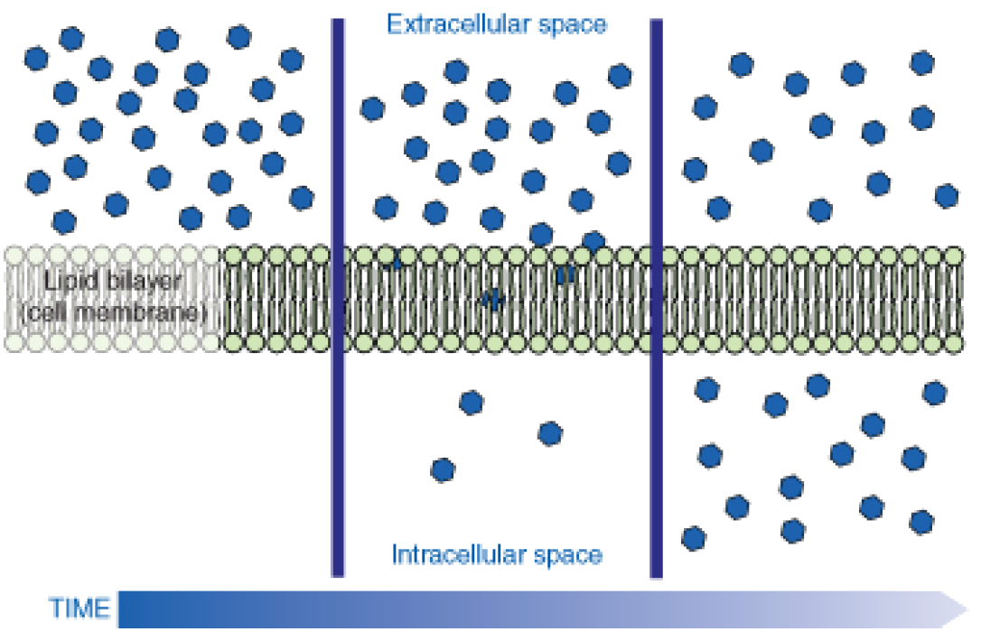

Slide 88
Passive Transport
Moves with the concentration gradient from high to low concentration
Does not require energy

Slide 89
Passive Transport
Bulk Flow
Hydrostatic pressure move molecules all together in the same direction. This will move a lot of molecules all at once. Typically seen in plants, when sugars are moved from the leaf to the root. Molecules move from areas of very high pressure to low pressure by moving through open channels or pores between the cells.

Slide 90
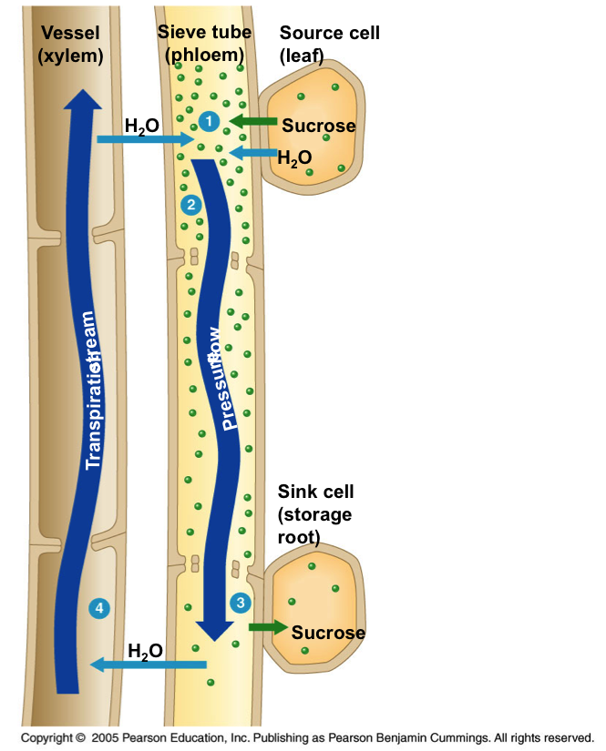

Slide 91
Passive Transport
Diffusion
Movement of molecules from an area of high to low concentration. Can only occur for very small molecules across the cell membrane. Can also occur in atmosphere.
Requires no energy
This will allow some molecules to move through the cell membrane without the aid of a transport protein

Slide 92
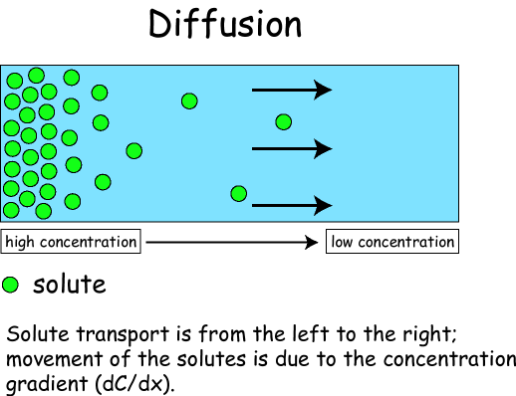

Slide 93
Passive Transport
Osmosis
Movement of water from an area of high to low concentration without energy.
Water concentrations are determined by the relative amounts of solute dissolved in them, typically it will be a salt or sugar

Slide 94
Passive Transport
Osmotic Environments
Isotonic/Isosmotic: the water concentration inside the cell and outside the cell are the same, meaning there is no net flow of water into or out of the cell. It is at equilibrium.
Preferred state of animal cells since they do not have a cell wall to prevent bursting (lysing).

Slide 95
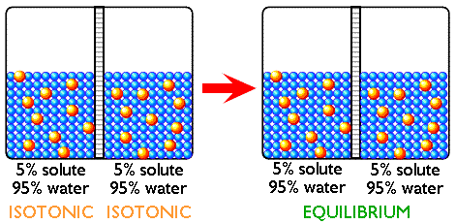

Slide 96
Passive Transport
Osmotic Environments
Hypertonic/hyperosmotic: refers to the fact that there is more solute dissolved which means there is a lower concentration of water. Paired with hypotonic.
Hypotonic/hyposmotic: refers to the fact that there is less solute dissolved, which means there is a higher concentration of water. Paired with hypertonic.

Slide 97
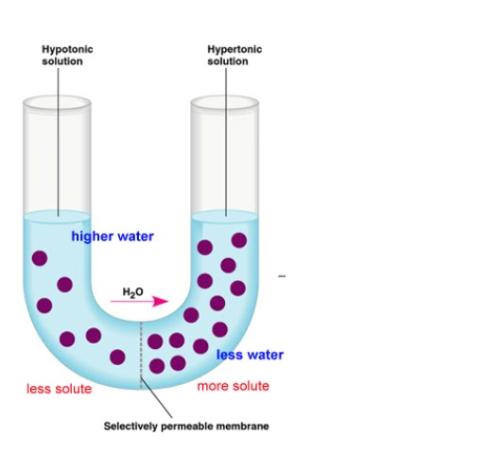

Slide 98
Passive Transport
Hypertonic and Hypotonic Solutions
If the environment around the cell is hypertonic (more solute, less water) then the cell has to be hypotonic (more water, less solute).
If the environment around the cells is hypotonic (more water, less solute) then the cell has to be hypertonic (more solute, less water)

Slide 99
Passive Transport
Hypertonic and Hypotonic Solutions
Water will always move from the area that is hypotonic to the area that is hypertonic (moving from the area where the water is high to the area where the water is low)
It will continue to do this until the water concentrations are equal.
The solute will never follow the water. Solute doesn’t move, only water.

Slide 100
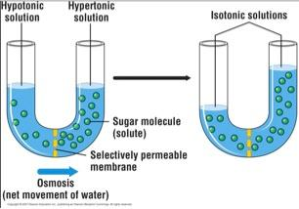

Slide 101
Passive Transport
Osmotic Environments
Plant cells prefer to be hypertonic to their environment so that water is always coming in. They can do this without lysing because their cell wall prevents the cell from bursting.

Slide 102
Passive Transport
Facilitated Diffusion
The use of a protein to transport large polar molecules such as glucose and water. No energy is required.
Transport proteins are highly selective
Uniport: carries a single molecule across the membrane
Symport: carries 2 different molecules into or out of the cell at the same time
Antiport: carries 1 molecule into the cell while at the same time carrying 1 molecule out of the cell

Slide 103
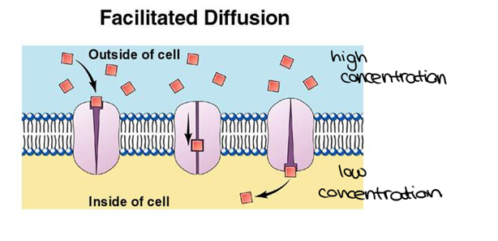

Slide 104
Active Transport
Requires ATP to be used to active the cell
Always move molecules against the concentration gradient from low concentration to high concentration
Sodium-Potassium pump: moves sodium ions outside the cell at the same time that it moves potassium ions into the cell. Used by nerve cells to create the charge they use to fire the nerve

Slide 105
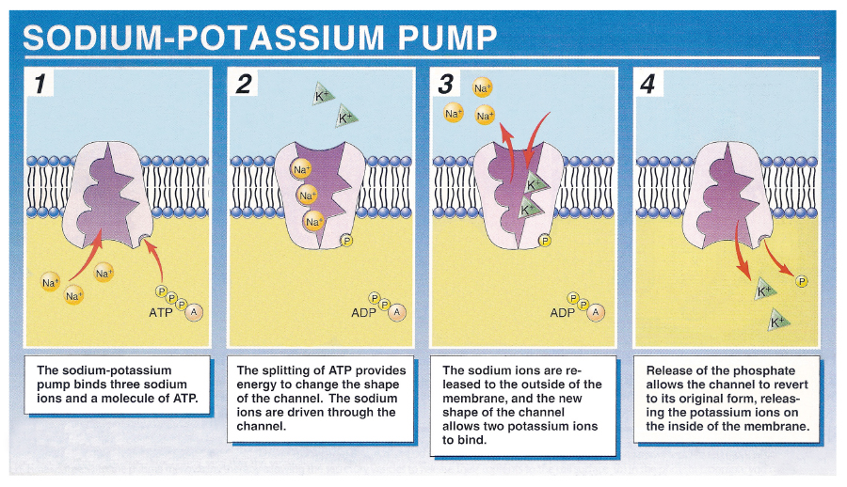

Slide 106
Active Transport
Vesicle Mediated Transport
Vesicles formed inside the cell from the Golgi Body have the ability to fuse with the cell membrane expelling their contents from the cell. Called exocytosis

Slide 107
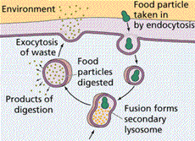

Slide 108
Active Transport
Vesicle Mediated Transport
Vesicles formed at the cell membrane bring substances into the cell. Called endocytosis
Phagocytosis: cell eating
Pinocytosis: cell drinking
Receptor-Mediated Endocytosis: when a molecule attaches to a receptor protein on the cell membrane and a vesicle forms around it to bring it in the cell

Slide 109
Active Transport
Cell-cell junction
Only usable by multicellular organisms who have cells organized into tissues
Chemical signals are sent from one cell with exocytosis to another cell which uses endocytosis to bring it in

Slide 110
