Slide 1
Biotechnology

Slide 2
Key Terms
Genetic Engineering: manipulating genes for practical purposes such as
Creating GMOs
Creating transgenic organisms
Gene therapy
Cloning
Creating artificial chromosomes

Slide 3
Key Terms
Vector: Method of transmission
Used for gene therapy and creating transgenic organisms
Restriction Enzymes: Enzymes used to cut DNA at known sequences. Can be either a straight cut through to create blunt ends or create sticky ends
Used for gel electrophoresis (blunt ends), transgenic creation (sticky ends), and the creation of artificial chromosomes (sticky ends), and gene therapy (sticky ends)

Slide 4
Restriction Enzymes
Enzymes taken from bacteria that cut DNA at specific sequences.
These are originally used as the bacteria’s “immune system” against bacterial viruses
There are over 1,000 known restriction enzymes which all cut at different sequences.

Slide 5
Restriction Enzymes

Slide 6
Restriction Enzymes
“Sticky ends” are important in biology because they allow for DNA segments to be combined together in a process called splicing
Key when trying to insert genes into an organisms chromosomes.

Slide 7
Transgenic Organisms

Slide 8
Transgenic Organisms
Genetic engineering to modify organisms
Can include the following
Genetically Modified Organisms (GMO)
GMOs can be transgenic if combined with the genes from another species but they don’t have to be
Transgenic
Made for a variety of reasons

Slide 9
What is a transgenic?
A transgenic organism is any organism that has been created by adding genes from one species into another species (ex: adding the genes to make spider silk into a goat)
Made by creating recombinant DNA
The DNA created when splicing 2 segments of DNA together using restriction enzymes that cause sticky ends

Slide 10
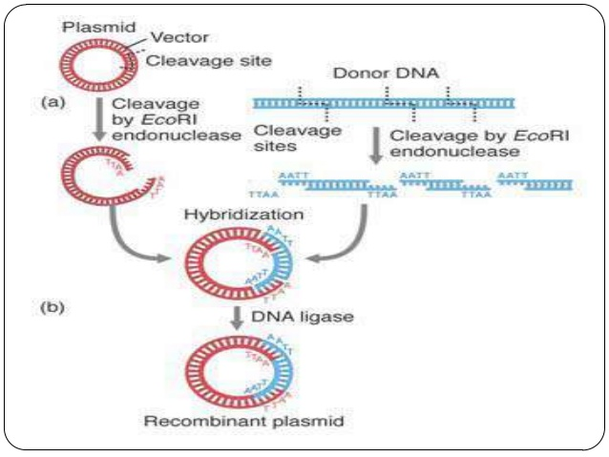
Making Recombinant DNA in Prokaryotes
What type of organism does a plasmid come from?
What is the purpose of DNA ligase here?
Why do you have to cut bother the plasmid and the donor DNA with the gene of interest with the same type of restriction enzyme?
How do you think that this process is different in eukaryotes?
Typically from a eukaryote

Slide 11
Process of creating Recombinant DNA
A restriction enzyme cuts out the “gene of interest” from the source
The same type of restriction enzyme cuts open the DNA of the organism that the gene of interest will be inserted into
In prokaryotes this is very easy as the gene is inserted into the plasmid rather than the main body of DNA, reducing the likelihood that the gene will insert in the middle of a gene the bacteria needs
In eukaryotes, this is more difficult as the gene must be inserted directly into the genome

Slide 12
Once the DNA has been combined together, DNA ligase seals the 2 pieces of DNA together just like it did in DNA Replication
The recombinant DNA is then placed back into the host organism
In prokaryotes this can happen at any time in its life cycle and is extremely successful
In eukaryotes this needs to happen early in the embryonic development before too many cells are produced and because the insertion of the DNA is tricky as it can mess up other genes very easily. Many trials are typically required to get the desired outcome

Slide 13
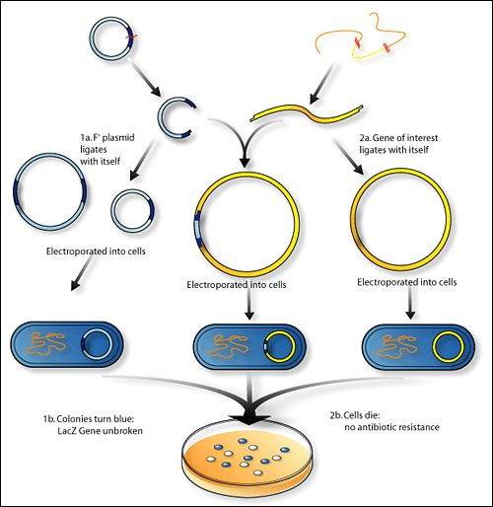
prokatyotes
What do you think the term “electroporation” means?
Why would this be important?

Slide 14
Reasons for making transgenic organisms
Medical Uses
Diagnosis of diseases
Human gene therapy
Vaccines
Pharmaceutical Production:
Insulin
Human Growth Hormone
Erythropoietin-hormone that increases the production of red blood cells

Slide 15
Reasons for making transgenic organisms
Environmental Use
Bacteria can be used to remove heavy metals (copper, lead, nickel) from the environment. They combine these metals with natural chemicals they make to produce compounds that are easily harvested.
Convert toxic portion of sewage into non-toxic forms
Clean up oil spills

Slide 16
Reasons for making transgenic organisms
Agricultural Use
Create animals that will produce their own vaccines, antibodies, hormones to limit the overuse of them by farmers
Plant Manipulation-make plants resistant to herbicides, slow spoiling, resist pathogens, increase nitrogen fixing ability of bacteria, and making transgenic organisms such as tomatoes that resist freezing for a longer growing season, and golden rice that contain beta-carotene.

Slide 17
Cloning

Slide 18
Cloning
Process of making an exact copy of an organism or part of an organism
Done by removing a nucleus from a somatic cell from the target organism and replacing an egg cell nucleus with the target nucleus. The egg cell then goes into a surrogate mother.
Challenges to overcome
Making the somatic nucleus unspecialize and become a stem cell again
Making that stem cell omnipotent (meaning that it can become any cell)
Getting the cells to divide

Slide 19
Ways to Clone
There are 2 primary aplpications of cloning
Whole organism cloning which is exactly what it sounds like…you clone the whole organism. Much easier because you let the mother do what mother’s have done for millions of years and apply the chemical signals to grow the organism.
Therapeutic Cloning
You are only cloning 1 organ out of the organism. Much more difficult because the scientist has to apply the correct chemical signal, at the right time, in the right dose to get the organ functioning properly.

Slide 20
Uses of cloning
Food production
Quickly grow organisms that are harvested for medicines
Preserve endangered wildlife

Slide 21
Stem Cells
There are 2 different sources of stem cells
Embryonic: omnipotent stem cells found in developing embryos
Adult: some omnipotent but rare, most are pleuripotent (they can develop into a few of a certain type of cell ie. Stem cells in the bone marrow can become red blood cells, white blood cells, or platelets but nothing else)

Slide 22
Uses of stem cells
Uses of stem cells are as varied as you can think of. Theoretically you could use stem cells to cure any defect in an organism including but not limited to:
Cancers
Paralysis
Brain disorders like Alzheimers and Parkinsons
Diabetes
Arthritis
Cloning organs

Slide 23
Stem cells can also be pleuripotent or omnipotent
Pleuripotent stem cells are what most adult stem cells are, they have the ability to become many different types of cells but cannot become any cell in the organism. An example would be the stem cells in the bone marrow that can make any of the cells in the blood but no others.
Omnipotent stem cells are what a few adult stem cells are but what all embryonic stem cells are. They can become any cell in the body. It is why scientists want embryonic stem cells more than they want adult stem cells.

Slide 24
Challenges of using stem cells in cloning organs
It is much easier to produce an entirely new organism than a specific organ because when cloning the new organism the surrogate mother provides all of the chemical signals to stimulate development. When cloning just an organ scientists need to apply the correct chemical signals at the appropriate time otherwise you only get one type of tissue or the organ is defective

Slide 25
Challenges of using stem cells in cloning organs
If you are using the organ to replace a genetically defective organ such as a heart, kidney, liver, or pancreas, a straight cloned organ will have the genetic defect as well and eventually fail.
Benefits: the cloned organ will not be rejected by the host and therefore immunosuppressants will not be given to the host
What would be the optimal treatment for this type of situation?
Gene Therapy on the stem cell before the cloning process starts

Slide 26
Gene Therapy

Slide 27
Gene Therapy
Process of using a viral vector to administer functional DNA into an organism that has a genetic disorder to hopefully cure them
Only disorder cured thus far has been Severe Combined Immune Deficiency (SCID)
At this point in time, the cure is not 100% effective because everyone has a slightly different reaction to the treatment

Slide 28
Process of Gene therapy
Healthy DNA is placed into a viral vector.
A viral vector is a virus that has had its DNA/RNA removed and is just a viral protein shell. These are useful to us because the protein shell will still only attack it’s target cell (ie. Hepatitis will attack only liver cells while the flu will only attack lung cells) and it can deliver the healthy DNA to the target cells
Why don’t we need to deliver the healthy DNA to every cell?

Slide 29
An alternative way to get the DNA to an organism would be through either 1 of 2 ways depending on the type of organism
If a plant you could use direct injection with a needle to get the DNA into the cell
If an animal you could use Electroporation which uses a small electrical impulse to form temporary holes in the cell membrane that will allow the DNA inside

Slide 30
Once inside the cell, the DNA will naturally migrate into the nucleus (if the organism has one) and hopefully it will fully integrate itself into the genome, similar process to crossing over.
Results in the best case scenario
Alternatively, the injected DNA could sit in the nucleus but not integrate in which case the cure is temporary because the injected DNA will eventually degrade
Thirdly the injected DNA will never make it to the nucleus and the treatment does not work.

Slide 31
How do you get the DNA
Use of restriction enzymes that cause sticky ends

Slide 32
Complications of gene therapy
The patient will have a poor reaction to the virus (ie. An allergic reaction)
The virus will insert in the wrong location,
Why would this by bad?
The treatment may be rejected by the host cells
Cancers are not uncommon

Slide 33
Benefits of gene therapy
Only cure available for genetic disorders
May be able to be used in the future to completely remove genetic disorders from the human population

Slide 34
Gel Electrophoresis

Slide 35
What is it used for?
Criminal Testing
Since every cell has the same DNA, DNA that is found at the crime scene can be matched to DNA taken from any cell in the body
Theoretically it should be a 100% match but it rarely is due to contamination
Parernity/Maternity Testing
A child should have half of its bands match to each parent
A child should not have bands that do not match with either parent
Parents will have about half of their bands match with their kids since they only get to give 50% of their DNA to each child

Slide 36
DNA can be extracted using a number of techniques
On rare occurrence, there is DNA but not enough to perform this technique. To increase the amount of DNA, scientists use a technique called Polymerase Chain Reaction (PCR) to simulate DNA replication
A bunch of free nucleotides, primers, and polymerase is added to the DNA and it will very quickly replicate about 40,000 times so you have enough DNA to do the electrophoresis

Slide 37
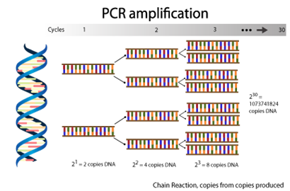

Slide 38
Agar gel is used to make the medium that separates the DNA. It has little holes that DNA can fit through
Separates the DNA by size rather than by sequence
A restriction enzyme is added to the DNA to cut it into different sized pieces. You don’t want sticky ends though
These pieces of DNA are called Restriction fragment length polymorphs (Rflps)

Slide 39
Since the phosphate on DNA has a strong negative charge, we use electricity to push/pull the DNA through the gel
A negative electrode is put close to the wells where the DNA is loaded so it can “push” the DNA
A positive electrode is put at the far end of the gel so it can “pull” the DNA
Typical run time is ~20 minutes

