Slide 1
Warmup 2/06
What do you think the purpose for each of the following molecules is in living organisms?
Carbohydrates (Sugar)
Lipids (Fats)
Proteins

Slide 2
Biochemistry

Slide 3
pH

Slide 4
Basic Chemistry
Acids, Bases, and pH
Acids and Bases result from water molecules reacting to form ions
pH Scale: indicates the concentration of Hydrogen ions in solution; ranges from 0 - 14

Slide 5
Basic Chemistry
pH Scale → scale that measures acidity (hydrogen ion)

Slide 6
Buffers
-Buffers: chemicals that keep the pH of a liquid (solution) the same
Examples: Sodium Bicarbonate in the blood and Alka-Seltzer

Slide 7
Organic Molecules

Slide 8
Biochemistry
Study of the chemicals necessary for living things.
Involves the element carbon (C)
Organic: molecules that have Carbon and hydrogen bonded together
Inorganic: molecules that do not have carbon and hydrogen bonded together

Slide 9
Biochemistry
Six elements needed in large quantities for living things are:
Carbon (C), hydrogen (H), nitrogen (N), oxygen (O), phosphorus (P), and sulfur (S)

Slide 10
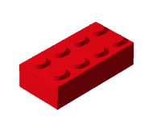
Biochemistry
Terms to Know:
Monomer – the smallest unit of a substance
Also known as subunits
Example: like one Lego block
Polymer – many monomers linked together to make a large structure; also called macromolecules
Example: Lego blocks put together to make a Lego house

Slide 11
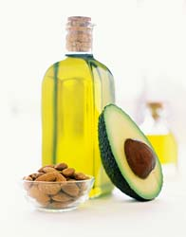
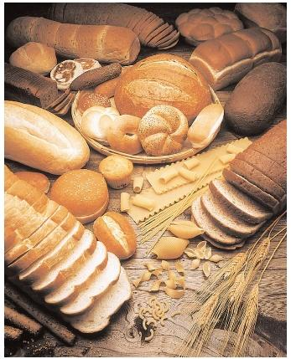
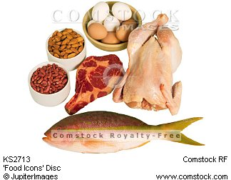
Biochemistry
Types of Organic Molecules (Macromolecules)
Carbohydrates
Lipids
Proteins
Nucleic Acids

Slide 12
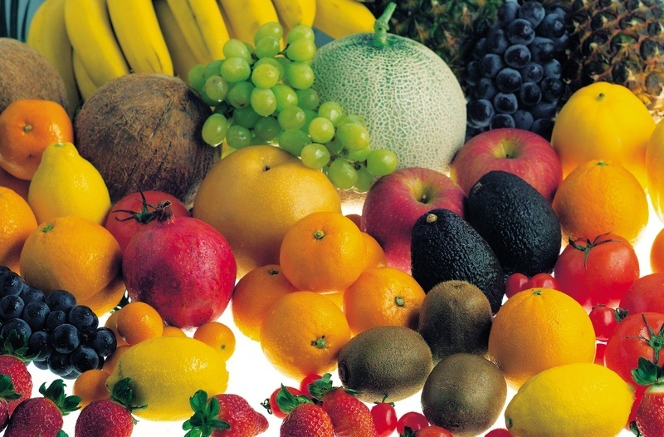
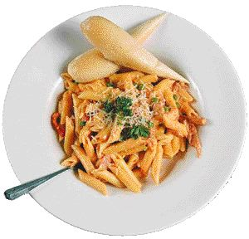
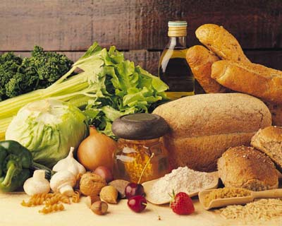
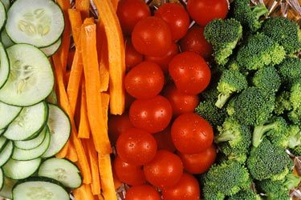
Carbohydrates

Slide 13
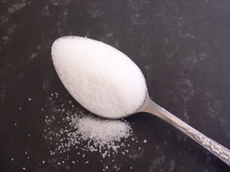
Carbohydrates
Also called sugars
Elements: C, H, and O in a 1:2:1 ratio (Example: C₆H₁₂O₆)
Typically end in –ose (Example: glucose)
Function: to store and release quick energy

Slide 14
Carbohydrates
Monomer: Monosaccharide
Example: glucose
Polymer: Polysaccharide

Slide 15
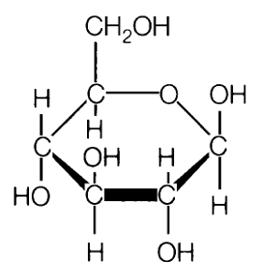
Monosaccharide Picture

Slide 16
Warmup 2/07
What is the role of carbohydrates in our bodies?
What elements make carbohydrates?
What is the monomer of a carbohydrate?

Slide 17
Warmup 9/06
Pick the stronger acid or base in the choices below:
2 or 4
10 or 12
8 or 14
Which is the weaker acid?
6 or 8
3 or 4

Slide 18
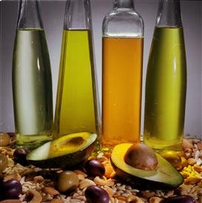
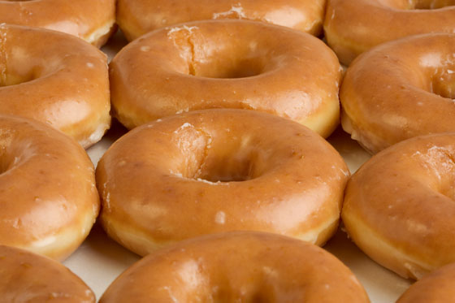
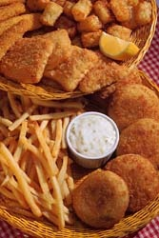
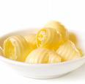
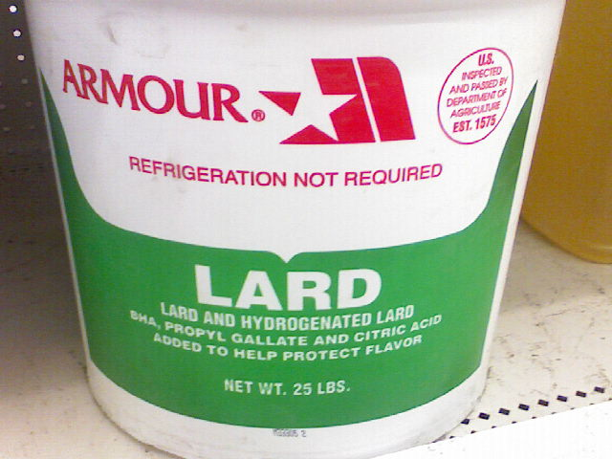
Lipids

Slide 19
Lipids
Commonly called fats, oils, and waxes
Elements: C, H, and O in a non-specific ratio (Example: C₅₄H₉₀O₆)
Typically end in – ol (EX: glycerol)
Function:
Long-term energy storage
Cell membranes
Insulation
Body padding
Monomer: Glycerol and 3 fatty acids

Slide 20
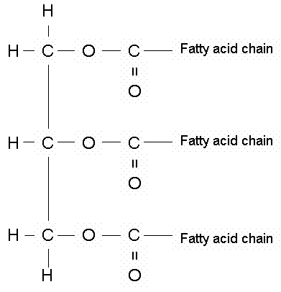
Lipid monomer Picture

Slide 21
Polymers
Triglycerides (Finished product when combining the glycerol and fatty acid chains)
Can be modified to make other polymers

Slide 22
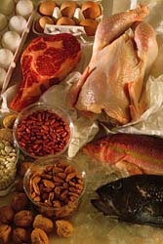
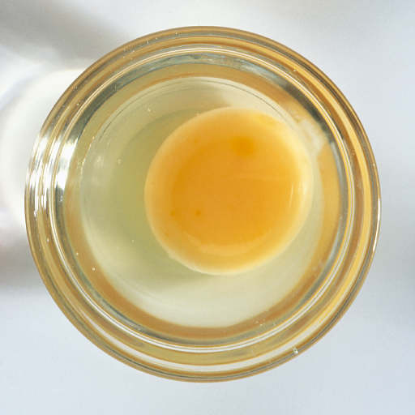
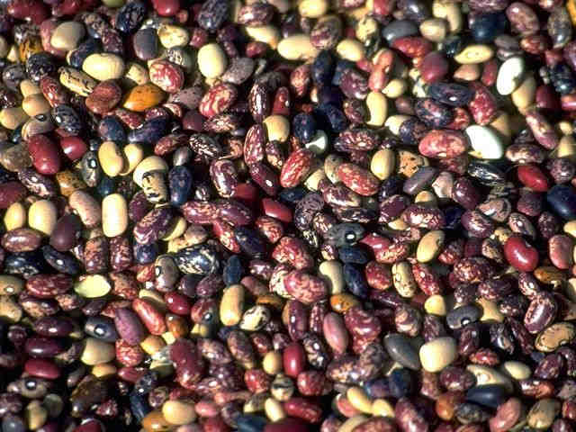
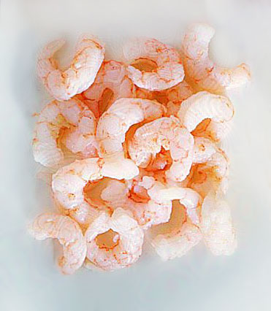
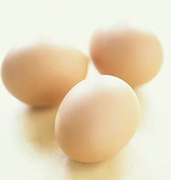
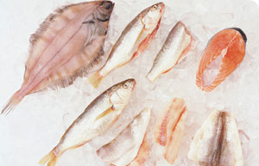
Proteins

Slide 23
Proteins
Elements: C, H, O, N, sometimes S
Typically end in –in (Ex: Insulin)
Monomer → amino acids
Polymer → polypeptide

Slide 24
Proteins
Functions of Proteins
Movement
Building and repairing structures in cells and tissues
Homeostasis regulation (hormones and enzymes)
Defense against disease (antibodies)

Slide 25
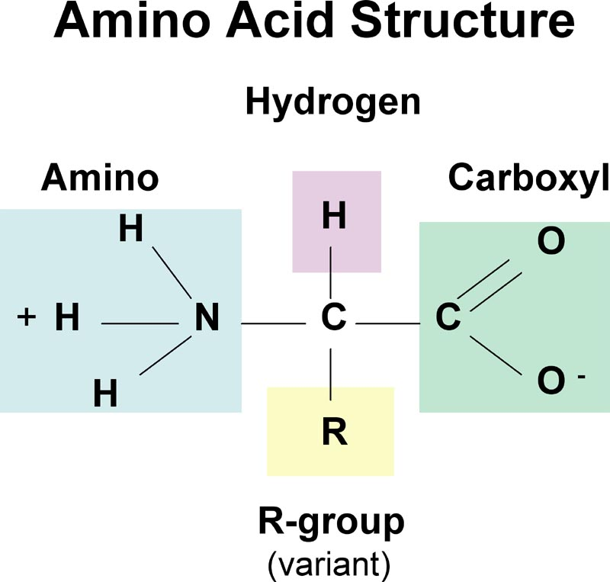

Slide 26
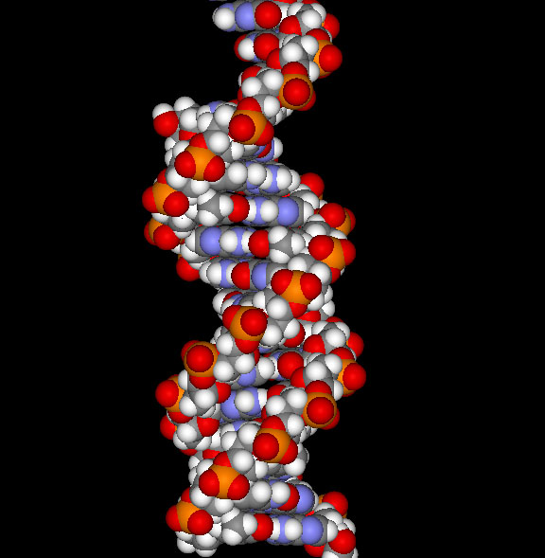
Nucleic Acids

Slide 27
Nucleic Acids
Elements: C, H, O, N, P
Function → control genetic information
Monomer → nucleotide
Polymers
DNA → deoxyribonucleic acid
RNA → ribonucleic acid

Slide 28
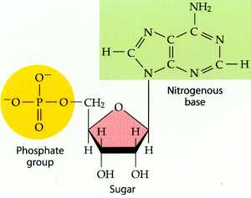

Slide 29
Warmup 9/07
Draw a polymer of the following organic groups
Carbohydrate
Lipid
Protein
Circle 1 monomer from your polymer and label it

Slide 30
Wanted Posters
Create a wanted poster for each of the 4 groups of biomolecules. (4 total)
For each
Name of the molecule (Ie. Protein)
Picture
Outfit (Elements)
Aliases (names of monomers and polymers)
Crime (Functions)

Slide 31
Exit Ticket
Monomers of each molecule
Carbohydrate
Lipid
Protein
Nucleic Acid

Slide 32
Warmup 9/11
What is the definition of an enzyme?
How do enzymes affect activation energy?
What term is used for when the active site of an enzyme changes and the enzyme is no longer working?

Slide 33
Warmup 4/24
Do enzymes always break down molecules or always put them back together? (35)
Why is the difference in activation energy between using an enzyme (less energy used) and not using an enzyme (more energy used) important for chemical reactions? (41)
Why are enzymes commonly found in the digestive tract?

Slide 34
Warmup 4/14
Was antibiotic resistance already present in the population of bacteria or did it develop because antibiotics have been used?
Why is antibiotic resistance an example of artificial selection?
What is a dichotomous key used for?

Slide 35
Warmup 4/22
Who is the “Father of Modern Genetics”?
What does dominant mean?
How are codominant and incomplete dominant different?
What are 2 examples of sex-linked traits we have looked at in class?

Slide 36
Warmup 9/09
What are 2 examples of reproduction?
What is the difference between growth and synthesis?
Provide 2 examples of nutrition.
What is homeostasis?

Slide 37
Warmup 4/15
What are vestigial structure?
How are fossils used to support evolution?
Where in the earth levels are the oldest fossils found?
How are arm bones used as evidence of natural selection?

Slide 38
Warmup 9/09
What does a buffer do?
What is an example of a compound?
What are hydrogen bonds?

Slide 39
Warmup 3/26
What was the purpose of the Miller and Urey experiment?
If a type A man and a type AB woman had a child, what are all the possible blood types the baby could have?
What is an example of how gel electrophoresis is used in society today?

Slide 40
Warmup 11/16
What is the monomer of a protein?
What is the test for proteins and what indicates a positive test?
What is a polymer of a protein?
What elements make up proteins?

Slide 41
Warmup 9/15
What is the role of lipids in our bodies?
What elements make lipids?
What is the monomer of a lipid?
What is an example of a lipid?

