Slide 1
Ecology

Slide 2
study of the relationship of living things and their environment.

Slide 3
Population Dynamics
Population-a group of organisms of the same species living in the same area at the same time that reproduce with each other
Properties of populations:
patterns of growth that include carrying capacity
survivorship patterns
age structure
density and dispersion
regulation of population size
Regulation of population size is determined by density dependent factors, density independent factors, population cycles, life history patterns, asexual advantage and consequences of life history patterns.

Slide 4
Patterns of population growth
Growth is determined by the birth rate minus the death rate and can be positive or negative. This assumes that there is no net immigration or emigration.
If the population increases at a constant rate it demonstrates exponential growth.
This growth pattern can be seen in microorganisms in the lab, initial phases of an algal bloom and in nature short term in the initial phases of an opportunistic species such as weeds and insects.

Slide 5
Logisitic Growth:
For many populations the environment determines the number of individuals in an area. A given environment can only support a limited number of individuals. Population size hovers around this number known as carrying capacity and produces an S-shaped graph.

Slide 6
Mortality also affects population size. There are 3 survivorship patterns:
Type 1-most organisms die late in life Ex. humans
Type 2-mortality rate is equal across all age groups Ex. hydra
Type 3-most organism die off early Ex. oysters where most die in larval stage.

Slide 7
Number of reproductive episodes:
Semelparity-one single and large reproductive episode. Ex. some butterflies, cicadas, etc
Iteroparity-repeated by smaller reproductive episode.

Slide 8
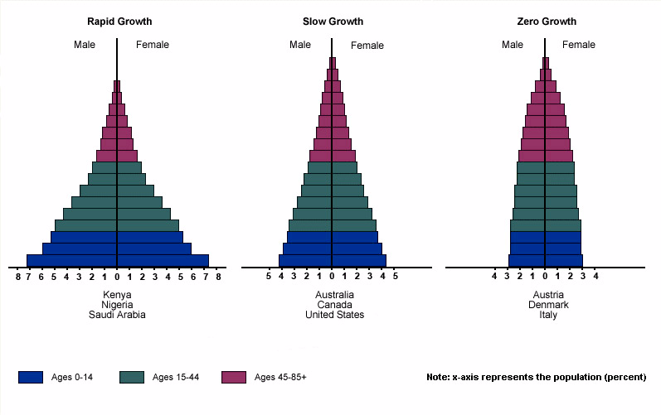
Age Structure:
Looking at survivorship patterns and the number of individuals at each age range can help predict population growth.

Slide 9
Density and Dispersion
Population density-# of individuals per unit of area or volume.
Dispersion-the pattern of distribution of the organisms within a 2 or three dimensional space. 3 patterns:
1. random-spacing irregular b/t individuals
2. clumped-individuals associated in patches
3. regular-individuals evenly spaced.
the dispersion pattern of a population is determined by a number of factors and may change seasonly, in different parts of the life cycle or not at all.

Slide 10
Regulation of population size
Limiting factor-anything that affects size and density of a population. Most important are organism's tolerance to light, temperature, available water, salinity , nesting space and availability of required nutrients.
Density dependent factors-Have an increased effect the larger the population. Ex. food, water, competition
Density independent factors-have the same effect on population regardless of size. These are natural disasters such as floods, drought, fire etc.

Slide 11
Life History patterns
1. Early or late reproduction: breeding early or late affects population growth. Early reproduction is an advantage to animals with a short life span.
2. The asexual advantage-allows increase in a population to occur quickly. For example some plants have runners that allow them to cover large areas.
3. Consequences of life-history patterns-
*organisms such as opportunistic organisms have rapid growth change but can rebuild populations quickly from a small number of individuals.
*organisms who are long-lived, and slow to mature have a probability of long-term survival but are slow to rebound if population size is reduced drastically.

Slide 12
Community Interactions

Slide 13
Community-All populations of organisms inhabiting a common environment and interacting with one another. These interactions are classified as: competition, predation, and symbiosis.

Slide 14
Competition
Interaction between individual organisms of the same species (intraspecific) or different species (interspecific) that use the same resources that are present in limited supply.
As a result the overall fitness of one or both competitors may be reduced.

Slide 15
Competition Types
1. Interference competition: In animals this involved overt fighting (face to face interaction). In plants this may take the form of secreting toxins that harm or restrict the growth of potential competitors.
2. Exploitative competition-removing the resource and leaving less for competitors.

Slide 16
Ecological Niche-specific role of an organism in its community. Niche could include physical factors such as temperature & moisture as well as biological factors such as food availability, competitors, predators, and behavior habits such as season activities and movement.
Fundamental Niche-refers to physiological limits of tolerance for the organism.
Realized niche-portion of the fundamental niche actually used by an organism and is determined by physical factors and interactions with other organisms.

Slide 17
Resource partitioning:
If 2 similar species are living in the same area, their niches are expected to be different in some way. They may utilize the same resource but if observed closely there will be small differences in the way they use it.
Competition may not wipe out individual organisms but may lead to the elimination of a species from a particular area.

Slide 18
Predation:
The eating of live or freshly killed organisms.
Escape from predation often occurs without engaging in combat. Strategies include: camoflage, hiding places such as burrows, physical structures such as thorns, and chemicals that are distasteful or harmful.
Predation is often the main cause of death, though predators tend to have more than one prey source. Should one source decrease predation on the other source increases. This contributes to carrying capacity.

Slide 19
Symbiosis
close and long term association between organisms of 2 different species.
Parasitism
When one organism benefits and the other is harmed. Can be a specialized form of predation. However, if a parasite kills its host it too dies.
Mutualism
both organisms benefit. Ex. evolution of the eukaryotic cell AKA the endosymbiont theory
Commensalism
One benefits and the other is unaffected.

Slide 20
Community composition and stability
6 theories and all have experiments that back their position.
1. Island biography model-states that there is a balance between species that immigrate to an island and the rate of extinction of local organisms.
2. Intermediate disturbance hypothesis-In diverse ecosystems such as a tropical rain forest it is believed that diversity is a function of the frequency and magnitude of disturbances such as immature forms of a species invading an open area. The more frequent and the higher the magnitude the greater the diversity.

Slide 21
3. Ecological succession-occurs when the intervals between disturbances are long. Generally photosynthetic organism invade first and then the remaining life follows.
PRIMARY SUCCESSION-is when there was originally no life and spores blow into the area and begin colonizing. (Gomphidius, Monet . . . RUN . . . SPORES.)
SECONDARY SUCCESSION-occurs after some disturbance such as a fire.

Slide 22
4. Facilitation hypothesis-States that one organism prepares the way for the next.
5. Inhibition hypothesis-States that an early species will actually inhibit colonization by new species.
6. The tolerance hypothesis-States that early species neither help nor hinder new species.

Slide 23
Ecosystems

Slide 24
Ecosystem: combination of biotic and abiotic components through which energy flows and materials cycle.
The sun is the ultimate energy source for Earth.

Slide 25
Flow of Energy
Approximately 0.1% of the solar energy reaches the Earth's surface; and of that 1-3% hits plants and it therefore used for photosynthesis.
Food Chain is the passage of energy from one organism to another starting with a producer. These are often linked togehter in food webs that show branches and interconnections between species.
Terrestrial primary producers=plants
Aquatic primary producers=algae

Slide 26
Producers use light to produce carbohydrates through photosynthesis that powers the rest of the food chain and web. The biomass of producers outweigh the consumers in an ecosystem. Generally 99% of all organic matter is made up of plants and algae.

Slide 27
Gross productivity-measure of the amount of energy assimilated by organisms in a particular trophic level (similar to gross income).
Net productivity=gross productivity - the energy cost of carrying out respiration.
Primary productivity-is the total rate at which organisms synthesize new biomass.

Slide 28
Consumers
Energy enters the animal world through herbivores AKA primary consumers. These are organism that eat algae or plants. This is always the 2nd trophic level.
The third level is the secondary consumer and is made up of carnivores. These are animals that eat other animals. This level can also be made up of omnivores that eat both plants and animals.
There are generally no more that 5 steps in a food chain because energy passed from one organism to the next decreases as you move up the food chain.

Slide 29
Detritovores-live off of refuse or detritus. Ex. dead leaves, branches, feces, dead animals, discarded exoskeleton of insect AKA YUCKY STUFF
Scavengers also fall into the detritovore group and include fungi and vultures. The organisms utilize dead prey.
Decomposers-break down dead or decaying matter ex. bacteria and fungi

Slide 30
Efficiency of Energy Transfer:
It is estimated that only 10% of energy gets transferred from one trophic level to the next. This is an average but the range generally is from 5-20%.

Slide 31
Systems

Slide 32
CYCLES: Matter is recycled but energy is lost!
Sulfur cycle:
Sulfur is naturally found in plants and is decomposed in 1 of 2 ways:
1. Anaerobic-without oxygen hydrogen sulfide is formed which then enters the atmosphere and combines with oxygen to make sulfuric acid that combines with the rain.
2. Aerobic-decay with oxygen producing sulfur dioxide gas. This enters the atmosphere and combines with water and oxygen to form sulfuric acid which combines with rain.

Slide 33
Phosphorus Cycle:
Phosphorus exists in inorganic compounds such as phosphate as well as being washed from rocks by rain.
a. Ground-plants pick up phosophorus--> Plants get eaten by animals and produce waste-->Phosphorus from waste and from eventual animal death and decay go back into the ground.
b. River or stream-River or stream leads to the ocean where the phosphorus sinks to the bottom. Algae absorb phosphorus and are then eaten by fish, snails, etc. Other animals eat the fish and then the phosphorus waste goes back into the ground.

Slide 34
Water Cycle:
Evaporation changes liquid water to a vapor.
Transpiration is the evaporation of water from plant leaves.
Condensation-When water vapor changes to liquid water. This is the process of cloud formation.
Precipitation-When water condenses and clouds become too heavy the water falls back to the Earth as rain, snow, sleet or hail.

Slide 35
Nitrogen Cycle:
4 processes:
1. Atmospheric nitrogen is converted to ammonia by lightening or nitrogen-fixing bacteria.
2. Ammonia is converted to nitrates by bacteria. Plants use the nitrates. Animals eat the plants.
3. Animals wastes and the death and decay of plants and animals cause nitrogen to be converted back to ammonia by ammonification bacteria.
4. Nitrogen is returned to the atmosphere through denitrifying bacteria changing nitrates into nitrogen.

Slide 36
Oxygen Cycle:
Oxygen is taken in by organisms through respiration who then release carbon dioxide. Carbon dioxide is taken in by producers to make carbohydrates and release oxygen.
This also happens in water. Oxygen enters the water and is used by aquatic life. Carbon dioxide by-product is used by algae who then produce oxygen.

Slide 37
Carbon Cycle:
Producers take in carbon dioxide and store some carbon as glucose. The plant is eaten by animals.
The carbon re-enters the atmosphere as a waste product of respiration and from decomposition of dead organisms.

Slide 38
The elements in these cycles tend to be in higher concentration inside organisms than in the environment because organisms selectively take in needed minerals.
Foreign substances can also be passed through the trophic levels and get concentrated at the top of the food chain. An example of this is DDT. This is called biological magnification.

Slide 39
Human Population

Slide 40
Human Population
Human Population → 7.5 billion people

Slide 41
Factors that Influence Population Size
Natural Factors:
Birth Rate
Death Rate/Diseases
Amount of food and water
Amount of space

Slide 42
The medical revolution of the 19th and 20th centuries
The medical revolution of the last 200 years has drastically extended the lifespan of the average human. Major contributors include
Better sanitation
Access to better healthcare
More education on living healthy
Better medicines
Vaccines and antibiotics
Extermination of smallpox

Slide 43
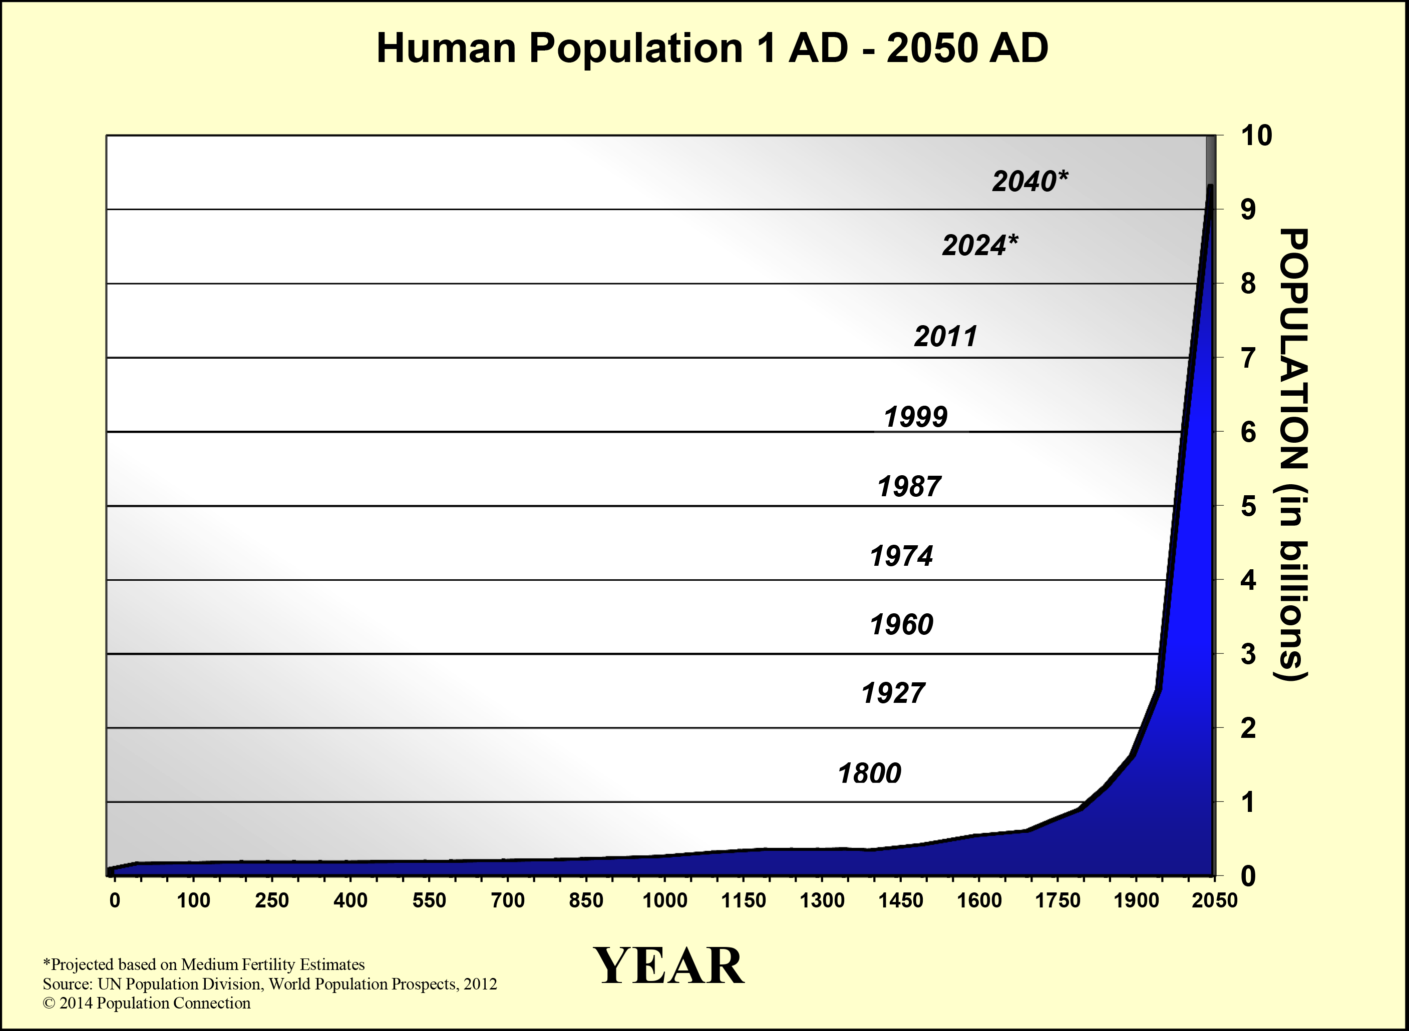
Interpreting population graphs

Slide 44
Effects of a growing population
Overpopulation: the more people that are on the planet, the more resources they will need
Eutrophication: addition of chemicals such as nitrates and phosphates into water supplies
Acid Rain: acidic rainfall that is more common in mountain areas which destroys the vegetation in the area, caused by carbon dioxide emissions from cars and factories
Beach Erosion: Loss of sand caused by building houses

Slide 45
Deforestation: cutting trees for commercial use
Urban Development: destruction of habitats so humans can build homes and factories
Waste Lagoons: pollution of the water supply due to massive amounts of animal waste being improperly stored

Slide 46
Climate Change
Global Warming: increase in global temperature as a result of increased amounts of CO2 in the atmosphere
mainly a result of burning fossil fuels

Slide 47
Bioaccumulation: build up of pesticides in organisms
Biomagnification: pesticide accumulation is more dangerous for top predators because they eat a lot of individuals which have eaten pesticides

Slide 48
Invasive Species: species which have been brought over to America from other countries which kill the native species and damage the ecosystem
Examples: Kudzu in NC, pythons in FL, Zebra mussles in the Great Lakes, Snakehead fish in the Mississippi River

Slide 49
Chlorofluorocarbons:
Also called CFCs
Gas released by aerosol cans and cooling units (AC, frig, etc)
Destroys the ozone layer of earth, increases the amount of UV rays that come down.

Slide 50
Taking care of the earth
Using renewable sources of energy to get power
Reducing the amount of carbon dioxide that is put into the air
Use more renewable resources
Renewable Resources: resources we can replenish in our lifetime
EX: trees, solar energy, wind energy

Slide 51
Non-renewable Resources: resources we absolutely cannot replenish in our lifetime
EX: fossil fuels
Reduce the use of nonrenewable resources

Slide 52
Crop Rotation: splitting the field into quarters and growing different crops in each quarter. Every year you change which crop is grown in each quarter
Prevents the depletion of nutrients in the soil
Replant trees and other plants
Prevents soil and beach erosion. Removes CO2 from the atmosphere
Be careful with the water supply.
Prevents eutrification. Prevents the bacteria from waste lagoons from getting into the water.

